Slide 1
Physical Training Model for Robotic Blood Vessel Dissection
Shayer Chowdhury (schowdh8@jhu.edu)
Project #3
Mentors: Dr. Gyusung Lee, Dr. Mija Lee
Notes:
approx cost?
- technical summary? More technical
-vendors?
show more of progress by now technically
- what if cant get surgeons?
- how much money needed?
- what other material?
- lab space; no fabrication stuff, just basic lab space

Slide 2
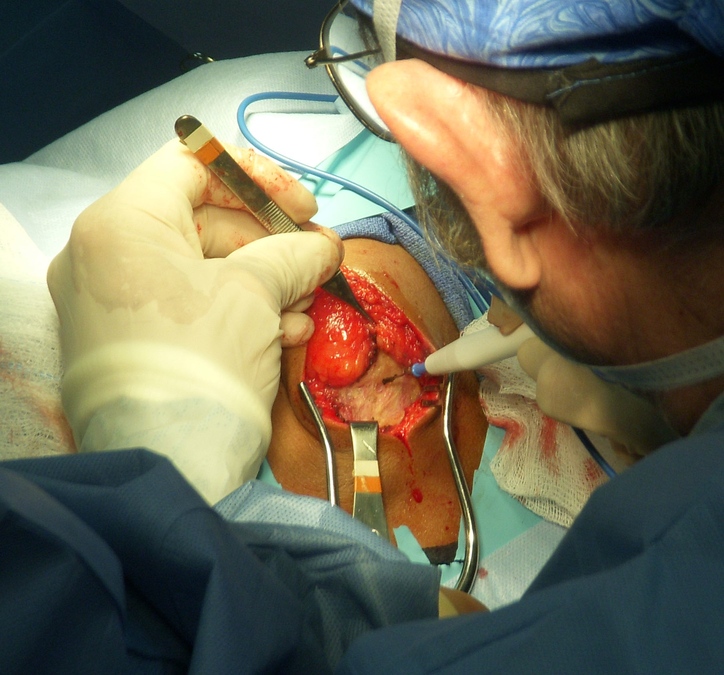
Background and Relevance
Robotic surgeons have expressed a desire to spend more time on blood vessel dissection preparation
Want to practice different techniques: blunt dissection, sharp dissection, and electrocoagulation

Slide 3
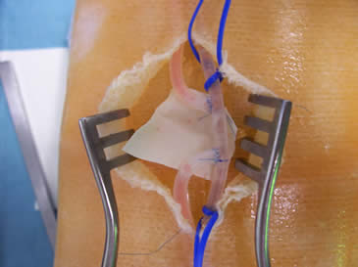
Background and Relevance
Current practice models run up to $75-80 and are not reusable
Want a realistic phantom training model, but one that is also cheap and efficient to make, and potentially reusable

Slide 4
Stated Topic and Goal
Current state: Lack of a cheap, effective, and reusable blood vessel dissection phantom for robotic surgery training
Approach: Model creation, then frequent updating and testing through user feedback with surgeons at JHMI
Goal: Create a comprehensive inanimate surgical training model for sharp/blunt dissection and blood vessel electrocoagulation

Slide 5
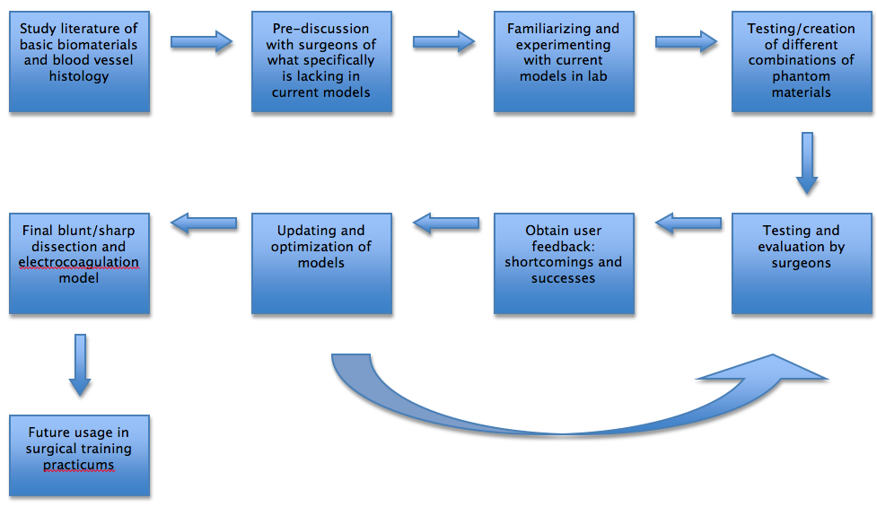
Approach and Technical Summary

Slide 6
Deliverables
Minimum:
Blunt/sharp dissection model prototype
Expected date: March 20th
Expected:
Modified and improved blunt/sharp dissection model with user feedback and experimentation with other materials
Electrocoagulation model prototype
Expected date: April 1st
Maximum:
Completed blunt/sharp dissection and electrocoagulation models
Integration into future standard robotic surgery training practicums
Production and storage of models for future planned usage
Expected date: May 4th

Slide 7
Key Dates
March 7th
Finish discussion with surgeons regarding current models
Familiarization with current models and production of phantom materials
March 20th
Creation of first blunt/sharp dissection model prototype
March 29th
Obtain user feedback from surgeons on blunt/sharp model
Creation of first electrocoagulation dissection model prototype
April 15th
Continue modifying blunt/sharp dissection model
Obtain user feedback from surgeons on electrocoagulation model
May 4th
Continued modification and optimization of models
May 9th
Poster presentation and final report

Slide 8
Dependencies
Access to mentors
Weekly meetings with Dr. Gyusung Lee and/or Dr. Mija Lee
Access to relevant literature
Articles available online and at MSE Library
Access to lab space to create phantom media
Available lab space at MISTIC at the JHMI (12th floor of Blalock)
MISTIC will also be used as headquarters and main address for delivery of materials
Cost to afford material
Material will be fairly inexpensive, since cheap and efficient is our goal anyways
Dr. Lee is in the process of obtaining a small grant to fund the project
Attempt to use recyclable lab material
Access to surgeons who are willing to practice and evaluate the effectiveness of the model prototypes
Dr. Lee will arrange and work with surgeons at MISTIC who will participate in testing out prototypes and commenting on shortcomings and successes

Slide 9
Management Plan
Meet with Dr. Lee at least once every week, more if necessary
Meet with surgeons participating in evaluation by appointment
Keeping track of progress through meticulous notes and checkpoint presentations in class
MISTIC lab will be used by other researchers – will plan accordingly

Slide 10
Reading List
C Schneider, C Kut, N Carter-Monroe, Creation of Ultrasound Elastography Phantoms
GI Lee, MR Lee, T Clanton, E Sutton, AE Park, MR Marohn, Comparative assessment of physical and cognitive ergonomics associated with robotic and traditional laparoscopic surgeries
DS Kopac, J Chen, R Tang, A Sawka, H Vaghadia, Comparison of a novel real-time SonixGPS needle-tracking ultrasound technique with traditional ultrasound for vascular access in a phantom gel model
KB Lawrenson, FO Stephens, The Use of Electrocutting and Electrocoagulation in Surgery
T Diamantis, M Kontos, A Arvelakis, S Syroukis, D Koronarchis, A Papalois, E Agapitos, E Bastounis, AC Lazaris, Comparison of monopolar electrocoagulation, bipolar electrocoagulation, Ultracision, and Ligasure.

