Slide 1
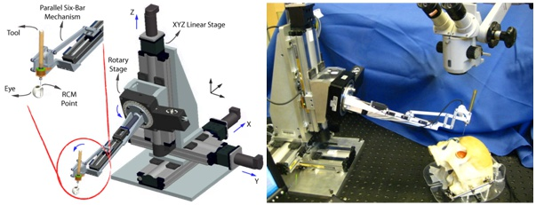
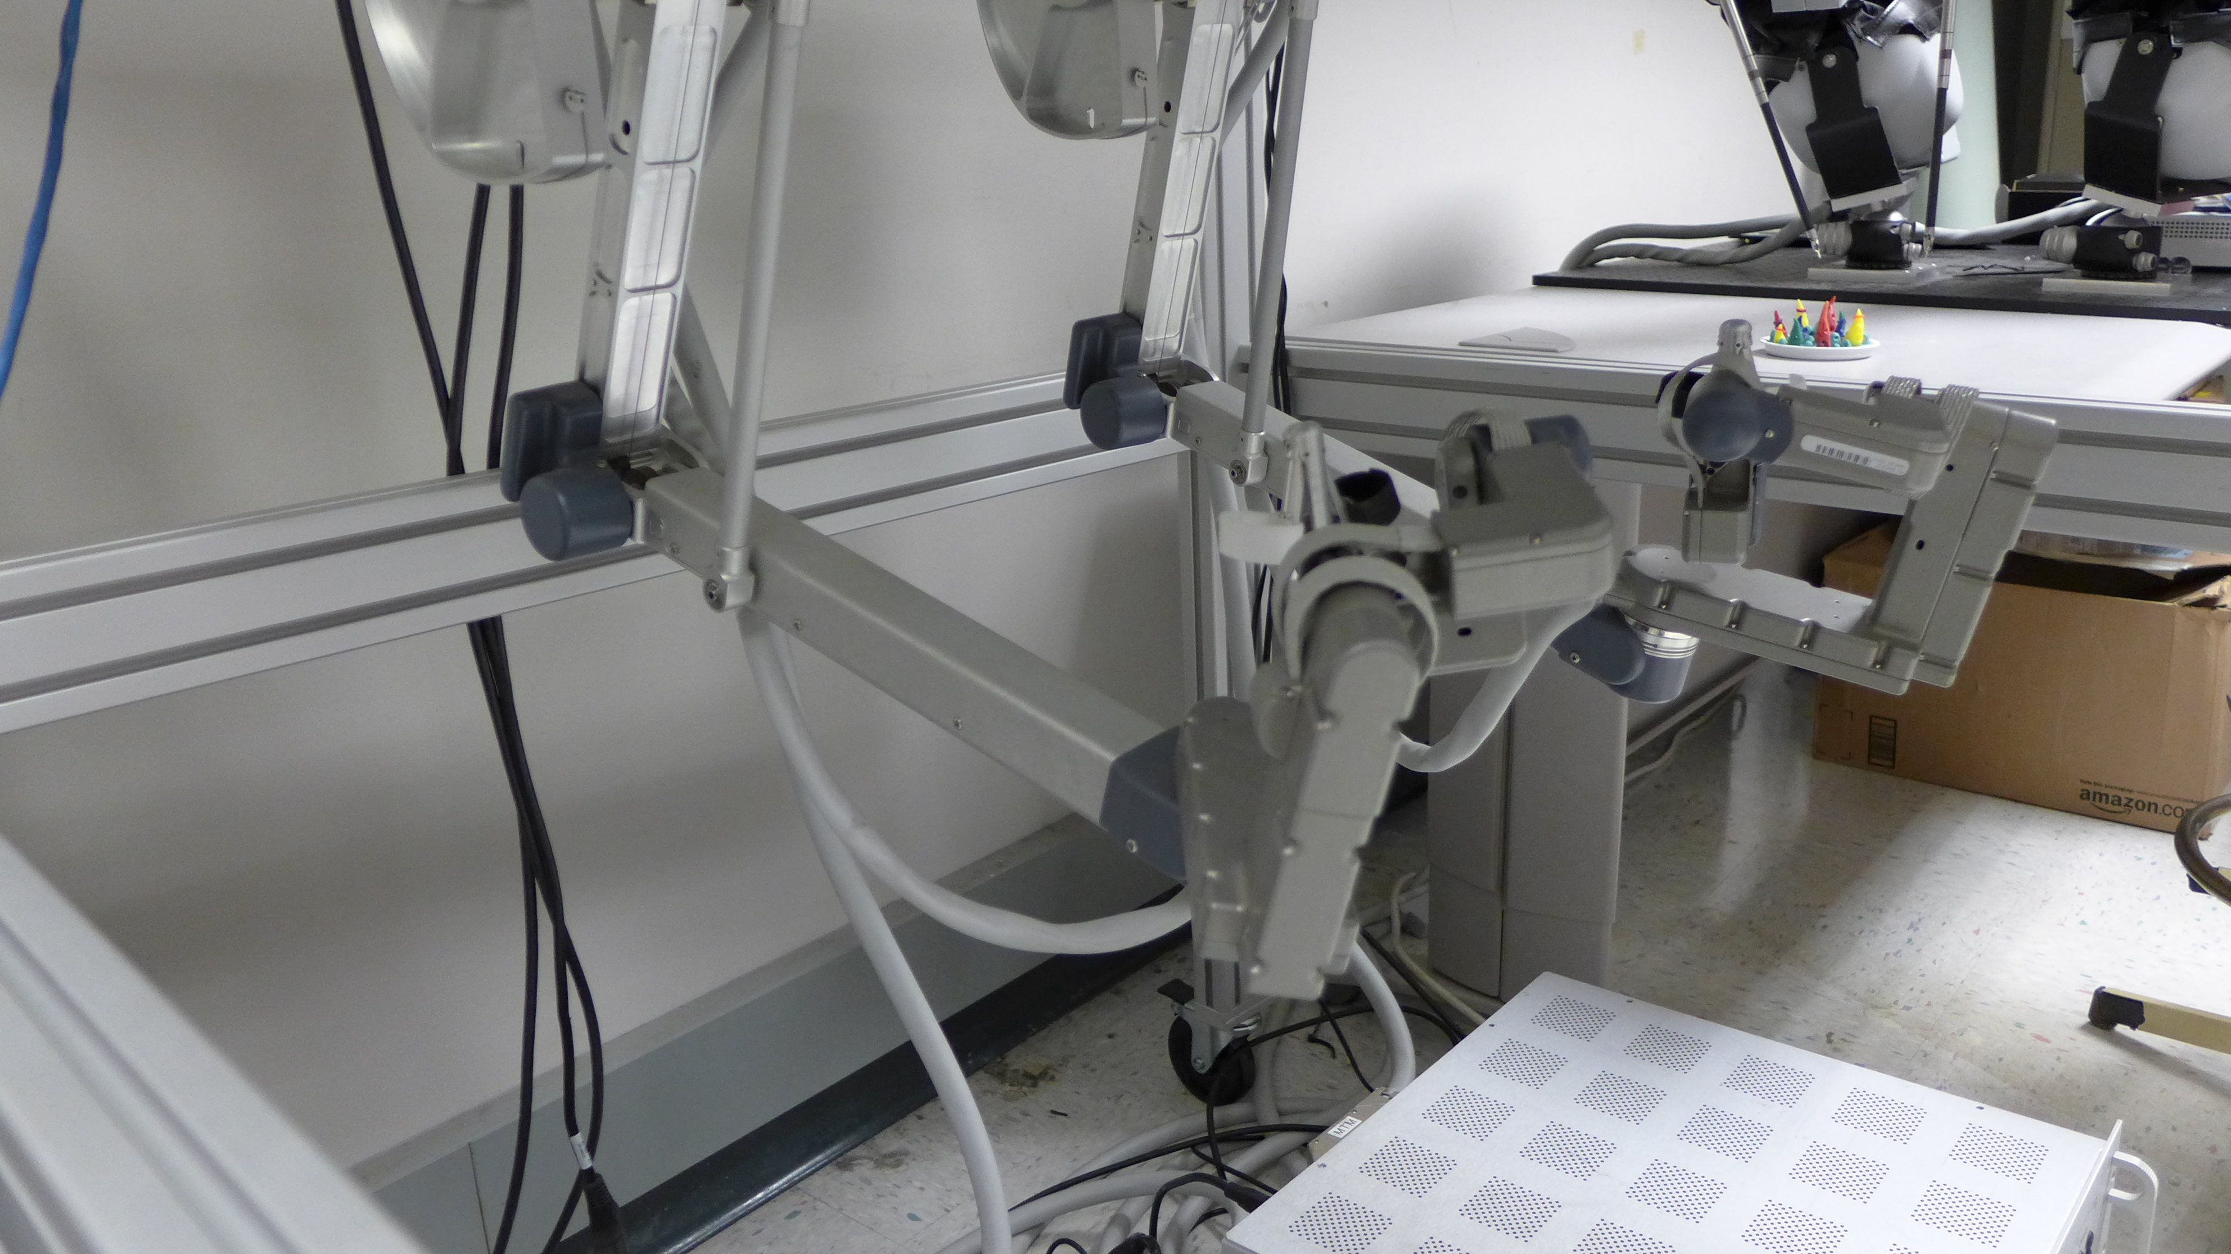
Bimanual teleoperation of Steady Hand Eye Robots with DVRK
The aim of this project is to develop ROS components to teleoperate Steady Hand Eye Robot (SHER - ER 2.0 and ER 2.1) with DVRK
What Students Will Do:
Develop necessary software components to provide
ROS interface for SHER
ROS interface for DVRK (some of them do already exist)
Integrate both the Eye robots and demonstrate teleoperation with 2 Master Tool Manipulators (MTM)
1 mm
Steady Hand Eye Robot (SHER)
DVRK - MTMs

Slide 2
Bimanual teleoperation of Steady Hand Eye Robot with DVRK
Deliverables:
ROS interface for EyeRobots (preferably C++)
DVRK/MTM ROS interface customized for EyeRobot teleoperation (preferably C++)
Integrated ROS launch files for both the EyeRobots and DVRK
Video interfaces for stereo video display on DVRK console
Size group: 2
Skills:
Required: Programming: Experience with Linux environment, ROS, C/C++, python
Desired: Robot kinematics, Control Theory , Gazebo simulator
Mentors: Drs. Nirav Patel (npatel89@jhu.edu), Iulian Iordachita, Russell Taylor
ER 2.0
ER 2.1
ER

