Slide 1
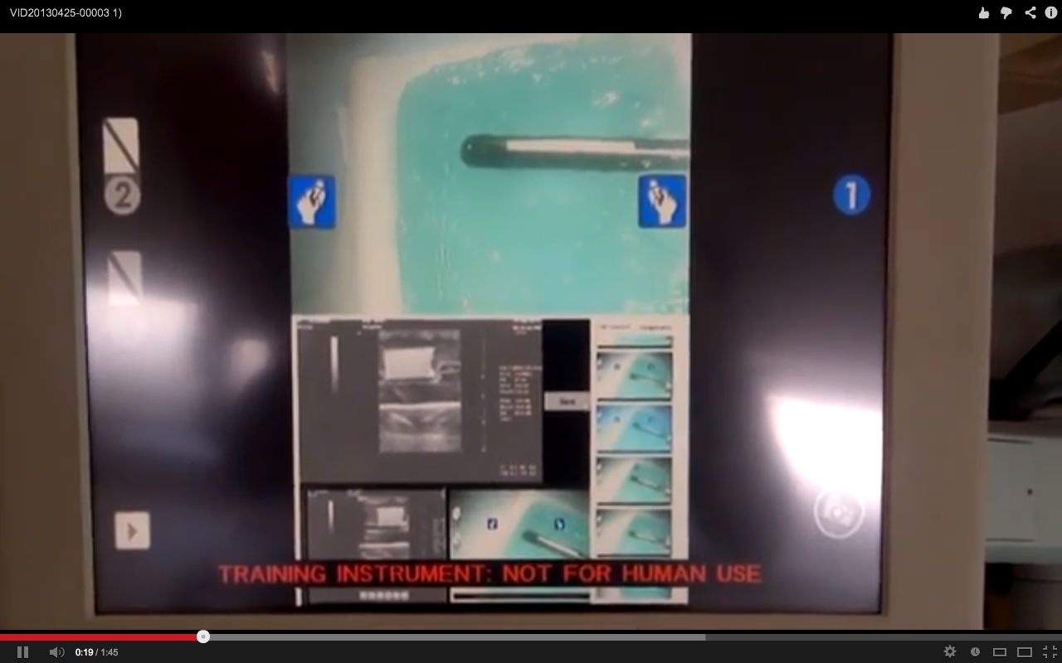
Data Integration During Robotic Ultrasound-Guided Surgery Team 9 Vineeta Khatuja, Andrew Wang, Tifany Yung Mentors: Michael Choti MD MBA, Colin Lea, Theodoros Katsichtis, Russell Taylor PhD
Goals
Create a novel Da Vinci interface
Integrate live intraoperative ultrasound data.
Integrate preoperative data
Interface Image

Slide 2
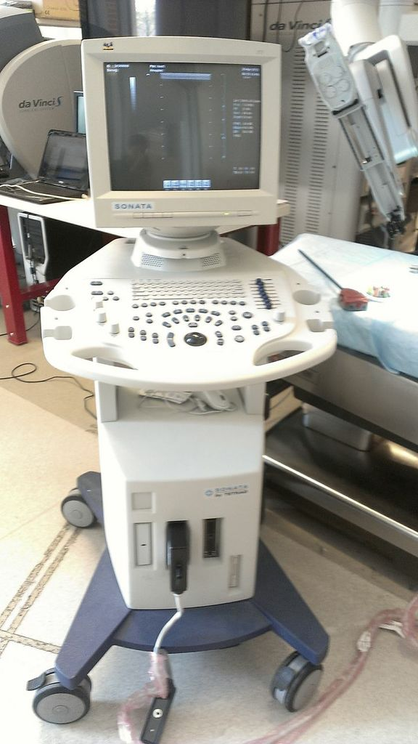
Significance and Results
Significance:
Provides real-time imaging, improving perception.
Enhanced surgeon manipulability.
Results:
Ultrasound viewing widget.
Image viewer for stored ultrasound and preoperative images.

Slide 3
Before
After
Prototype by Colin Lea. 2012
Design by CIS II Team 9 2013

Slide 4
Interface Demonstration

