Slide 1
Augmented Reality Aided Craniofacial Surgery
CIS2 Project Proposal
Team Members: Nikhil Dave & Yihao Liu
Mentors: Dr. Peter Kazanzides, Ehsan Azimi, Dr. Cecil Qiu, Dr. Shashank Reddy

Slide 2
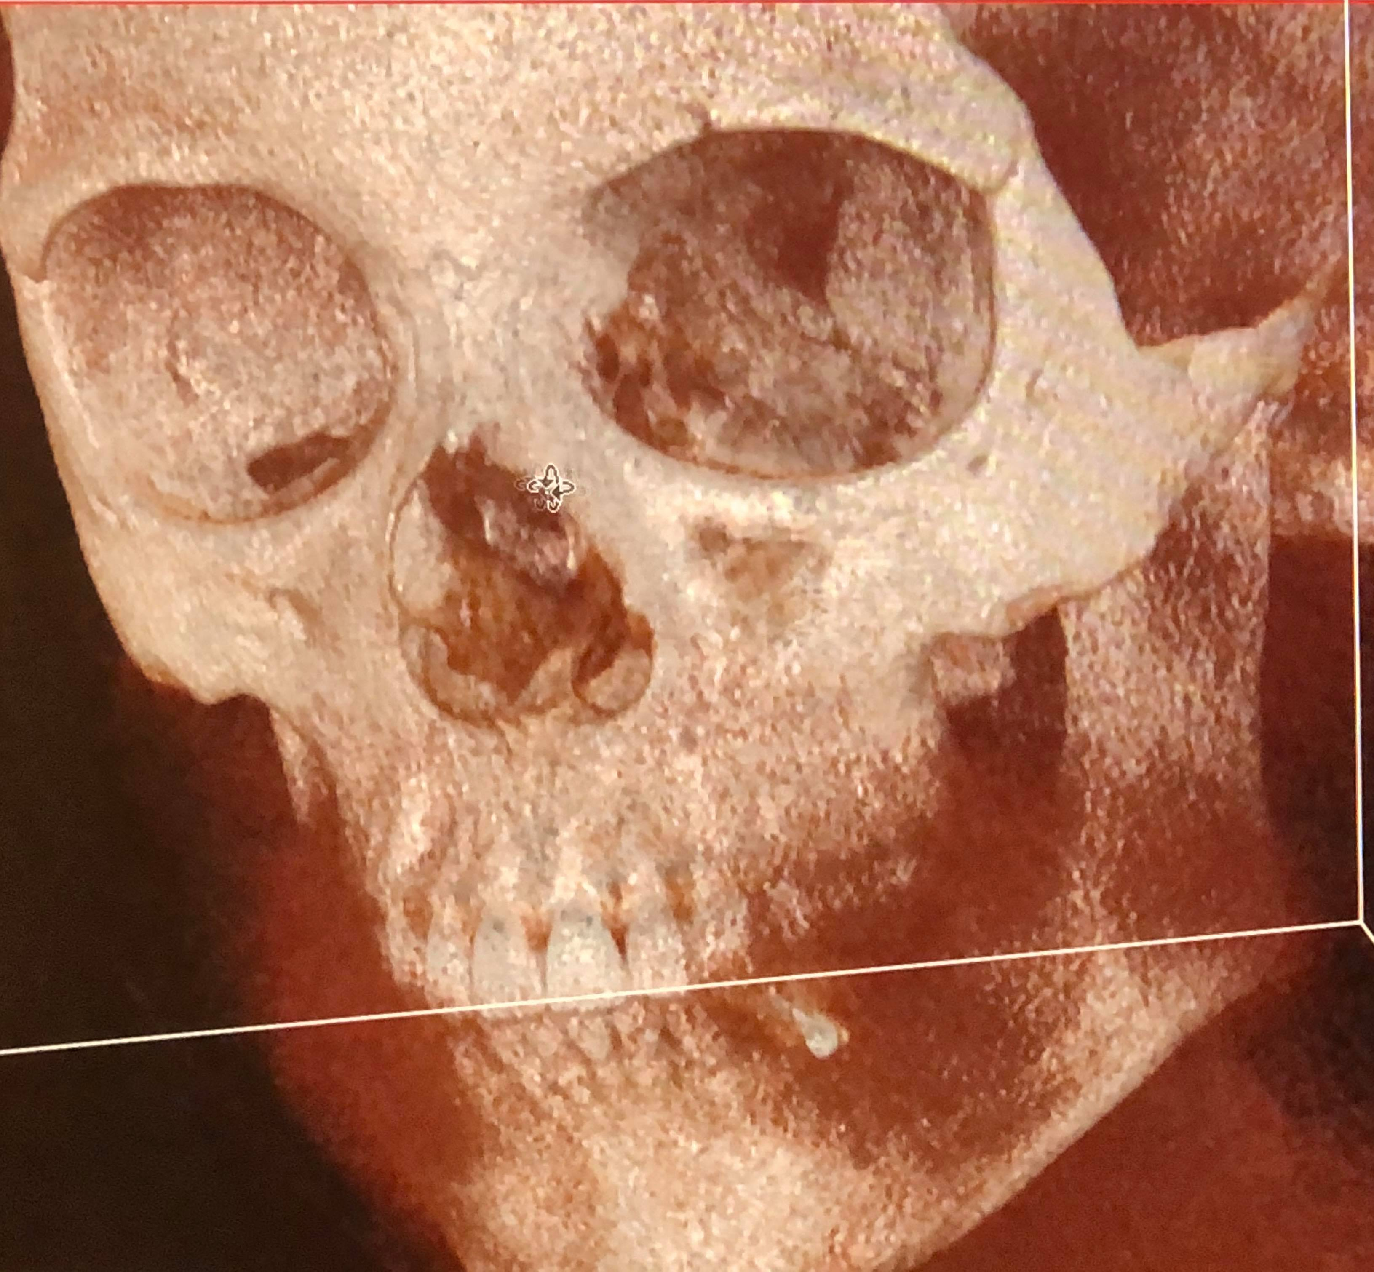
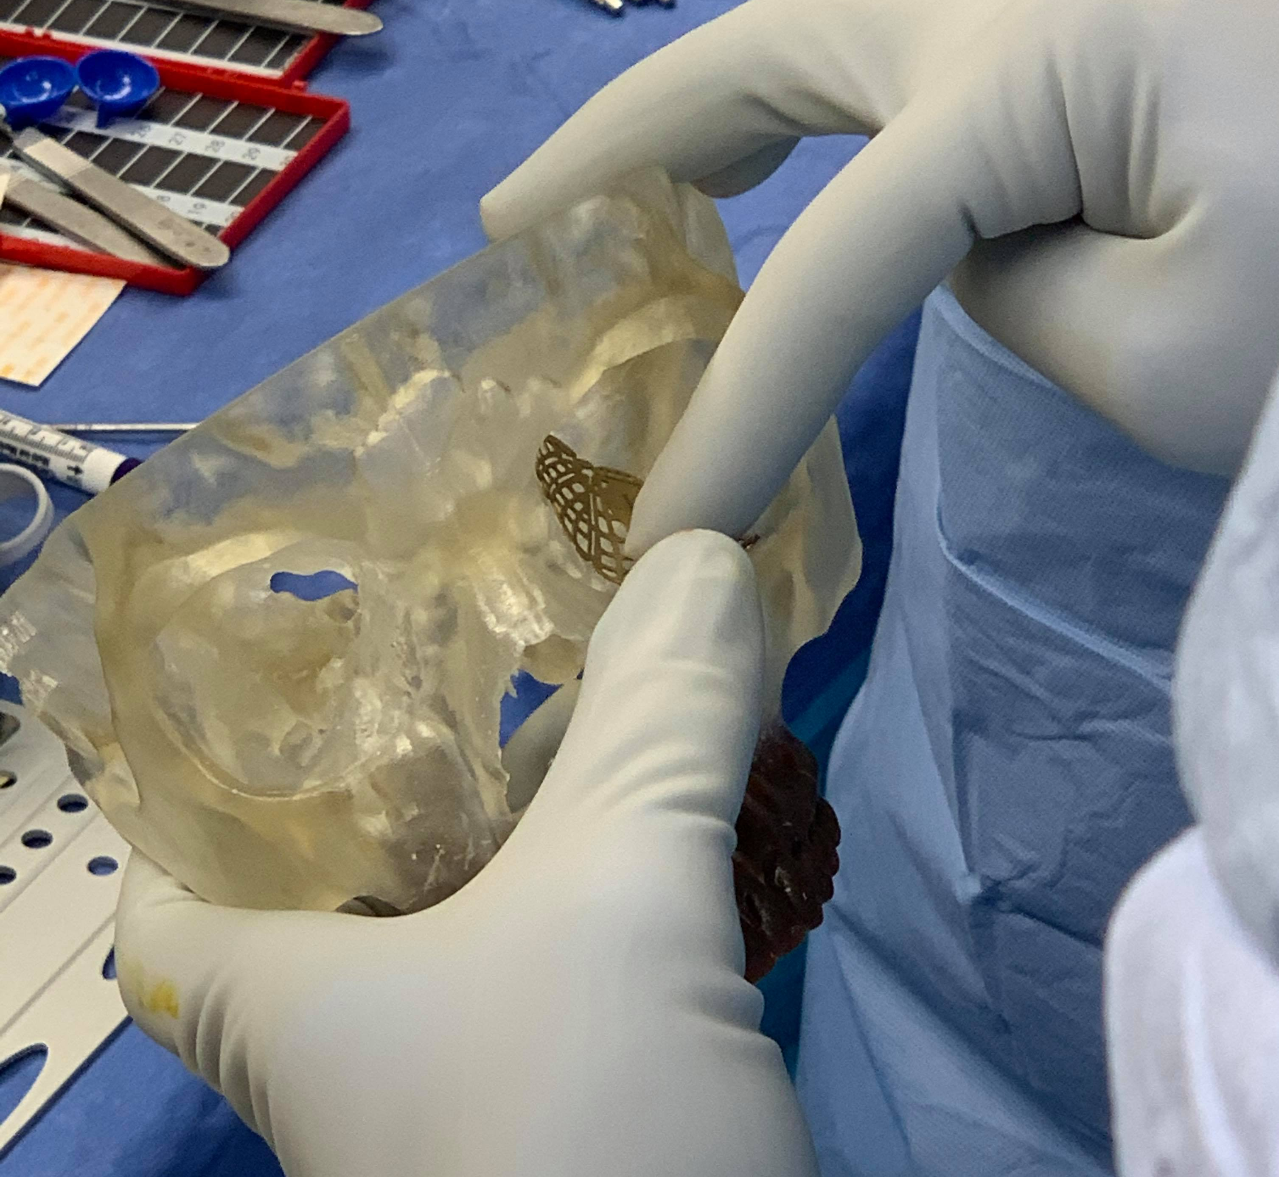
Background
Reconstruction:
A concave plate is placed along the wall of the eye socket to prevent tissue from entering fracture cavity.
Hard to place.
Low visibility
Misplacement can result in injury to sensitive tissue.
Long operating time.
Orbital Floor Fracture:
Due to pressure on the eye from blunt trauma, the medial wall and orbital floor can fracture.
Fracture repair requires manipulation of delicate and complex structures in a tight, compact space.
Surgeons struggle with visibility in the confined region.

Slide 3
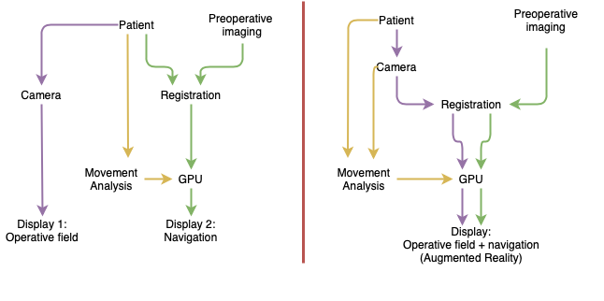
Importance
Surgeons have direct visualization by using AR.
Flow chart from: R. Hussain, A. Lalande, C. Guigou and A. Bozorg Grayeli. (2019) Contribution of Augmented Reality to Minimally Invasive Computer-Assisted Cranial Base Surgery, IEEE Journal of Biomedical and Health Informatics.​

Slide 4
Li, Y., Chen, X., Wang, N., Zhang, W., Li, D., Zhang, L., Qu, X., Cheng, W., Xu, Y., Chen, W., and Yang, Q. (2018). A wearable mixed-reality holographic computer for guiding external ventricular drain insertion at the bedside, Journal of Neurosurgery JNS, 131(5), 1599-1606.

Slide 5
Current Intraoperative Surgical Workflow
Length of Time for Completion Gradient:
GREEN ~ Standard
BLUE ~ Slow Step
RED ~ Time Limiting Step

Slide 6
Simplifying Implant Placement
Length of Time for Completion Gradient:
GREEN ~ Standard
BLUE ~ Slow Step
RED ~ Time Limiting Step

Slide 7
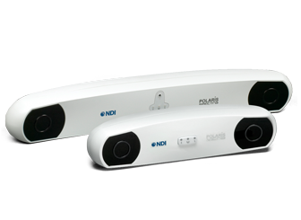
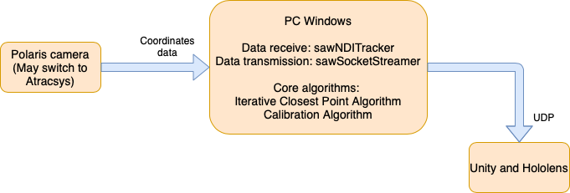
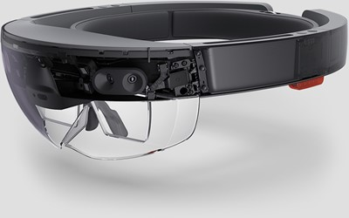
Preliminary System Components Diagram
Polaris image and product info: https://www.ndigital.com/medical/products/
Hololens image and product info: https://docs.microsoft.com/en-us/hololens/hololens1-hardware
Notes:
PC1 PC2 and Unity Windows?
Merge PCs Tracksys
ICP noise model Seth thesis
ICP: assumption uniform noise model
Find the noise model – IMLP
Orientations _ IMLOP
Teeth + orbital bones

Slide 8
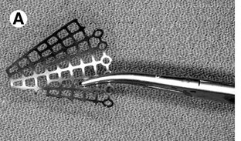
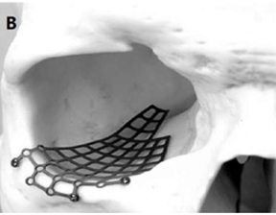
Deliverables
The following deliverables are all expected before the end of the semester (final presentation).
Point/surface registration method for orbital socket
Min: Target registration error (TRE) <4mm
Expected: TRE <3mm
Max: TRE <2mm
Calibration of implant with respect to tracked hemostat
Min: Pivot Calibration of the distal edge of the implant (only model the distal edge)
Expected: Use calibrated pointer to model the implant distal edge
Max: Use calibrated pointer to model the entire implant
Visualize position of tracked implant respect to CT
Min: Visualization on 3D slicer (Open IGT link on client to update model)
Expected: Visualization in AR system (Hololens)
Max: A comparison between 3D slicer implementation and Hololens implementation
Pictures Courtesy of : Dr. Peter Kazanzides
[1] Kazanzides, P. (2020). Navigation for Orbital Floor Fracture Repair. [PowerPoint Slides]
Notes:
Confirm calibration deliverables
Cal: Min: pivot calibration if only distal edge
Exp: tracked pointer to get position

Slide 9
Dependencies | Solution | Alternatives | Status or expected resolve date
Computer with Linux | Use personal computers | Use LCSR cab computer | Resolved
Computer with Windows PC1 | Use personal desktop | Seek for borrowing a laptop | Resolved
Computer with Windows PC2 (HMD development) | Use personal computers | Request lab computer | Resolved
Data Back-ups | Use Microsoft OneDrive | Use personal hardrive | Resolved
Learn Workflow from Surgeons | Shadow surgery in OR | Meet with surgeons | Resolved
STL Files for Implants | Coordinate with clinical partners | Find potential online source | Resolved
CT Scans of Skulls for Corresponding STL Files | Coordinate with clinical partners | Obtain other model from Dr. Kazanzides | 3/15/20
Polaris Camera | Coordinate with Anton | Coordinate with Dr. Kazanzides | Resolved
Learn CISST Library ICP | Refer to online material | Work with Anton | 3/15/20
Passive Rigid Body Pointer | Coordinate with Ehsan & Dr. Kazanzides | Make a rigid body pointer and calibrate it | 3/7/20
Installation of SAWSocketStreamer | Discuss with Anton | Discuss with Long | Resolved
Notes:
Hand made passive rigid
Make a rigid body, ask for reflective balls. Hemostat attachment
Ask for Skull CT from Cicel. We can get the the CT for the skull model on Dr. PK’s table and do experiments

Slide 10
Dependencies | Solution | Alternatives | Status
Learning Python Wrapper Check ICP | Refer to Online Material | Seek mentorship from Anton and Ehsan | 3/1/20
Hemostat (or clamp) | Coordinate with Dr. Kazanzides and Ehsan | Seek from Clinical Mentors | Resolved
Attachable Rigid Body for Polaris and Hemostat | Seek from Ehsan or Dr. Kazanzides | Coordinate with LCSR, Potentially make our own. | 3/15/20
HoloLens | Coordinate with Ehsan | Coordinate with Dr. Kazanzides | 4/1/20
Unity Installation and Hololens Set-up | Utilization of Online Resources | Help from Ehsan | 4/1/20
3D-Slicer Installation and Set-up | Utilization of Online Resources | Coordinate with Dr. Kazanzides and Ehsan | 4/1/20

Slide 11
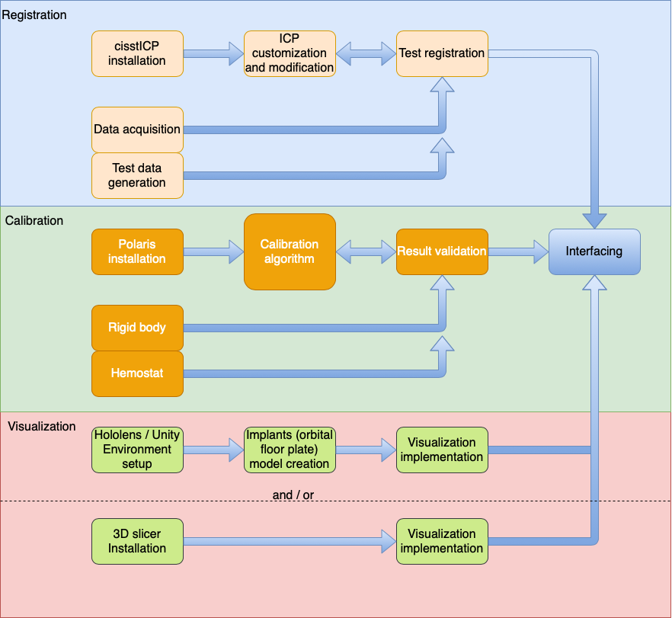
Mar. 10
Mar. 15
Apr. 1
Y
Y
N
Mar. 15
Management Plan – Development Flow Chart
N
Mar. 1
Mar. 15
Apr. 1
Y
Y
N
Y
N
N
Mar. 7
Interfacing and documentation will happen along the development between Mar 7 to Apr. 25
N
Apr. 1
Apr. 7
Apr. 15
Y
Y
Y
Y
Yihao Liu
Apr. 1
Apr. 15
N
Nikhil Davé
N
N

Slide 12
Jan | Feb |  |  |  |  | March |  |  |  |  | April |  |  |  |  | May
Project Selection
Projection Plan and Report
ICP Registration Implementation
Validation
Dev. Tracked Hemostat
Calibration Implementation
Phase Legend
Planning
Registration
Calibration
Visualization
Final
Validation
Visualization in 3D-Slicer
Visualization in HMD
Validation
Final Presentation Prep

Slide 13
Meeting Management
Biweekly mentor meeting (Friday 3 pm.)
Weekly progress report
Scheduled surgeon meetings
Scheduled technician engineer meetings
Daily sprint group meeting (3 or 4 meetings / week)
M: 12.00-15.00
TTh: 18.00-21.00
F: 15.00 - 18.00
Weekend technical meeting
Saturday 15.30 - 19.30
Notes:
Send email schedule Monday 12. (Kazanzedis), Friday (3pm),

Slide 14
Reading List
Hussain, R., Lalande, A., Guigou, C., and Bozorg Grayeli, A. (2019). Contribution of Augmented Reality to Minimally Invasive Computer-Assisted Cranial Base Surgery, IEEE Journal of Biomedical and Health Informatics.
Gsaxner C., Pepe, A., Wallner, J., Schmalstieg, D., and Egger, J. (2019). Markerless Image-to-Face Registration for Untethered Augmented Reality in Head and Neck Surgery, MICCAI 2019.
Li, Y., Chen, X., Wang, N., Zhang, W., Li, D., Zhang, L., Qu, X., Cheng, W., Xu, Y., Chen, W., and Yang, Q. (2018). A wearable mixed-reality holographic computer for guiding external ventricular drain insertion at the bedside, Journal of Neurosurgery JNS, 131(5), 1599-1606.
Chen, X., Xu, L., Wang, Y., Wang, H., Wang, F., Zeng, X., Wang, Q., and Egger, J. (2015). Development of a surgical navigation system based on augmented reality using an optical see-through head-mounted display, Journal of Biomedical Informatics, Volume 55, 2015, Pages 124-131
Bong, J. H., Song, H. J., Oh, Y. , Park, N., Kim, H., and Park, S.. (2018). Endoscopic navigation system with extended field of view using augmented reality technology, Int. J. Med. Robot., vol. 14, no. 2, pp. e1886
Inoue, D., Cho, B., Mori, M., Kikkawa, Y., Amano, T., Nakamizo, A., Yoshimoto, K., Mizoguchi, M., Tomikawa, M., Hong, J., and Hashizume, M.. (2013). Preliminary study on the clinical application of augmented reality neuronavigation, J. Neurol. Surg. Part A, vol. 74, no. 02, pp. 71-76
Lapeer, R. J., Jeffrey, S. J., Dao, J. T., García, G. G., Chen, M., Shickell, S. M., Rowland, R. S., and Philpott, C. M.. (2014). Using a passive coordinate measurement arm for motion tracking of a rigid endoscope for augmented‐reality image‐guided surgery, Int. J. Med. Robot., vol. 10, no. 1, pp. 65-77

