Slide 1
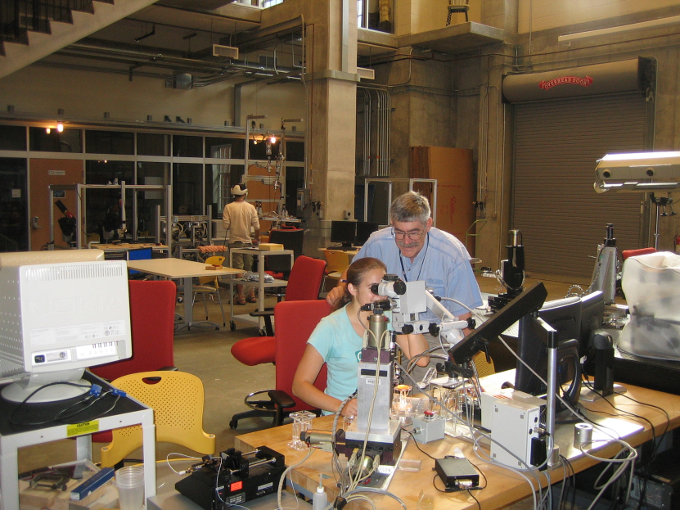
JHU Laboratory for Computational
Sensing and Robotics and CISST ERC
About 100 people:
> 10 faculty
> 15 postdocs
> 60 Graduate students
10 administrative and engineering staff
Hundreds of undergraduates
Total yearly research of > $4M
NIH
NSF
DARPA
ONR
Collaborations with
CMU, University of Maryland, Morgan State University, MIT, Columbia, U Washington, Harvard, Upenn, NIH ...
TU Munich, Queens University
Siemens, Medtronic, Intuitive Surgical, Hologic, Sentinelle Medical, Ikona Inc.
LCSR is located in approx. 15,000 sq. ft custom designed space in Hackerman Hall, the new Computational Sciences and Engineering Building (CSEB)
Hackerman Hall
Integrating Research and Education

Slide 2
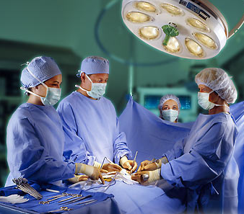
Information
Closed Loop Interventional Medicine
Patient-specific Information ( Images, lab results, genetics, etc.)
Model
Plan
Action
Patient-specific loop
General information ( anatomic atlases, statistics, rules)
Patient-specific Evaluation
Process Loop
Statistical Analysis

Slide 3
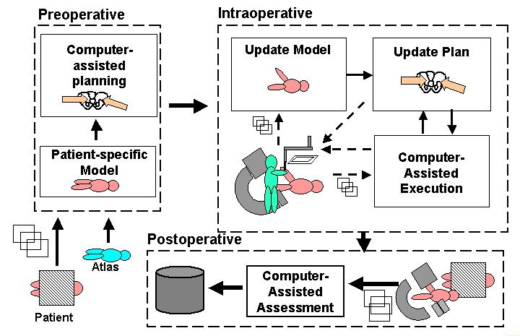
Multidisciplinary Integration is Crucial
Modeling & analysis
Segmentation
Registration
Atlases
Optimization
Visualization
Task characterization
etc.
Interface Technology
Sensing
Robotics
Human-machine interfaces
Systems
Safety & verifiability
Usability & maintainability
Performance and validation

Slide 4
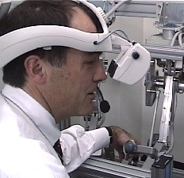
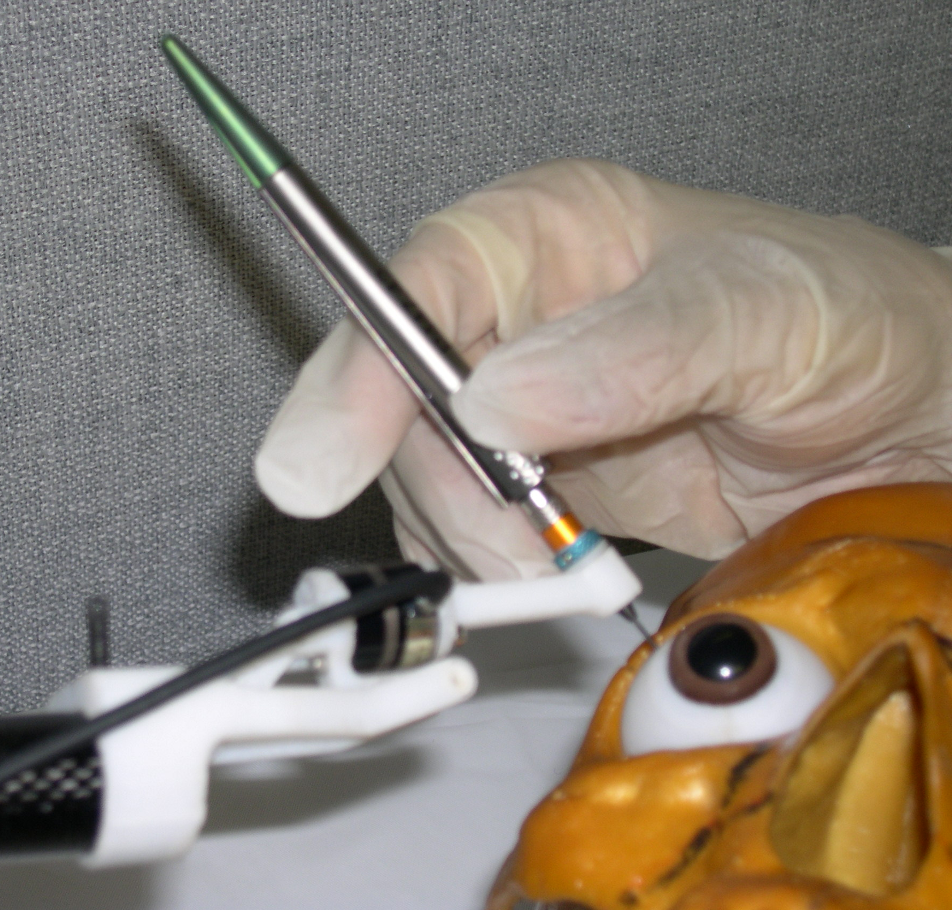
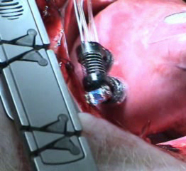
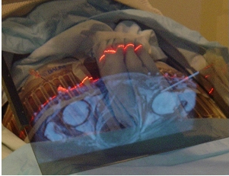
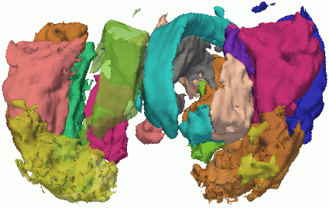
Engineering Research Center for Computer Integrated Surgical Systems and Technology (CISST ERC)
The CISST ERC is developing a family of surgical systems that combine innovative algorithms, robotic devices, imaging systems, sensors, and human-machine interfaces to work cooperatively with surgeons in the planning and execution of surgical procedures.
Areas of Research
Robotic surgical assistants
Image-guided interventional systems
Focused interdisciplinary research in algorithms, imaging, robotics, sensors, human-machine systems
Institutions & Funding
Johns Hopkins, MIT, CMU, BWH, Harvard, Penn, Morgan State, Columbia
Years 1-11: NSF = $32.7M; Total = ~$64.7M In-kind support = ~$13.9M
cisstweb.cs.jhu.edu

Slide 5
1998
1998

Slide 6
2010
Engineered Systems & Applications
Enabling core technology
Fundamental Knowledge

Slide 7
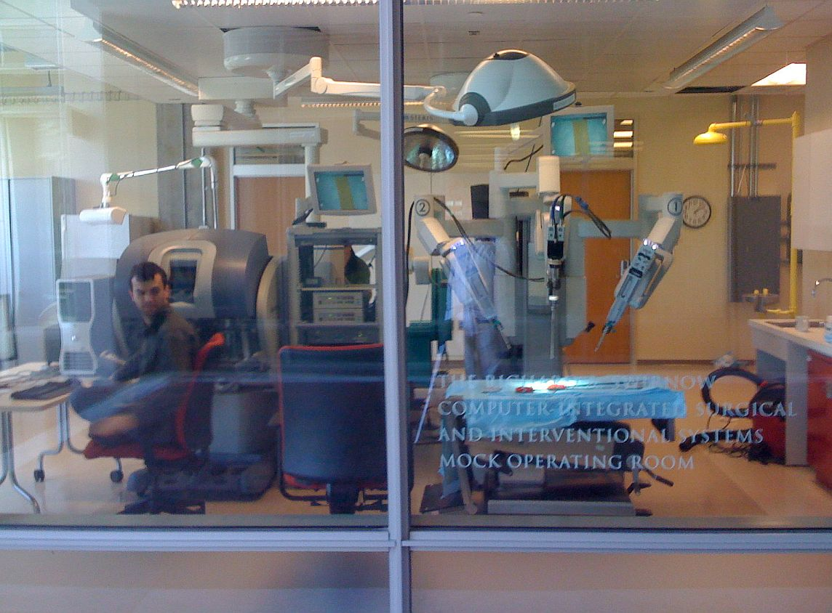
Swirnow Mock OR
System integration testbed
Research
Education
Medical robots
da Vinci telesurgical system
Robodoc orthopaedic robot
Neuromate neurosurgical robot
Imaging equipment
X-ray C-arm
Ultrasound
Key faculty: Taylor, Kazanzides, Kumar
Key engineers: Deguet, Vagvolgyi

