Slide 1
Paper Presentation
Saumya Gurbani
April 19, 2011
Ascari, L.; Bertocchi, U.; Laschi, C.; Stefanini, C.; Starita, A.; Dario, P.; , "A segmentation algorithm for a robotic micro-endoscope for exploration of the spinal cord," (May 2004)

Slide 2
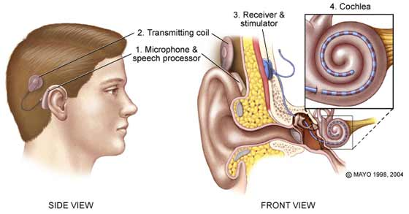
Project Review
Use borescope imaging of the cochlea in order to generate safe paths and virtual fixture for use in cochlear implant surgery

Slide 3
Background and Motivation
Ascari et al present a new algorithm for segmenting visual feeds from an endoscope
Is robust enough to use for grainy and blurry images
We plan to implement such an algorithm for the video feed from our borescope

Slide 4
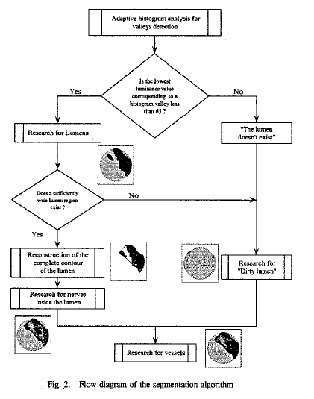
Algorithm Overview
Histogram Pre-processing
Lumen search
Contour Formation
Nerve and Vessel Detailing

Slide 5
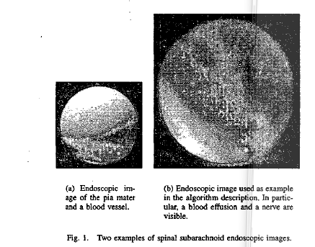
Sample Image Analyzed in Paper

Slide 6
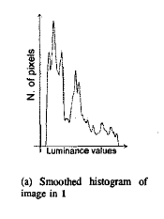
Image Pre-processing
Uses an adaptive histogram with a 5-pixel sliding window
Sorts the pixels by their luminance (0-255)
Ascari et al (2004)

Slide 7
Image Pre-processing
Find local minima on histogram
Function h[i] defines the number of pixels in image at luminance value i
Find h[i] s.t.

Slide 8
Image Pre-processing
Always underestimate luminance
Merge minima together if they are close. Keep higher luminance value only if

Slide 9
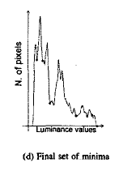
Image Pre-processing
There is a peak between two minima if
Apply same formula to choose
one peak
Ascari et al (2004)

Slide 10
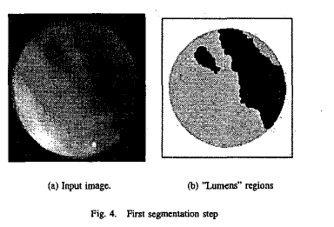
Lumen Search
Set the threshold value to be the maximum of the local minima, and threshold less than 65 (clear lumen) or 135 (“dirty” lumen)
Filter out small regions
Ascari et al (2004)

Slide 11
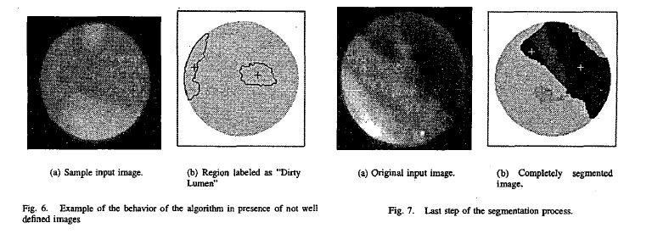
Clean vs “Dirty Lumen”
Dirty lumen caused from image blurring or from semi-transparent structures blocking view
Dirty Lumen
Clean Lumen

Slide 12
Finding Contours
Traditional edge segmentation yields very smooth contours which do not match the image
Authors present a hybrid method

Slide 13
Finding Contours
Join all segments labeled as lumen
Use a modified “Convex Hull” algorithm to determine the shape of lumen
Convex Hull algorithm finds a set of points P which form a polygon surrounding the lumen.
Algorithm modified and image sub-sampled to give
O(n)

Slide 14
Convex Hull Algorithm Example
http://www.cse.unsw.edu.au/~lambert/java/3d/hull.html

Slide 15
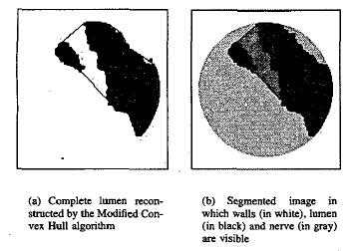
Segmented Image
Ascari et al (2004)

Slide 16
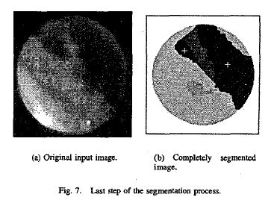
Experimental Results
Showed “complete accordance with classification made by medical doctors”
Runs at 16fps in 2004
Ascari et al (2004)

Slide 17
Critique
Safety minded
Algorithm is shown to be quite robust
Runs at 16fps, which could be dramatically faster on today’s architecture

Slide 18
Critique
Threshold value of 65/135
More data from experimental trials
Limited analysis of running time; lack of explanation of computational modifications

Slide 19
Relevance to Our Project
Live video analysis while surgeon guides borescope
Segmentation allows for semi-automated safe path planning
Additional safety measure for detecting sensitive features during surgery

Slide 20
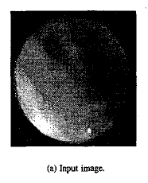
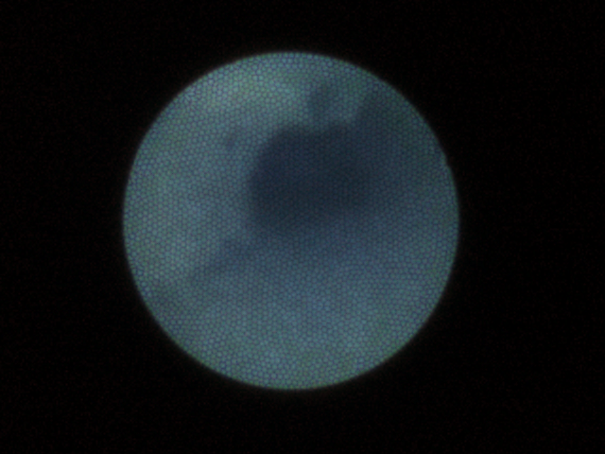
Paper vs Our Pictures
Ascari et al (2004)

Slide 21
Future Work
Authors mention further studies into developing 3D perception during navigation
Combine with pre-operative CT images to generate 3D meshes and registration

Slide 22
Questions?

