Slide 1
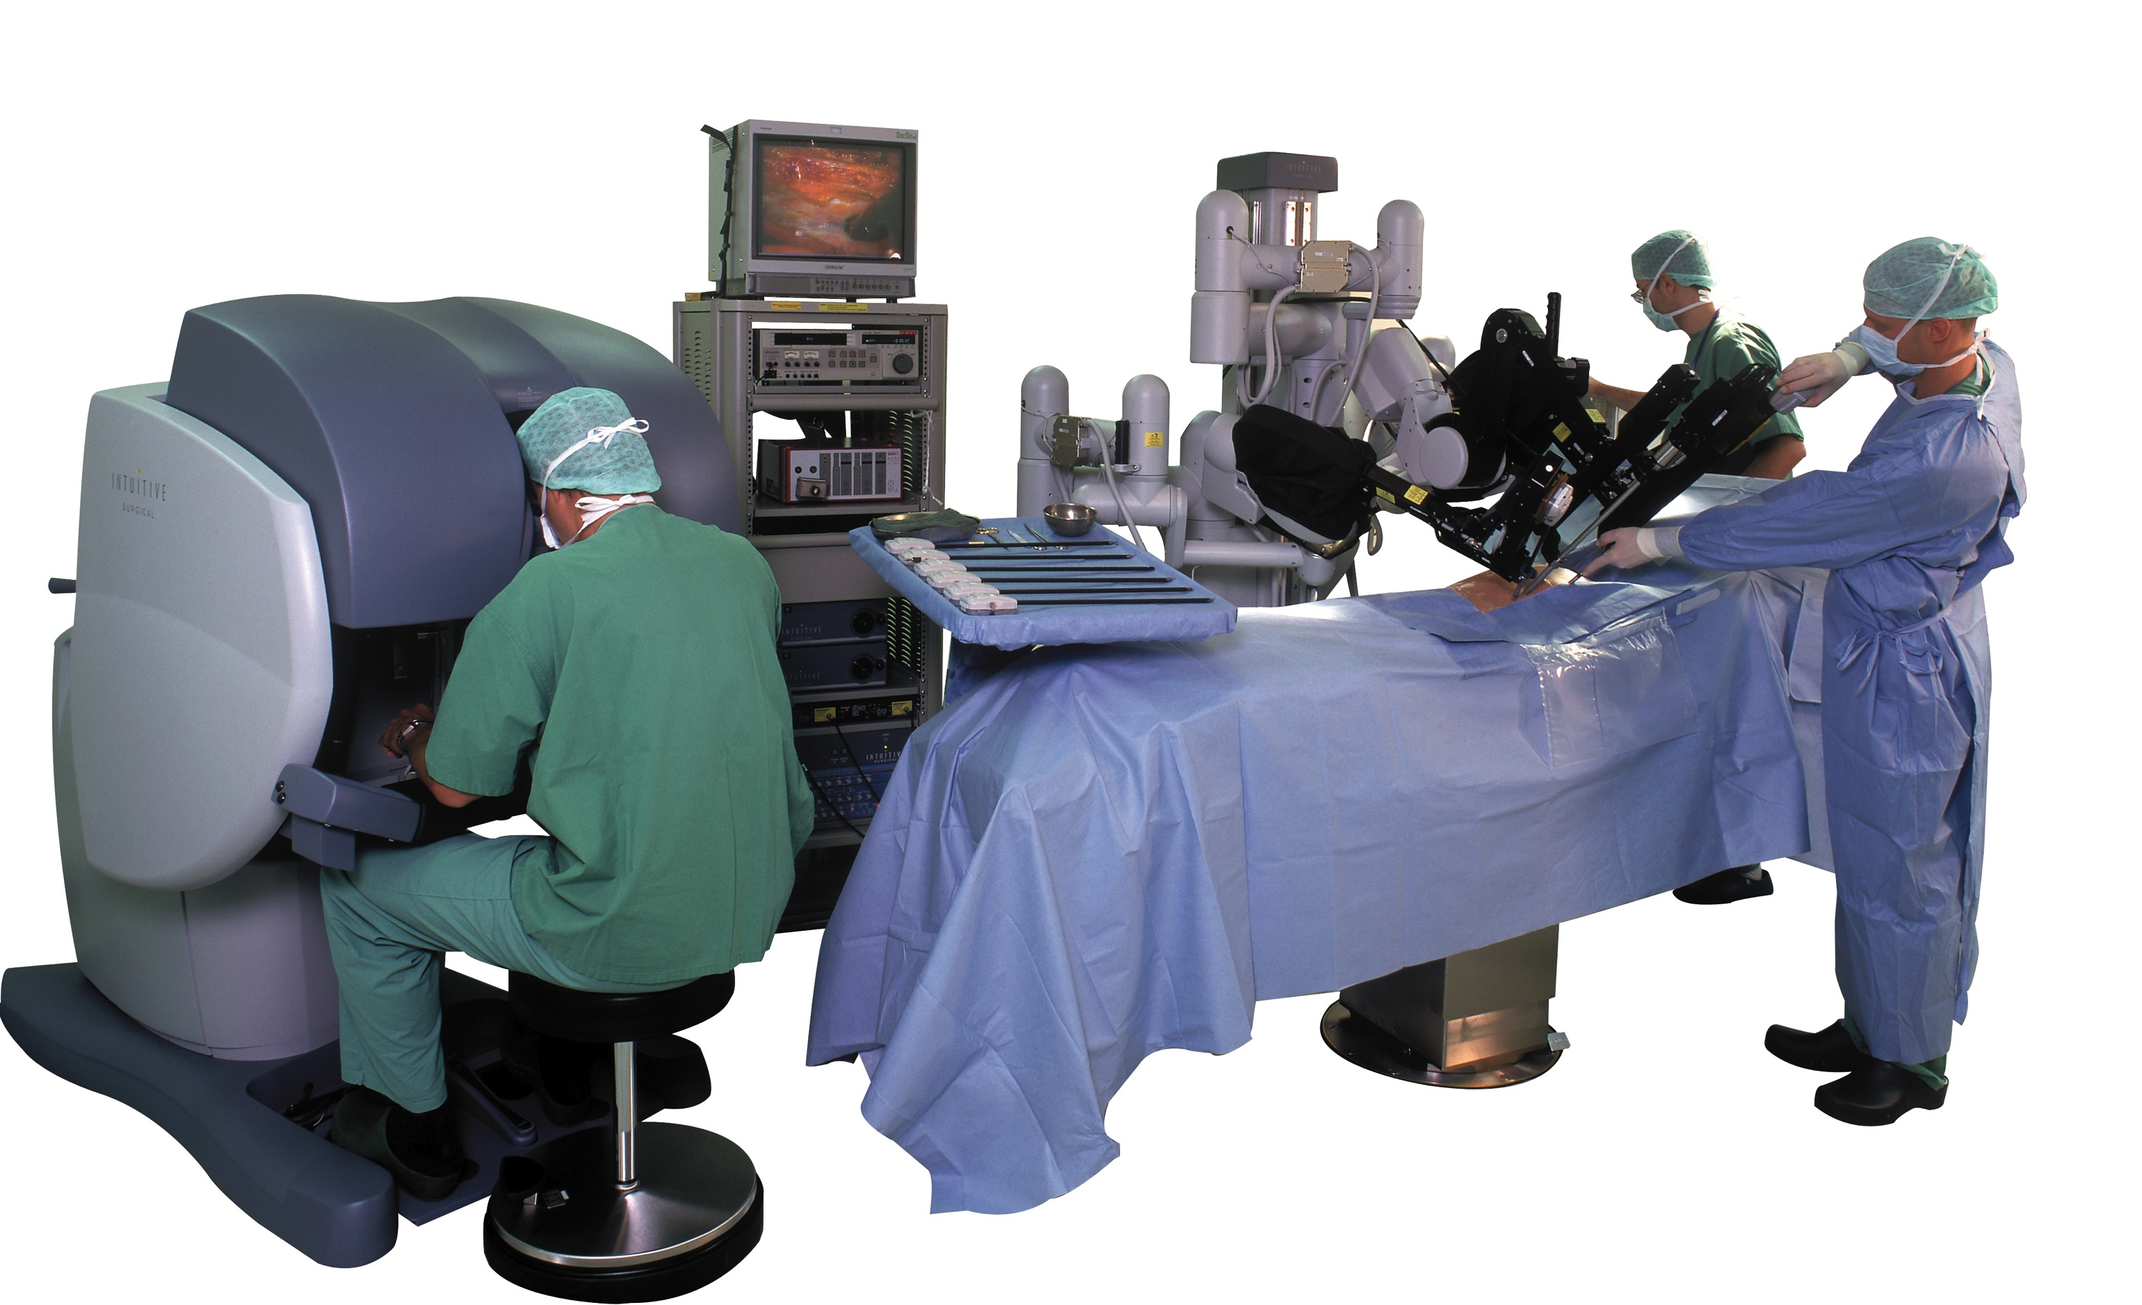
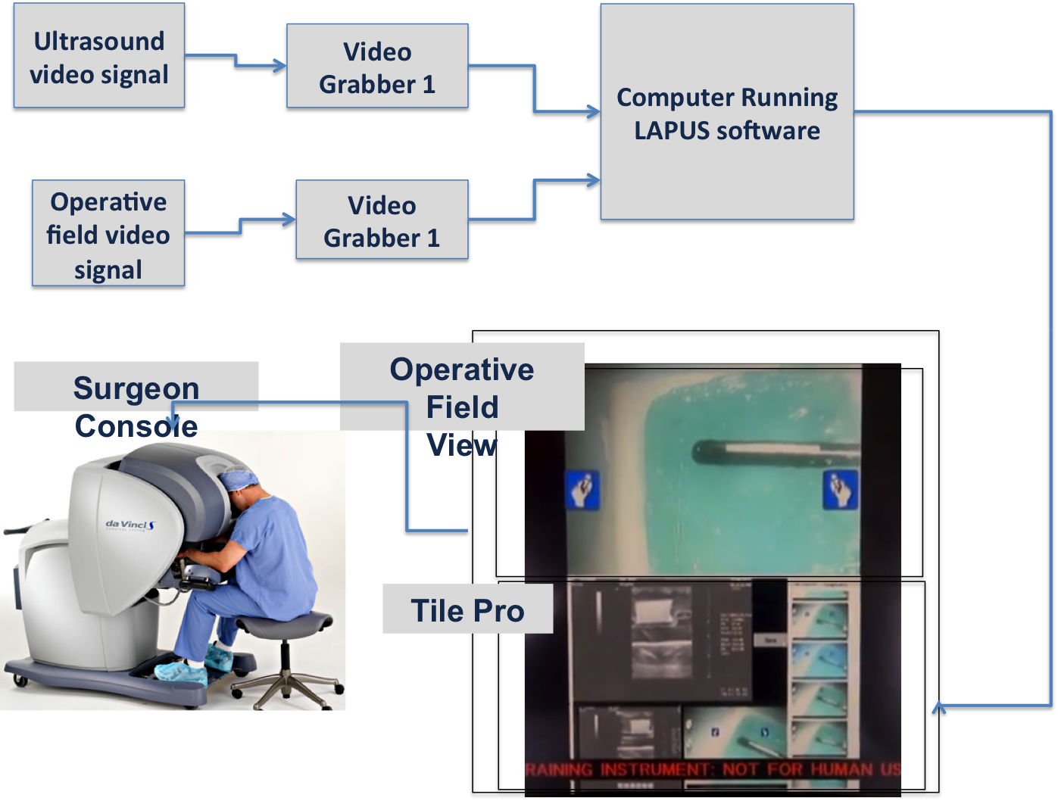
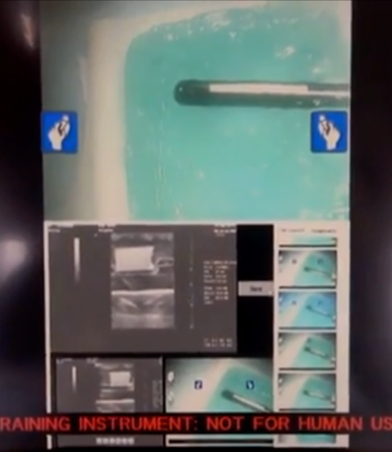
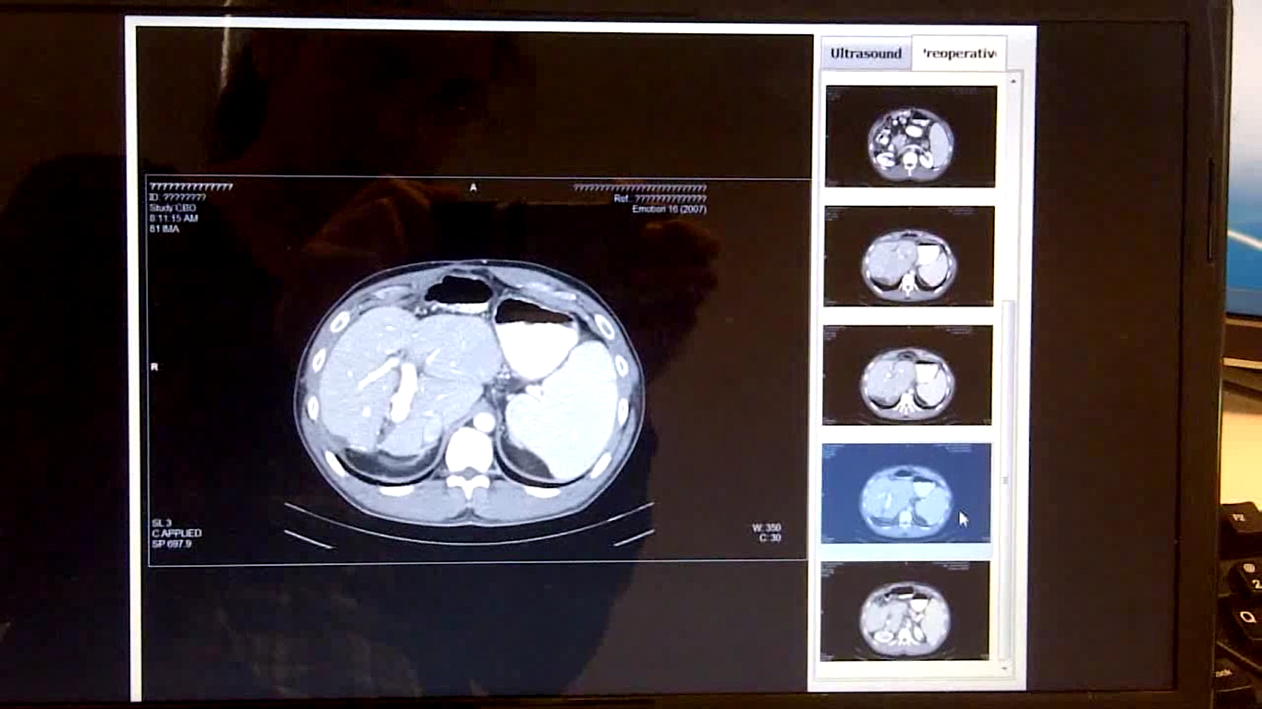
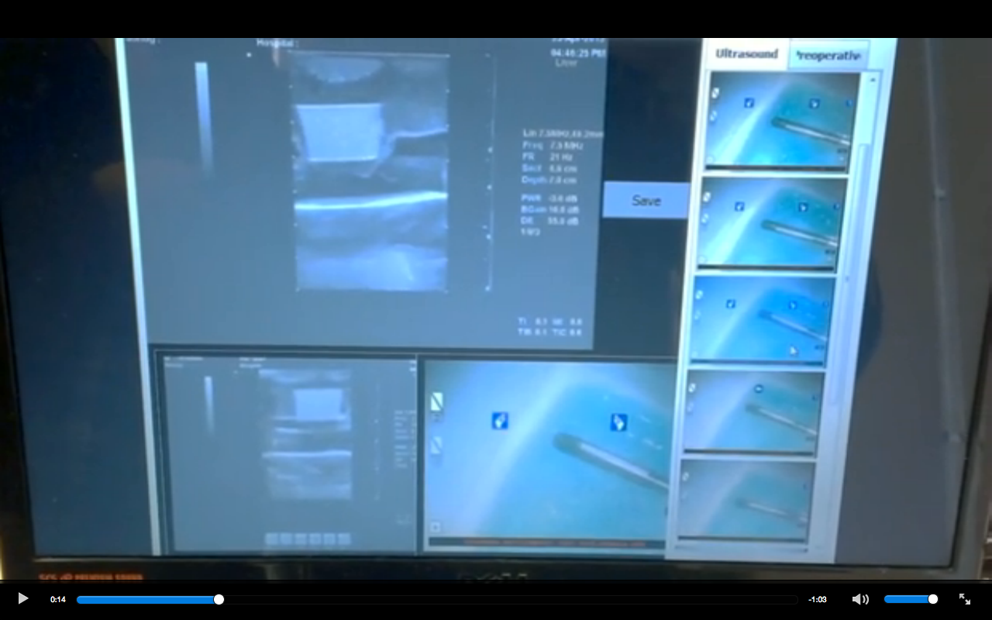
Data Integration during Robotic Ultrasound-guided Surgery
Computer Integrated Surgery II
Spring, 2013
Tifany Yung, Andrew Wang, and Vineeta Khatuja under the guidance of Michael Choti MD MBA, Theodoros Katsichtis, Colin Lea, Russell Taylor PhD
Introduction
A novel da Vinci interface was developed integrating live ultrasound feed, patient preoperative imaging, and image browsing within the master console.
The da Vinci system is used for minimally invasive surgical procedures, providing 7 degrees of freedom, 3D vision, and tremor attenuation.
TilePro is a da Vinci feature that allows an interface to be placed underneath the camera feed in the console.
www.intuitivesurgical.com
Problem
Surgeons must view ultrasound data and preoperative data external to the da Vinci console, requiring them to divert their attention.
Non-Clinical testing setup
Video grabbers transmit the ultrasound and live operative field video feed to the laptop, which projects these feeds video viewers in the interface.
HDMI cable connects the computer to the daVinci.
Solution
Project an interface in the TilePro allowing surgeons to view the ultrasound and preoperative data.
Use the Da Vinci right tool manipulator as mouse to control the interface.
Left: Entire da Vinci console display. Stereo camera feed from the da Vinci is in the top half, and the interface in the ultrasound viewing state is in the bottom half.
Results
IRB for clinical testing is approved.
Dr. Choti found the interface satisfactory and suggested future work/modifications.
Below: Enlarged view of the bottom half of the display. Left, the preoperative image viewing state. Right, the ultrasound viewing state.
Lessons learned
Starting from scratch and using snippets from old code can be more efficient than modifying old code.
Use setbacks and delays as a chance to prepare other aspects of the project to run more smoothly in the future.
Future Work
Clinical testing of the interface at the Johns Hopkins Hospital will take place during the summer.
Advanced tools (i.e. 3D organ model building, operative field measuring tool, etc.)
Acknowledgements
We would like to thank our mentors for their support and guidance on all aspects of this project.
Anton Deguet and Balazs Vagvolgyi for helping to resolve software dependencies.
Credits
Vineeta designed and developed the interface.
Andrew and Tifany developed the testing protocol and phantom design, also assisting with drafting an IRB.

