Slide 1
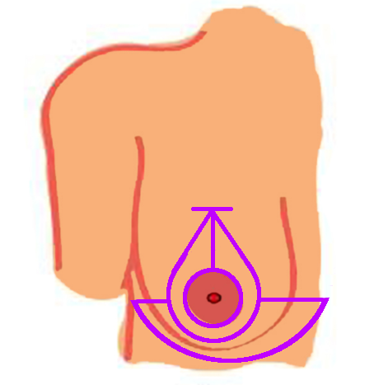
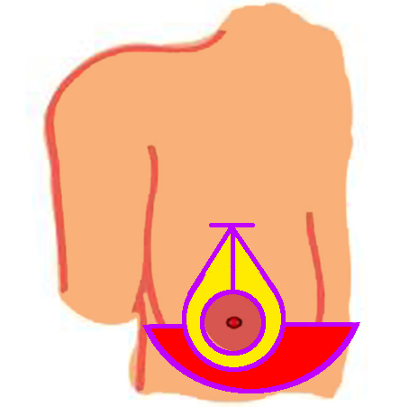
AR for Symmetric Outcome in Plastic Surgery
Breast reconstruction is high volume
Many procedures are bilateral e.g. reductions
Outcome is unclear:
Healing pattern
Amount …
… and distribution of removed tissue
etc.
During the procedure, patient is raised to sitting pose at least once for verification
AR solution to assess symmetry of intra-operative result
Incision lines
Skinned
Removed

Slide 2
AR for Symmetric Outcome in Plastic Surgery
What Students Will Do:
Use RGBD camera on HMD to get 3D model of sitting patient
Asses asymmetry in the 3D patient model
Develop AR solution to provide this information to the surgeon
Deliverables:
Unity + C# source code (proof-of-principle implementation)
Code documentation
Report describing the methods and achievements
Size group: 2
Skills: Experience in Unity + C# desired
Mentors:
Mathias unberath@jhu.edu, Prof. Navab
Clinical collaborator: Prof. Soltanian M.D.

