Slide 1
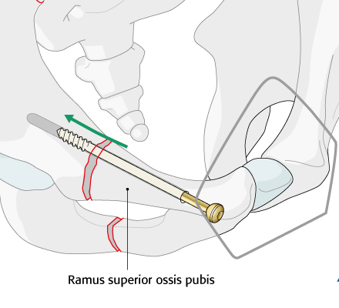
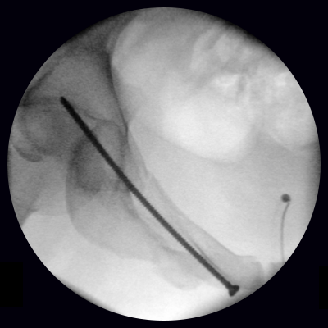
Low Dose Fluoroscopy for Orthopedic Surgery
Orthopedic trauma surgery is X-ray guided
High density of bones (e.g. pelvis) ➔ High dose required
Reduce dose: Digital Radiographs (DR) only ➔ DR is single-shot ➔ Changes to tools not immediately visible
Fluoroscopy (“live X-ray video”) established in Radiology (e.g. endovascular)
Machine learning solution to predict high dose image from: - Previous high dose image - Current low dose image

Slide 2
Low Dose Fluoroscopy for Orthopedic Surgery
What Students Will Do:
Use MCGPU (Monte Carlo) to obtain low and high dose images
Perform dose computations to understand benefit margin
Develop machine learning model to predict images
Deliverables:
MCGPU files and Python source code
Code documentation
Report describing the methods and achievements
Size group: 2
Skills: Experience with Python and Tensorflow desired
Mentors:
Mathias unberath@jhu.edu, Prof. Navab
Clinical collaborator: Prof. Osgood M.D.

