Slide 1
Physical Training Model for Robotic Blood Vessel Dissection
Checkpoint Presentation
Shayer Chowdhury (schowdh8@jhu.edu)
Project #3
Mentors: Dr. Gyusung Lee, Dr. Mija Lee

Slide 2
Project Overview
Current state: Lack of a cheap, effective, and reusable blood vessel dissection phantom for robotic surgery training
Goal: Create a comprehensive inanimate surgical training model for sharp/blunt dissection and blood vessel electrosurgery

Slide 3
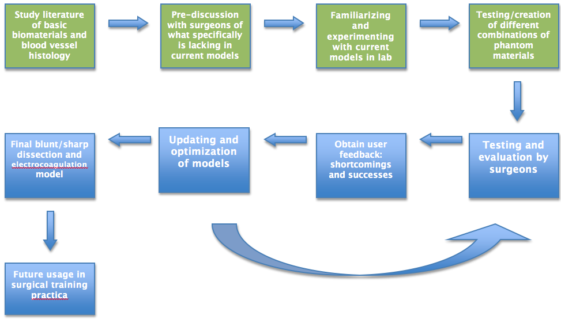
Approach

Slide 4
Progress To Date
Discussion with surgeons at MISTIC
Dr. Lee was able to get me in touch with three surgeons
Emphasized in both blunt/sharp surgery and electrosurgery simulation, option of keeping “tissue” opaque or transparent to obscure or display location of blood vessels
In blunt/sharp simulation, focus on tissue to behave realistically in terms of resisting dissection
In electrosurgery, focus on conductivity of gel and blood vessels, shrinking of blood vessel at high heat, and if possible, coagulation of “blood” inside vessel

Slide 5
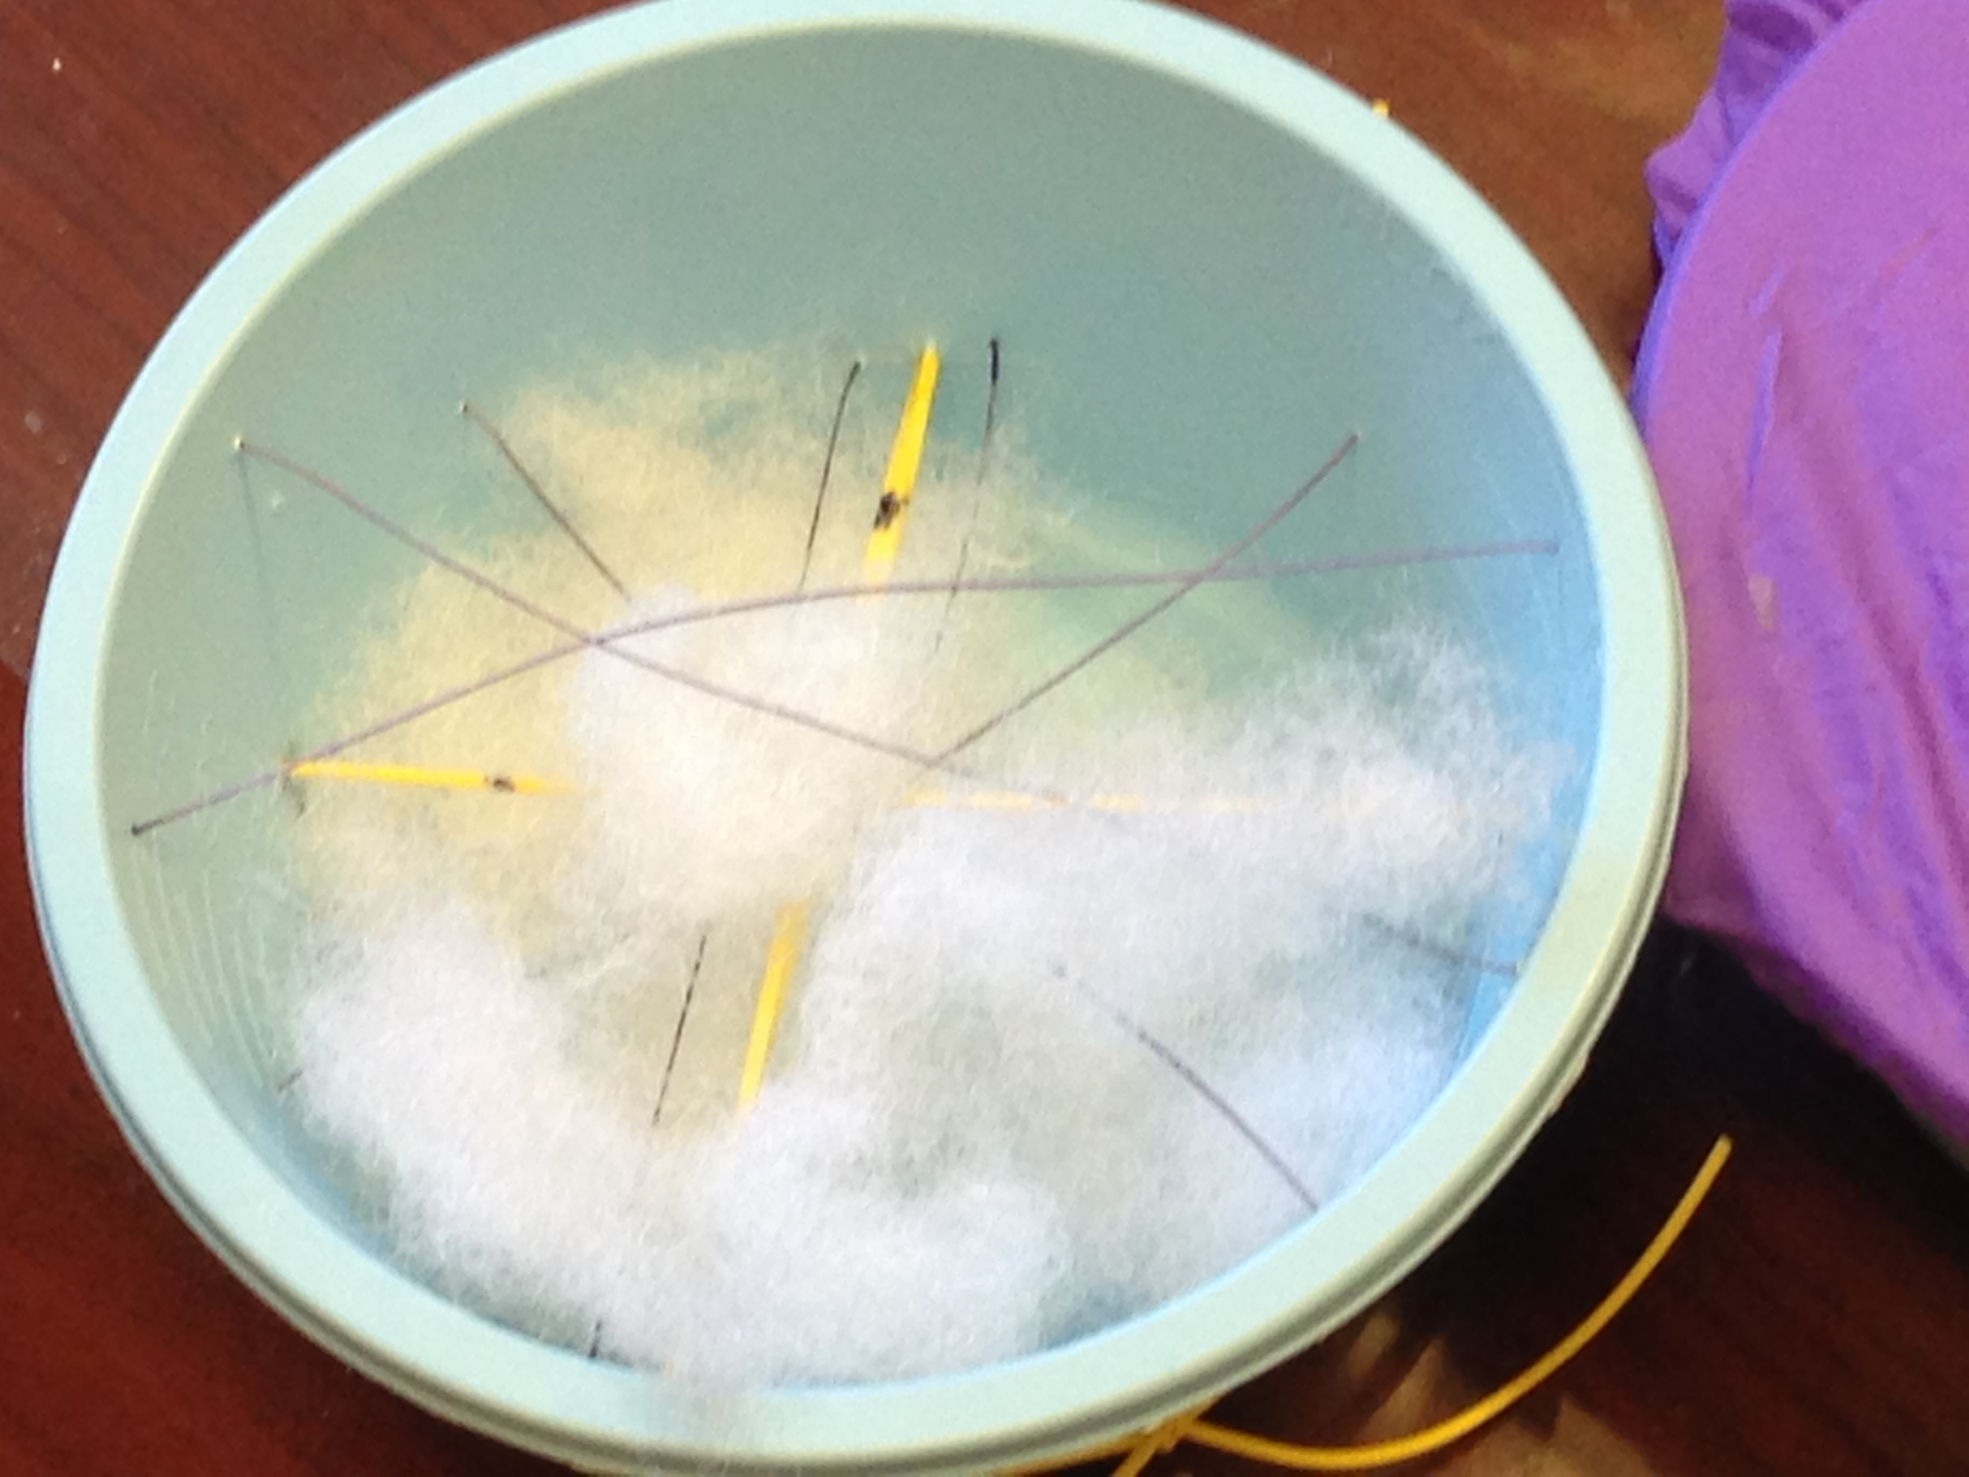
Blunt/Sharp Dissection Model Prototype: Summary
Cotton stuffing to simulate dissectible tissue and rubber bands to simulate blood vessels
Cheap and reusable
Strings/thread used as barriers and obstacles to maneuver around

Slide 6
Blunt/Sharp Dissection Model Prototype: Successes
Cotton stuffing, rubber bands, string/thread, and plastic bowls are inexpensive, recyclable lab materials that can be bought in bulk
Model exercises main concepts of blunt/sharp dissection
Cotton stuffing displays elastic/spring-like properties while being cut and moved around
String/thread obstacles prevent haphazard dissection
Simple to construct and reuse
Cutting does not permanently damage cotton, so can be reused and replaced easily

Slide 7
Blunt/Sharp Dissection Model Prototype: Weaknesses
Aiming to make model more sophisticated while keeping cost at a minimum
Prototype is fairly crude, but serves its purpose
Approximate cost currently at less than $10, which is the goal
Thickness and texture of cotton not exactly representative of human tissue
Looking into more synthetic material that better mimics tissue, but is still easily reusable

Slide 8
Blunt/Sharp Dissection Model Prototype: Moving Forward
Test out model and receive feedback from surgeons’ evaluations
Additional dependency: availability of surgeons will be dependent on their schedule; evaluation of models may take longer than expected
May push back April 1st date of expected deliverables accordingly
Continue search for more cheap, synthetic, and realistic material to replace or enhance cotton stuffing

Slide 9
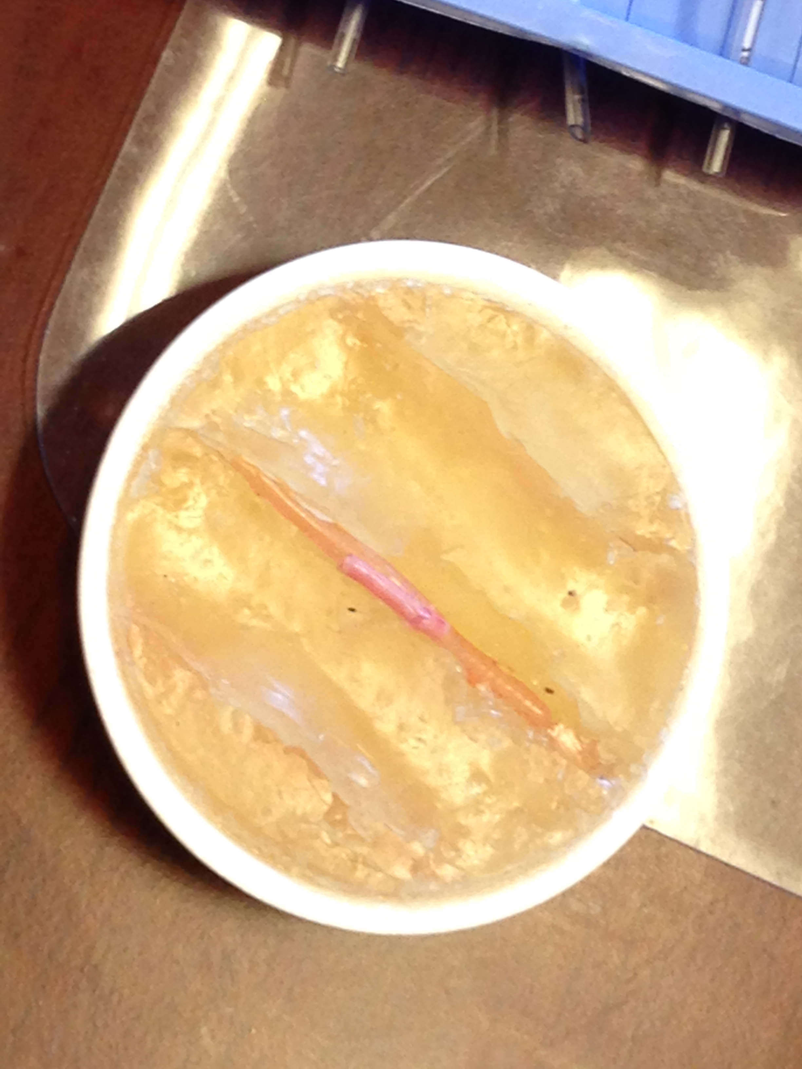
Electrosurgery Dissection Model Prototype: Summary
3mm silicone rubber tubing segments embedded in “gelatin from porcine skin” from Sigma-Aldrich
Tubing shrinks at temperatures higher than 100°C
Relatively cheap and easy to make

Slide 10
Electrosurgery Dissection Model Prototype: Successes
Rubber tubing simulates shrinking of blood vessels when high temperature is applied
Approximate cost is $30 per unit
Tubing can be bought for cheap off of amazon.com; gel purchased through Sigma-Aldrich
Much cheaper than current models, which run up to $75-80
Gelatin-based gel is potentially reusable
Described as having properties such that it can be re-melted at high enough temperatures
Simple to make in a basic lab environment

Slide 11
Electrosurgery Dissection Model Prototype: Weaknesses
Rubber tubing and gelatin gel have low conductivity
Searching for a more conductive blood vessel and tissue phantom
While much cheaper than current models, still fairly expensive
Goal is still less than $10 per unit, but will try to get as close as possible
Reusability of gel is questionable
Even if it can be re-melted at high enough temperatures, will need to accommodate by placing phantom in a metal dish and ensuring that tubing doesn’t shrink concurrently

Slide 12
Electrosurgery Dissection Model Prototype: Moving Forward
Search for a more conductive gel and rubber tubing material while maintaining realistic and reusable properties
Have model tested and evaluated by practicing surgeons then update using their feedback
Still haven’t figured out a way to model coagulation
Once rubber tubing choice is ascertained, can work on coagulation

Slide 13
Summary
Additional dependency of relying on availability of surgeons to evaluate according to their schedule
Access to surgeons is possible, but may need to adjust schedule
Extending expected deliverable date of April 1st to TBD, according to surgeon availability
Crude blunt/sharp prototype ready for evaluation
Electrosurgery model still needs improvement before evaluation

Slide 14
Questions?
Comments?

