Slide 1
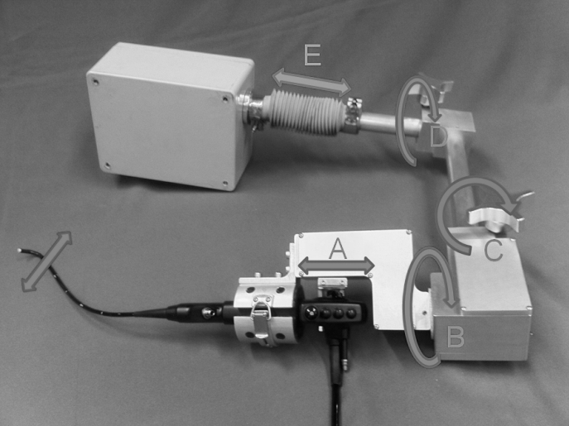
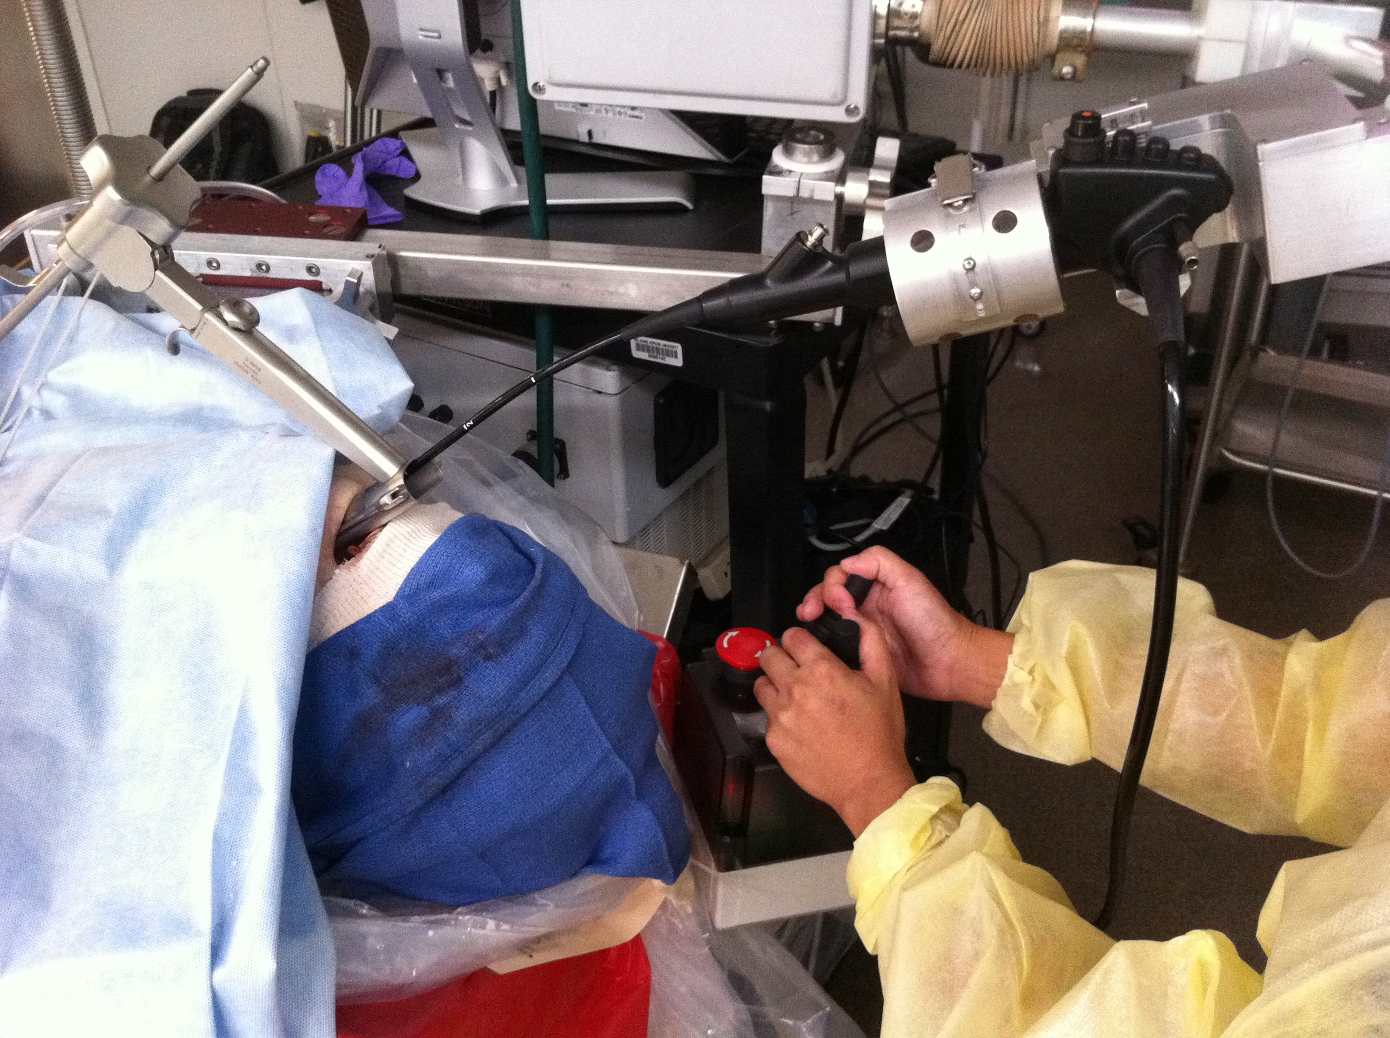
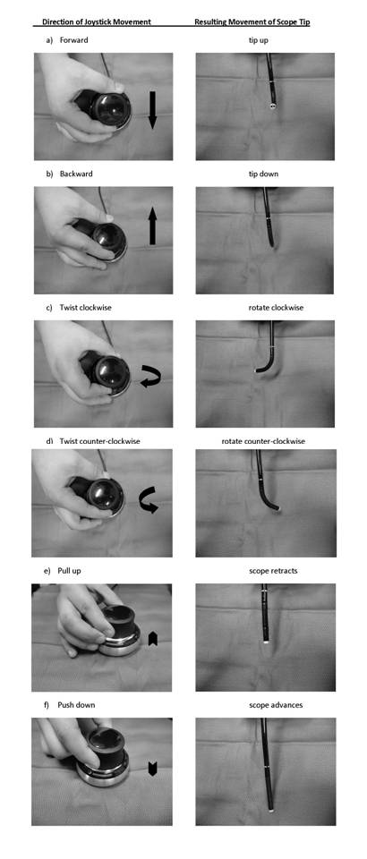
Assessment of the
Robotic Endolaryngeal Flexible (Robo-ELF) Scope
by Novice Users
Kevin Olds, BE; Lee M. Akst, MD; Russell H. Taylor, PhD, Jeremy D. Richmon, MD
Department of Otolaryngology – Head and Neck Surgery, Johns Hopkins University; Baltimore, Maryland
Engineering Research Center for Computer Integrated Surgery, Johns Hopkins Hospital, Baltimore, Maryland
CONTACT
Jeremy D. Richmon, MD Department of Otolaryngology – HNS Division of Head and Neck Surgery
Director of Head and Neck Robotic Surgery
Johns Hopkins Hospital : Email: jrichmo7@jhmi.edu
Supported by the Department of Oto-HNS, Johns Hopkins Hospital
INTRODUCTION
RESULTS
Minimally-invasive, transoral surgery is a technologically driven enterprise that is constantly evolving. Despite the advances in both transoral laser microsurgery (TLMS) and transoral robotic surgery (TORS), obtaining a complete endoscopic evaluation and adequate access to the entire human larynx remains challenging. Our group recently described a robotic endolaryngeal flexible (Robo-ELF) scope (1) which may help overcome some of these limitations [Figure 1]. The Robo-ELF provides a high-resolution image via a distal-chip scope that is able to curve around corners, thereby overcoming line-of-sight limitations. The flexible tip provides a wide field of vision in a single instrument that is controlled by a joystick [Figure 2]. The working port allows for the use of laser fibers or instruments for therapeutic use. As with any technology, the ease of use and learning curve necessary to master it will determine its adoption.
Tables and Figures
All residents completed the exercise in under five minutes. The survey results demonstrated that each item was scored as easy to very easy with the exception of visualization of the piriform sinus, which was neutral [Table 1].
DISCUSSION
Surgeons are less likely to adopt complex technology if there is a steep learning curve and a long lag period before efficiency is attained. We developed a robotic endolaryngeal scope driver that is intuitive and easy to learn allowing for the rapid adoption of the technology. We believe this device further complements existing techniques for transoral access to and visualization of the endolarynx.
Figure 1. The robotic endolaryngeal flexible scope with attached flexible distal-chip laryngoscope. A = active scope tip manipulator; B = active axial rotation of the scope; C = passive lockable joint to adjust scope entry angle; D = passive lockable joint to adjust scope height; E = active in-out translation.
Figure 3. An otolaryngology resident driving the Robo-ELF for the first time (with second prototype joystick) obtaining a view of the anterior commissure.
METHODS AND MATERIALS
One fresh human cadaver with full dentition was suspended with a Steiner laryngoscope to afford direct visualization of the arytenoids but not of the anterior commissure, thereby creating the view commensurate with an anteriorly displaced larynx. Seven otolaryngology residents naïve to the Robo-ELF were individually given a thirty second tutorial. This included instructions on docking and undocking the robot and how to control the joystick. They were then allowed approximately thirty seconds to familiarize themselves with the joystick controls [Figure 3]. They were instructed to view all anatomic subsites of the larynx and advance into the subglottis until the carina was visualized. No time limit was given and assistance was provided if there were questions. At the end of the exercise each participant filled out a de-identified survey regarding the ease of use of the Robo-ELF.
CONCLUSIONS
This study has shown that residents with no prior experience with the Robo-ELF can learn to use it to visualize common anatomical sites of interest effectively within minutes.
REFERENCES
1. Olds K, Hillel AT, Cha E, Curry M, Akst LM, Taylor RH, Richmon JD. Robotic
endolaryngeal flexible (Robo-ELF) scope: a preclinical feasibility study. Laryngoscope. 2011 Nov;121(11):2371-4
Figure 2. The primary directions of scope movement are demonstrated by joystick control (note: first joystick prototype illustrated here).
Table 1. Resident assessment of ease of using the Robo-ELF for the first time.

