Slide 1
Enabling Technologies for Robot Assisted Ultrasound Tomography
Team Members: Rishabh Khurana , Fereshteh Aalamifar
Mentors: Emad Boctor, Iulian Iordachita, Russell Taylor
Group 11
Notes:
F

Slide 2
Table of Contents
Summary & Goal
Timeline
Motivation
Dependencies
Technical Approach
Management Plan
Deliverables
Reading List
Motivation & Goal
Technical Approach
Deliverables
Timeline
Dependencies & Plans
Notes:
F

Slide 3
Motivation
Ultrasound vs. CT
 | CT | Ultrasound
Cost | $1200-$3200 | $100-$1000
Imaged structure | Bony structures | Soft or internal organs
Radiation exposure | 2-10 msv | None
Weight | 2000 kg (1000 mm diameter x 5000 mm long) | > 5 Kg
Scan time | 30 secs | 10-15 min
Ref: http://www.diffen.com/difference/CT_Scan_vs_Ultrasound
http://www.dimensionsinfo.com/how-big-is-a-ct-scanner/
http://www.absolutemed.com/Medical-Equipment/Ultrasound-Machines/GE-Vivid-e-Portable-Ultrasound-Machine
Motivation & Goal
Technical Approach
Deliverables
Timeline
Dependencies & Plans
Notes:
R

Slide 4
Summary & goal
Ultrasound (US) penetration: 10-15 cm
Thick tissues or obese patients?
US waves can not travel through air
Human operated probe + Robotic probe
Goal:
Higher imaging depth
Faster scan
Ultimately: US tomography
Motivation & Goal
Technical Approach
Deliverables
Timeline
Dependencies & Plans
Notes:
F

Slide 5
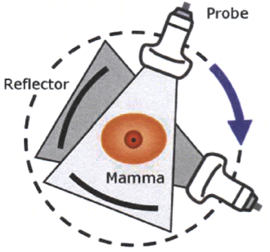
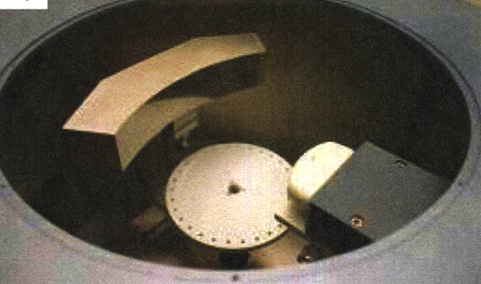
Motivation
An US Tomography Example:
Full Angle Breast Cancer Imaging
Ultrasound data from all viewing angles around the cancerous breast (360 degrees)
Ref: Christian Hansen et. all, “Ultrasound Breast Imaging using Full Angle Spatial Compounding: In-vivo results,” IEEE International Ultrasonics Symposium Proceedings, 2008.
Motivation & Goal
Technical Approach
Deliverables
Timeline
Dependencies & Plans
Notes:
R

Slide 6
Motivation
US Tomography in mid 20th century
soon were retired or some were never used because:
Lie in a pool of water
Not so good US image quality
Penetration limited to 10-15 cm
sonographer did not have enough control
Today:
Better quality US images and faster processors
Our system enables US tomography which:
- does not require the use of the pool of water
- can cover higher imaging depth
- directly controlled by sonographer
Motivation & Goal
Technical Approach
Deliverables
Timeline
Dependencies & Plans
Notes:
R

Slide 7
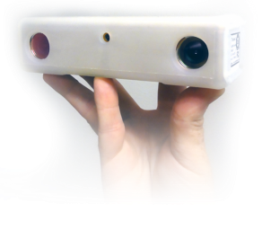
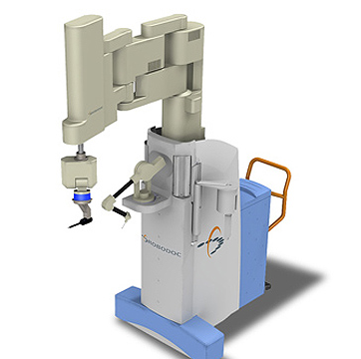
Technical Approach
Summary:
Optical Tracker (MicronTracker):
Light weight & Easy installation
Low cost
Passive markers
Robot (Robodoc): 5DOF
Passive arm instead of human probe
Cylindrical phantom
Copyright: Claron Inc.
Copyright: hyundaiengineering.blogspot
Motivation & Goal
Technical Approach
Deliverables
Timeline
Dependencies & Plans
Notes:
F

Slide 8
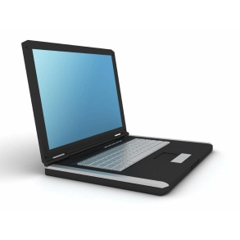
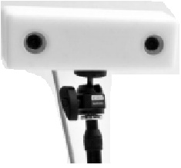
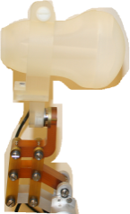
Technical Approach
Schematic
Control Software
Robot to Tracker Calibration
Robot to US calibration
Probe Tip Calibration
Tracking loops
Control Software
Robotic Arm
Passive Arm
Ref coordinate
Motivation & Goal
Technical Approach
Deliverables
Timeline
Dependencies & Plans
Notes:
F

Slide 9
Technical Approach
Control Software
Get 6D pose of freehand probe
Control Software
Calculate robotic probe’s desired pose
Robotic Arm
Passive Arm
Transform it to robot coordinate system
Get robot probe’s position
Calculate kinematics
Registration
Ref coordinate
Command robot controller
Motivation & Goal
Technical Approach
Deliverables
Timeline
Dependencies & Plans
Notes:
F

Slide 10
Technical Approach
Schematic
Registration:
Control Software
Robot end effector
& OPT Marker
Robotic Arm
Passive Arm
Robot
T_{R}
T_{o}
T_{RO}
Optical Tracker
T_{RO} = inverse(T_{O}) . T_{R}
Registration
Ref coordinate
Motivation & Goal
Technical Approach
Deliverables
Timeline
Dependencies & Plans
Notes:
R

Slide 11
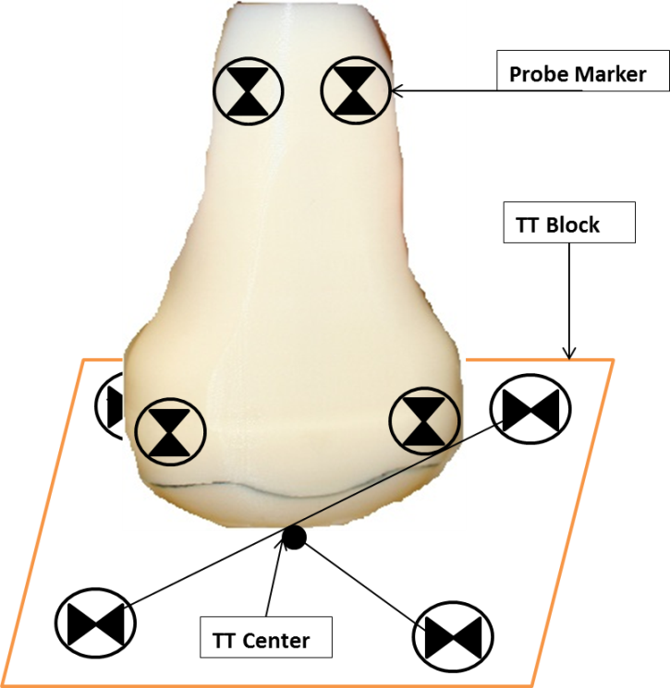
Technical Approach
Probe tip calibration
Control Software
Robotic Arm
Passive Arm
Ref coordinate
Motivation & Goal
Technical Approach
Deliverables
Timeline
Dependencies & Plans
Notes:
R

Slide 12
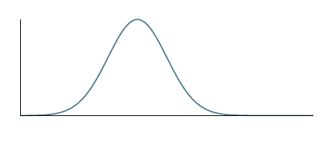
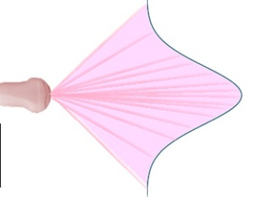
Technical Approach
Energy Profile Tracking (EPT)
B-Mode Tracking
Aligned
Not Aligned
Motivation & Goal
Technical Approach
Deliverables
Timeline
Dependencies & Plans
Notes:
R

Slide 13
Deliverables
Minimum Deliverables: (Expected by April 1)
A robotic arm should follow the position of a mock ultrasound probe attached to a passive arm, on the other side of a cylinder, using optical tracking system
Motivation & Goal
Technical Approach
Deliverables
Timeline
Dependencies & Plans
Notes:
F

Slide 14
Deliverables
Expected Deliverables: (Expected by April 22)
Build a transparent cylindrical phantom
The mock probes should be replaced with real ones.
Real data should be collected.
Study EPT and B-Mode. This should be thoroughly investigated.
Motivation & Goal
Technical Approach
Deliverables
Timeline
Dependencies & Plans
Notes:
F

Slide 15
Deliverables
Maximum Deliverables: (Expected by May 6)
Implement EPT or B-Mode and conduct its accuracy study.
Real images shall be collected and reconstructed on a PC to display real-time ultrasound images.
Motivation & Goal
Technical Approach
Deliverables
Timeline
Dependencies & Plans
Notes:
F

Slide 16
Deliverables
Future Directions:
More advanced reconstruction algorithms
Force sensors
Determine shape of the tissue
Irregular Phantoms
Motivation & Goal
Technical Approach
Deliverables
Timeline
Dependencies & Plans
Notes:
F

Slide 17
Project Timeline
Motivation & Goal
Technical Approach
Deliverables
Timeline
Dependencies & Plans
Notes:
R

Slide 18
Dependencies Phase 1
 | Dependency | Plan/Source | Status/Comments | Not met? | Due
Phase 1 | 5 DOF robot and training | Robodoc/ Min Yung | In process | Learn ourselves | Mar 4
 | Mock ultrasound probes | Rapid prototyping | Done with CAD/ have to print | Project will be delayed | Feb 22
 | PC or laptop | Provided by Prof. Iordachita | Acquired | Project will be delayed | Feb 11
 | Optical tracking system | Micron Tracker by Prof. Boctor | -Order in process -Using Prof. Kazanzides’s tracker in the mean time | Use Dr. Kazanzides OPT! | Feb 28
 | Cylindrical solid phantom | Acquired | Will get transparent one | Build ourselves | Mar 30
 | Mechanical designs & interfacing robot wrist to probe | Prof. Iordachita if we cannot handle | Talked to Prof. Iulian | Project will be delayed | Mar 15
Motivation & Goal
Technical Approach
Deliverables
Timeline
Dependencies & Plans
Notes:
r

Slide 19
Dependencies Phase 1
 | Dependency | Plan/Source | Status/Comments | Not met? | Due
Phase 1 | Required wires/ cables/ tools | Prof. Iordachita lab | Or from Profs Iordachita and Boctor internal funds | Project will be delayed | TBD
 | Matlab Visual Studio | Requested | In progress | Contact technical support | Feb 28
 | Weekly meeting with mentors | Arrange via email | In progress | Project will be delayed | Feb 28
Motivation & Goal
Technical Approach
Deliverables
Timeline
Dependencies & Plans
Notes:
R

Slide 20
Dependencies Phase 2
 | Dependency | Plan/Source | Status/Comments | Not met? | Due
Phase 2 | Ultrasound machine & probes | Provided by Prof. Boctor | Considered 2 in Dr. Boctor’s lab One probe available and the other order in progress | Expected deliverables will be delayed | Apr 1
 | Ultrasound physics and images | Prof. Boctor | We rely on Dr. Boctor on ultrasound technical information | Investigate | Apr 1
Motivation & Goal
Technical Approach
Deliverables
Timeline
Dependencies & Plans
Notes:
R

Slide 21
Dependencies Phase 3
 | Dependency | Plan/Source | Status/Comments | Not met? | Due
Phase 3 | Transmitter, receiver and processing units | From Profs Iordachita and Boctor internal funds | Upon necessity | Maximum not met | Apr 22
 | Ultrasound imaging reconstruction resources | Provided by Prof. Boctor | Upon necessity | Maximum not met | Apr 22
Motivation & Goal
Technical Approach
Deliverables
Timeline
Dependencies & Plans
Notes:
r

Slide 22
Management plan
Spend average of 15-18 hours/team member/week
Assigned Monday, Tuesday, Wednesday, and Thursday as “working on project days”
Will try to maximize the “working together” time on these days
Have weekly meeting with mentors
Have assigned responsibilities to each person
but will do most of the work together and help each other =>
both of us will learn the most from this project.
Motivation & Goal
Technical Approach
Deliverables
Timeline
Dependencies & Plans
Notes:
F

Slide 23
Reading list
Ultrasound Calibration
[1] J. D. Achenbach., “Wave Propagation in Elastic Solids,” volume 16 of North-Holland series in applied mathematics and mechanics, North-Holland, 1973.
[2] D. V. Amin, et al, “Calibration method for determining the physical location of the ultrasound image plane. In Proceedings of the fourth International Conference on Medical Image Computing and Computer-Assisted Intervention,” Lecture Notes in Computer Science, volume 2208, pages 940-947. Springer-Verlag, 2001.
[3] K. S. Arun, T. S. Huang, and S. D. Blostein, “Least-squares fitting of two 3-D point,” IEEE Transactions on Pattern Analysis and Machine Intelligence, 9(5):698-700, 1987.
[4] L. G. Bouchet, et al, “Calibration of three-dimensional ultrasound images for image-guided radiation therapy,” Physics in Medicine and Biology, 46:559-577, 2001.
[5] M. Burcher, “A force-based method for correcting deformation in ultrasound images of the breat,” PhD thesis, University of Oxford, Oxford, United Kingdom, 2002.
[6] R. M. Comeau, A. Fenster, and T. M. Peters, “Integrated MR and ultrasound imaging for improved image guidance in neurosurgery,” In Proceedings of SPIE, volume 3338, pages 747-754, 1998.
[7] S. Dandekar, Y. Li, J. Molloy, and J. Hossack, “A phantom with reduced complexity for spatial 3-D ultrasound calibration,” Ultrasound in Medicine & Biology, 31(8):1083-093, 2005.

Slide 24
Reading list
Ultrasound Tomography
[1] Christian Hansen et. all, “Ultrasound Breast Imaging using Full Angle Spatial Compounding: In-vivo results,” IEEE International Ultrasonics Symposium Proceedings, 2008.
[2] T.S. Kim, S.H. Do, V.Z. Marmarelis, “Multi-band Tissue Differentiation in Ultrasonic Transmission Tomography,” Ultrasonic Imaging and Signal Processing, Medical Imaging (SPIE), 2003.
[3] V.Z. Marmarelis, T.S. Kim, R. E. N. Shehada, “High Resolution Ultrasonic Transmission Tomography,” Ultrasonic Imaging and Signal Processing, Medical Imaging (SPIE), 2003.
[4] U. M. Hamper, M. R. DeJong, L. M. Scoutt, “Ultrasound Evaluation of the Lower Extremity Veins,” Radiol Clin N Am Elsevier, 2007, pp. 525–547.
[5] X. Pan, Y. Zou, and M. A. Anastasio, “Data Redundancy and Reduced-Scan Reconstruction in Reflectivity Tomography,” IEEE Transactions on Image Processing, Vol. 12, No. 7, Jul. 2003, pp. 774-795.
[6] David Gillespie, and Carolyn Glass, “Importance of Ultrasound Evaluation in the Diagnosis of Venous Insufficiency: Guidelines and Techniques,” Elsevier Seminars in Vascular Surgery, 2010, pp. 85-89.
Optical Tracking System
[1] Claron optical tracking system manual

Slide 25
Reading list
Hand-eye calibration
[1] Y. Shiu, S. Ahmad, “Calibration of Wrist-Mounted Robotic Sensors by Solving Homogeneous Transform Equations of the Form AX=XB,” IEEE Transactions on robotics and automation, Vol. 5, No. 1, Feb. 1989
[2] K. Daniilidis, “Hand-Eye Calibration Using Dual Quaternions,” The International Journal of Robotics Research, Vol. 18, No. 3, March 1999, pp. 286-298.
Robotic Ultrasound Technology
[1] Pezhman Foroughi, “Tracked Ultrasound Elastography,” Johns Hopkins Universiy PhD Thesis, June 2012.
[2] S. E. Salcudean, et. al, “Robot-Assisted Diagnostic Ultrasound – Design and Feasibility Experiments,” Medical Image Computing and Computer-Assisted Intervention – MICCAI’99 Lecture Notes in Computer Science Volume 1679, 1999, pp 1062-1071.
[3] Purang Abolmaesumi, et. al, “Image-Guided Control of a Robot for Medical Ultrasound,” IEEE Transactions on Robotics and Automation, Vol. 18, No. 1, Feb. 2002, pp. 11-23.
Robotics
CIS I Lectures
[0] Fundamentals of serial robots
[1] Denevit Heartenburg and Jacobian matrix derivation
[2] Robot’s manual and tutorials
[3] Kinematics and inverse kinematics

Slide 26
Thanks!
Questions?

