Slide 1
Project Update: An Improved GUI and Vision-based Guidance for the Robo-ELF
Team Members: Jon Kriss
Collaborators: Renata Smith
Mentors: Kevin Olds, Dr. Russ Taylor, Dr. Jeremy Richmon

Slide 2
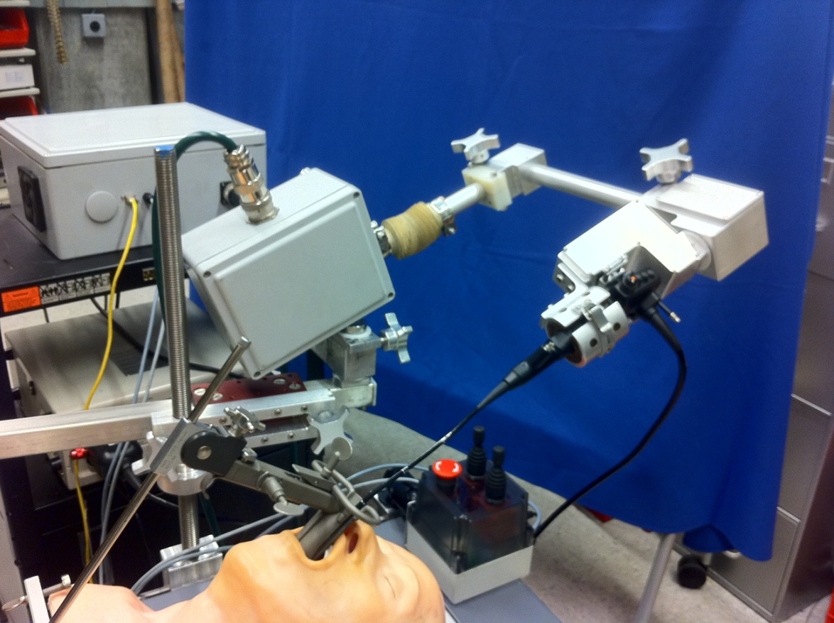
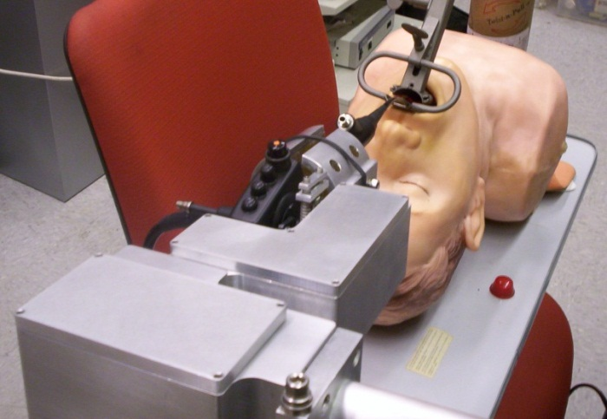
Background
Robotic EndoLaryngeal Flexible Scope (Robo-ELF) system for endoscope manipulation
Background
Goal
Progress
Revisions

Slide 3
Current System
Joysticks
Galil
Heartbeat
Digital/Analog I/O
Robot
Motors/Encoders
Potentiometers
Limit Switches
PC
TaskManager
GUI
RobotTask
Robot Control
Safety Features
Galil Controller
cisst wrapper
EStop
Video Display/ Recording
Video Capture Card
Endoscope
HD Video
Background
Goal
Progress
Revisions

Slide 4
Motivation
Current Robo-ELF system provides a great improvement over standard laryngeal surgery techniques
Drawbacks of current system
Non-intuitive control mechanism
Lack of a useful intra-operative GUI
Ultimate goal of project is clinical human trials
Background
Goal
Progress
Revisions

Slide 5
Goal
Complete regulatory requirements for clinical trials with current system
Software documentation and review
Risk analysis and validation
Develop a robust GUI including vision-based guidance
Provide useful tools to the surgeon
Provide an intuitive control method
Background
Goal
Progress
Revisions

Slide 6
Proposed System
Galil
Heartbeat
Digital/Analog I/O
Robot
Motors/Encoders
Potentiometers
Limit Switches
Joysticks
PC
TaskManager
GUI
Robot state/error display
RobotTask
Robot Control
Safety Features
Galil Controller
cisst wrapper
EStop
Video Recording/Display
Vision-based Control
Video Capture Card
Endoscope
HD Video
Background
Goal
Progress
Revisions

Slide 7
Approach
Work Required for FDA submission
Documentation and testing of safety features
Software design review
Risk assessment and validation, FMEA
User manual
Physical setup instructions
Cleaning procedures
Computer setup/calibration instructions
Explanation of error codes
Background
Goal
Progress
Revisions

Slide 8
Approach
Work required for GUI
svlFilter for existing vision code
Integrate existing code into control process
Design a new GUI with input from surgeon
Build new GUI
Visual representation of the robot position
Quick access to pre-op images
Background
Goal
Progress
Revisions

Slide 9
Completed Objectives
Implemented recommendations of first software review and design review
Improved error detection and handling
Minor GUI updates
General bug fixing
Draft of FMEA
Draft of user manual
Mechanical changes are in progress
Discussed new GUI features with surgeon
Background
Goal
Progress
Revisions

Slide 10
Improved Safety/Error Detection
Added confirmation with previous results to startup calibration to detect sensor failures
Implemented software limits
Galil motor controller throws more useful errors
Eliminated software joystick checking
Not useful and inconvenient for user
Background
Goal
Progress
Revisions

Slide 11
FMEA
Preliminary draft complete
Biggest concerns
Inter-patient infection
Mechanical failure in arm or attachment
Major software failure
Mitigations
Draping/Cleaning procedure
Proper setup instructions
Watchdog timer and software safety checks
Background
Goal
Progress
Revisions

Slide 12
Deliverables
Minimum
Submit current system plan for FDA approval
Expected
Point-and-click visual navigation
Maximum
Robust intra-operative GUI
Background
Goal
Progress
Revisions

Slide 13
Dependencies
Dependency | Plan to Resolve | Resolve by
Draping procedure | Renata is working on it Waiting for parts | April 13
Mechanical changes | Waiting for machinist to complete | April 13
Software walkthrough | Schedule with lab personnel | April 6
User manual | Renata is working on it Requires machining and OR photos | April 18
Access to OR to photograph setup | Dr. Richmon can get us in after a completed surgery | Resolved
Design review and FMEA | Schedule meeting with lab personnel and Dr. Richmon | Resolved
Surgeon’s desired features | Meet with Dr. Richmon | Resolved
Background
Goal
Progress
Revisions

Slide 14
Original Timeline
Deliverables | 24-Feb | 2-Mar | 9-Mar | 16-Mar | 23-Mar | 2-Apr | 6-Apr | 13-Apr | 20-Apr | 27-Apr | 4-May | 10-May
Implement and test safety features
Improve Error Logging and Handling
Software Documentation
Software Risk Analysis
Software Walkthrough and Review |  |  |  | Software for FDA approval finished
FMEA |  |  |  |  |  | Ready for full design review
User Manual
Vision-based navigation |  |  |  |  |  |  |  | Vision-based nav finished
svlFilter for vision code
Integrate vision into control code
New intra-operative GUI |  |  |  |  |  |  |  |  |  |  | New GUI finished
Design for new GUI
Visual representation of robot pose
Full display of robot status
Final Report |  |  |  |  |  |  |  |  |  |  |  | Course Complete
In progress
Complete
Major Milestone
Background
Goal
Progress
Revisions

Slide 15
Revised Timeline
Deliverables | 24-Feb | 2-Mar | 9-Mar | 16-Mar | 23-Mar | 2-Apr | 6-Apr | 13-Apr | 22-Apr | 27-Apr | 4-May | 10-May
Implement and test safety features
Improve Error Logging and Handling
Software Documentation
Software Risk Analysis
Software Walkthrough and Review |  |  |  |  |  |  |  | Software for FDA approval finished
FMEA |  |  |  |  |  |  |  | Ready for full design review
User Manual
Vision-based navigation |  |  |  |  |  |  |  |  | Vision-based nav finished
svlFilter for vision code
Integrate vision into control code
New intra-operative GUI |  |  |  |  |  |  |  |  |  |  | New GUI finished
Design for new GUI
Visual representation of robot pose
Full display of robot status
Final Report |  |  |  |  |  |  |  |  |  |  |  | Course Complete
In progress
Complete
Major Milestone
Background
Goal
Progress
Revisions

Slide 16
Milestones
Finish software requirements for FDA
March 16 => April 13
Complete Design Review for Robo-ELF
April 2 => April 18
Vision-based Navigation
April 13 => April 22
New GUI
May 4
Background
Goal
Progress
Revisions

Slide 17
Management Plan
Reassess deliverables and timeline after each milestone is complete
Meeting schedule
Weekly meetings with Kevin Olds, Renata Smith
Meet with Dr. Taylor at least every other week
Monthly meetings with Dr. Richmon
Background
Goal
Progress
Revisions

Slide 18
Questions?

