Slide 1
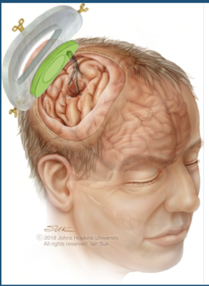
MRI-Compatible Skull-Embedded Implant for Direct Medicine Delivery Group 16: Vivian Looi, Henry Noren, Disha Mishra Mentors: Tushar Jois, Dr. Chad Gordon, Dr. Avi Rubin, Dr. Nathan Scott, Dr. Mehran Armand
Context:
Pump-assisted implant with the first chronic infusion of medicine directly into the brain
Goal:
Integrate Bluetooth Low Energy (BLE) with current implant prototype allowing clinicians to access medicine infusion data and alter delivery settings
Results:
Use readings from sensing pins to perform flow rate calculations every minute
Utilize BLE to transmit pump flow rates
Allow user to send signals to turn pumps on and off

