Slide 1
Group 10: Cross Modality Medical Image Synthesis and Registration through Machine Learning
Project Checkpoint Presentation
Team member: Ping-Cheng Ku (pku1@jh.edu)
Mentors: Mehran Armand, Alejandro Martin Gomez

Slide 2
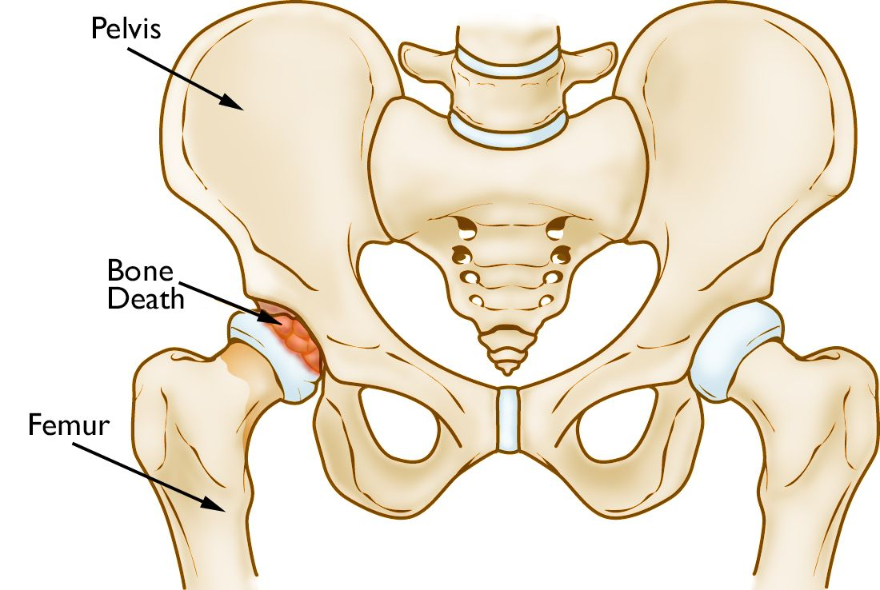
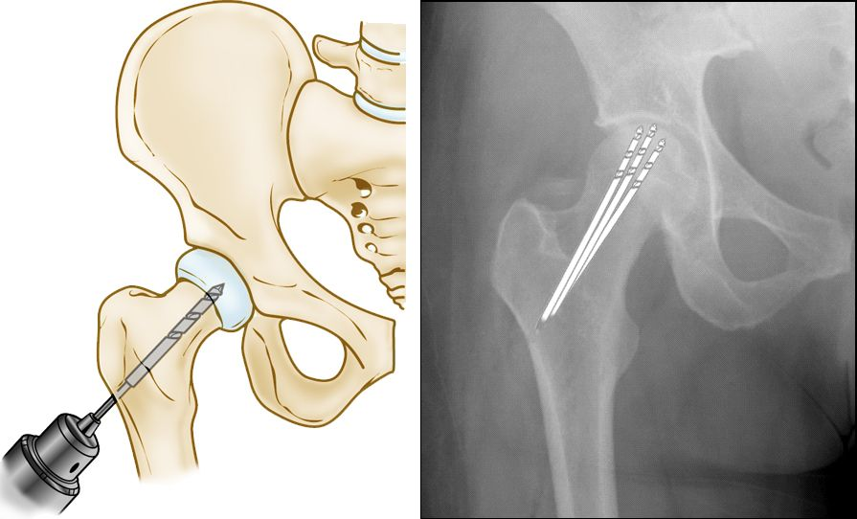
Background – Osteonecrosis of the Hip
Core Decompression for Osteonecrosis
Drilling several holes into the femoral head to relieve pressure in the bone and create channels for new blood vessels to nourish the affected areas of the hip
X-rays provides images of dense structures (like bones) and intraoperative x-ray shots are taken to monitor the surgical procedure.
Image source (Left and right image): [1] orthoinfo - aaos. Retrieved February 16, 2021

Slide 3
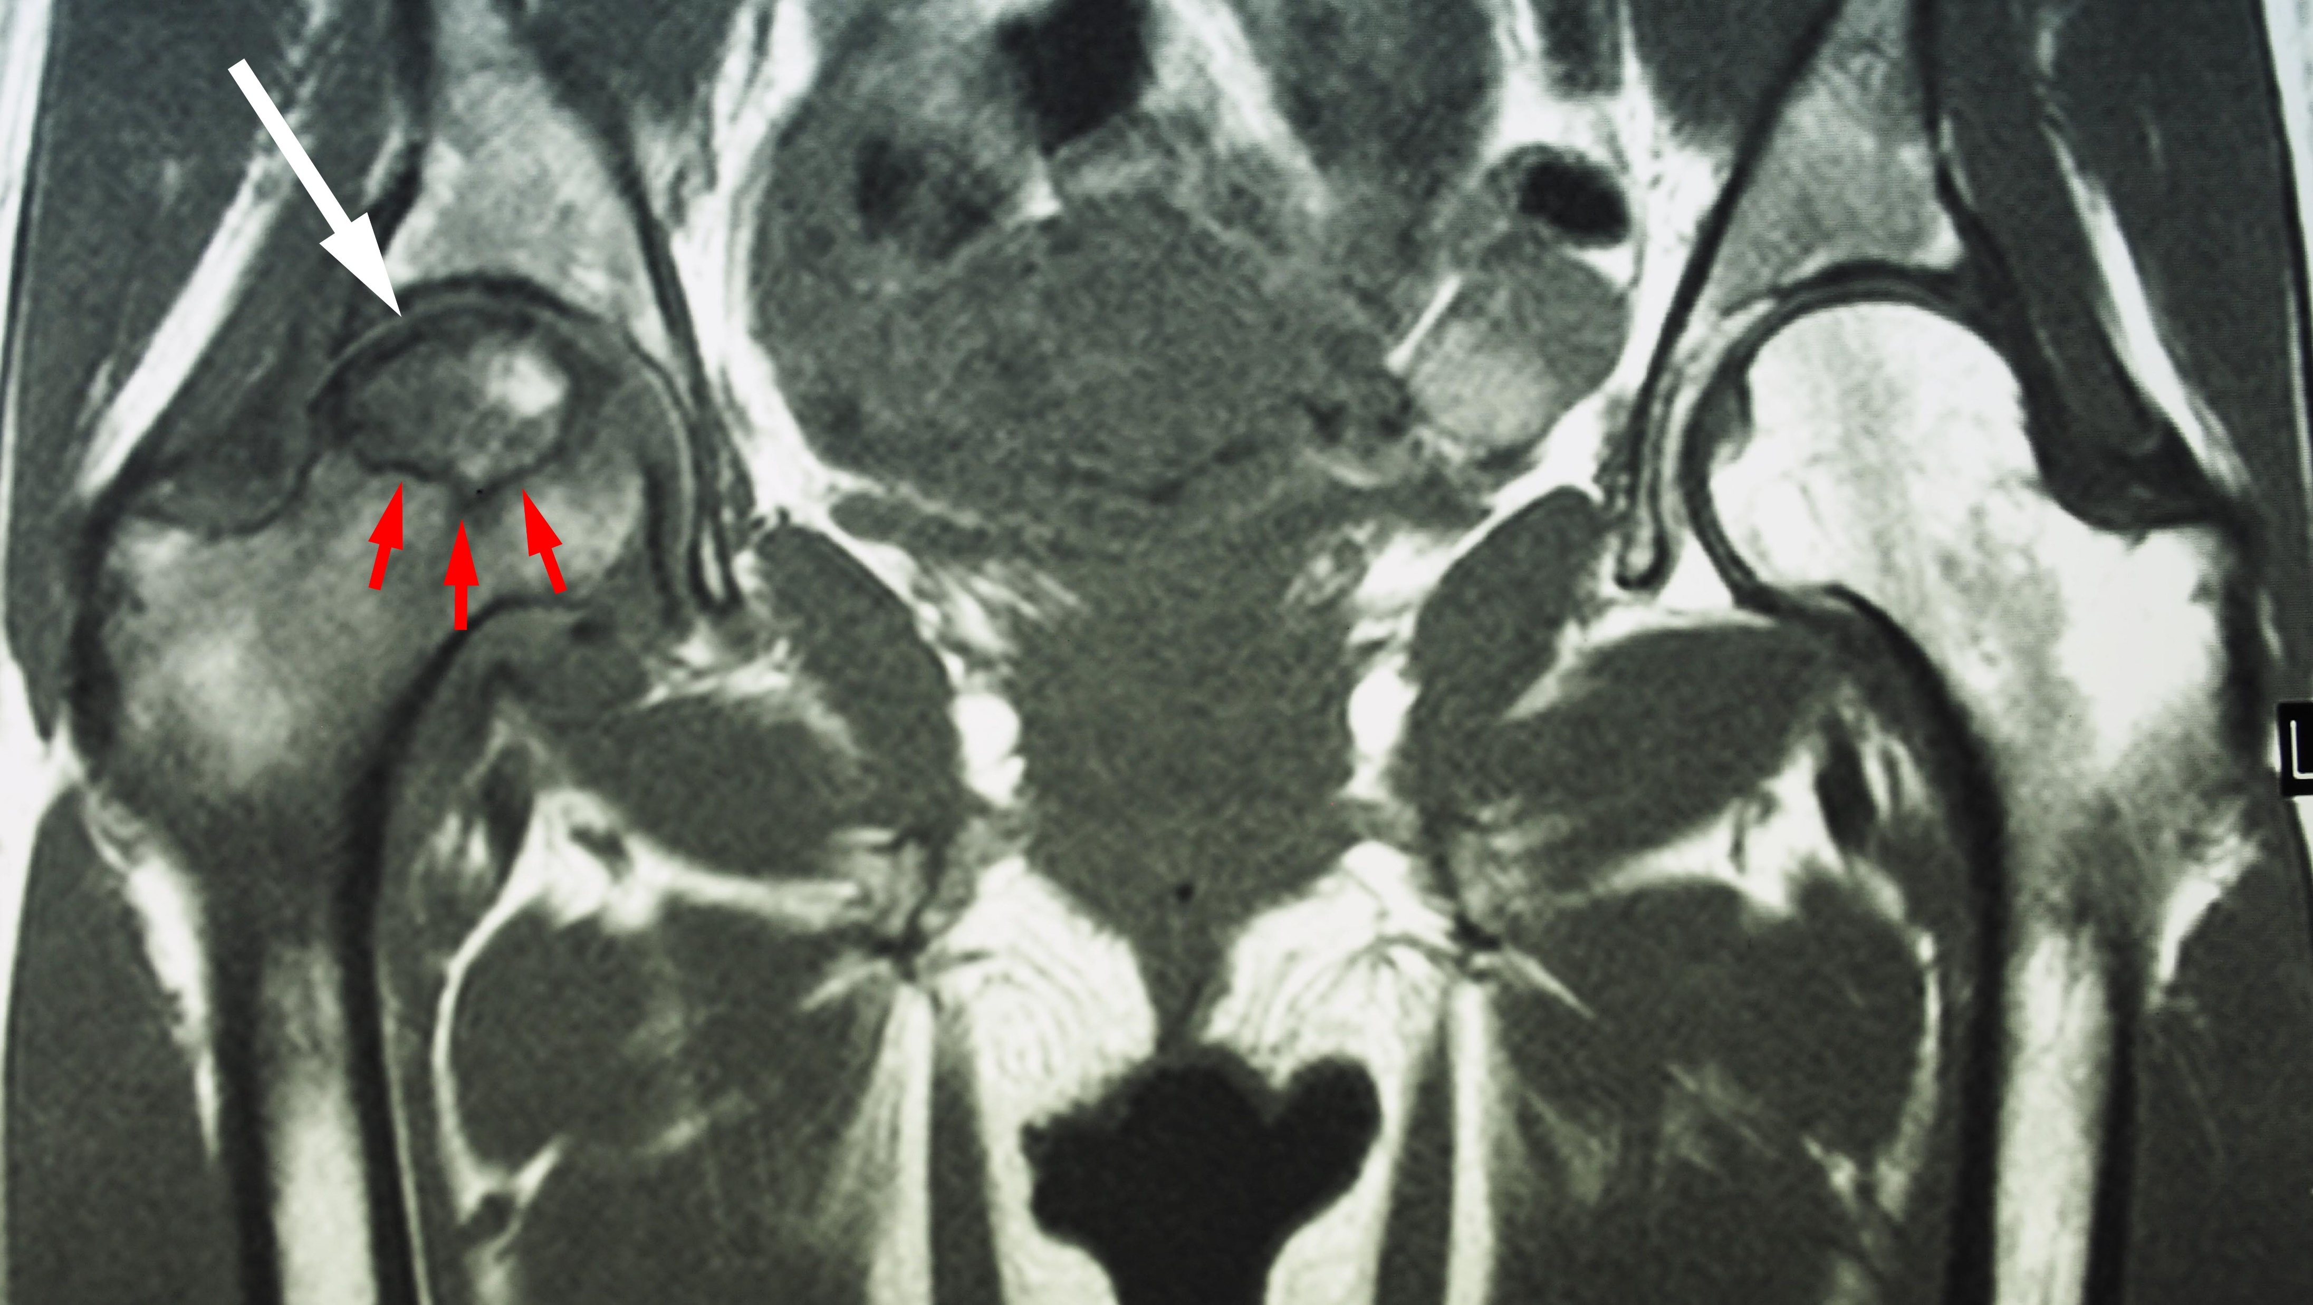
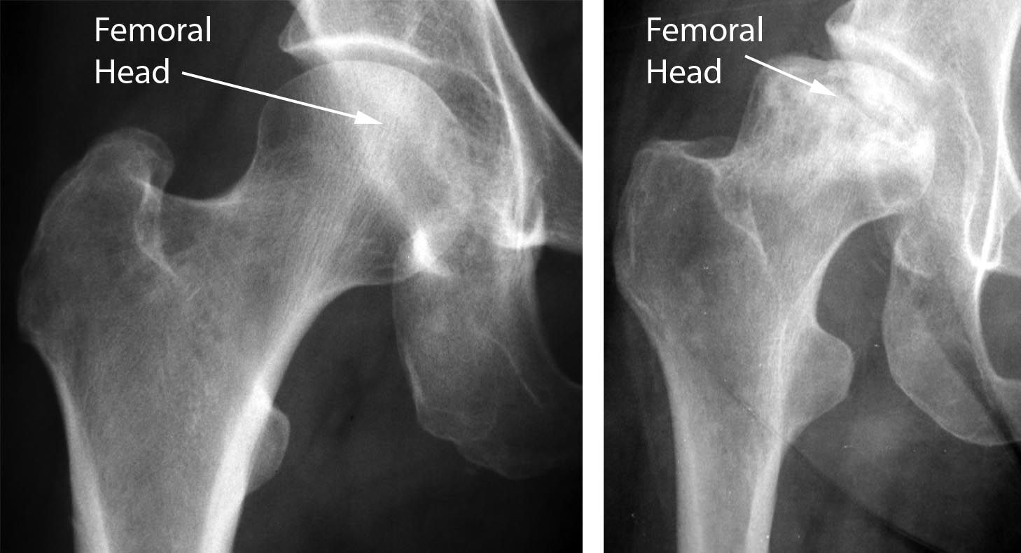
Motivation and Project Goal
Motivation
Surgeons also rely on preoperative MR scans for tool trajectory planning for core decompression surgery, but there is no easy way for them to visualize the planned paths in the intra-operative X-ray shots
Project Goal
We would like to convert the annotations of segmentation of the necrotic tissues and the drill insertion paths from preoperative MR images to intraoperative x-rays would be helpful for surgeons.
Image source (Left and right image): [1] orthoinfo - aaos. (n.d.). Retrieved February 16, 2021

Slide 4
Approach
MR-Xray registration issue:
Direct registration between MR and X-ray is difficult due lack of cross-modality information between MR and X-ray
Indirect approach to achieve this goal:
1. MR-CT synthesis
2. Validation of synthesized CT
3. CT-Xray registration
4. Annotated path projection from MR to X-ray (removed)

Slide 5
Workflow (MR-CT Synthesis)
Datasets
Packages
trained models
Training Dataset
AVN Dataset (CT, MR, Xray)
NMDID (CT)
ImagePreprocessing
Unpaired MR images (.jpg)
Unpaired CT images (.jpg)
cycleGAN
Generator models
(from MR to CT)
(Developed by Jun-Yan Zhu et al.) (Modified)

Slide 6
Workflow (Validation of synthesized CT)
Datasets
Packages
trained models
AVN Dataset MR volume
Generator models
(from MR to CT)
Synthesized CT volume
Manual registration
volumeValidation
AVN Dataset CT volume
ImageSimilarity

Slide 7
Workflow (CT to X-ray registration)
Datasets
Packages
Synthesized CT volume
AVN Dataset Xray
Bone-segmentation
(Developed by Marcel Krčah et al.)
Regi2D3D-IPCAI2020
Segmented CT volume
touch-up?
(Developed by Robert Grupp)
Registration output

Slide 8
Dependencies Update
Dependency | Plan | Estimated time | Current Status
GPU resource access for network training | Talk to Dr. Armand to get access to MARCC | 2/26 3/25 | Resolved on 3/16. Allocation to MARCC has been acquired.
 | (alternative) Lab GPU resource (thin6), Google cloud | Resolved | Access to thin6 has been acquired.
Access to CT dataset for additional training images | Request access to New Mexico Database | 2/26 | Access to images of 24 additional patients submitted on 2/22, acquired on 2/26
 | (alternative) Raise the issue during the 3/2 weekly meeting with Dr. Armand. | 3/2 | N/A
Acquire tool path annotations in MR images | Check with Alejandro if we can get collect annotated MRs from surgeons | 3/18 | Discussed during 3/1 meeting with Alejandro. Going for the alternative approach below.
 | (alternative) Generate simulated tool paths ourselves | 3/20 | I have access to Imfusion Suite which allows simple path annotations to be made (two points that forms a line). The method to extract the paths out from the software still needs to be figured out.

Slide 9
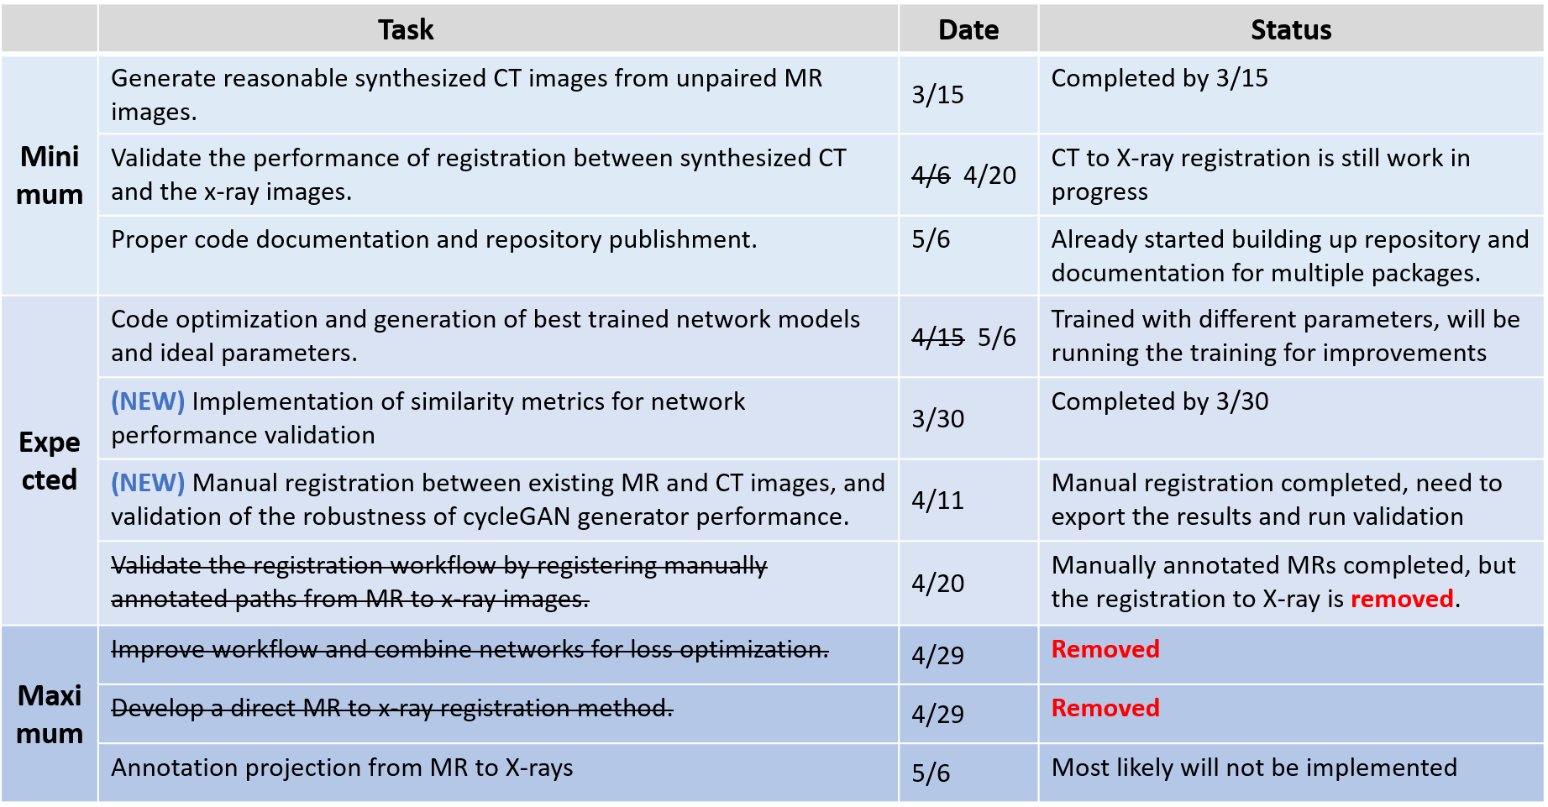
Deliverables (by 4/5)

Slide 10
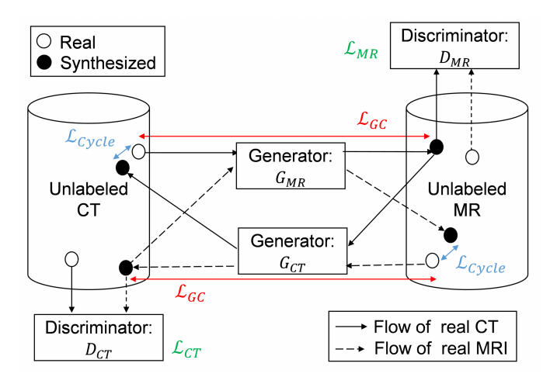
Progress Update (MR-CT Synthesis)
ImagePreprocessing
Data loading (Support different datasets and formats (AVN and NMDID))
Data augmentation (random rotation, random cropping, intensity shift)
Dataset generation (training, validation and testing sets)
CycleGAN (Jun-Yan Zhu et al.)
Modifications: adjusted loss function to take structural loss into consideration
Image Reference: [5] Hiasa, Y et al.

Slide 11
Progress Update (MR-CT Synthesis)
CycleGAN (Jun-Yan Zhu et al.)
Training dataset: 3000 CT from 12 patients (AVN and NMDID), 3000 MR images from 15 patients (all AVN)
Testing dataset: CT volumes from 3 patients (AVN and NMDID) and MR volumes from 3 patients (AVN)
Generator from MR to CT (GCT): (epoch = 200)

Slide 12
Progress Update (Validation of synthesized CT)
Manual registration between paired MR and CT images in AVN dataset
8 MR and CT pairs in AVN dataset (completed)
volumeValidation (70% completion)
Reads the entire MR and CT volumes as input
Converts volumes to tensors and run them through CT generator in cycleGAN
Calculation of image similarity between ground truth CT and synthesized CT
ImageSimilarity
Image quality metrics implementation:
Mean square error(MSE),
Peak Signal to Noise Ratio (PSNR),
Structural similarity index(SSIM)

Slide 13
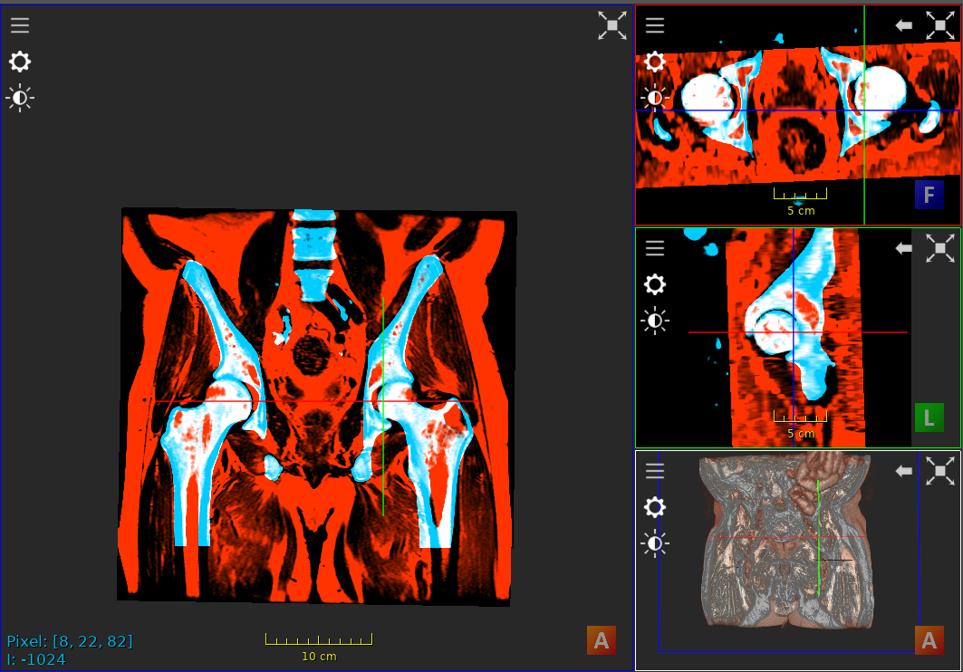
Progress Update (Validation of synthesized CT)
Manual registration (Imfusion Suite)

Slide 14
Progress Update (Validation of synthesized CT)
volumeValidation
Issue: Generated CT seem to have low resolution and have much thinner volumes (around 15 slices)

Slide 15
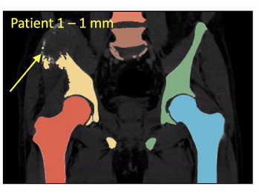
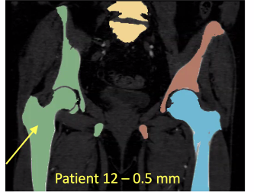
Progress Update (CT to X-ray registration)
Bone-segmentation (Developed by Marcel Krčah et al.)
Black-box segmentation method for hip CT
Not 100% accurate, requires manual adjustments
Test result on real CT images in AVN dataset (NO tested result on synthesized CT yet , the results will be worse due to the thinner volume and less accurate CT, which may require implementation of additional post-processing packages)

Slide 16
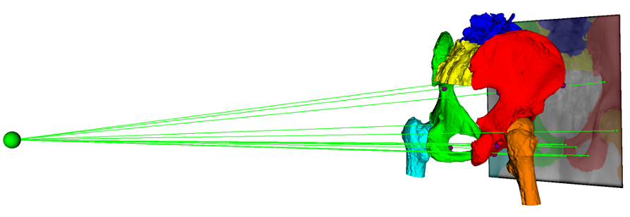
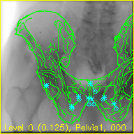
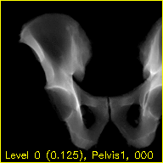
Progress Update (CT to X-ray registration)
Regi2D3D-IPCAI2020 (Developed by Robert Grupp)
2D/3D registration process between fluoroscopy images and CT images
NO tested results yet
I can directly discuss with Robert if I run into trouble working on implementation and modification of this package.
Image reference: [6] Grupp, R

Slide 17
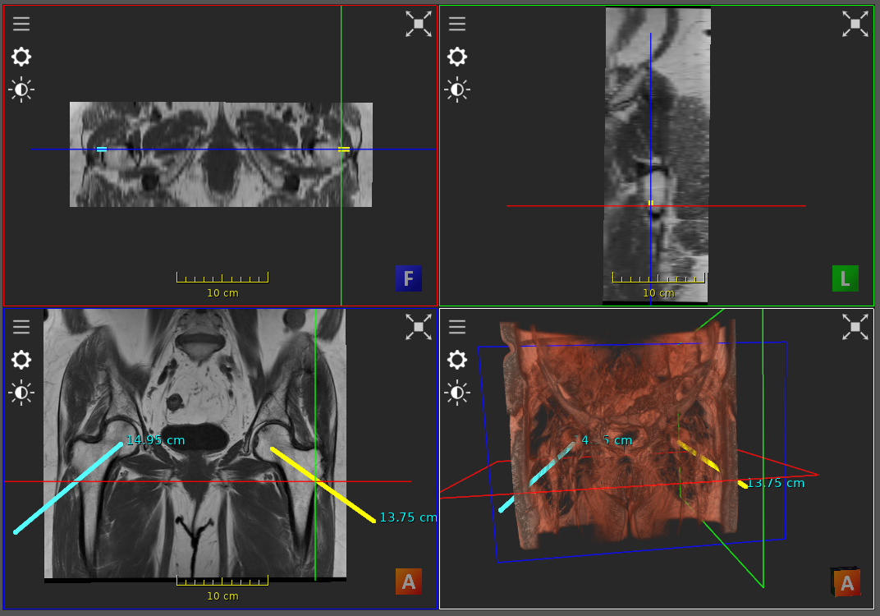
Registration of annotated paths (removed)
Core decompression drilling path planning in Imfusion Suite
Exporting the annotated path

Slide 18
Project Milestones
Tasks | Expected Date | Completion Date | Status
MR to CT synthesis - Dataset collection | 2/15 | 2/22 | Completed
MR to CT synthesis - Dataset preprocessing | 2/18 | 3/01 | Completed
MR to CT synthesis - CycleGAN network architecture design | 3/08 | 3/08 | Completed
MR to CT synthesis - Network performance improvement | 3/15 | 3/23 | Completed
MR to CT synthesis - Validation and debugging | 3/21 4/11 |  | 70% complete. TODO: exportation of manually registered MR-CT pairs, volume test
CT to X-ray reg. - Model dependency setup | 3/21 3/30 | 3/30 | Completed
CT to X-ray reg. - Model training and evaluation | 4/18 |  | Main focus in the next few weeks
Code optimization - Combination of model loss | 4/29
Code optimization - Code cleanup & documentation | 4/29 |  | Github repository is now up

Slide 19
Responsibility & Management plans
Responsibility
The Team:
Ku Ping-Cheng: Takes the responsibilities for all tasks
Mentors:
Mehran Armand (Mehran.Armand@jhuapl.edu)
Alejandro Martin Gomez (alejandro.martin@jhu.edu)
Meetings:
Weekly meeting with Mehran Armand and Robert Grupp on Tuesday
Weekly meeting with Alejandro on Friday
Code: repository hosted on Github (https://github.com/AxDante/MR_Xray_registration)
Reports and writeups: Overleaf

Slide 20
Reference
Osteonecrosis of the hip - orthoinfo - aaos. (n.d.). Retrieved February 16, 2021, from https://orthoinfo.aaos.org/en/diseases--conditions/osteonecrosis-of-the-hip
Zhu, J., Park, T., Isola, P., & Efros, A. A. (2017). Unpaired image-to-image translation Using Cycle-Consistent adversarial networks. 2017 IEEE International Conference on Computer Vision (ICCV). doi:10.1109/iccv.2017.244
Liao, H., Lin, W., Zhang, J., Zhang, J., Luo, J., & Zhou, S. K. (2019). Multiview 2D/3D RIGID registration via a Point-Of-Interest network for tracking and triangulation. 2019 IEEE/CVF Conference on Computer Vision and Pattern Recognition (CVPR). doi:10.1109/cvpr.2019.01292
Toth, D., Panayiotou, M., Brost, A., Behar, J. M., Rinaldi, C. A., Rhode, K. S., & Mountney, P. (2017). 3D/2D registration With superabundant VESSEL reconstruction for cardiac resynchronization therapy. Medical Image Analysis, 42, 160-172. doi:10.1016/j.media.2017.08.001
Hiasa, Y., Otake, Y., Takao, M., Matsuoka, T., Takashima, K., Carass, A., . . . Sato, Y. (2018). Cross-Modality image synthesis From UNPAIRED data Using CycleGAN. Simulation and Synthesis in Medical Imaging, 31-41. doi:10.1007/978-3-030-00536-8_4
Grupp, R. B., Unberath, M., Gao, C., Hegeman, R. A., Murphy, R. J., Alexander, C. P., . . . Taylor, R. H. (2020). Automatic annotation of hip anatomy in FLUOROSCOPY for robust and efficient 2D/3D REGISTRATION. International Journal of Computer Assisted Radiology and Surgery, 15(5), 759-769. doi:10.1007/s11548-020-02162-7

