Slide 1
Physical Training Model for Robotic Blood Vessel Dissection
Seminar Presentation
Shayer Chowdhury (schowdh8@jhu.edu)
Project #3
Mentors: Dr. Gyusung Lee, Dr. Mija Lee

Slide 2
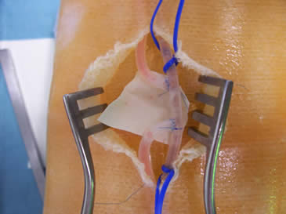
Project Overview
Current state: Lack of a cheap, effective, and reusable blood vessel dissection phantom for robotic surgery training
Goal: Create a comprehensive inanimate surgical training model for sharp/blunt dissection and blood vessel electrosurgery

Slide 3
Articles for Discussion
BL Hainer. Fundamentals of Electrosurgery. The Journal of the American Board of Family Practice, 4(6): 419-426, 1991.
C Schneider, C Kut, N Carter-Monroe. Creation of Ultrasound Elastography Phantoms.

Slide 4
Motivation
Hainer paper will provide context and background regarding the complexities behind electrosurgery
Will facilitate my understanding of the properties that blood vessels in my phantom simulation should have and how to exercise those properties while being used by practicing surgeons
Schneider, et al. paper discusses the specifics behind physically creating gel phantoms
Specifically discusses the creation of ultrasound elastography phantoms, but the same principles can be applied to blood vessel dissection simulation

Slide 5
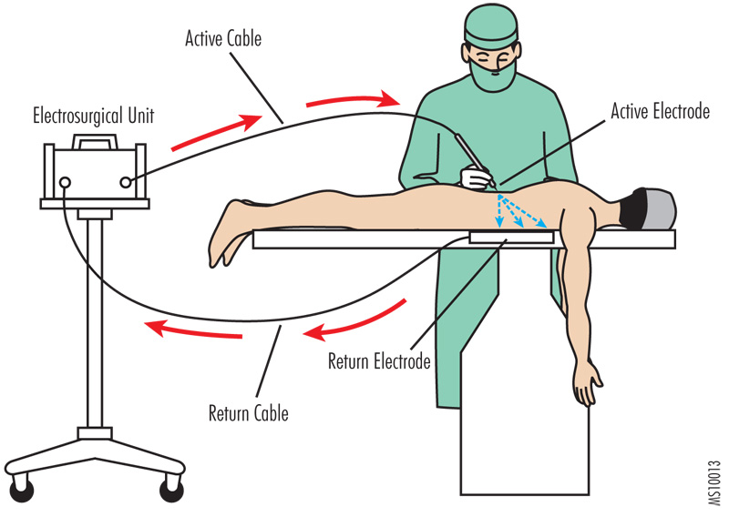
Hainer, Introduction
Describes how an electrical current applied to the tip of surgical tools can be used to produce different dissection methods
Namely cutting, coagulation, desiccation, and fulguration
Focus on cutting and coagulation in regards to my project
Main advantages of electrosurgery in comparison to normal sharp/blunt methods are rapid completion of dissection and minimal blood loss
“The ‘Shocking’ Results of Poor Device User Training” by James P. Keller

Slide 6
Hainer, Mechanism of Action and Effects on Tissue
High frequency alternating current is applied to the tip of surgical tools
By modulating that current, can produce different effects:
Electrosection: cutting effect achieved through heat basically exploding cells as tool is passed through them
Electrocoagulation: current is less concentrated and heat is produced over a larger area; cells are dehydrated, protein contents denature, and blood vessels are thrombosed, so a coagulating effect is produced
Electrodesiccation: higher voltage, less current; dehydrates the cell but leaves structure intact
Electrofulguration: spark gap between tool and surface, which chars the tissue, insulating the tissue from deeper destruction

Slide 7
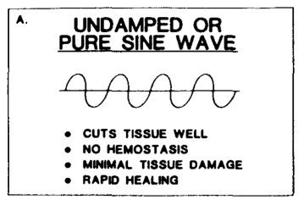
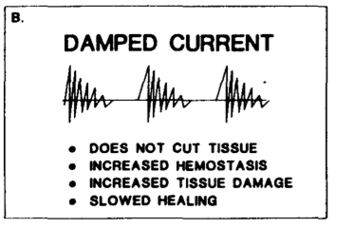
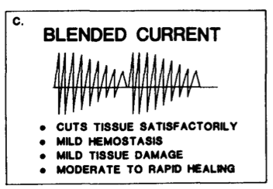
Hainer, Electrosurgical Modalities
Electrosection
Produced by the undamped current
Acts like a normal steel tool incision
Fast healing
Electrocoagulation
Produced by the damped current
Rapid hemostasis without cutting
Both
Produced by blended current
Allows incisions to be made with minimal blood loss

Slide 8
Hainer, Comparison of Electrosurgery with Other Surgical Methods
Advantages
Takes little time
Equipment is easy to set up and use, compact and reliable
Control of bleeding at time of incision is fast
Disadvantages
If misused, can increase the risk of hypertrophic scarring
Must be cautious working with high currents around critical nerves and vessels
A sutured wound heals faster than an electrosurgically produced one; need to weigh the cost of time versus healing of the wound

Slide 9
Hainer, Conclusion
Wide variety of techniques beyond just simple incisions with normal tools
Developing field with the increased prevalence of robot-assisted surgery
Adverse effects are present, but also provide excellent advantages both in and out of the operating room

Slide 10
Hainer, Application to Project
Properties and techniques I want to make sure are utilized in the design of my project
Different techniques, specifically electrosection and electrocoagulation
Blood vessel behaves realistically when an electrosurgical tool is used on it
Want the vessel to sort of shrink when heat is applied to it
Possibly a fluid in blood vessel that can be coagulated
Tissue behaves realistically as well
Might be difficult to produce something that is reusable and at the same time able to be burned away

Slide 11
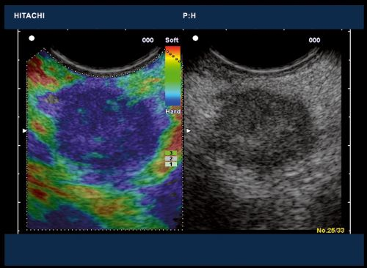
Schneider, et al., Introduction
Discussed the creation of two different gel phantoms used for ultrasound elastography
Artificial gel phantom and a true tissue phantom made using chicken breast
Have properties that mimic cancerous lesions, but not necessary for my project
Low cost, safe, easily obtainable material, reusable, and easy to construct with minimal experience
“Hitachi Medical Systems”

Slide 12
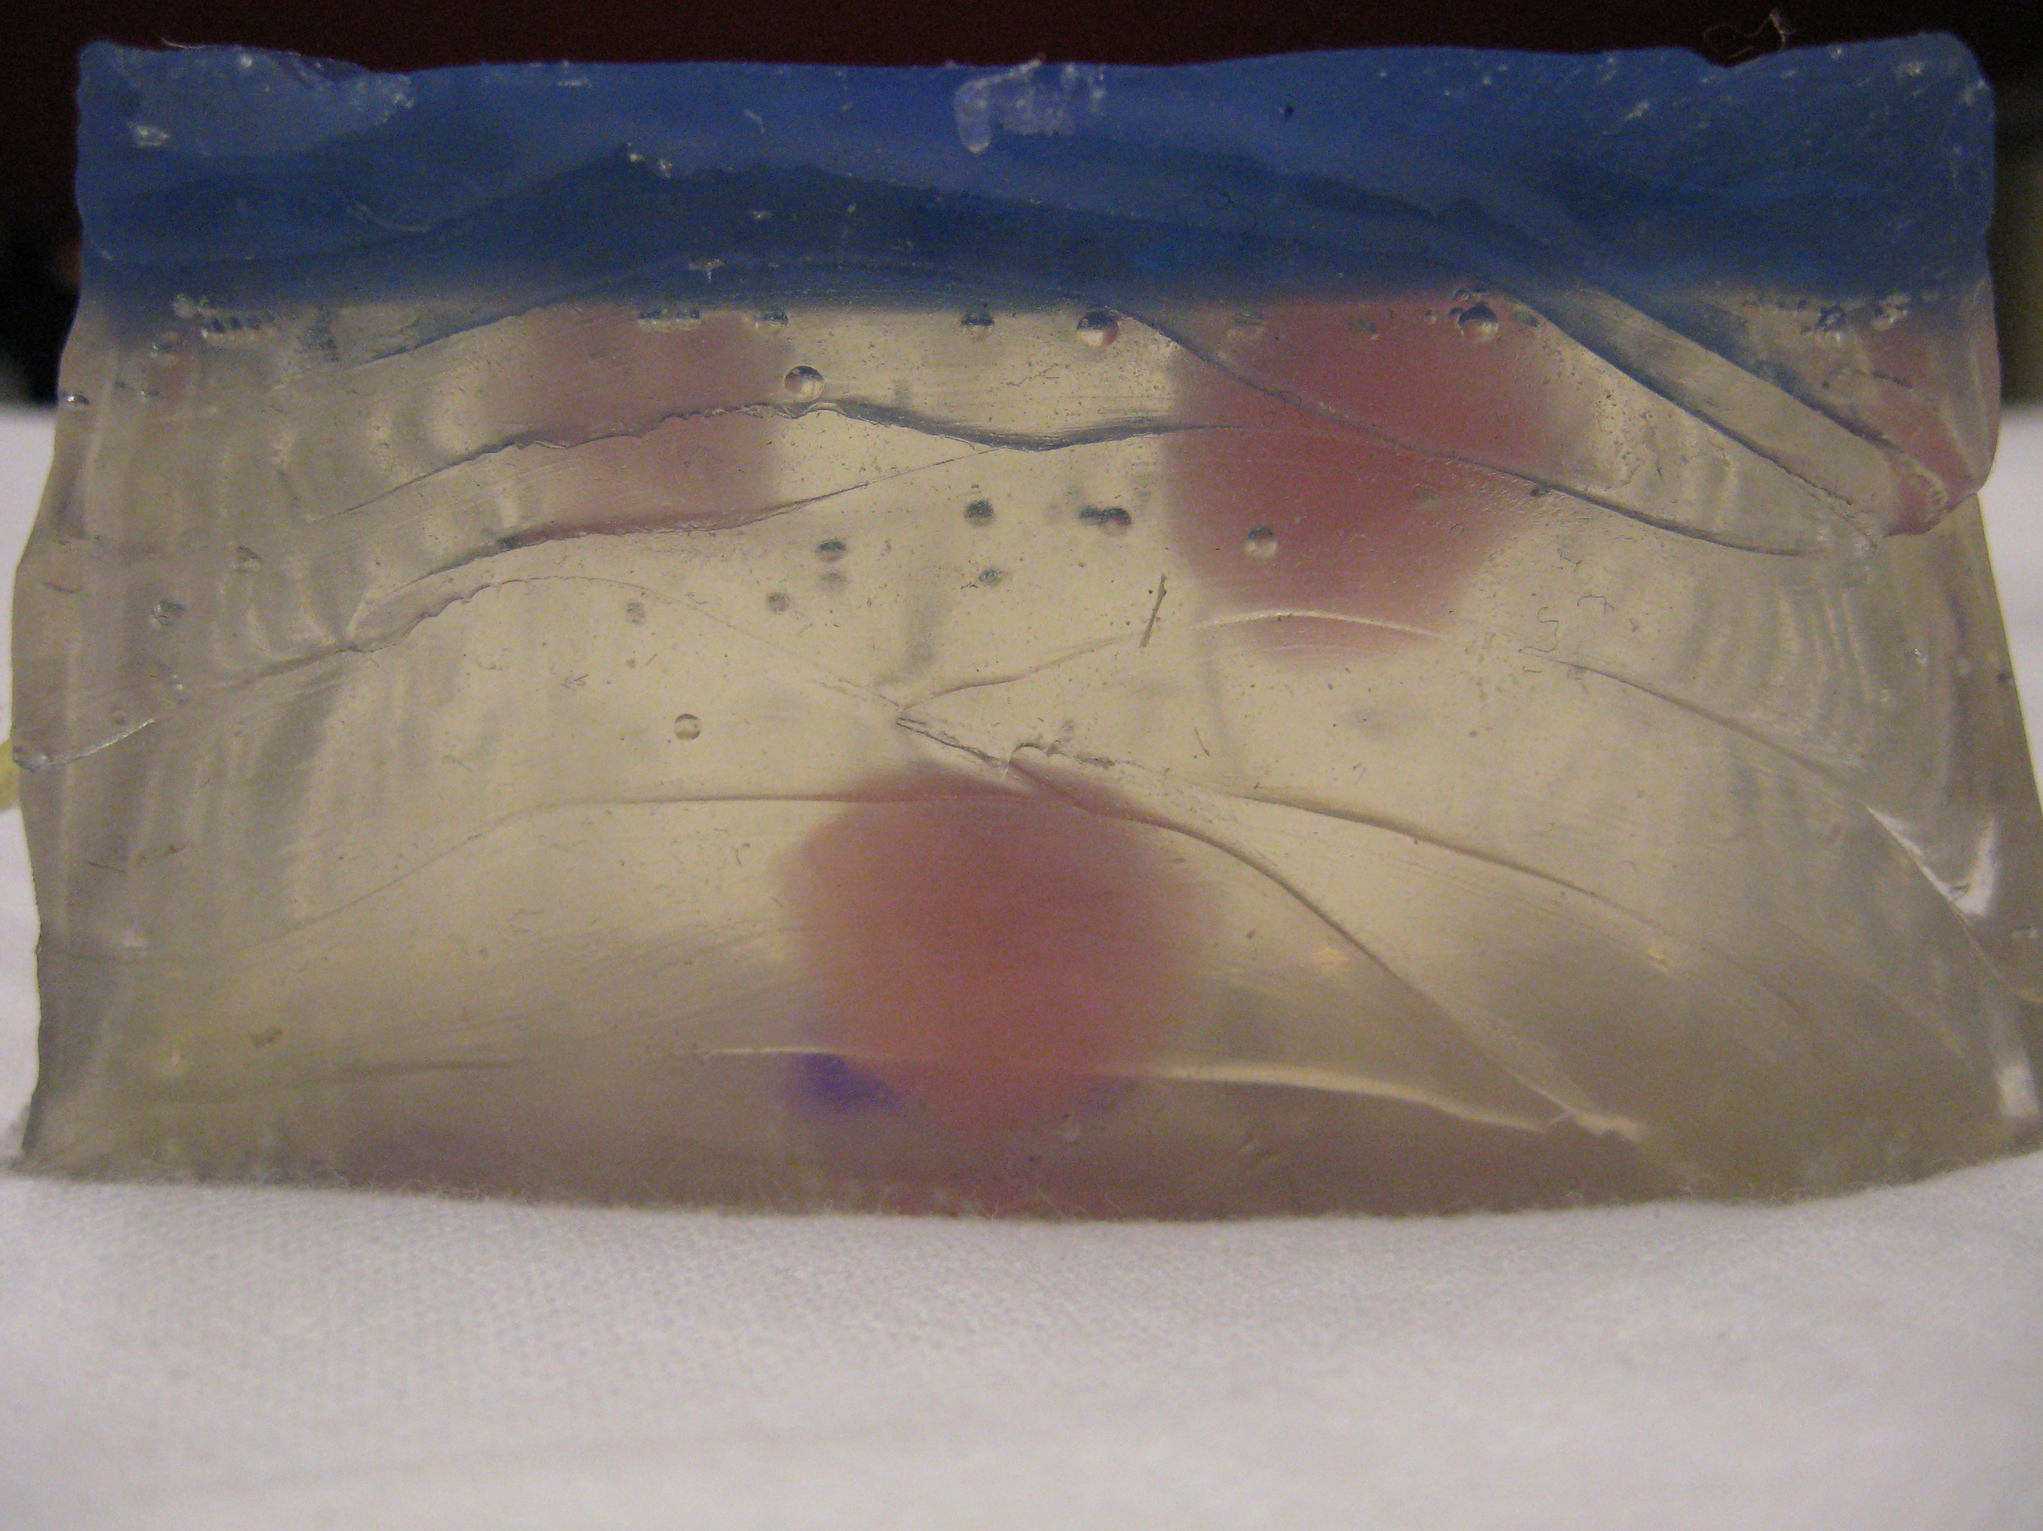
Schneider, et al., Materials and Methods
Gel Phantom
Used plastisol, specifically M-F Manufacturing Super Soft Plastic and Plastic Softener
Can form different layers of varying thickness
Produced an opaque gel phantom, but can be made less transparent by adding Sigmacell Cellulose

Slide 13
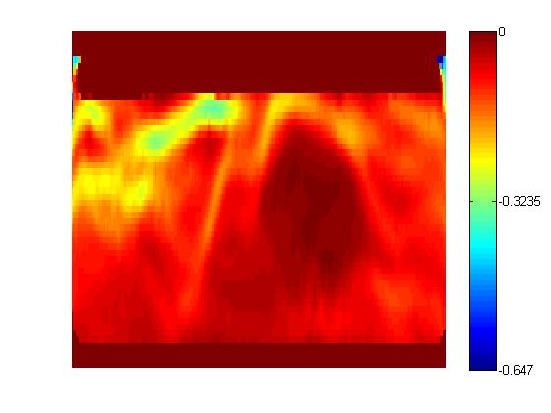
Schneider, et al., Materials and Methods
Chicken breast phantom
Very cheap and simple
Encased in porcine gel
Created lesions within the chicken breast using an ablation machine
Might be more difficult to embed blood vessels within in the chicken breast phantom compared to the artificial gel phantom

Slide 14
Schneider, et al., Conclusion
Successful in mimicking tissue with cancerous lesions
Proved to be long-lasting and durable for repeated ultrasound usage
Gel phantom was designed to mimic the prostate, but can vary thickness of layers if needed; chicken breast phantom was a direct tissue type

Slide 15
Schneider, et al., Application to Project
Use of artificial gel phantom seems to be more feasible
Might be difficult to embed blood vessels into the chicken breast phantom
Depth and placement of blood vessels and thickness of surrounding tissue easier to control using the gel phantom
Repeatable in regards to ultrasound use, since ultrasounds are non-invasive, but may need to modify process to maintain reusability in regards to blood vessel dissection
Cheap and easy way to create gel phantoms

Slide 16
Assessment
From Hainer, want to specifically implement a way to test electrosection and electrocoagulation
Want surrounding tissue to behave realistically
Want blood vessel to shrink when heat is applied
Possibility of injecting a fluid within the embedded vessels that can be coagulated
Also want to maintain reusability of phantom
From Schneider, et al., examined a cheap and efficient way to produce gel phantoms
Intended use for ultrasound elastography, but with a few modifications can be applied to blood vessel dissection

Slide 17
Questions?
Suggestions?

