Slide 1
Integration of LARS and Snake Robots & System Development
600.446 – Computer Integrated Surgery II
H. Tutkun Şen
Mentor:
Paul Thienphrapa
Project Plan
February 15, 2011

Slide 2
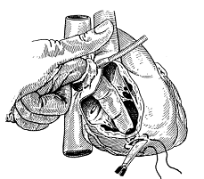
Motivation & Significance Foreign Bodies in the Heart
Causes: Posttraumatic result of explosions and gunshot injuries
Symptoms: Cardiac tamponade, hemorrhage, shock, infection, embolism, arrhythmia, valve dysfunction
Treatment: Median sternotomy, sometimes cardiopulmonary bypass (CPB) is used
Notes:
Complicated procedure for simple task

Slide 3
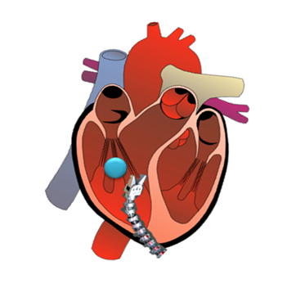
Motivation & Significance A Minimally Invasive Surgical Approach
Minimally Invasive Surgery
Helps avoid open surgery/CPB
But more challenging to perform
Integrate 3D transesophageal echocardiography (TEE) to aid:
Localization of foreign body
Tracking
Robot guidance
Focus on heart for establishing system performance requirements

Slide 4
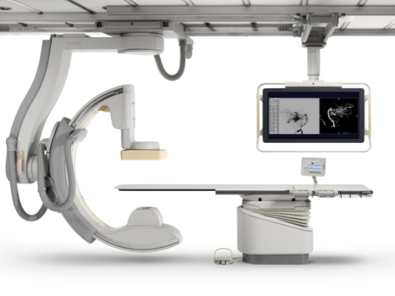
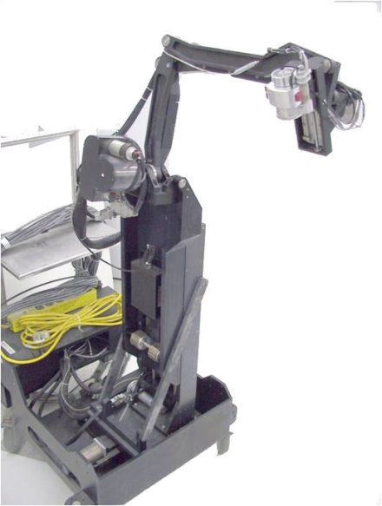
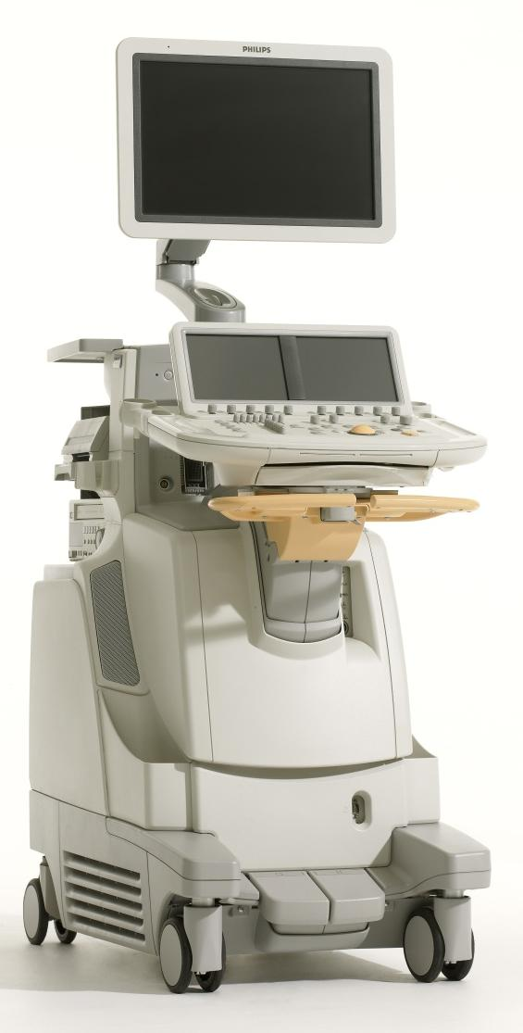
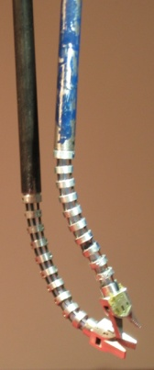
Experimental Setup
Main Focus
Workstation
Computer(s)
TCP/IP
TCP/IP
?
Trigger(s)?
Ultrasound
System
C-arm
Linux RTAI
TCP/IP
FireWire
LARS + Snake Robot
Probe
Snake
Water Tank

Slide 5
Background & Aim
For now:
LARS robot is working only in Windows,
Snake robot is working only in RTAI Linux.
Aim:
Both robots should be able to work together on a single environment.
Hardware integration
Software integration
Kinematics analysis of the united system

Slide 6
Things to be done..
Design of a counterweight fixture for snake on LARS and robot assembly.
Software development.
Come up to speed with :
CISST Library
Snake Robot Control
LARS Robot Control
Devise some schemes of integration e.g. :
Programming both robots on RTAI Linux,
Running only the snake robot on the slave computer such that windows runs the overall system.

Slide 7
Things to be done.. (cont’d)
Kinematics analysis of the overall system. (milestone-1)
Set up the forward kinematics equation of the overall system.
Make a visual demonstration of the system as a verification tool.
Using MATLAB, MATHCAD or Excel.
Solve the inverse kinematics problem that minimizes the sum of the joint motions that take the robot to the desired position
Software integration. (milestone-2)
Learn the API for the Snake and Lars robots and test them on RTAI Linux.
Integrate the software of both LARS and Snake robots.
Modify the system code using new kinematics

Slide 8
Things to be done.. (cont’d)
Debugging and testing the integrated system.(milestone-3)
Develop different tests for different parts.
Offline text output files.
Inline hardware simulator.
Test the individual joints or actuators.
Compare the results with their old software.
Use Phantom Omni to make sure that it is working properly.
Calibrating the sytem and then taking it to the medical school for imaging experiments. (Time Permitting milestone-4)

Slide 9
Challenges
LARS robot is running at 125 Hz, because it has a Commercial-off-the-shelf (COTS) Galil controller.
Snake robot has a 1 kHz custom made FireWire controller.
Create higher level functions that call appropriate lower level routines based on which joint or actuator
Code segments are compiled in different versions of CISST Library.

Slide 10
Goals & Deliverables
Minimum
Software development, kinematics analysis, software integration and partial debugging of the software with a partial demo.
Expected
Software development, kinematics analysis, software integration and FULL debugging of the software with a working demo.
Maximum
Expected + calibration of the robot + imaging experiments in the medical school.

Slide 11
Key Dates
Milestone 1 : (Mar 21th)
Kinematics analysis of the overall system.
Milestone 2 : (Apr 11th)
Software integration and testing it with primitive methods.
Milestone 3 : (May 6th)
Debugging of the system and verification with Phantom Omni and other tools.
Milestone 4 : (Time Permitting Early May)
Medical school imaging experiments.

Slide 12
Project Timeline
1
2
3
Task | 14-Feb | 21-Feb | 28-Feb | 7-Mar | 14-Mar | 21-Mar | 28-Mar | 4-Apr | 11-Apr | 18-Apr | 25-Apr | 2-May
Project Proposal Presentation |  |  |  |  |  |  | SPRING BREAK
Counterweight Design and Order
Come Speed with CISST Library
Come up to Speed with Snake and LARS Robot Control
Devise Schemes of Integration
Kinematics Analysis of the Overall System
Software Integration
System Debugging
Medical School Experiments
Documentation
Final Presentation

Slide 13
Management Plan
Weekly meetings with Paul.
In the following three weeks (since he is out of town)
Teleconferences will be used, if required weekend face-to-face meetings will be made.
Additional help will be obtained from Prof. Peter Kazanzides in software integration part. Weekly meetings will be arranged with him when needed.

Slide 14
Dependencies
Counter weight order.
Linux computer access.
Paul’s Linux Computer.
Access of the robots.
Assembly of the system.
Paul will help the assembly.
Phantom Omni access.
Permission will be sought from Anton.

Slide 15
References & Reading List
[1] J. Funda, R. Taylor, B. Eldridge, S. Gomory, and K. Gruben,
"Constrained Cartesian motion control for tele-operated surgical
robots," IEEE Transactions on Robotics and Automation, vol. 12, pp.
453-466, 1996
[2] A. Kapoor, M. Li, and R. Taylor. Constrained Control for Surgical
Assistant Robots. IEEE Int’l Conf. on Robotics and Automation. pp.
231-236. May 2006.
[3] A. Kapoor. Motion Constrained Control of Robots for Dexterous
Surgical Tasks. Johns Hopkins University Ph.D. Thesis. Sept, 2007
[4] Additional readings on Seth Billings and Ehsan Basafa CIS 2 final project report on “Tele-operation of LARS Robot”

Slide 16
THANK YOU FOR LISTENING!!
QUESTIONS??

