Slide 1
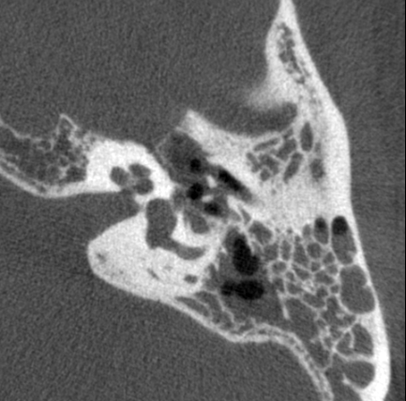
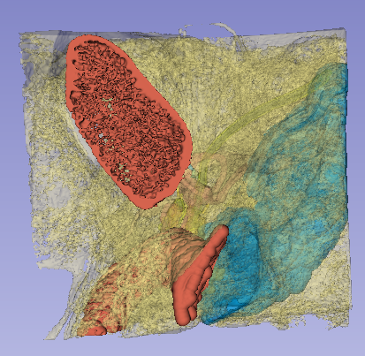
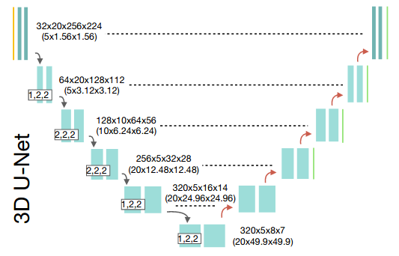
Automated Segmentation of Temporal Bone CT Imaging for Robot-Assisted Microsurgery Breakout Room 3, Group 4: Jessica Soong, Andy Ding Mentors: Dr. Francis X. Creighton, Dr. Russell H. Taylor, Dr. Mathias Unberath, Zhaoshuo Li
Goal:
To develop a deep learning model for segmenting critical structures in the temporal bone.
Significance:
Accurate labeling of anatomy on CT imaging will provide the foundation for robot-enforced virtual safety barriers and prevent intraoperative injury.
Results:
State-of-the-art segmentation results on temporal bone CTs using 3D U-Net and GAN Label Refinement with a shape model-based data augmentation method.
CT Image
GT Label
[Isensee et al.]
Discriminator
$$L_{1}=CE −DSC$$
Noisy Label
$$L_{2}=BCE$$
$$L=L_{1}+L_{2}$$

Slide 2
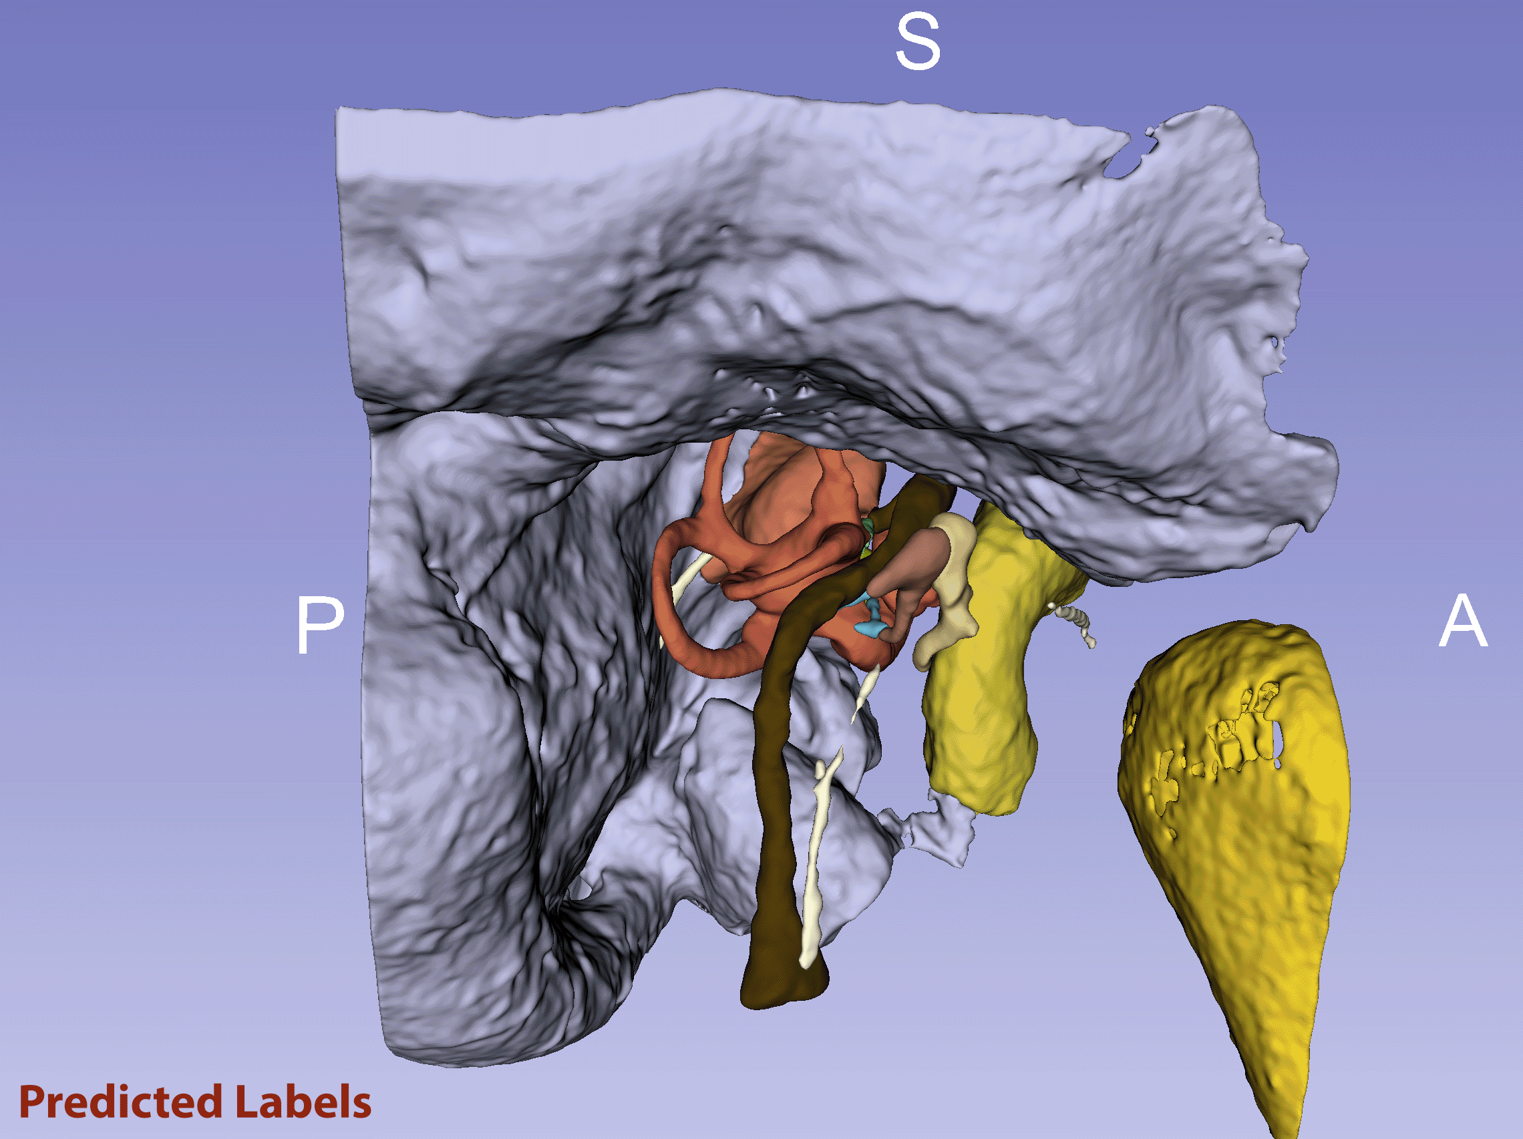
nnUnet Validation Results
Clas​s | Mean Val DSC (VANILLA)
Bone​ | .95
Malleus​ | .93
Incus​ | .93
Stapes​ | .59
Bony Labyrinth | .96
IAC | .93
Superior Vestibular Nerve​ | .62
Inferior Vestibular Nerve​ | .53
Cochlear Nerve​ | .79
Facial Nerve​ | .85
Chorda Tympani​ | .72
Internal Carotid Artery​ | .93
Sigmoid Sinus + Dura​ | .80
Vestibular Aqueduct​ | .67
Mandible​ | .94
External Auditory Canal​ | .84

