Slide 1
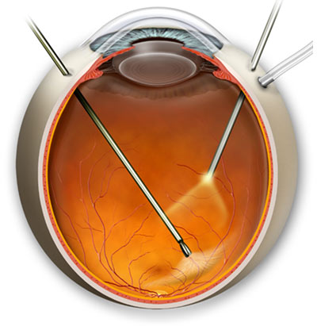
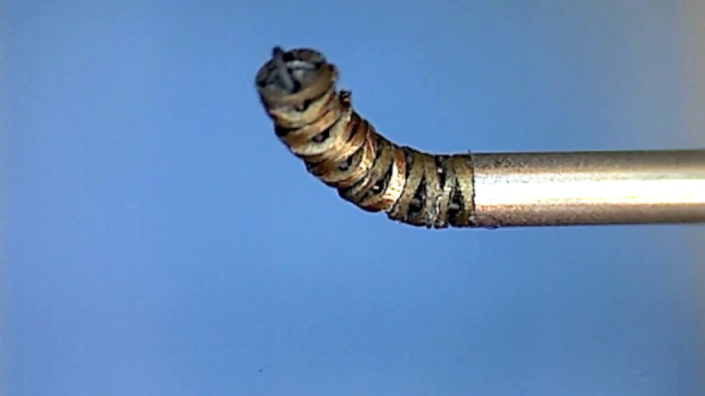
IRIS 02: Integrated Robotic Intraocular Snake
Vitreoretinal surgery is one of the most challenging microsurgery disciplines. A tendon-driven snake micro-manipulator can provide dexterous intraocular tool motion.
What Students Will Do:
Finalize robot actuation unit
Integrate robot with Phantom Omni
Design control algorithm for IRIS
Conduct experiments
1 mm

Slide 2
IRIS 02: Integrated Robotic Intraocular Snake
Deliverables:
Interface the IRIS actuation unit with Phantom Omni
Control algorithms
Experimental results
Size group: 2
Skills:
Required: Good analytical skills, Programming (Matlab, C/C++), CAD
Desired: Control Theory, Electronics, Prototyping, Embedded Systems
Mentors: Ehsan Azimi, Dr. Peter Kazanzides, Dr. Iulian Iordachita

Slide 3
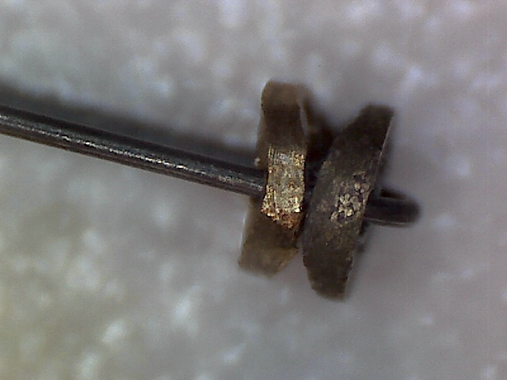
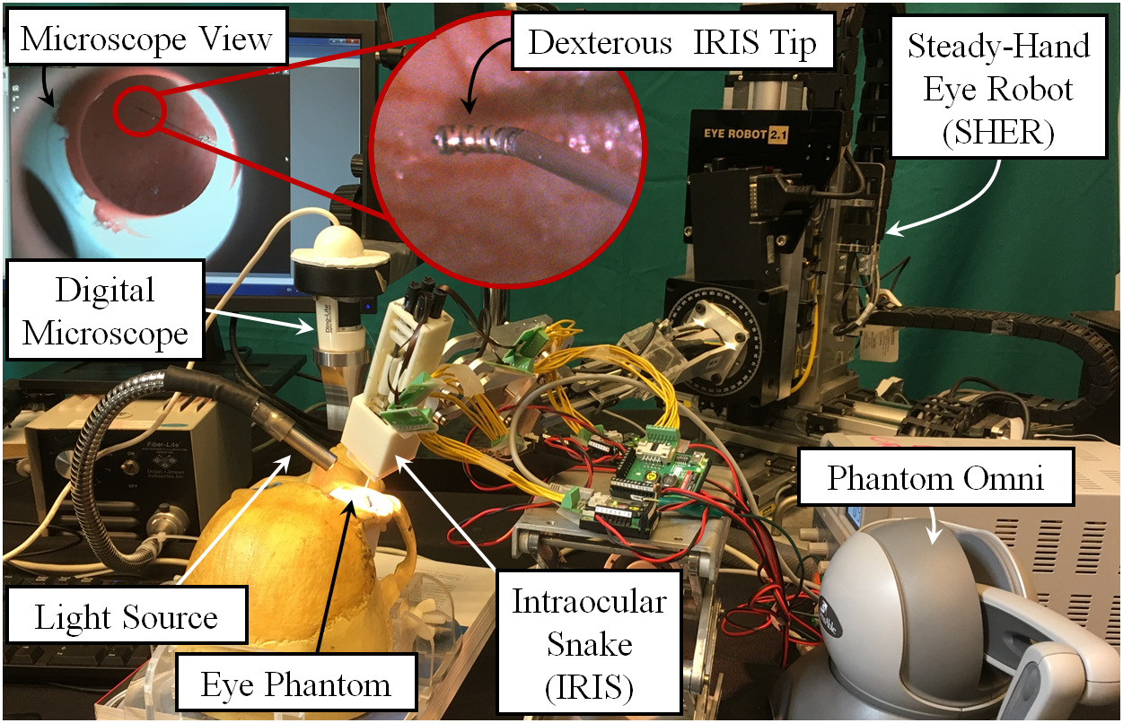
IRIS 02: Integrated Robotic Intraocular Snake
Current status
3 mm
0.9 mm
0.9 mm
0.25 mm

