Slide 1
Robotic Operation of ICU Equipment in Contagious Environments
Mentor : Dr. Axel Krieger, Dr. Balazs Vagvolgyi
Group 18:
Tianyu (David) Wang, Jiayin (Jaelyn) Qu

Slide 2
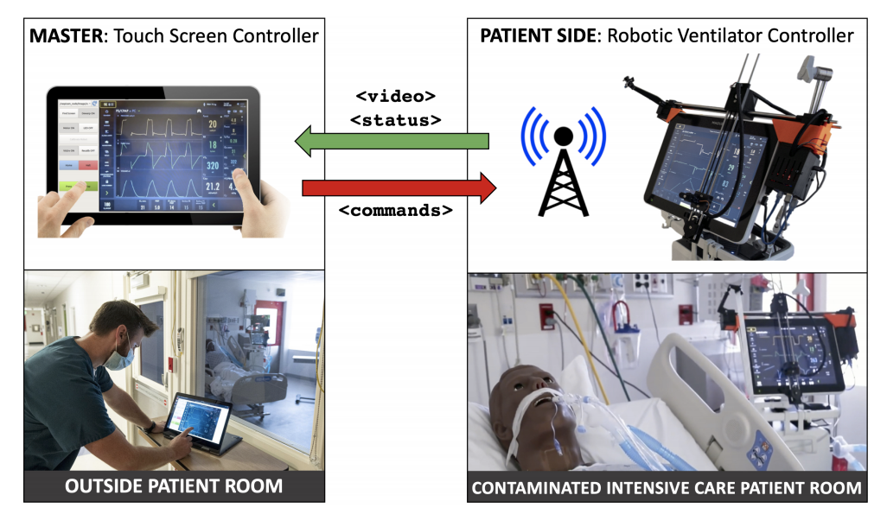
Project Summary
This project originates from the need to design a robot to recognize key ICU equipment, operate them, and project key information from such equipment straight back to the operator. Thus reducing the time, protection gear, and exposure risk cost that an ICU team member faces when entering an ICU room during a COVID-19 pandemic.
Our team targets the end-effector design and the user interface of this tele-operable robotics system.

Slide 3
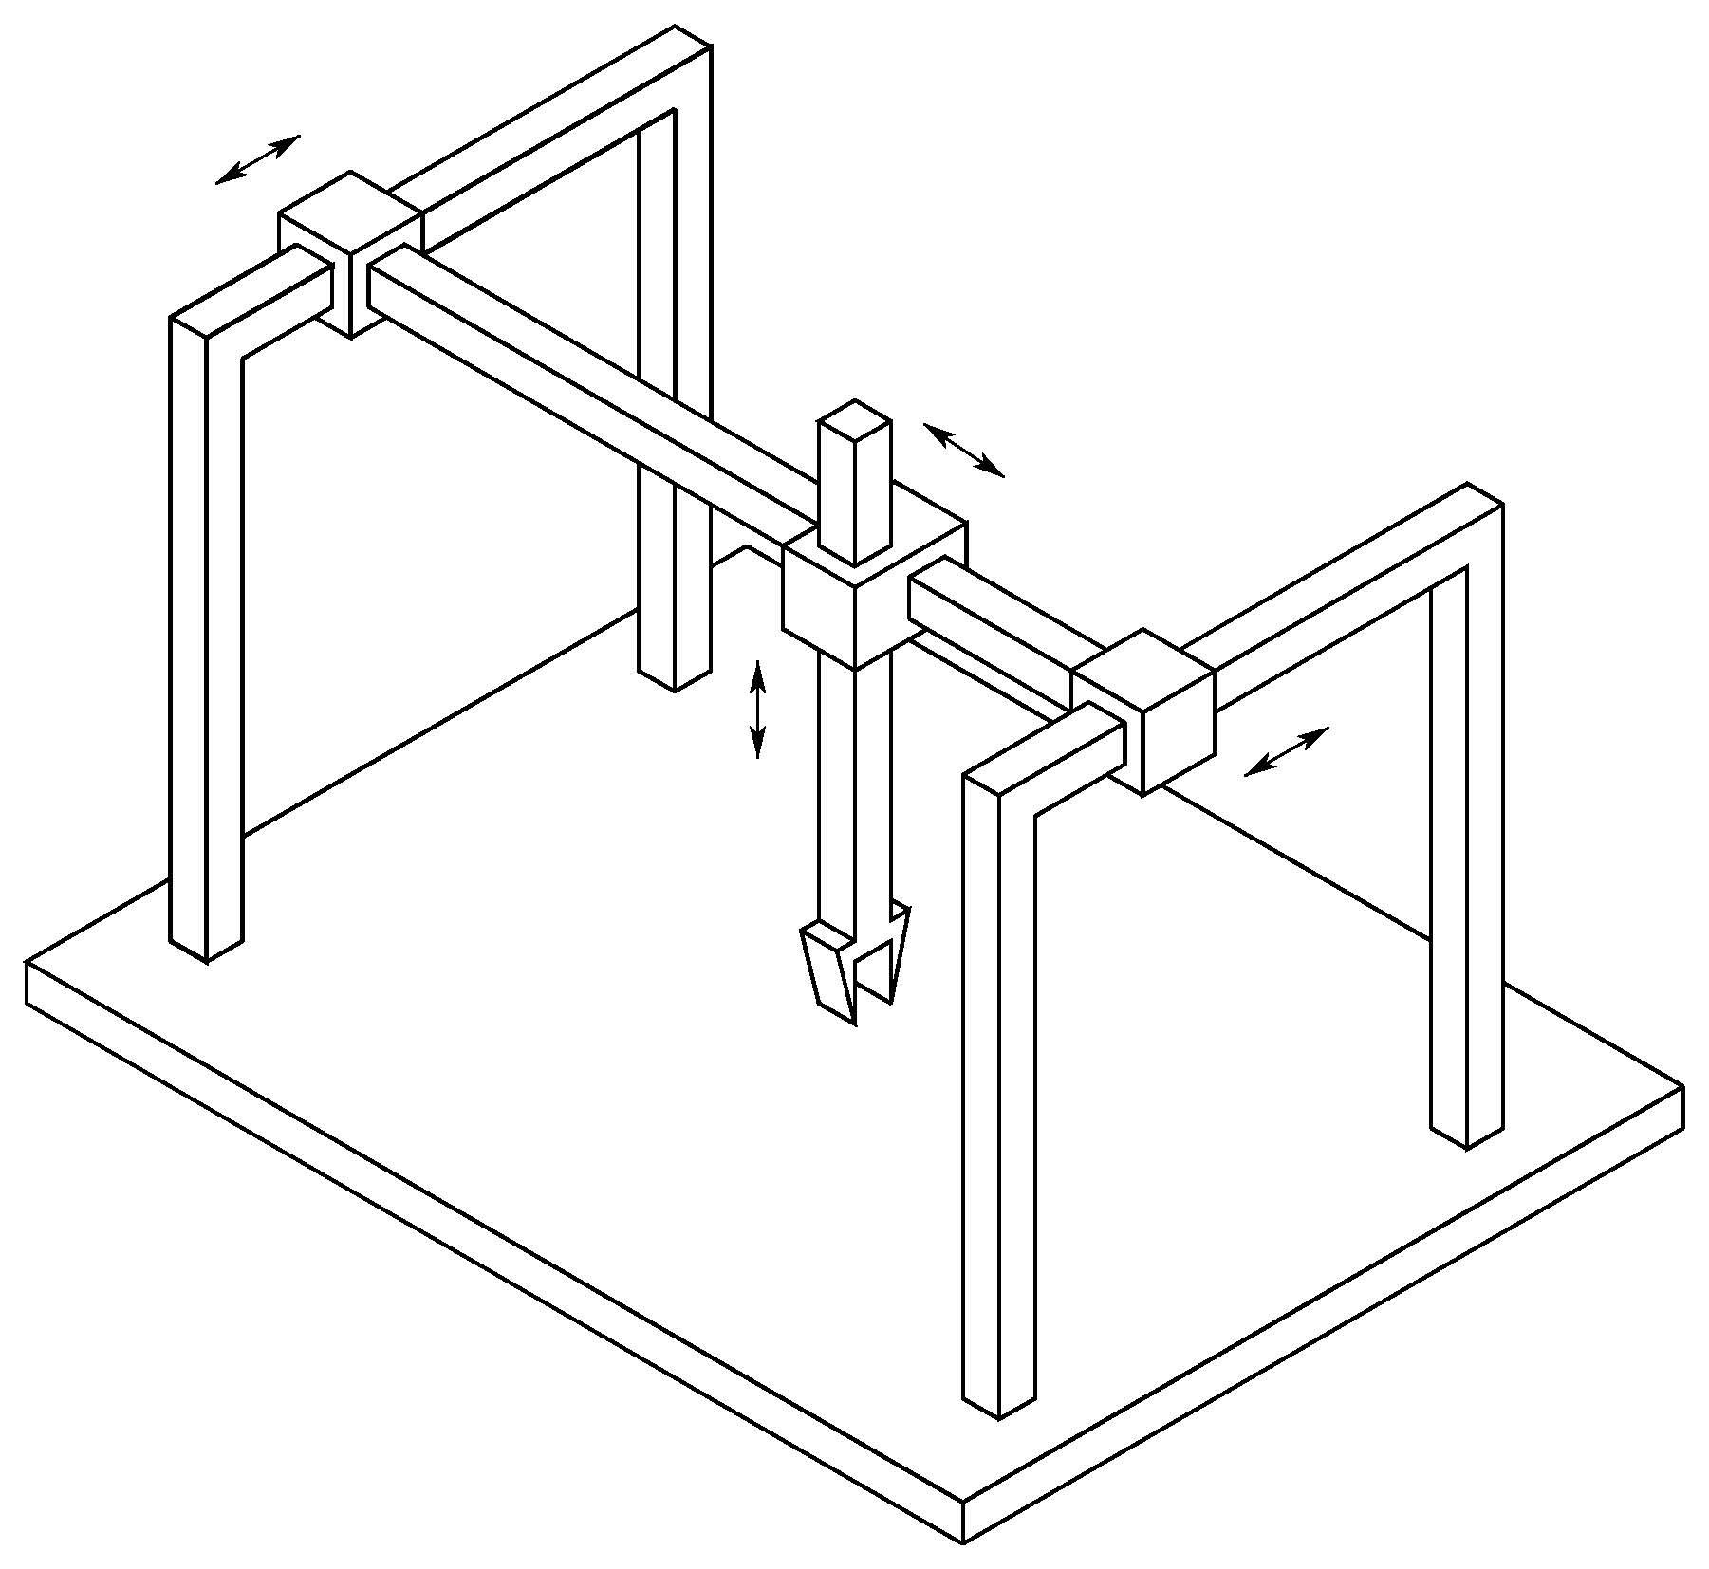
Goal
To build an effective end effector based on an cartesian robots that is able to interact accurately with different modalities (knob, buttons, sliders etc) of medical equipments in the ICU, and can be operate on a functional GUI.
Furthermore, additional object recognition algorithm will be developed alongside the above robot to provide the robot with the information of its relative location to the target equipment based on camera input.

Slide 4
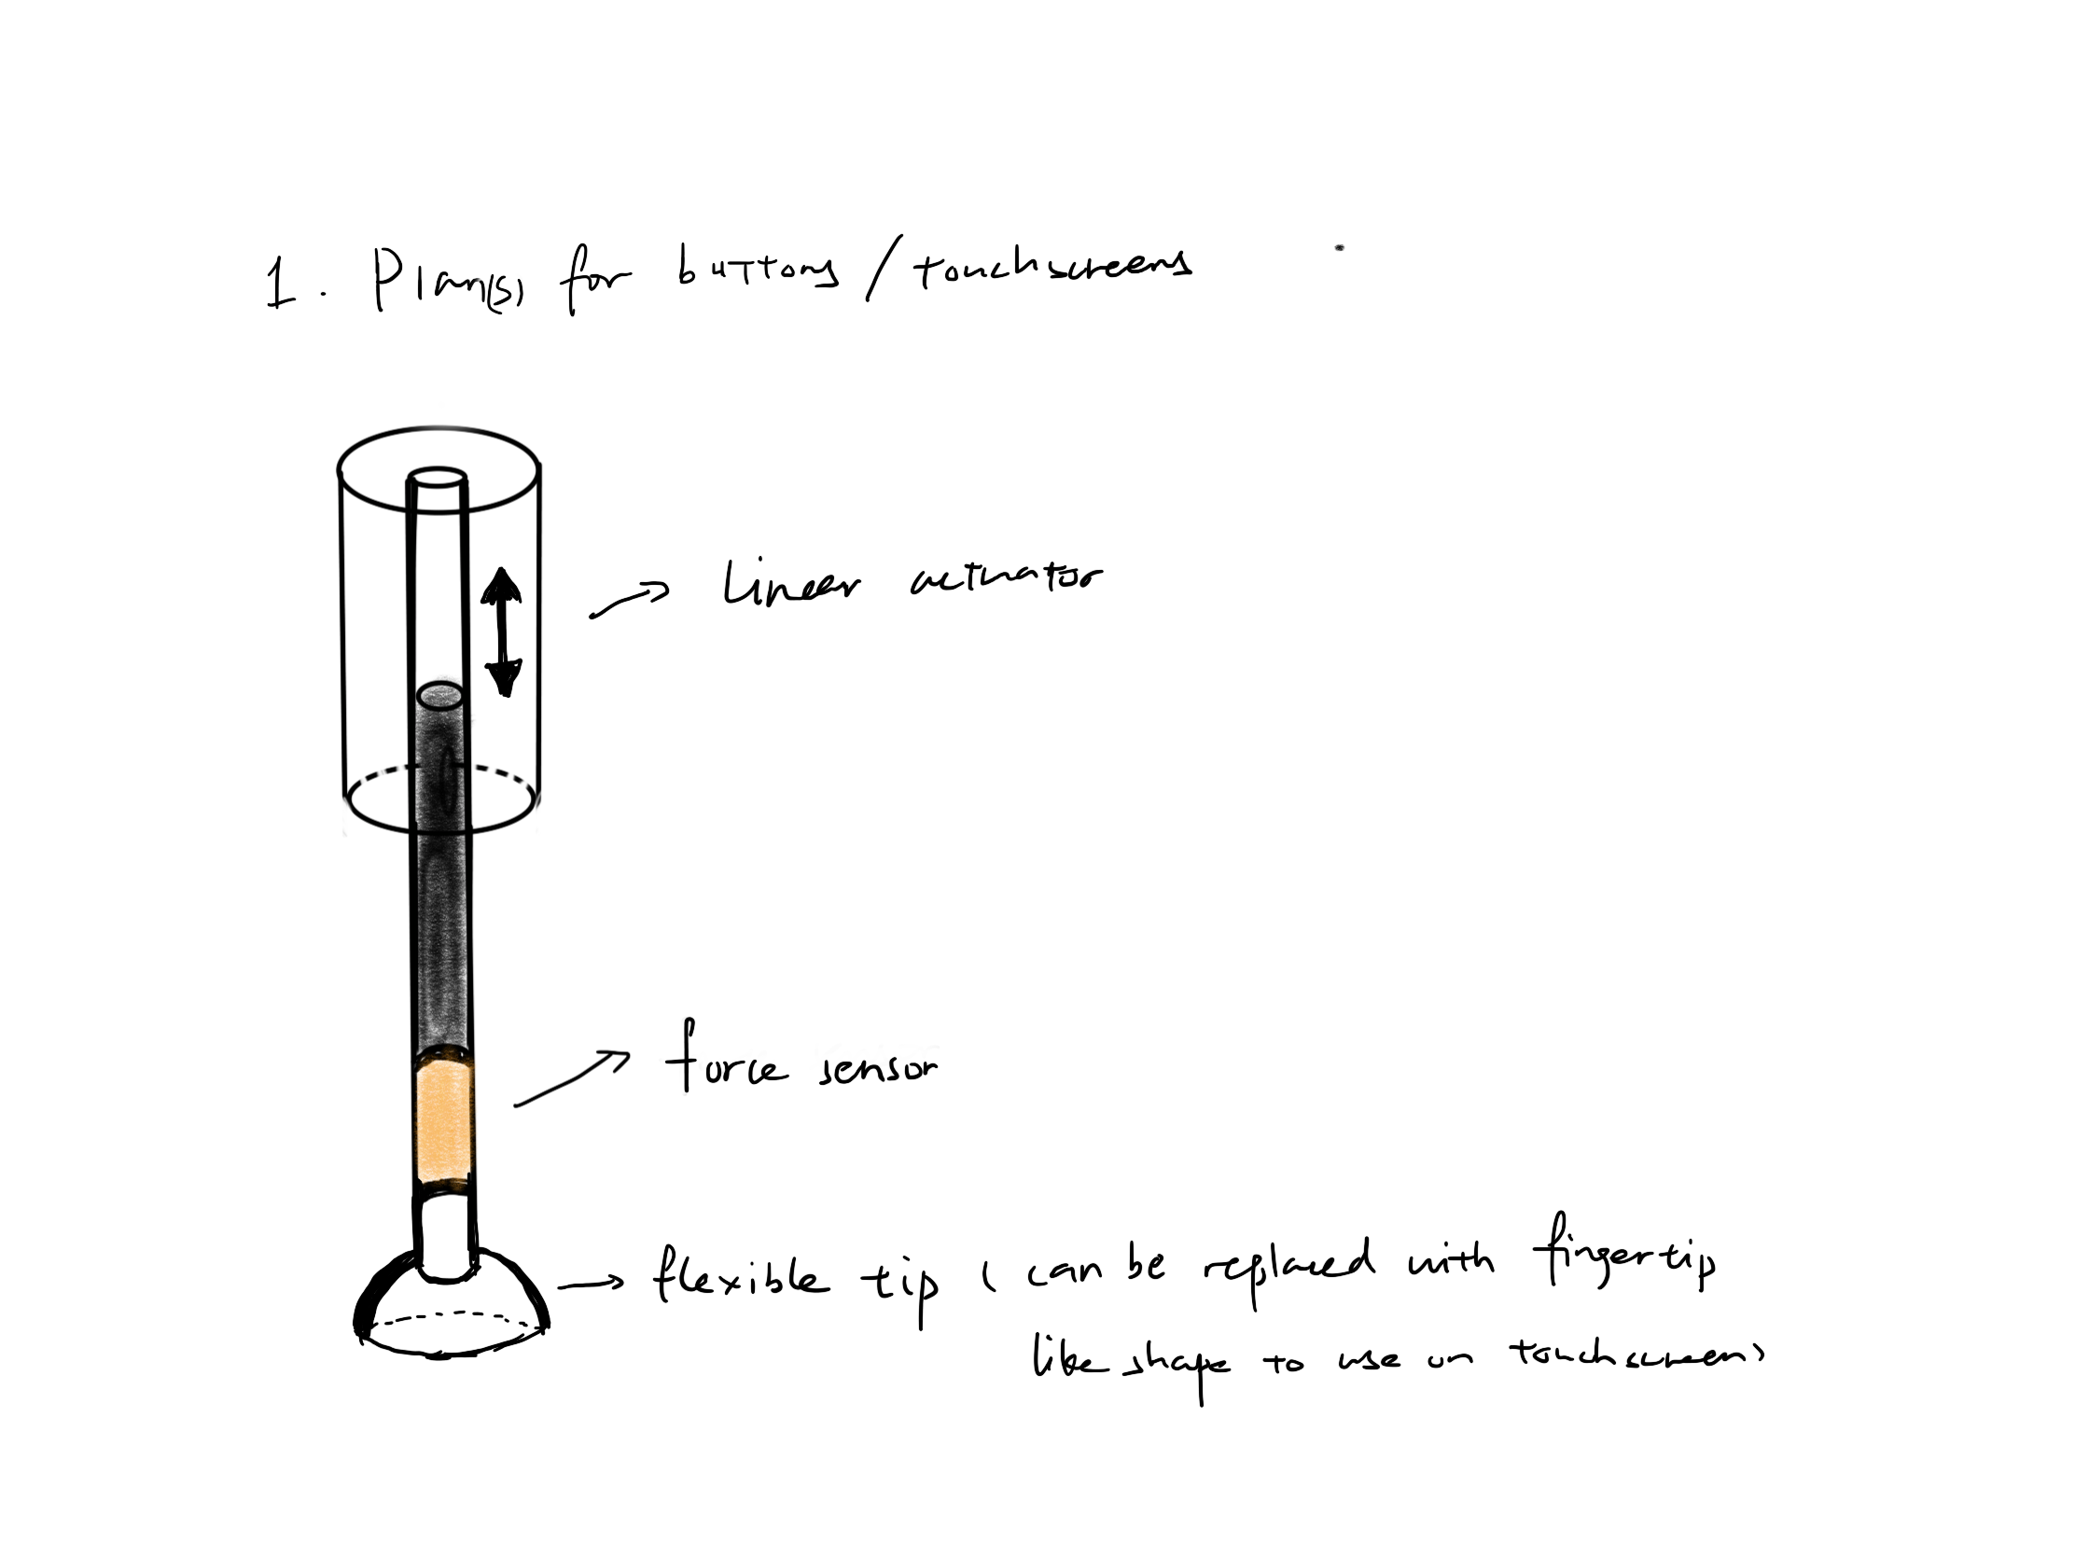
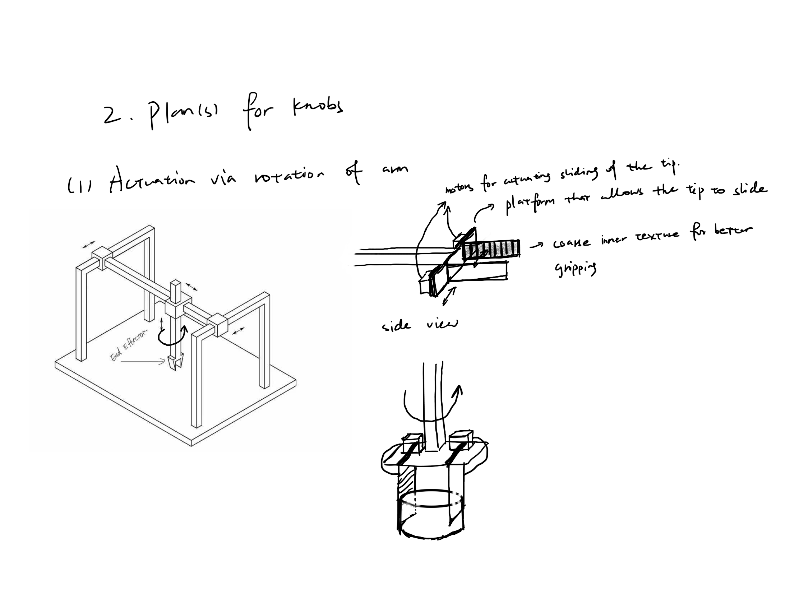
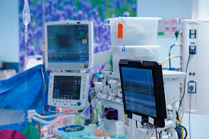
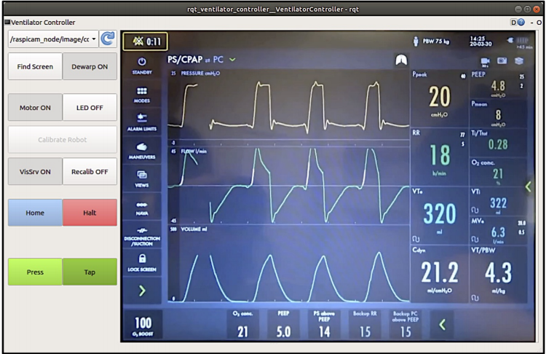
Expected Workflow
80 % Done
Prototyping of End Effector
Integration
Testing of End effector using interface
Object Recognition Algorithm
User Interface Construction

Slide 5
Timeline (Big Steps)
 | Event | Start | End | Status
Mechanical | Literature Research On End Effector | 2/22 | 3/6 | Done
 | Plan Presentation, Plan Proposal | 2/22 | 2/27 | Done
 | Ordering Basic Parts that will be needed | 3/1 | 3/7 | Done
 | Generate Evaluation Chart | 3/4 | 3/9 | Done
 | Rapid Prototype (2D Drawing) | 3/5 | 3/9 | Done
 | Rapid Prototype (3D Design) | 3/10 | 3/18 | In progress
 | 3D Printing | 3/14 | 3/18 | In progress
Computer Vision | Data preparation | 2/26 | 3/3 | Done
 | Writing a working user interface | 3/4 | 3/18 | In progress

Slide 6
Dependencies Update
Dependency | Need | Status | Followup | Contingency Plan | Planned | Hard DDL
Oscilloscope | In replace for ventilator in training CV model | RESOLVED | N/A | N/A | 26-Feb | 28-Feb
Tensorflow/OpenCV | Training model data preparation | RESOLVED | N/A | N/A | 27-Feb | 1-Mar
Camera | Taking real time input | RESOLVED | N/A | Take videos and pictures via personal iphone | 3-Mar | 5-Mar
X-code | Building user interface | In progress | N/A | N/A | 18-Mar | 20-Mar
Building blocks (T-slot), axels, screws etc | To build cartesian robot | RESOLVED | N/A | Buy Prebuilt Cartesian Robot | 5-Mar | 7-Mar
Motors (stepper motor, servo etc) | to actuate the end effector | RESOLVED | N/A | Buy Prebuilt Servo Assembly | 5-Mar | 7-Mar
Basic tools | to assemble and manipulate material | RESOLVED | N/A | N/A | 1-Mar | 5-Mar
3D prototypes printing (outsourced) | to prototype end effector | In progress | 1-Mar | Physically pick up the prototype | 16-Mar | 21-Mar
Measuring equipments | to quantify testing result | RESOLVED | 10-Mar | Borrow Equipment from my Lab in China | 15-Mar | 17-Mar
NEW DEPENDENCY
3D printing settings | reduce printing time and increasing print quality | In progress | 1-Apr | Print using alternative setting to find the balance | 3-Apr | 8-Apr
Parts compatibility | building cartesian robot | In progress | 1-Apr | Buy alternative parts that are compatible | 3-Apr | 8-Apr
Set up Linux & python environment | Set up linux environment for building UI | In progress | N/A | N/A | 26-Mar | 28-Mar

Slide 7
Deliverables Check Points
 | David | Jaelyn
Minimum | Functional prototype of end effector. | A working user interface written in Swift and Xcode that allows the user to see and control the panel through the robot;
Expected | Well tuned cartesian robot prototype with tested analysis and documentations. | Userface in python/Linux; a model capable of recognizing the desired machine and calculate relative position well tested
Maximum | Preliminary adaptation code for high DOFs ROS | An algorithm capable of calculating relative position and pose between the camera and the object w/ unit tests;

Slide 8
Key Milestone Achieved
Evaluation Chart
2D Design Drawing
3D CAD Design
Data Collection for CV algorithm
Preliminary UI via Swift/Xcode

Slide 9
Evaluation Chart
Does not work | Small chance it work | Most likely work | Works with reduced accuracy | Works consistently With accuracy
 | Variable | 1 | 2 | 3 | 4 | 5
General Purpose | (End Effector) only interacts with one (unit?)
 | tip interacts stably with one button
 | force precision
 | does not block camera view
Button | Force feedback (artificial or measured)
 | Damage prevention (Virtual fixture on travel length)
Knob | ability to actuate knob
 | turning accuracy within 1 degree(2-5) small range of error
 | turning on all knob materials
 | can press button in the middle of the knob
Slider | ability actuate slide
 | achieve good grip on all slider material
 | actuate slider with accuracy
 | boundary feedback
Touch Screen | drag and move amount touch screen
 | recognizable by touch screen
Overall efficiency | number of steps / time

Slide 10
2D Design of End Effector
Abstract:​
This Design has the specific purpose of pressing buttons in mind. Actuated in 1D with feedback on force exerted.​
​
Design Feature:​
1. Z-direction linear actuation​
2. Force sensor incorporation for better feedback on force exerted.​
3. Deformable plastic tip for smooth actuation and impact absorption.
Score: 35/80​

Slide 11
Ideation 2.0
Abstract:​
This design is intended to target knob turning modality, with two parallel moving finger interacting with the knob using friction​
​
Key features:​
1. Parallel slab for manipulation in between small button space​
2. Force feedback measured from servo current​
3. Flexible far end tip to accommodate different knob geometry​
4. Internally layered silicon, maximum grip while easy to clean​
5. Detachable slab for future design upgrade.​
​
Score: 55/80

Slide 13
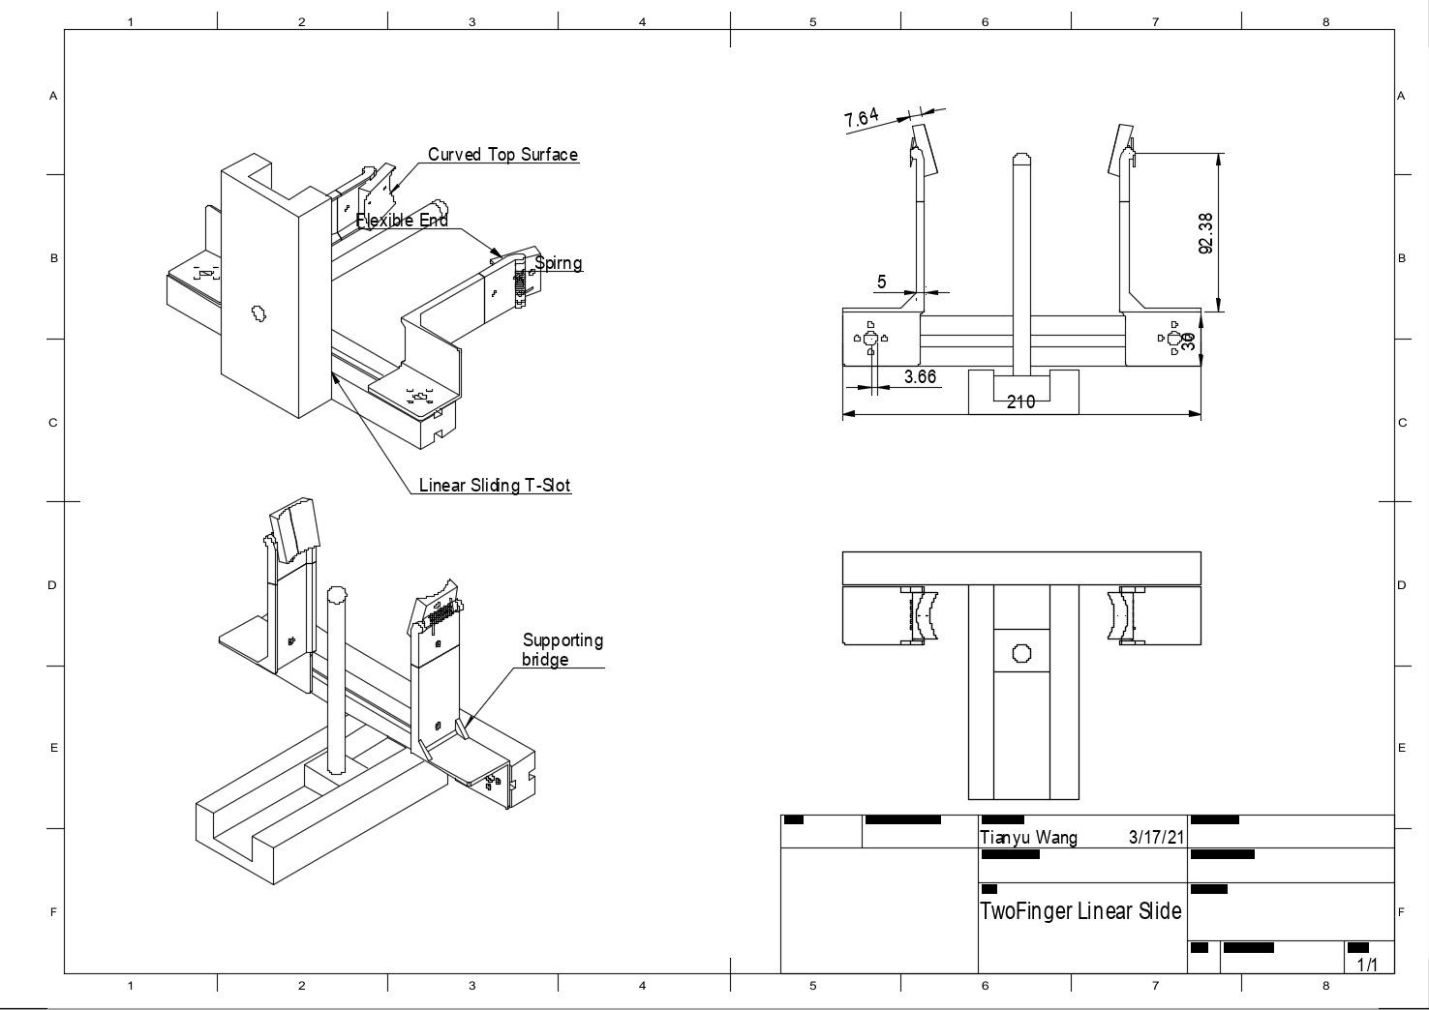

Slide 14
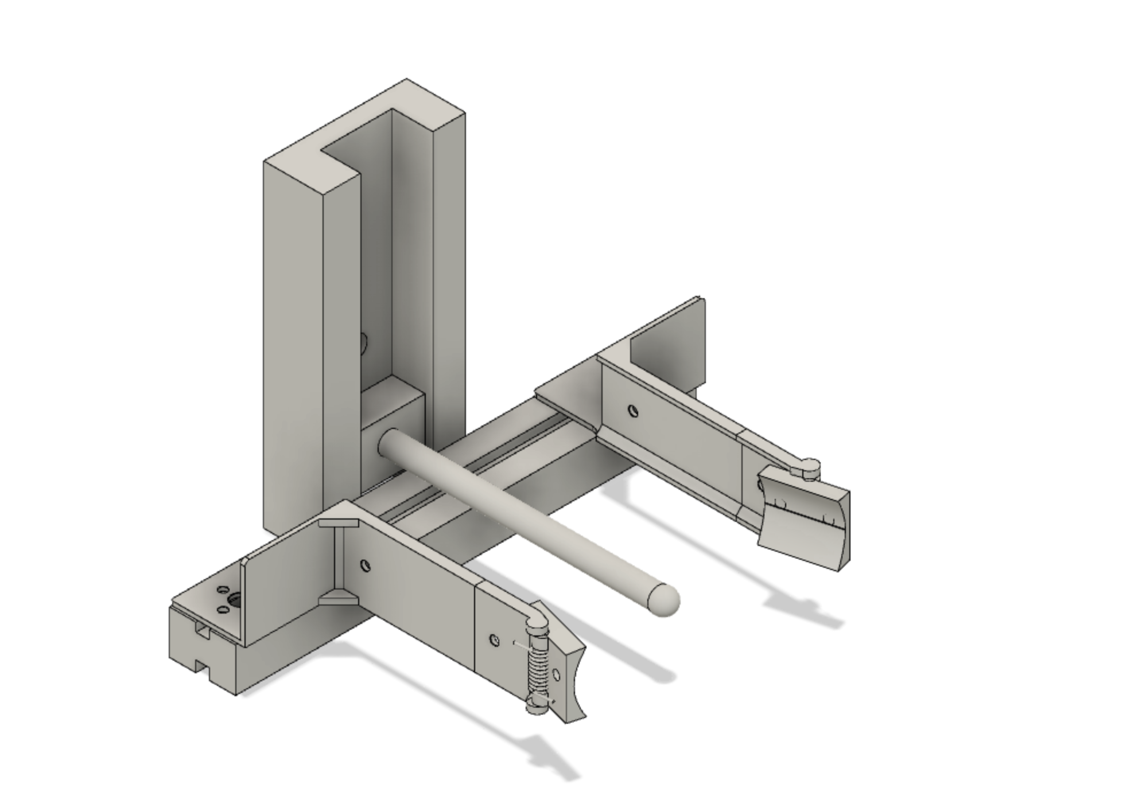
3D CAD of End Effectors
Demonstration of preliminary 3D CAD design in drawing.
Derived from the highest scoring design currently.

Slide 15
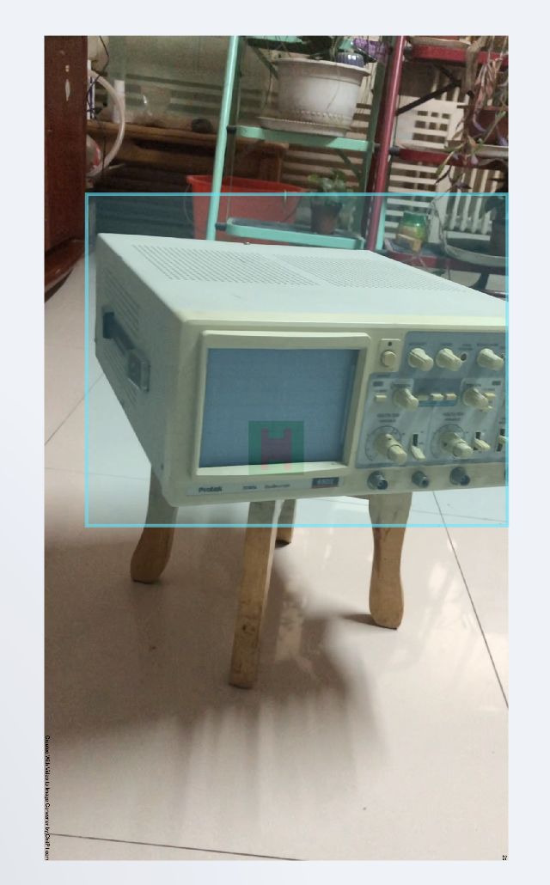
Data Preparation
Computer vision training data sets:
labeled positive/negative image sets with Training group and Testing group separated;

Slide 16
Working User Interface

Slide 17
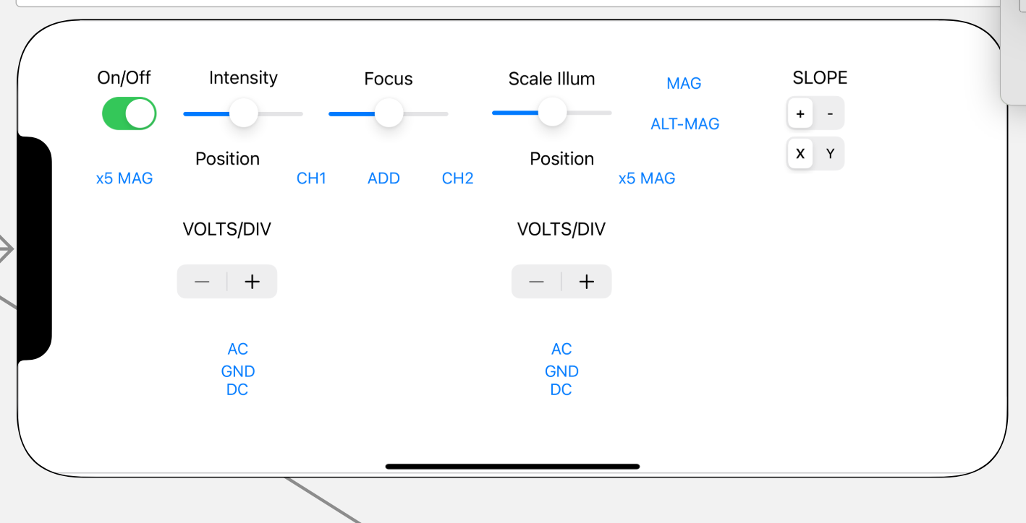

Slide 18
Next Steps
Mechanical:
Continue 3D CAD design
3D printing prototype
Testing Plan Preparation
Test Bed Construction
Computation:
Rewrite UI in python/Linux
Generate json file of oscilloscope for configuration
Train a CV model for recognizing oscilloscope in random environment

Slide 19
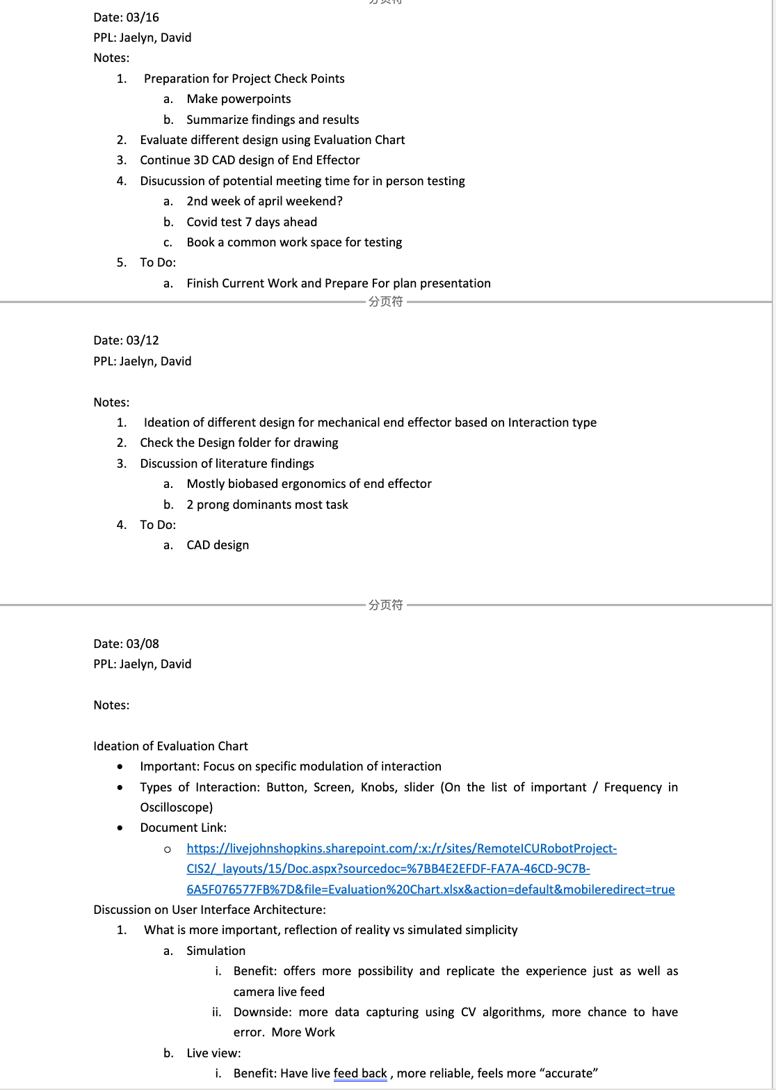
Documentation of Progress
Living Documents:
Design Folder
Meeting Notes
Data Processing Journal

Slide 20
Responsibilities So Far
David:
Prototyping,
Documentation Updating
Literature Summary
Evaluation Chart
Jaelyn:
Data Collecting
User Interface Construction
Concept Drawing
Evaluation Chart

