Slide 1
HMD-Based Navigation for Ventriculostomy
In ventriculostomy, the surgeon inserts a catheter into the third ventricle to drain fluid. It is typically performed as a bedside procedure without image guidance. The goal is to introduce image guidance via augmented reality on a head-mounted display (HMD).
What Students Will Do:
Implement HMD-based navigation system for ventriculostomy
Deliverables:
Automatic or semi-automatic segmentation of the ventricles
Registration of CT to patient using anatomic features
Overlay of ventricle model on HMD
Overlay of catheter guide on HMD
Size group: 2-3 students
Skills: HMD programming (Unity), C++ or Python, segmentation
Mentors: Ehsan Azimi (eazimi1@jhu.edu), Peter Kazanzides (pkaz@jhu.edu)

Slide 2
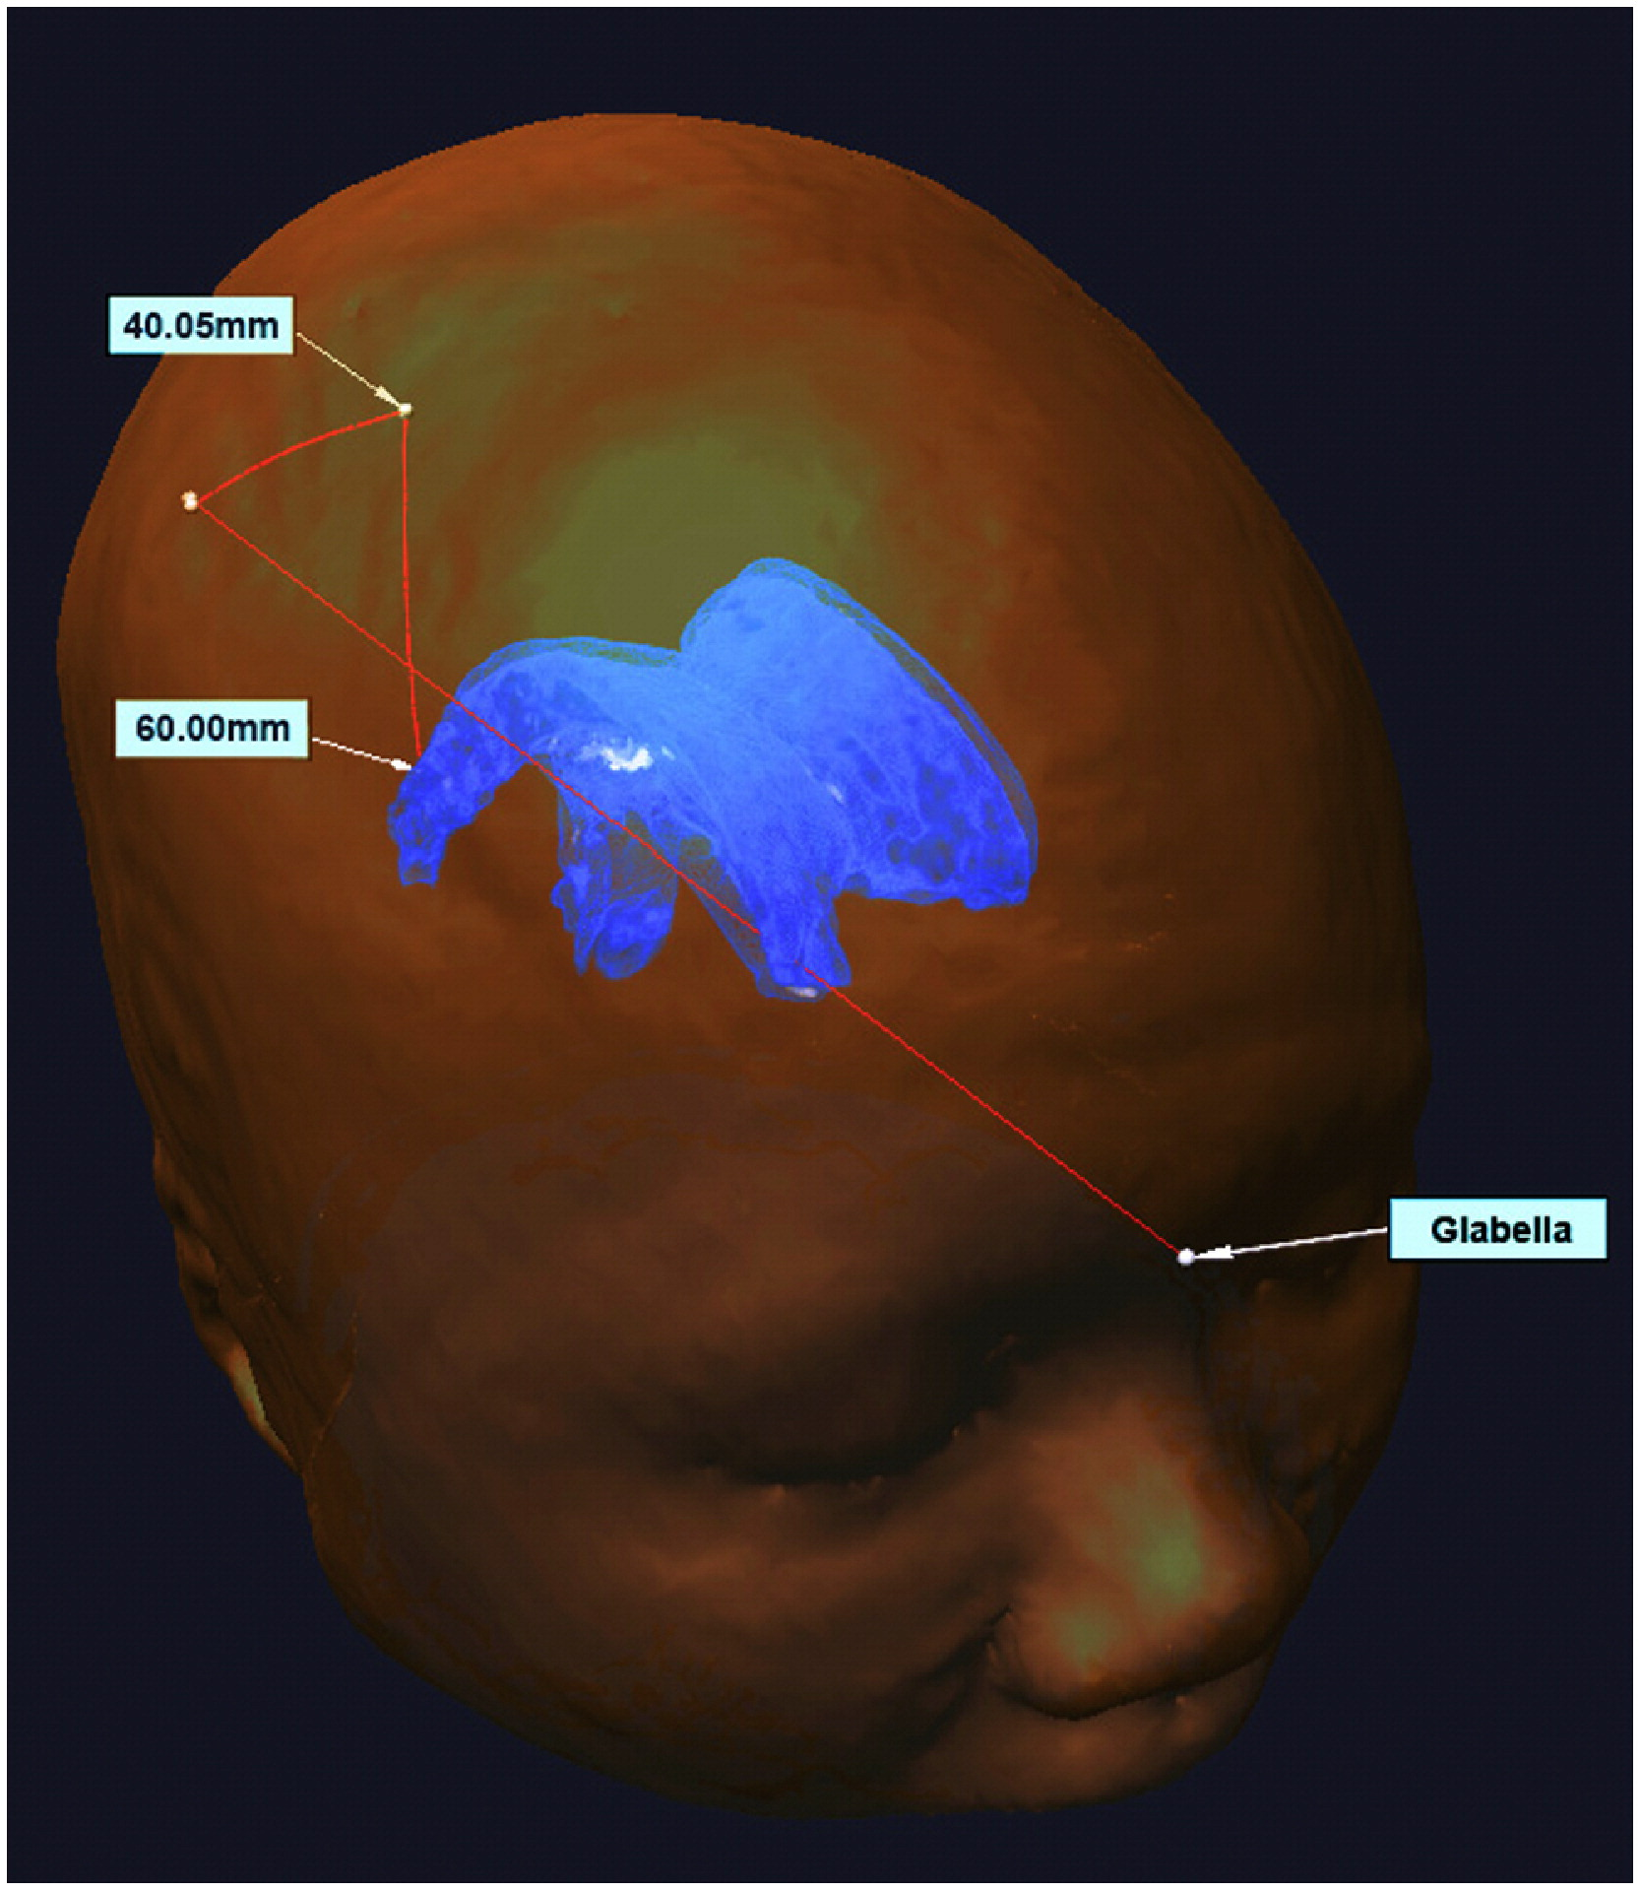
HMD-Based Navigation for Ventriculostomy
Workflow
Register CT to patient by touching anatomic points, such as glabella
Require accuracy within 3 mm
Create ventricle model by segmenting CT
AR overlay of ventricle model
Overlay of catheter guide, with possibility for adjustment
Hardware/Software
Microsoft HoloLens HMD
HMD application in Unity3D
External software in C++ or Python
CT segmentation
Tracking of catheter (optional)
Eye gaze to adjust guide (optional)
Catheter guide overlay(s)
Ventricle

