Slide 1
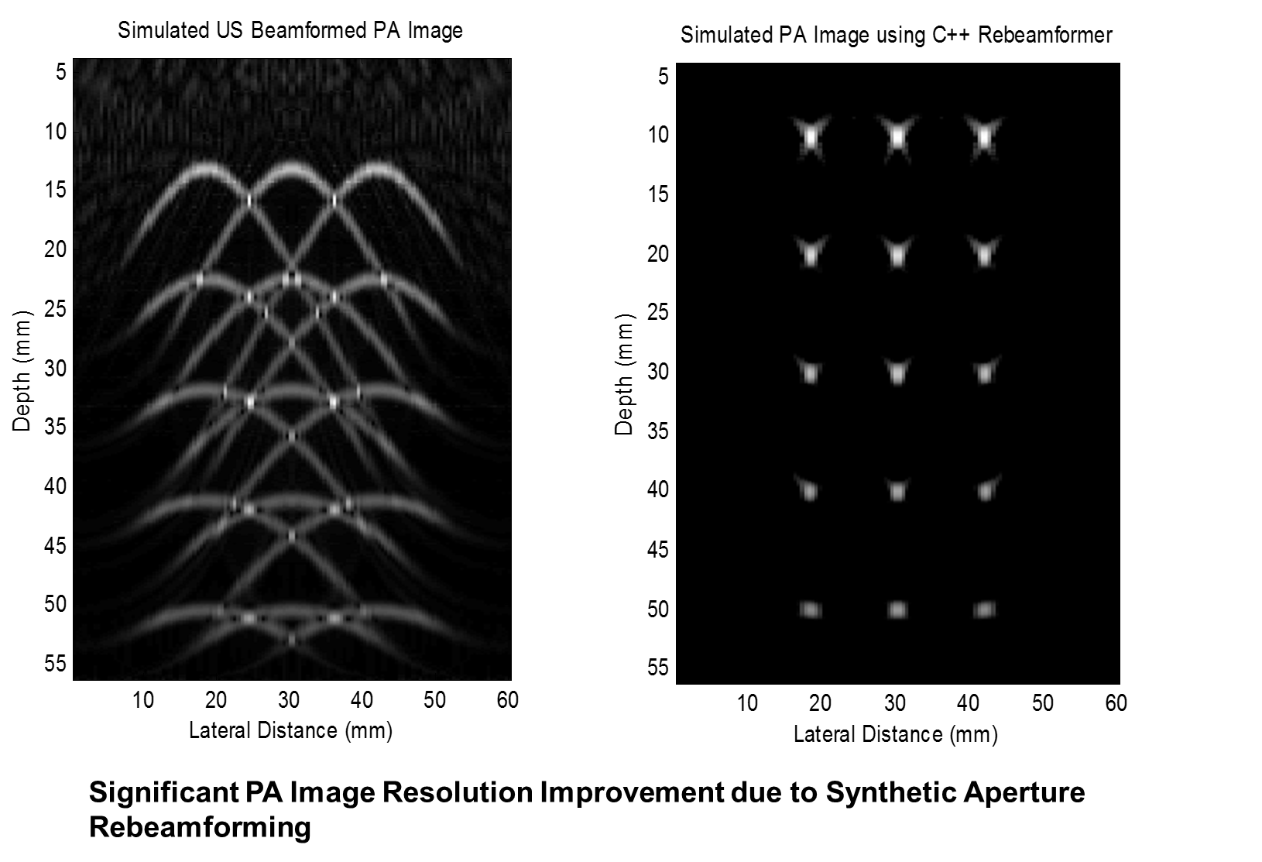
Software-based Approach for Real-time Photoacoustic Imaging using Vendor Independent US Beamformed Data Howard Huang Mentors: Kai Zhang, Emad Boctor
Goals:
Develop software for real-time PA imaging on conventional US systems.
Significance:
Circumvent need for specialized PA imaging hardware.
Results:
Developed fast PA rebeamformer in C++.
Integrated software into a live PA imaging demo.

Slide 2
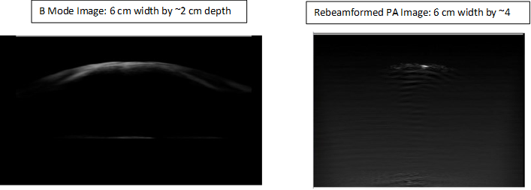
Results from Real-time Imaging Demo:
Software-based Approach for Real-time Photoacoustic Imaging using Vendor Independent US Beamformed Data
For low depths, system can produces images at over 30 frames per second.
Please come by to see our PA imaging demo!

