Slide 1
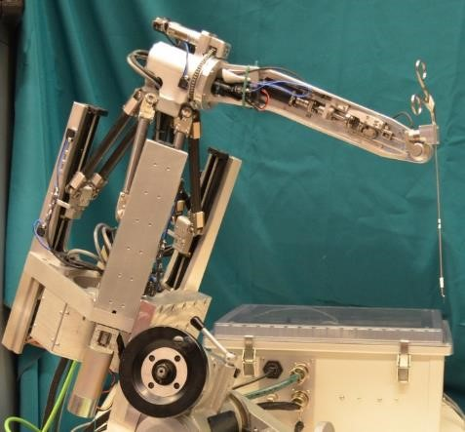
The Robotic Ear Nose and Throat Microsurgery System (REMS): IRB Study
Paper Seminar Presentation
Brian Gu
Group 12
Mentors
Kevin Olds Professor Taylor
Masaru Ishii

Slide 2
Presentation Overview
Project Review
Paper Selection
What and Why
Relevance
Paper Summary
Introduction
Experiments and Methods
Results
Conclusion

Slide 3
Project Review
REMS Sinus Validation Study (one of three sub-projects)
Primary Goal: Determine if robotic surgical assistance with REMS improves surgical skill compared to conventional methods
Protocol:
20 students recruited and separated into two groups
10 “learn sinus procedure” with REMS assistance
10 learn with current, nonrobotic protocol
Anaylze results (accuracy comparison etc.)
An expert group will perform the task to gather data on how REMS affects professionals

Slide 4
Paper Selection
Robotic Path Planning for Surgeon Skill Evaluation in Minimally-Invasive Sinus Surgery
Narges Ahmidi, Gregory D. Hager, Lisa Ishii, Gary L. Gallia, and Masaru Ishii
Department of Computer Science
Citation
Ahmidi N, Hager GD, Ishii L, Gallia GL, Ishii M. Robotic path planning for surgeon skill evaluation in minimally-invasive sinus surgery. Med Image Comput Comput Assist Interv. 2012;15(Pt 1):471-8.

Slide 5
Paper Selection – What and Why?
Published in 2012 by this department
Co-authored by our own mentor Dr. Ishii
Purpose:
Answer two questions:
Can comparison with an optimal surgical path be used to establish a measure for skill evaluation?
Does quality of motion, independent of path, provide additional information?

Slide 6
Paper Selection – Relevance
Purpose of our study is to evaluate surgical skill between two groups:
Free hand learning vs learning with the robot
had a very nebulous idea of what “skill” meant
This paper provides a way an accurate and objective way to quantify skill
Provides methods to evaluate data for our own study

Slide 7
Paper Summary- Introduction
Current method of evaluating surgical skill is the OSATS
Skill rated from 0-3 (0 being complete novice, 3 being an expert)
Requires a committee of faculty surgeons to rank surgical trials of residents
Is there a way to accurately and automatically assess skill?
Prior work used HMM (Hidden Markov Models)
Split skill rating into novice group (OSATS score 0 or 1) and expert group (OSATS score 2 or 3)
Was only 82.5% accurate with experts and 77.8% accurate with novices

Slide 8
Paper Summary- Introduction cont.
Answering the first two questions earlier in the presentation
Authors developed two metrics to compute skill
SPP (Surgical Path Planner)
DCC (Descriptive Curve Coding)
Both metrics are evaluated with FESS (Functional Endoscopic Sinus Surgeries) and compared with the ground truth (OSATS)

Slide 9
Paper Summary- Experiment and Methods
20 subjects (13 novices and 7 experts) performed FESS
Subjects tool tip tracked and head registered to optical tracker
Touch 3 targets in the sinuses of a cadaver head
Right Maxillary Sinus, right Eustachian Tube, left Lamina Papyracea
Every trial graded 0 or 1 (0=novice, 1=expert) by supervising surgeons, OSATS score calculated as the sum of all 3 trials.

Slide 10
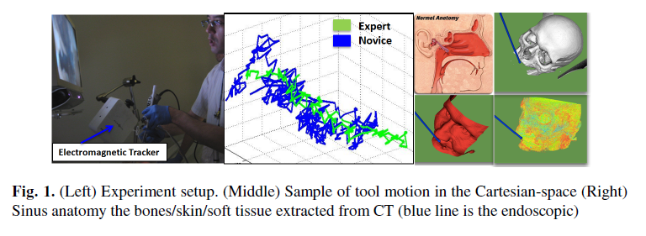
Paper Summary- Experiment and Methods

Slide 11
Paper Summary- Experiment and Methods
Recorded paths were run through three methods to replicate OSATS:
SPP only
SPP+DCC
HMM from prior paper
Compare results of 3 to ground truth (OSATS)

Slide 12
Paper Summary- Experiment and Methods
Surgical Path Planner (SPP)
With a start point and end point, generate a shortest path with given constraints
Nasal anatomy and stiffness of anatomy (skin, bone, tissue) extracted from CT scan data
Model tool as a cylindrical robot with tool length 200mm, radius 2mm, and 5 degrees of freedom

Slide 13
Paper Summary- Experiment and Methods
Surgical Path Planner (SPP) cont.
Use Probabilistic Road Mapping and Gradient Descent to create shortest path from just outside the nose to target point while minimizing collisions with nasal structures

Slide 14
Paper Summary- Experiment and Methods
Surgical Path Planner (SPP) cont.
Each trial generates a feature vector containing:
Correlation of SPP vs trial’s path
Mean and standard deviation of the difference in paths
A support vector machine was trained to classify trials into OSATS ratings (0-3)

Slide 15
Paper Summary- Experiment and Methods
Descriptive Curve Coding (DCC)
Quantifies the smoothness of paths, SPP cannot do this
Records the local curvature of a path from an imaginary observer traveling on the path
Traces the amount of change in the observers coordinate system

Slide 16
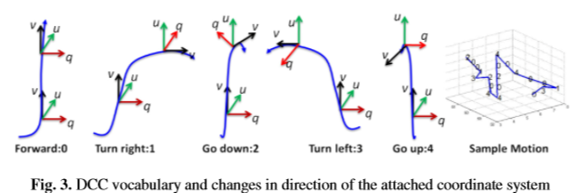
Paper Summary- Experiment and Methods
Descriptive Curve Coding (DCC)

Slide 17
Paper Summary- Experiment and Methods
Descriptive Curve Coding (DCC)
Benefits of DCC:
Flexible vocabulary
Rotation and translation invariant: independent of surgical setup and tracker
Easily extractable feature vector can be added to the SPP SVM
Augmented SVM can be used to evaluate skill

Slide 18
Paper Summary- Results
Performance of three models assessed by comparing their predicted OSATS score to the true OSATS score

Slide 19
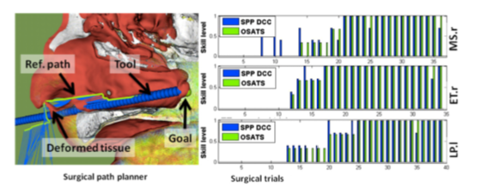
Paper Summary- Results

Slide 20
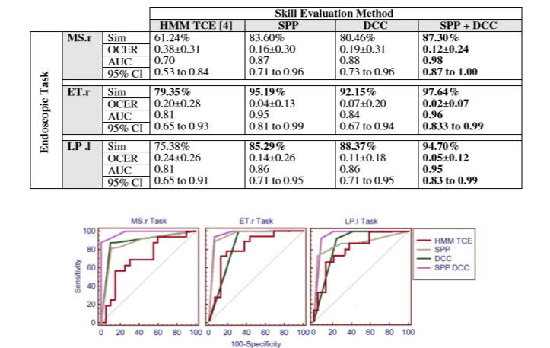
Paper Summary- Results

Slide 21
Paper Summary- Conclusion
SPP+DCC is very accurate in objectively determining skill
Clear advantage over the previous HMM method
Paths expert surgeons take in sinus are very close to ones computed by SPP

Slide 22
Good and Bad
Good
Easy to follow (even for someone not super familiar with machine learning)
Short but detailed
Very relevant to analyzing data for our own study
Bad
None, everyone from Hopkins is perfect (kidding)
Confused about some of the statistics (ROC curve)
Hard to understand exactly what HMM was
Had to go and read previous paper

Slide 23
End

