Slide 1
Algorithms for Fast / Automatic Anatomical Measurement in Cone-Beam CT
Project description:
Develop algorithms to speed-up / assist / automate anatomical measurements of anatomical alignment in cone-beam CT –
(viz., foot and ankle joints for orthopedics).

Slide 2
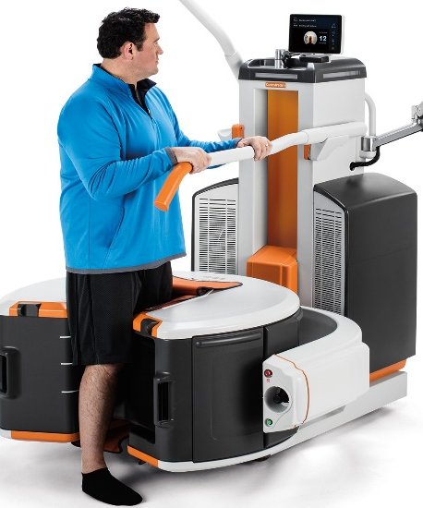
Algorithms for Fast / Automatic Anatomical Measurement in Cone-Beam CT
Extremity Cone-Beam CT (CBCT)
New capabilities:
High resolution 3D
Weight- bearing
Various measurements of joint alignment are used for diagnosis and to plan surgery.
θ_{T-M1}
Manual measurement:
Time consuming
User variability (training-dependent)
Unmet clinical need:
Software to simplify / assist / automate the measurement of key metrics
θ_{T-N}
θ_{T}

Slide 3
Algorithms for Fast / Automatic Anatomical Measurement in Cone-Beam CT
JMAT is software that supports anatomical measurements in CBCT data. You will extend JMAT to the metrics of foot and ankle.
JMAT is semi-automated: needs user input to select anatomical landmarks. We want to develop a fully automated method. You will help to develop, apply and validate it in the foot and ankle.
Register atlas volumes to new scan
Deformable registration
Load DICOM volume
Atlas landmarks
Landmarks
Atlas
Transformed landmarks

Slide 4
Algorithms for Fast / Automatic Anatomical Measurement in Cone-Beam CT
What Students Will Do / Deliverables:
Research and document existing anatomical measurements in the foot and ankle
Minimum 1: Implement semi-automatic (JMAT workflow) for CBCT of the foot and ankle.
Minimum 2: Interact with clinicians to learn about the anatomical metrics, refine user interface and validate the software
Expected: Data to develop and validate of the metrics: segment CBCT images, annotate anatomical landmarks. (Atlas of 15-20 CBCT datasets)
Maximum: Implement fully automatic (atlas-based / active shape model) anatomical measurements in CBCT of the foot and ankle.

Slide 5
Algorithms for Fast / Automatic Anatomical Measurement in Cone-Beam CT
Size group: 2
Skills:
Programming in C/C++ (basic/intermediate)
Programming in Matlab
Basic understanding of image segmentation

Slide 6
Algorithms for Fast / Automatic Anatomical Measurement in Cone-Beam CT
Mentors:
Wojtek Zbijewski
Dept. of Biomedical Engineering,
Johns Hopkins Hospital
720 Rutland Ave.
Traylor Building, Room 624A
wzbijewski@jhu.edu
Jeffrey Siewerdsen
Dept. of Biomedical Engineering,
Johns Hopkins Hospital
720 Rutland Ave.
Traylor Building, Room 622
jeff.siewerdsen@jhu.edu
Michael Brehler
Dept. of Biomedical Engineering,
Johns Hopkins Hospital
720 Rutland Ave.
Traylor Building, Room 624
michael.brehler@jhu.edu

