Slide 1
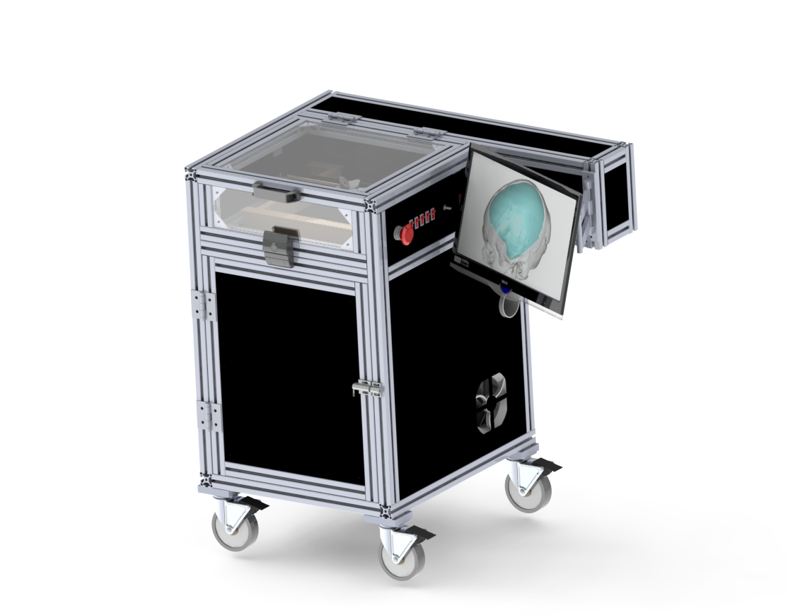
Control Architecture of Cranial Implant
Laser Cutting System
Group 18
Team members: Joshua Liu, Jerry Fang
Mentors: Dr. Mehran Armand, Dr. Ryan Murphy, Dr. Chad Gordon

Slide 2
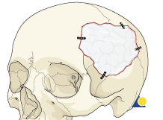
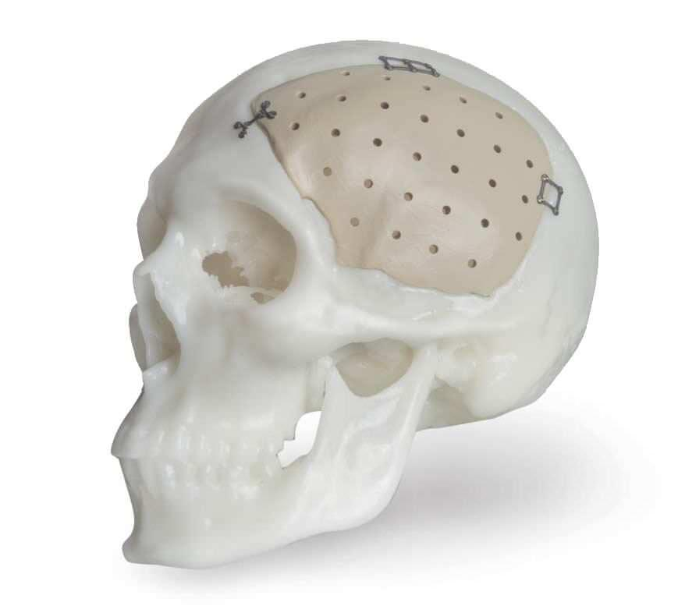
Introduction
Cranioplasty is a procedure to repair cranial defects and/or deformities
Customized cranial implants
Can be time consuming (80 min)
Modification based on surgeon’s visual analysis

Slide 3
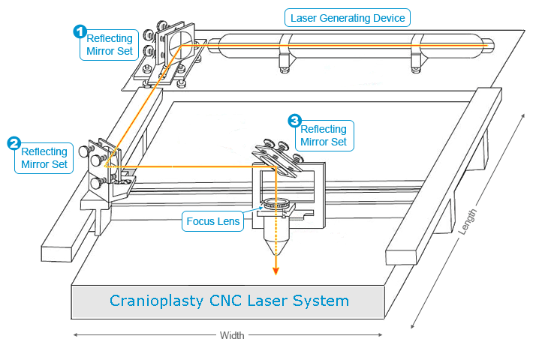
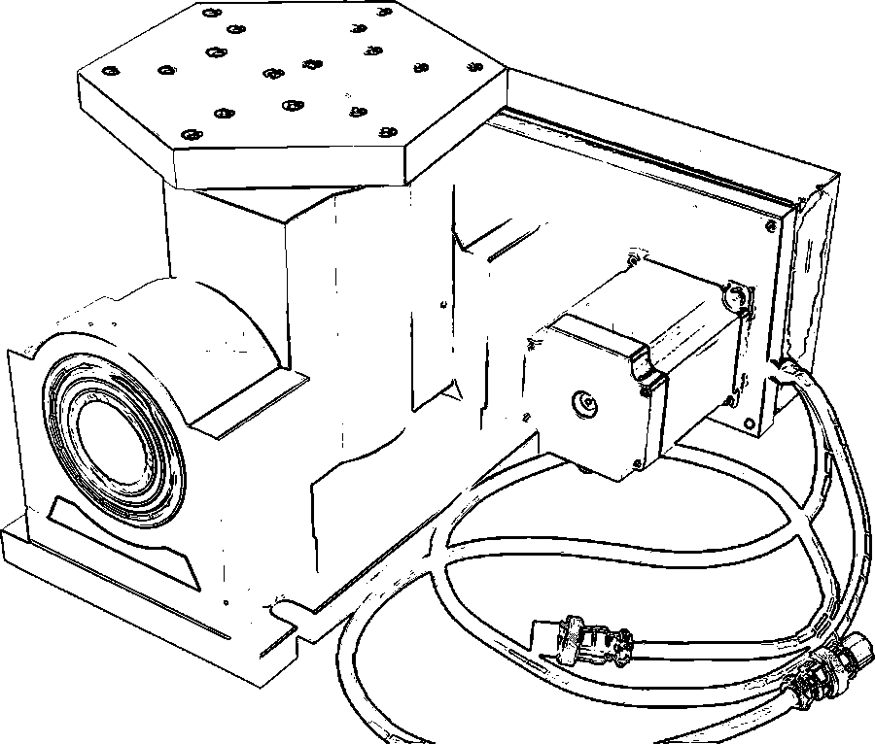
Proposed Solution
CNC laser system
35 W CO2 laser
3 reflecting mirrors
Linear stage
3-axis
Rotary table
rotational freedom
2-axis
Total 5 DOF
Automate the process
Save cost, labor work
Improve accuracy

Slide 4
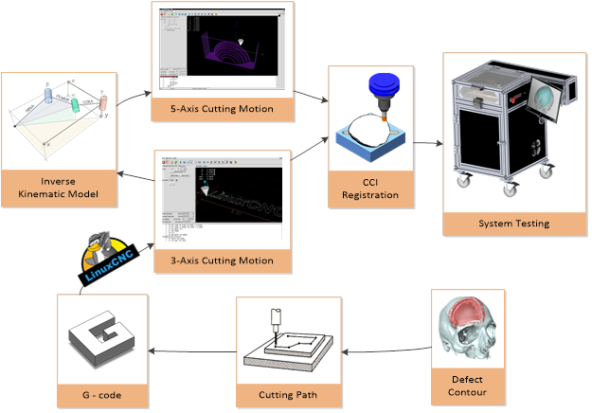
Work Flow

Slide 5
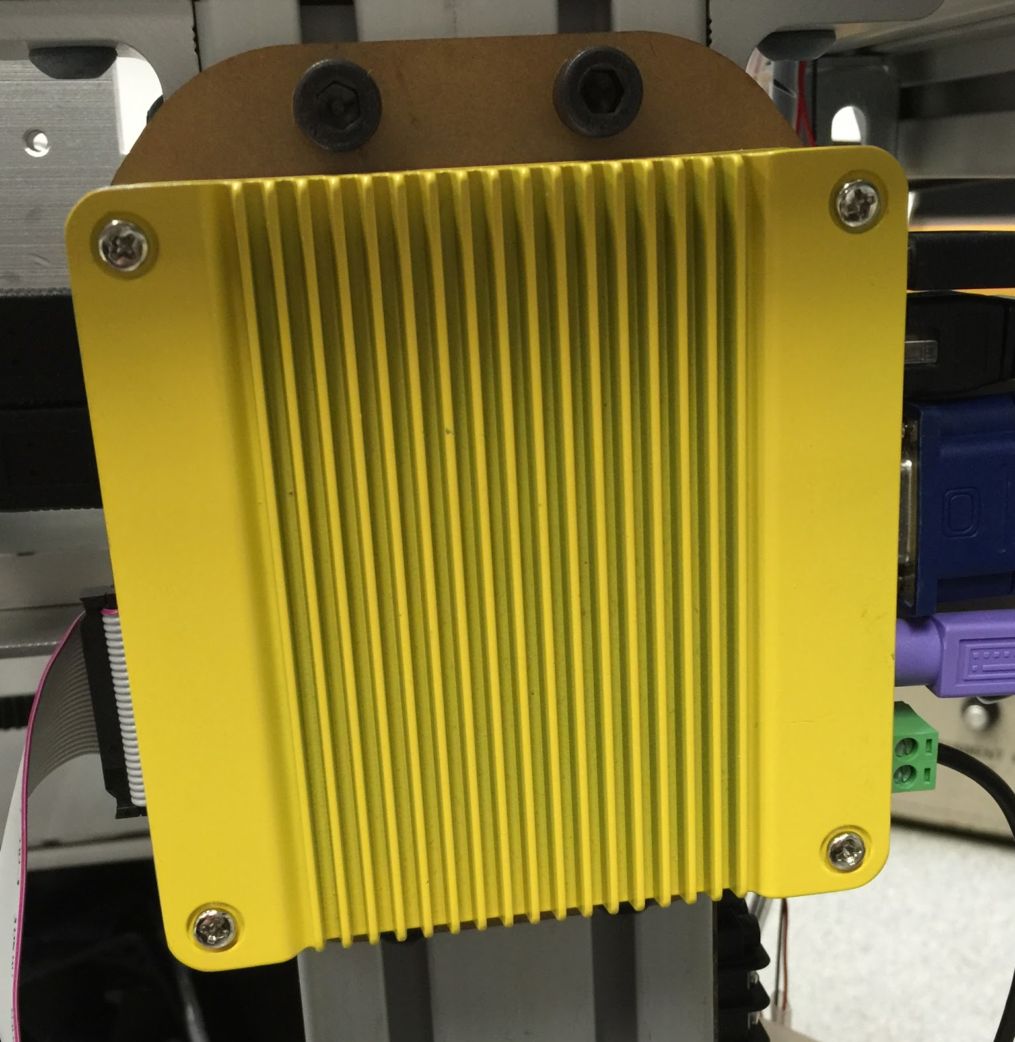
Dependencies
Hardware: Computer system (optional) Pending
Laser control Resolved
Software: LinuxCNC, TK, SolidWorks. Resolved
Registration: need .stl file of the implant registration process and system testing. Will discuss with Ryan and contact Dr. Gordon for the materials. Pending
Accessibility to laboratory and machine shop. Resolved
Notes:
Mention faulty nc box: computer does not support advanced system, only goes up to windows 98. So we can’t update it to the newest linuxCNC version
Laser control: spindle problem (20k frequency -> computer and current controller board can’t generate the frequency that high. got new controller board. currently looking into that.
Resolution: turn make laser on/off at max power all time. adjust cutting velocity instead
Stl file:

Slide 6
Updated Deliverables
Minimum
Hardware troubleshooting (Ongoing)
Laser components alignment (Completed 3/15)
Linear stage and rotary table motor calibration (Completed 3/25)
3-axis controlled cutting motion implementation (Completed 3/28)
Expected
Fabrication of workspace platform for raw implant material (Completed 3/17)
Inverse kinematics model for the rotary table (Completed 4/6)
5-axis controlled cutting motion implementation (Current Progress)
Maximum
Cutting path to G-code conversion algorithm (Current Progress)
Mechanism for implant registration (added)
User interface with visualization and cut path simulation
Testing of the laser cutting system on real implants

Slide 7
Progress
Outline
Laser alignment
Motor calibration
3-axis cutting motion
Kinematics model
Cutting path to G-code conversion

Slide 8
Laser Alignment
Notes:
2 sets of mirror to adjust near field and far field

Slide 9
5-axis Motor Calibration
Notes:
edit video realtime and simulation side by side

Slide 10
3-axis Cutting Motion
Notes:
show cutting video

Slide 11
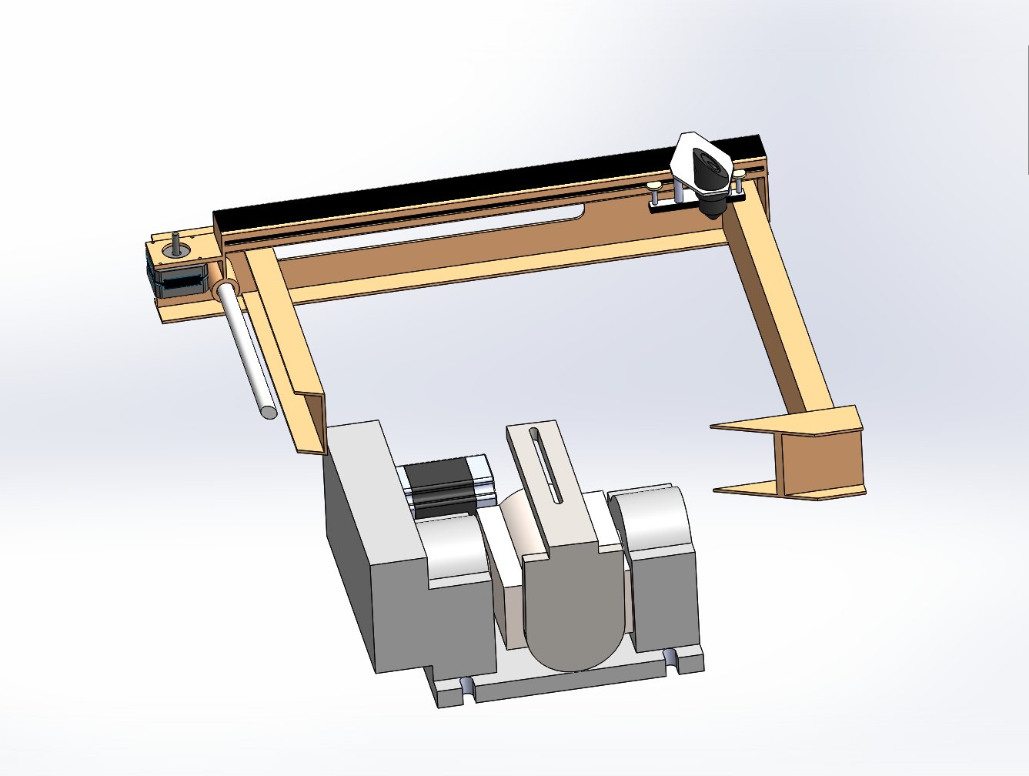
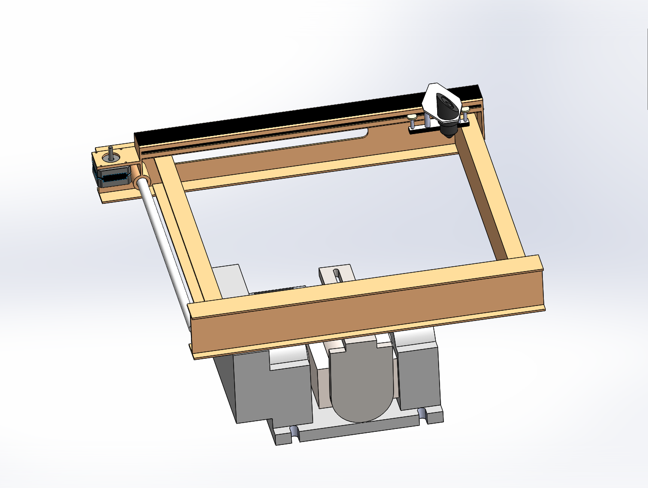
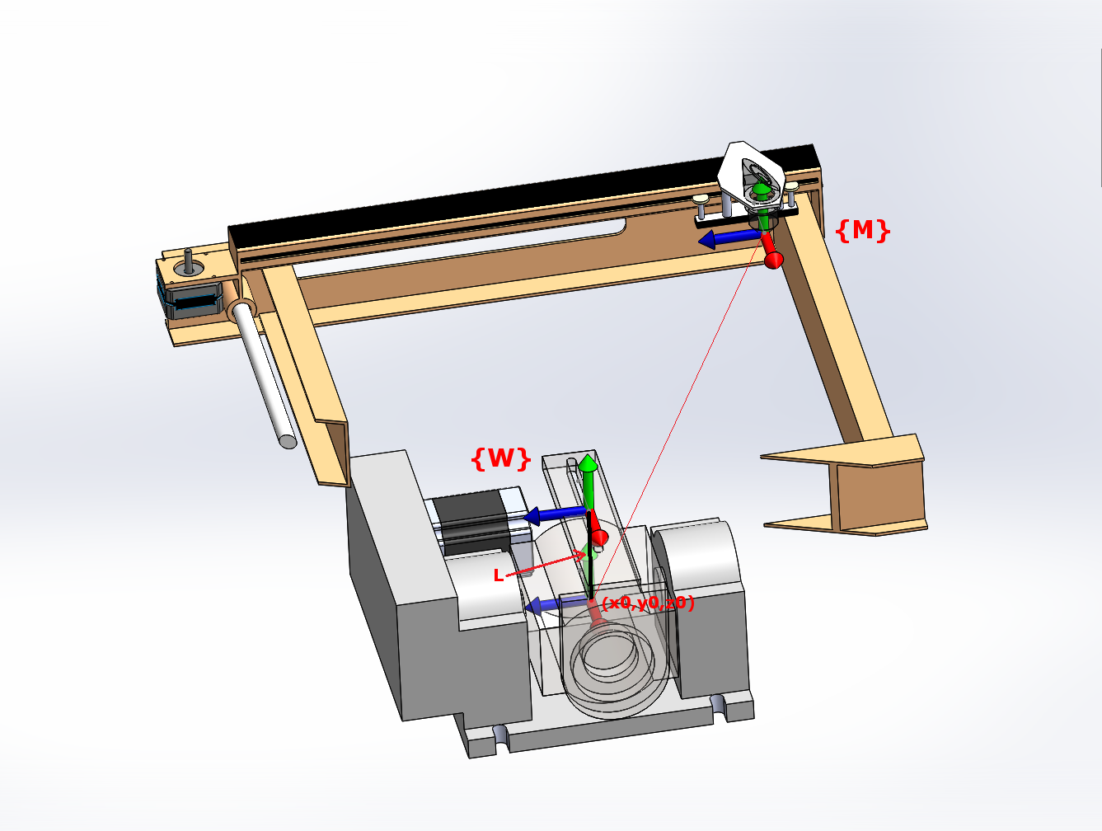
Kinematics
Coordinate System
Notes:
Add diagram and math

Slide 12
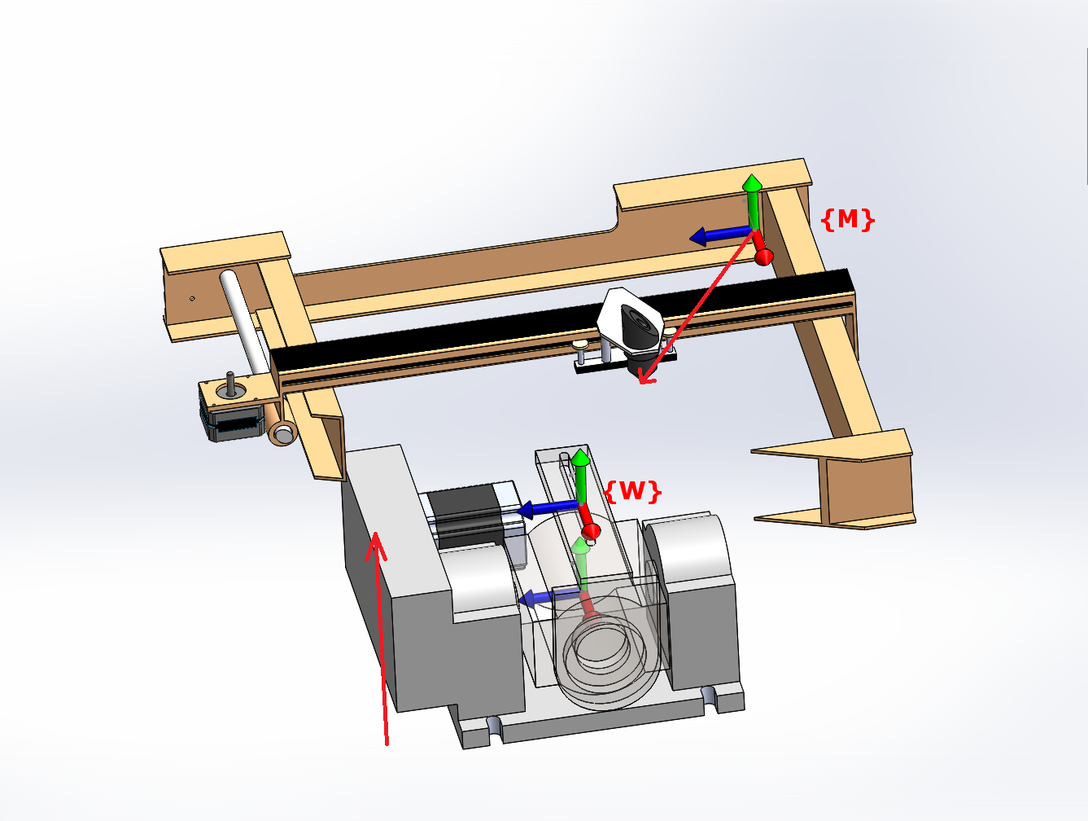
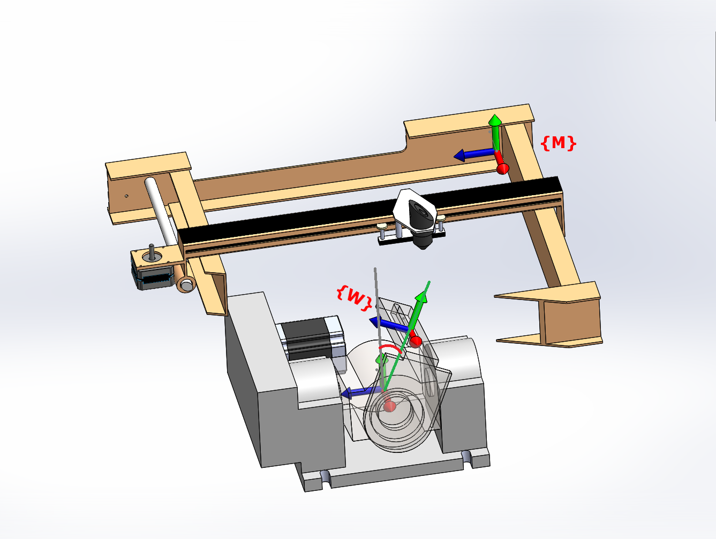
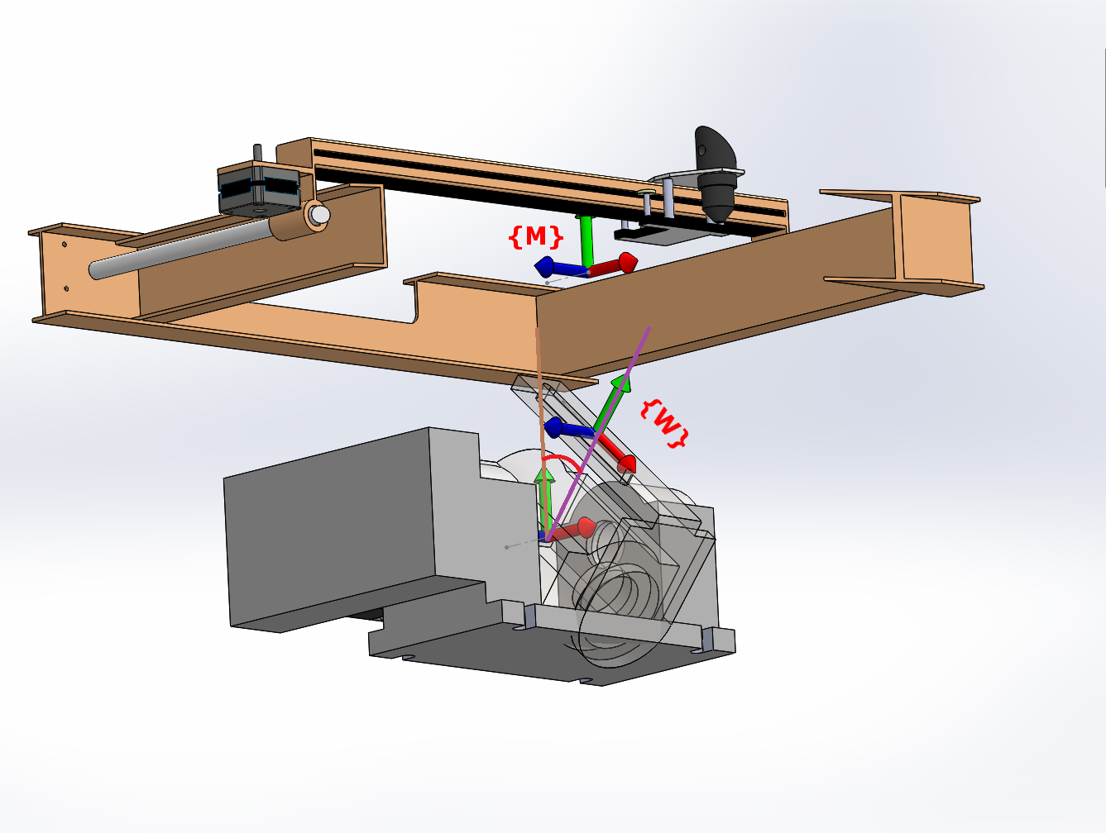
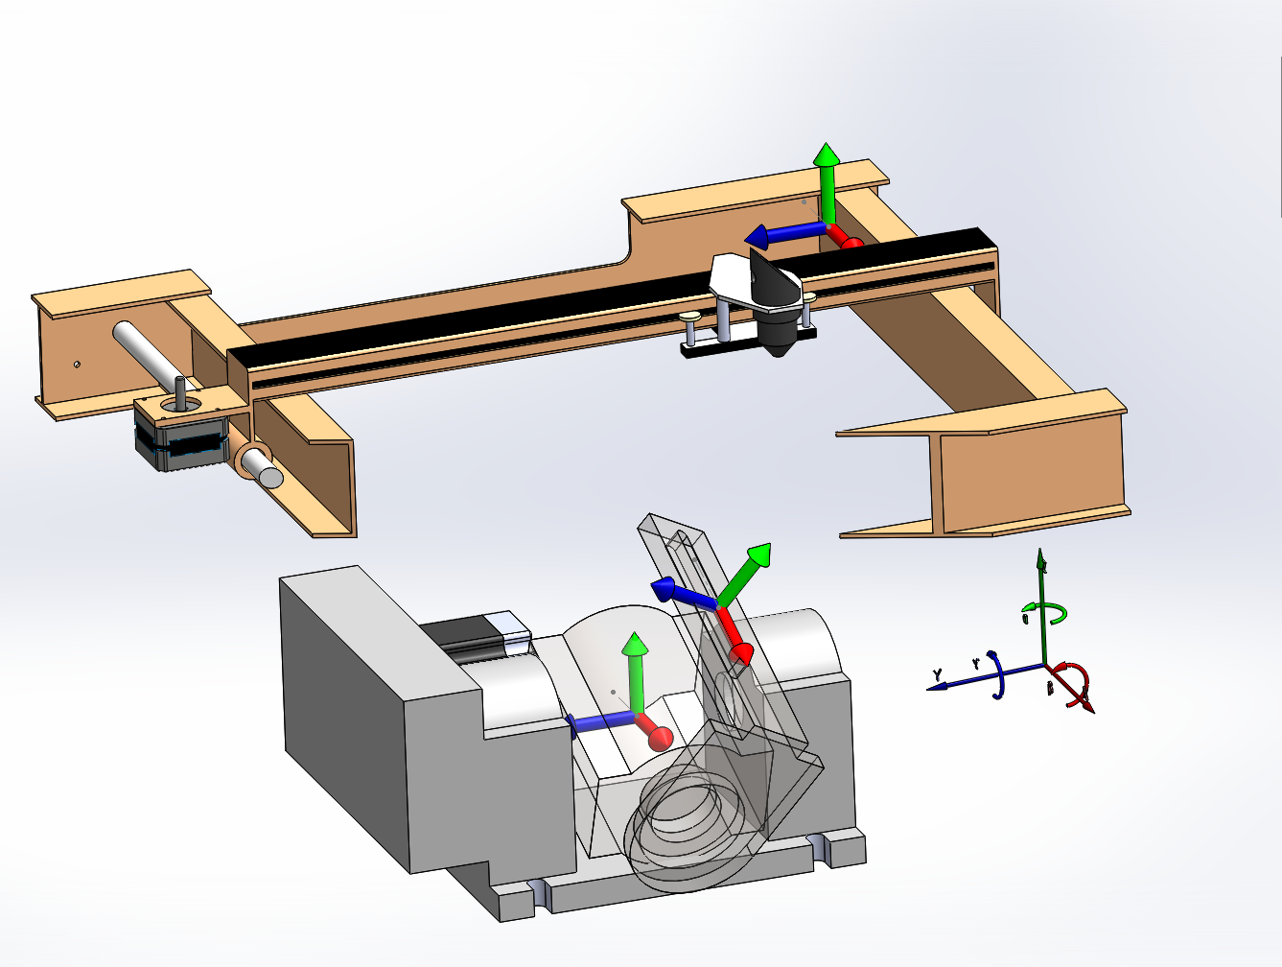
Kinematics - Machine Configuration
Notes:
Add diagram and math

Slide 13
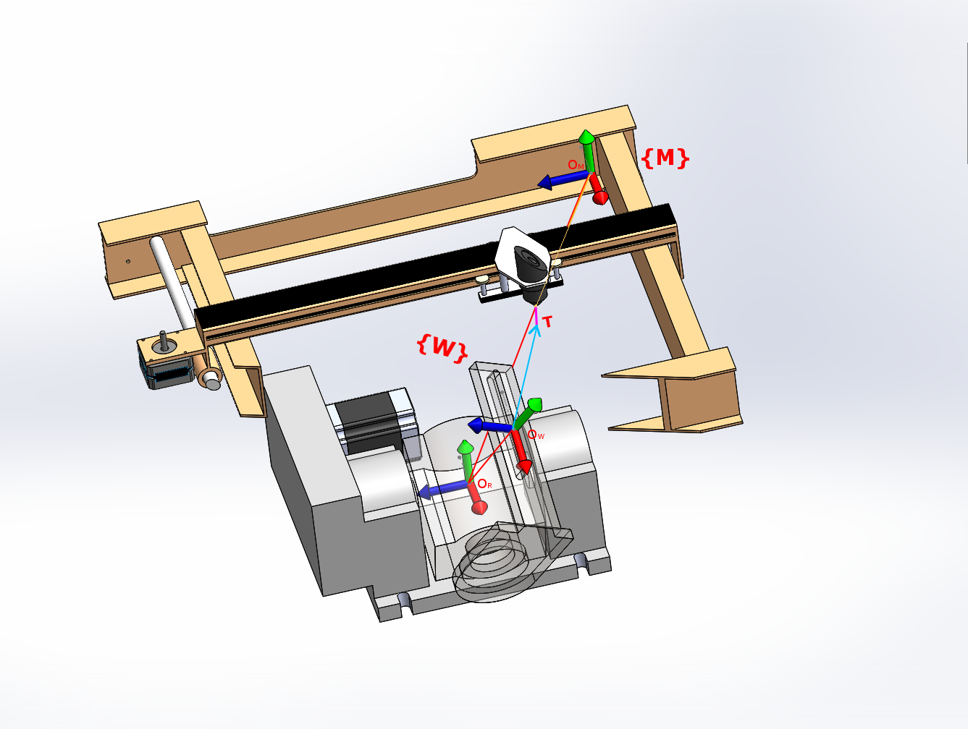
Kinematic Modeling
Notes:
Add diagram and math

Slide 14
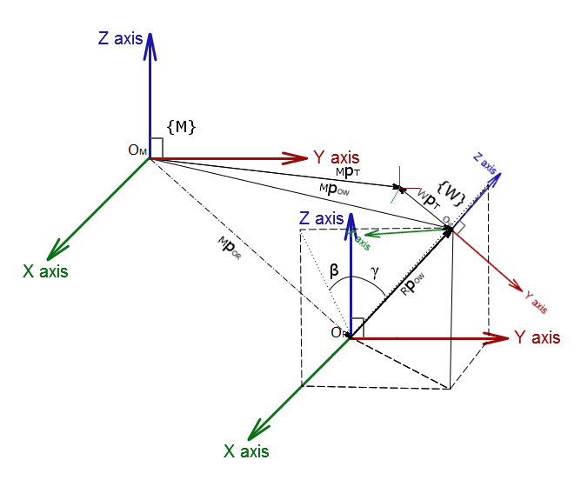
Kinematic Modeling
3 frames: M W T
Frame transformation
p + R*v
Can extract ⍺ and 𝛽 from the above matrix
World coordinate:
Notes:
Add diagram and math

Slide 15
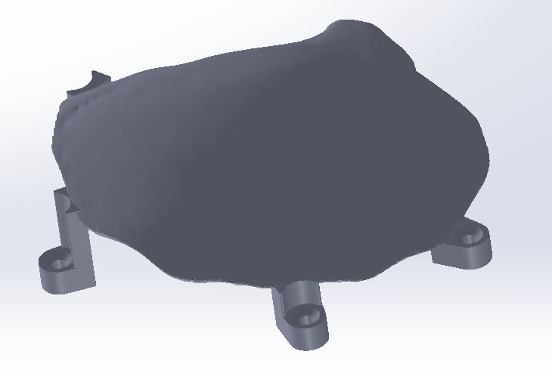
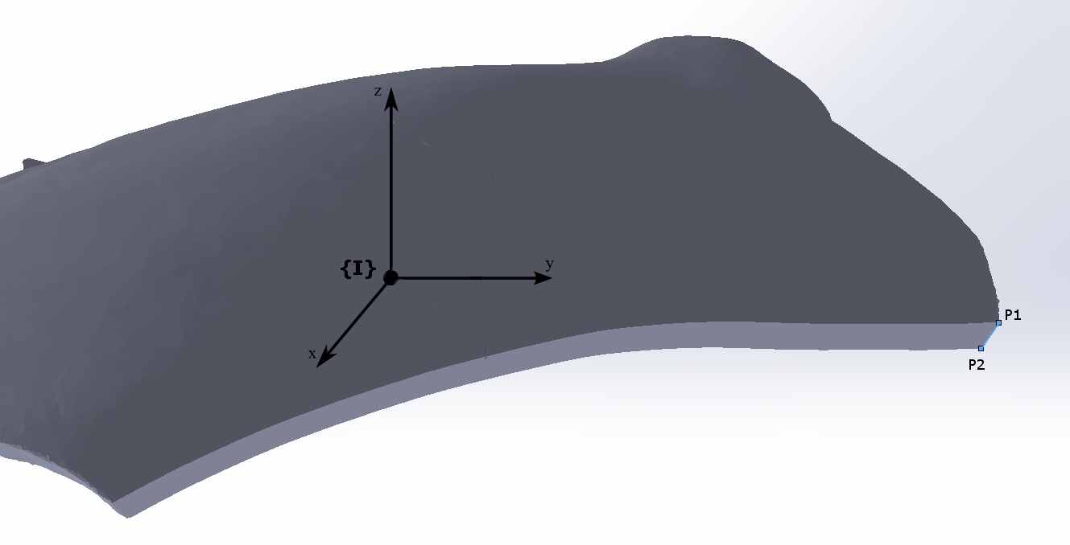
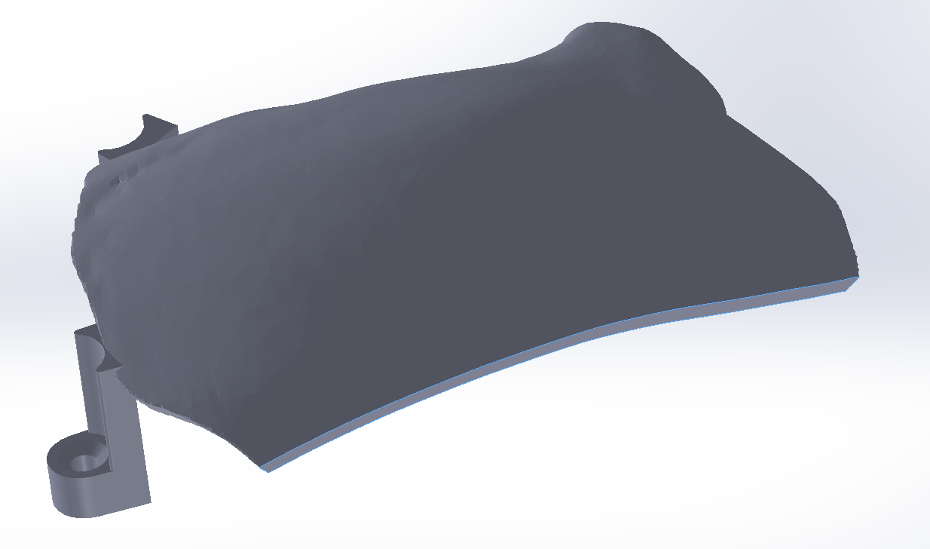
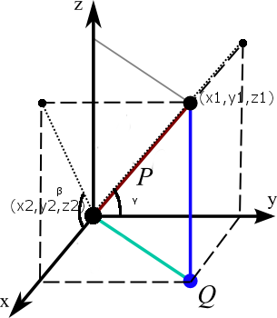
Cutting Path to G-code
{I}, (x1,y1,z1),(x2,y2,z2)

Slide 16
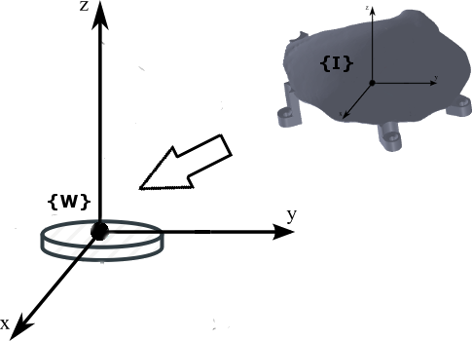
Implant Registration
2 objectives
Map {I} to {W}
Eliminate rotational offset
Possible approaches
Design a mount to secure implant on the work-piece
Drill two holes for screw placement as fixture
Register hole axes to the workspace {W}
Repeat step 2 on the implant
Register implant {I} to implant hole axes

Slide 17
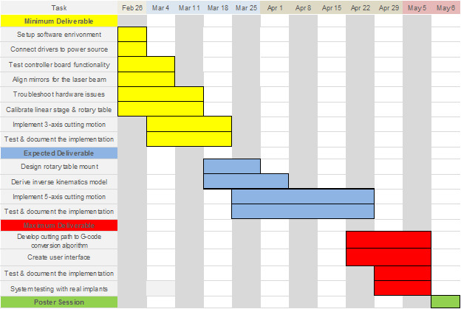
Original Project Timeline

Slide 18
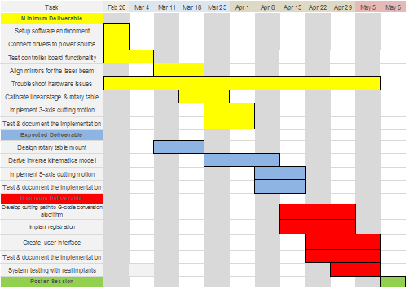
Updated Project Timeline

Slide 19
Reading List
[1] R. J. Murphy, K. C. Wolfe, P. C. Liacouras, G. T. Grant, C. R. Gordon, and M. Armand.
Computer-assisted single-stage cranioplasty. 2015 37th Annual International Conference of the IEEE Engineering in Medicine and Biology Society (EMBC), 2015.
[2] Milutinovic, D., Glavonjic, M., Slavkovic, N., Dimic, Z., Zivanovic, S., Kokotovic, B., & Tanovic, L.. Reconfigurable
robotic machining system controlled and programmed in a machine tool manner. The International Journal of
Advanced Manufacturing Technology Int J Adv Manuf Technol, 53(9-12), 2010, pp. 1217-1229.
[3] D. Winder. Computer Assisted Cranioplasty. Virtual Prototyping & Bio Manufacturing in Medical
Applications, 2008, pp. 1-19.
[4] J. U. Berli, L. Thomaier, S. Zhong, J. Huang, A. Quinones-Hinojosa, M. Lim, J. Weingart, H. Brem,
and C. R. Gordon. Immediate Single-Stage Cranioplasty Following Calvarial Resection for Benign and Malignant Skull Neoplasms Using Customized Craniofacial Implants. Journal of Craniofacial Surgery, 26(5), 2015, pp. 1456-1462.
[5] R. Zavala-Yoé, R. Ramírez-Mendoza, J. Ruiz-García. Mechanical and Computational Design for
Control of a 6-PUS Parallel Robot-based Laser Cutting Machine. Advances in Military Technology, 10(1), 2015, pp. 31-46.
[6] P. J. Besl and N. D. McKay, “Method for registration of 3-d shapes,” in Robotics-DL tentative.
International Society for Optics and Photonics, 1992, pp. 586–606.
[7] R. J. Murphy, C. R. Gordon, E. Basafa, P. Liacouras, G. T. Grant, and M. Armand,
“Computer-assisted, le fort-based, face–jaw–teeth transplantation: a pilot study on system feasibility and translational assessment,” International journal of computer assisted radiology and surgery, 2014, pp. 1–10.
[8] Giorgia Willits, Shahriar Sefati, Russell Taylor, Mehran Armand, “Robotics Drilling for Single-Stage
Cranioplasty.” JHU internal paper.

