Slide 1
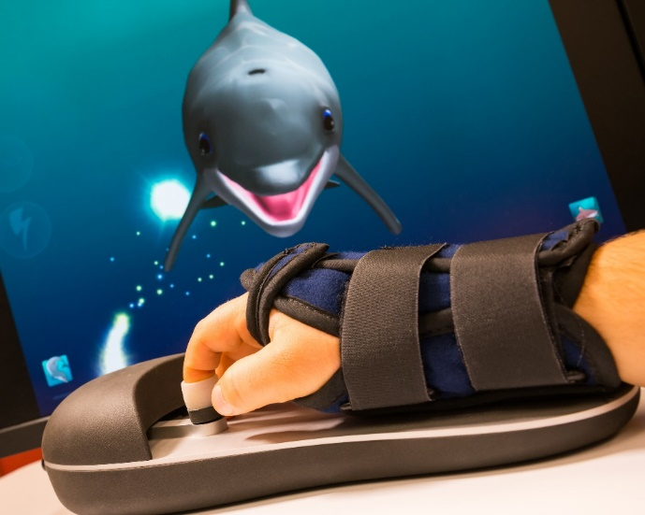
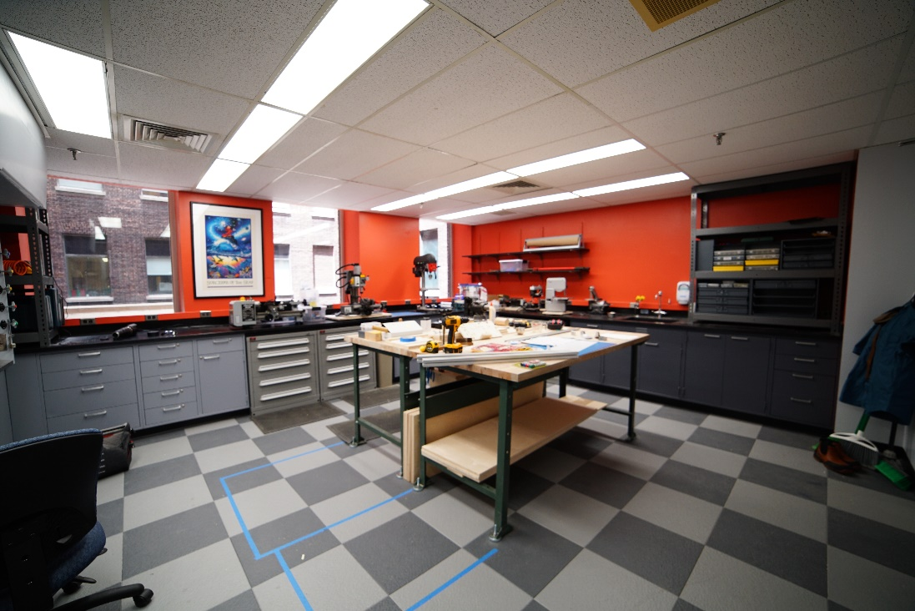
Project Overview
Hand rehab device for patients with neurological injuries (e.g. stroke)
First prototype built and tested
Need group to help build and test version 2.0
Project is funded and running
Group size 1-3 depending on skill sets
Mentor: Kevin Olds kolds1@jhu.edu

Slide 2
Tasks and Deliverables
2.0 Design for hand rehab device
CAD
3d printing/CNC machining
Basic PCB design
Embedded programming (Teensy, Arduino)
Hardware fabrication and testing
Clinical engineering clearance
Preliminary feasibility study with Johns Hopkins IRB
Great opportunity to work on a real medical device patients will use!

