Slide 1
Material Decomposition using Dual-Energy X-ray of the nView System
Team Member: Cong Gao (cgao11@jhu.edu)
Mentors: Mathias Unberath, Mehran Armand, Russ Taylor

Slide 2
Background
Conventional X-ray imaging not sufficient to characterize object precisely
e.g. density, material identity, volume thickness, 3D depth, etc.
Hard to identify ROI with multiple material stacked intensities
❗️
Dual-energy X-ray can help
Combine two radiographs acquired at two distinct energies, which permits to obtain both density and atomic number
Notes:
X-ray imaging is useful in clinical diagnosis, but it is still limited by its 2D characterization. Thus, it brings difficulty for surgeons to identify/locate ROI features, especially with stacked material intensities. While, taking dual-energy X-ray, which means acquiring two radiographs the same position at two distinct energies, will enable the recover of material density and thickness.

Slide 3
Background
Physics behind Dual-energy X-ray solution
Photons N received on detector from N0 photon emitting, attenuated by thickness T, attenuation u:
After log-measurement:
(ideal case)
Consider two materials, two energies LE and HE, then provide a linear system:
Analytical solution exists if only including 2 materials
Notes:
Here, I want to introduce physics behind dual-energy solution. N0 is the number of photons emitting from the source, and N is how many photons the detector receives, and they are related to the attenuation u and material thickness T. In ideal case, we don’t include noise, and we do log measurement, we will get a linear system for 2 materials, which means analytical solution exists if only including 2 materials.

Slide 4
Background
What if we have multiple (>2) materials?
Consider energy-dependent attenuation
multiple materials
Two energies:
ill-posed problem
💥
Notes:
So what if we have multiple materials? And we consider energy-dependent attenuation, which is a more realistic model, and we will derive this equations. And we can see that the number of unknown variables are more than the number equations, which is an ill-posed problem. Again, this is still not considering noise effect

Slide 5
Background
Challenges of Dual-energy X-ray multiple material decomposition
Mathematically impossible
Noise and disturbances
Photon number uncertainty
Attenuation uncertainty
Electronic noise
Scatter inside the detector
LE and HE scatters differ
Fig.1 illustration of Xray machine.
Copyright@ Dr’s Toy Store Siemens SireMobil C-Arm X-ray Machine

Slide 6
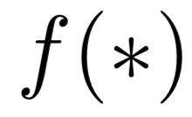
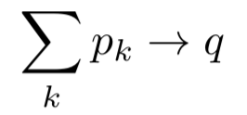
Our proposal
❗️
Explicitly include the physical constraint in the estimation part,
introduce Deep Learning to build end-to-end prediction framework
Dual-energy
Acquisitions
Deep Network
Decomposition
Result
Physical Constraint

Slide 7
Technique Approach
Simulation Study
DeepDRR Framework
Generate X-ray simulates
Segmentation result as groundtruth
Fig. DeepDRR Framework
Notes:
DeepDRR, a network framework that could segment materials in 3D from CT scans, and combining scatter and noise, which lead to high-quality simulations to the real X-ray images.

Slide 8
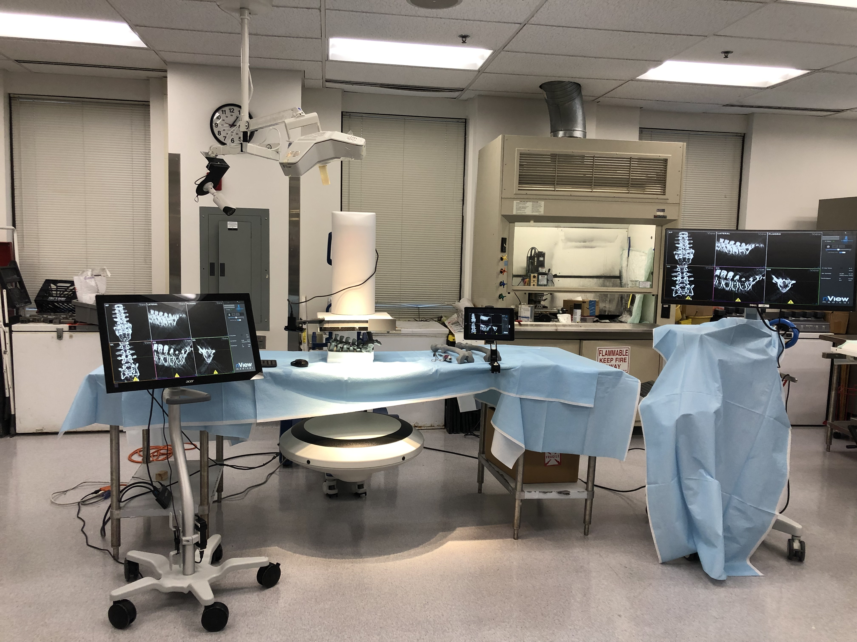
Technique Approach
Real X-ray Validation
The nView System
Fast and low-dose 3D reconstruction system
3D data can be used for groundtruth
Start with dual-energy, because nView is low-power Xray
Fig. Image captured from the nView System

Slide 9
Deliverables
simulation
Xray simulation software using DeepDRR framework from femur CT data
Minimum
algorithm
Deep Network software
Validation
Processed data & Validation result from real bone injection experiment
Documentation
Final Report of algorithm description, simulation & validation results
simulation
Xray simulation software with cement/metal simulation
Expected
algorithm
Deep Network software with workable architecture
Validation
Processed data & Validation result of cement injection dataset
Documentation
Final Report of algorithm description, simulation & validation results
simulation
Xray simulation software with cement/metal simulation, improvement of noise, scattering modeling, well fit nView system effect
Maximum
algorithm
Deep Network software with well-performed architecture and generalization ability
Validation
Real time cement monitoring using the nView system
Documentation
Final Report of algorithm description, simulation & validation results

Slide 10
Dependencies
 | Dependency | Solution | Alternative | Status
1 | Deep DRR software | Contact Dr. Unberath | X | Solved
2 | Real Femur CT Data before & after injection | Contact Amir. Farvardin | Contact BIGSS/CAMP lab | Solved
3 | Access to the nView system | Contact Dr. Armand | X | Solved
4 | nView system useage training | Contact Singchun Lee, watch the nView training video | Contact the nView team | Solved
5 | Femur injection experiment | Schedule with Dr. Armand | X | Solved
6 | Computation Resource | Desktop from BIGSS lab | MARCC | Solved
7 | Feedback from instructors | Attend group/personal meeting | X | Solved

Slide 11
Schedule
 | Feb |  |  |  | Mar |  |  |  | Apr |  |  |  | May
 | 1w | 2w | 3w | 4w | 5w | 6w | 7w | 8w | 9w | 10w | 11w | 12w | 13w | 14w | 15w | 16w
Brainstorm & Proposal
DeepDRR Femur Simulation
DeepDRR Cement Simulation
Design network architecture
Design Loss function
Simulation experiment
Get access to nView
nView system Training
Bone injection experiment
Real image labeling
Validation on Real image
Summary and Final report
Presentation

Slide 12
Milestones
Project Proposal & kick-off
nView system bone injection experiment
Finish simulation software and simulation dataset
Finish network design for 2 materials, get simulation result
Finish network design for multiple materials, get simulation result
Test on real dataset, get validation result
✅
✅
End Feburary
❗️
Mid March
❗️
End March
❗️
Mid April
❗️
End April

Slide 13
Management Plan
Meeting with mentors:
Weekly meet with Dr. Armand and Dr. Unberath, Tuesday morning
Attend weekly meeting with Dr. Taylor, Friday afternoon
Data management:
Simulation data: save locally on BIGSS desktop
Real Xray data: share across BIGSS shared drive
Software:
Save locally under development
Publish on github after work is published

Slide 14
Reading List & Reference
DEXA, Dual-Energy X-ray:
Mazess, R. B., Barden, H. S., Bisek, J. P., & Hanson, J. (1990). Dual-energy x-ray absorptiometry for total-body and regional bone-mineral and soft-tissue composition. The American journal of clinical nutrition, 51(6), 1106-1112.
Rebuffel, V., & Dinten, J. M. (2007). Dual-energy X-ray imaging: benefits and limits. Insight-non-destructive testing and condition monitoring, 49(10), 589-594.
Albarqouni, S., Fotouhi, J., & Navab, N. (2017, September). X-ray in-depth decomposition: Revealing the latent structures. In International Conference on Medical Image Computing and Computer-Assisted Intervention (pp. 444-452). Springer, Cham.
Lu, Y., Kowarschik, M., Huang, X., Xia, Y., Choi, J. H., Chen, S., ... & Maier, A. (2018). A learning‐based material decomposition pipeline for multi‐energy x‐ray imaging. Medical physics.
Ding, Q., Niu, T., Zhang, X., & Long, Y. (2017). Image-domain multi-material decomposition for dual-energy CT based on correlation and sparsity of material images. arXiv preprint arXiv:1710.07028.
Atria, C., Last, L., Packard, N., & Noo, F. (2018, March). Cone beam tomosynthesis fluoroscopy: a new approach to 3D image guidance. In Medical Imaging 2018: Image-Guided Procedures, Robotic Interventions, and Modeling (Vol. 10576, p. 105762V). International Society for Optics and Photonics.
Unberath, M., Zaech, J. N., Lee, S. C., Bier, B., Fotouhi, J., Armand, M., & Navab, N. (2018, September). Deepdrr–a catalyst for machine learning in fluoroscopy-guided procedures. In International Conference on Medical Image Computing and Computer-Assisted Intervention (pp. 98-106). Springer, Cham.
Deep DRR, nView System:

