Slide 1
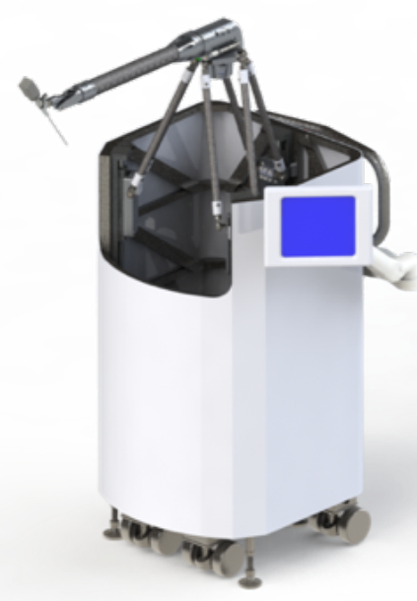
Improving Real-Time Control of the Galen Microsurgical Robot
Goal
Predictive control of Galen microsurgical robot for control-loop delay compensation
What Students Will Do
Implementing a Kalman filter to predict
next state of the robot based on the current
state measurements
Using the predicted state to update the
control signal
Comparing robot performance for the predictive
control approach and the current controller of
the robot

Slide 2
Deliverables
Minimum: Control-loop delay compensation for the Galen robot
Expected: Performance evaluation of the predictive approach
Maximum: Integration with virtual fixtures
Size group: 1-2
Skills:
C++ and ROS;
knowledge of control systems and experience with Kalman filters are plus
Mentors: Dr. Mahya Shahbazi, Dr. Russell Taylor
Contact: mahya.sh@jhu.edu, rht@jhu.edu

