Slide 1
Integration of LARS and Snake Robots (LARSnake) & System Development
600.446 – Computer Integrated Surgery II
H. Tutkun Şen
Mentor:
Paul Thienphrapa
Checkpoint Presentation
April 26, 2011

Slide 2
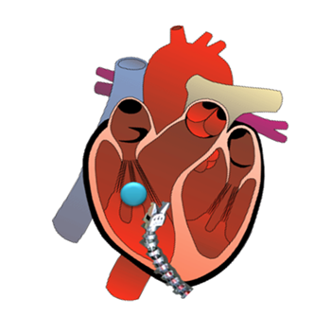
Motivation & Significance A Minimally Invasive Surgical Approach
Minimally Invasive Surgery
Helps avoid open surgery/CPB
But more challenging to perform
Integrate 3D transesophageal echocardiography (TEE) to aid:
Localization of foreign body
Tracking
Robot guidance
Focus on heart for establishing system performance requirements

Slide 3
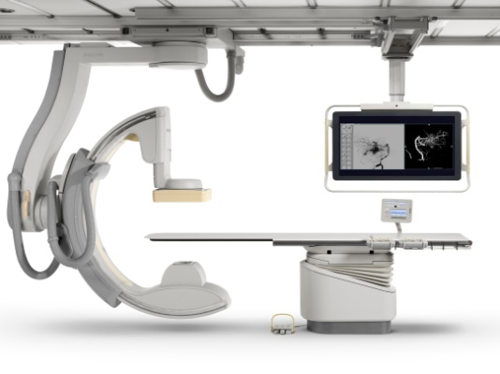
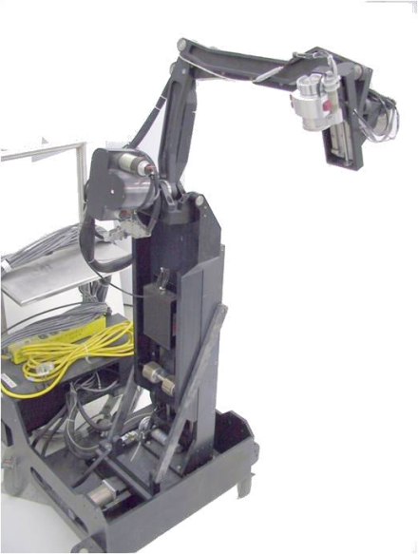
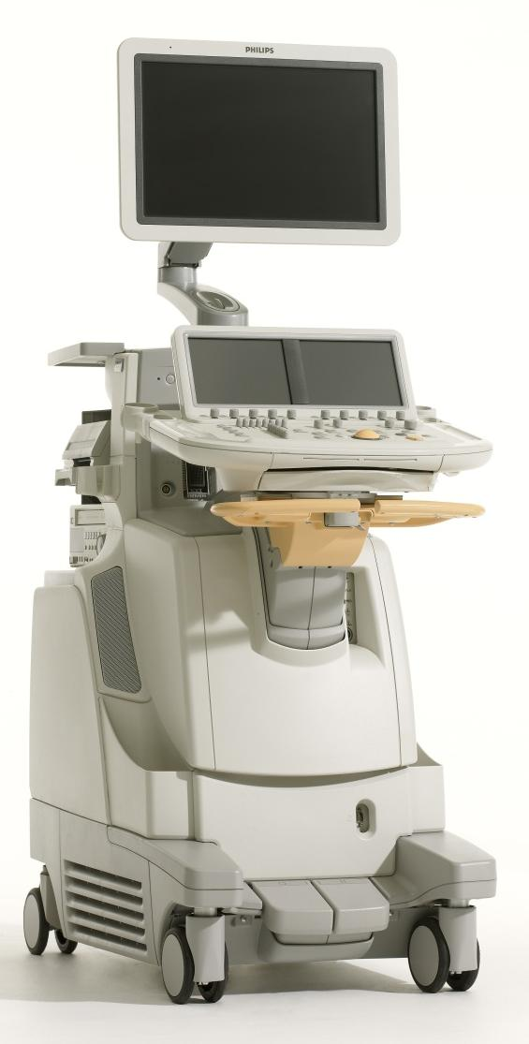
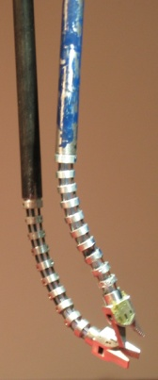
Experimental Setup
Main Focus
Workstation
Computer(s)
TCP/IP
TCP/IP
?
Trigger(s)?
Ultrasound
System
C-arm
Linux RTAI
TCP/IP
FireWire
LARS + Snake Robot
Probe
Snake
Water Tank

Slide 4
Approach Followed
LARS has 7 DOF
Snake has 4 DOF
Jacobian 6x7
Jacobian 6x4
LARSnake has 11 DOF
Kinematically Redundant System
For moving it optimization algorithm is needed
Jacobian 6x11

Slide 5
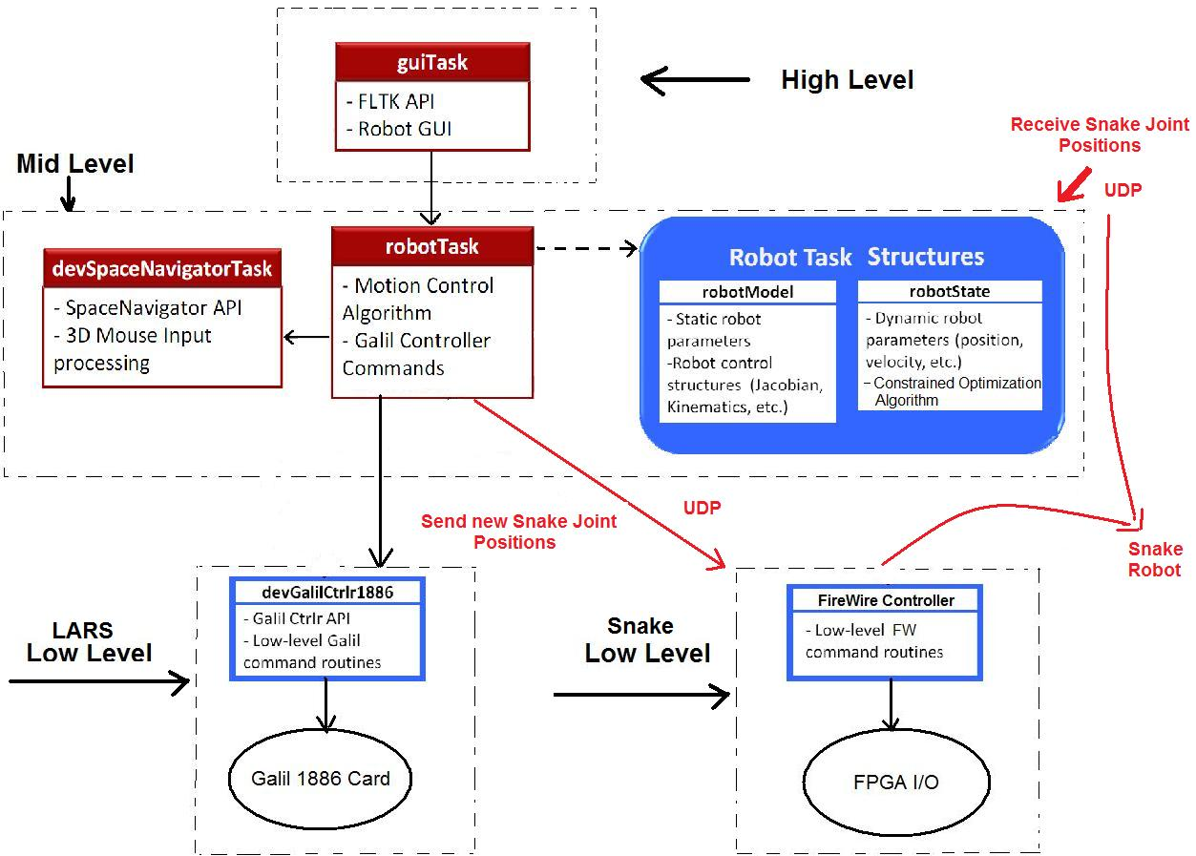
Class Hierarchy

Slide 6
Project Timeline
We are Here
1
2
Task | 14-Feb | 21-Feb | 28-Feb | 7-Mar | 14-Mar | 21-Mar | 28-Mar | 4-Apr | 11-Apr | 18-Apr | 25-Apr | 2-May
Project Proposal Presentation | DONE |  |  |  |  |  | SPRING BREAK
Come Speed with CISST Library |  | DONE | DONE
Come Speed Snake and LARS Robot Control |  | DONE | DONE
Devise Schemes of Integration |  |  |  | DONE
Kinematics Analysis of the Overall System |  |  |  |  | DONE | DONE
Software Integration |  |  |  |  |  | DONE |  | DONE DONE
System Debugging |  |  |  |  |  |  |  |  |  | DONE
Medica School Experiments
Documentation
Final Presentation

Slide 7
Milestones and Progress
Milestone name : Working demo with current approach
Planned Date: 04/22/2011
Expected Date: 04/22/2011
Milestone name : Working demo with partially updated snake code
Planned Date: 05/06/2011
Expected Date: 05/06/2011

Slide 8
Goals & Deliverables
Minimum
Working robot with separate snake computer as a "black box", so one can set the joints over the network but doesn't need to know what version of CISST it is using.
Expected
Working robot with “some” updated snake code.
Maximum
Working robot with full updated snake code.

Slide 9
Current Status
Come Speed with CISST Library
Come Speed Snake and LARS Robot Control
Devise Schemes of Integration
LARS Code is updated (Although this was not in the plan)
Kinematic and Software Integration of the Overall System
Communication between the computers is established
Joint values of the snake robot is obtained via UDP
Kinematic equations of both systems examined
Combining the Jacobians
Sending the calculated joint values to Snake Robot
System Debugging
Snake Code Update

Slide 10
THANK YOU FOR LISTENING
QUESTIONS??

