Slide 1
Automatic Identification of Critical Areas of the Head and Neck for Refined Dose-Toxicity Analysis in Radiotherapy
Chris Micek, Julie Shade, Arun Raghavan
Group 10
Mentors: Dr. Todd McNutt, Sierra Cheng

Slide 2
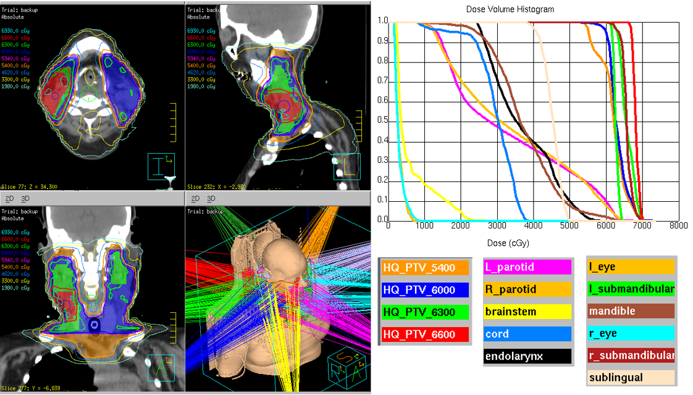
Goal and Clinical Significance
Goal: Design, implement, and evaluate an algorithm that creates spatially dependent dose features at the inter-organ level
Significance: Identify specific areas of the head and neck that are more or less critical and sensitive to radiation damage to improve radiotherapy planning and reduce negative outcomes
Fig. 1: View of sample radiotherapy treatment plan and the associated dose volume histograms for affected anatomical structures

Slide 3
Previous Deliverables
Min: Well-documented API for automatically detecting verified relevant features in contoured anatomy, written in Python / C++.
Expected: Automated script to add new points of fixation and evaluate either improvement or worsening of predictive power of the coordinate system, in addition to minimum deliverable.
Max: GUI to view ROI estimates along with dose volume histogram of identified regions in addition to the expected and minimum deliverables.
Problem: better way to accomplish desired goal suggested -> new deliverables with same end goal

Slide 4
Updated Deliverables
Min: Well-documented API for creation of a statistical atlas of contoured anatomy and script to register a new patient to this atlas using coherent point drift. Script to predict the location of a defined cube-shaped region from the atlas in this patient, written in Python.
Expected: Well-documented expansion on methods from minimum deliverable to define the same arbitrary volume in multiple patients, corresponding to the same anatomical soft-tissue region. Statistical validation of this method showing minimal error between arbitrarily selected regions.
Creation of multiple statistical atlases using different anatomical regions to determine which gives most accurate prediction of the location of the arbitrary volume in patients not included in the atlas.
Max: GUI to select anatomical region in statistical atlas and view ROI estimates along with dose volume histogram of carved regions in addition to the expected and minimum deliverables.

Slide 5
Technical Approach
Create a statistical atlas
Register a subset of patients to a reference, calculate a statistical mean of subsequent iterations over subsets of patient data.
Define a region of space in the atlas and transform to the patient.
Append data to the atlas before registration, or create a mapping function from the vector field returned by registration
Extract radiation dose in defined volume in patient from database.
Validate and improve #1-3

Slide 6
Deformable Registration: Coherent Point Drift
Fig. 2: Visual representation of coherent point drift registration method as described by Myronenko et al. on artificially created point clouds. [1]
Fig. 3: Before/after registration performed on head and neck structures using CPD registration method. (red points registered to frame of yellow points)
Notes:
Note: mention that we didn’t know if this was done but it already was and we looked at the paper and it seemed good so we moved on

Slide 7
Statistical Atlas Creation
Method:
Deformably register each patient data set to a chosen patient coordinate system
- Align the centroids of each data set.
- Use coherent point drift to register.
Take a statistical average of the data sets after point drift.
Set the resultant atlas as the reference patient coordinate system and repeat.

Slide 8
Statistical Atlas Creation
Status update: Working method and statistical atlas of brain, left eye, right eye, left parotid, and right parotid from 5 patients:
Fig. 4: Side, back, and angled view of statistical atlas created from 5 structures from 5 different patients.
Goal: Statistical atlas of almost-complete head and neck anatomy from 30+ patients
Challenge: Running time/complexity of atlas creation method

Slide 9
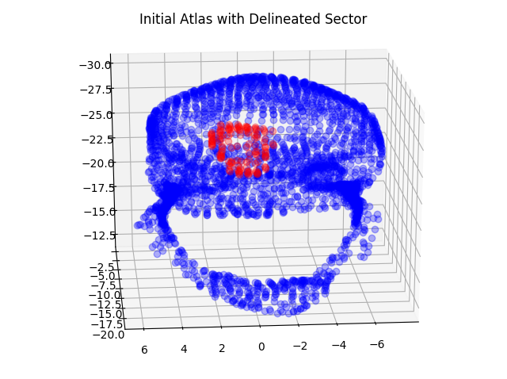
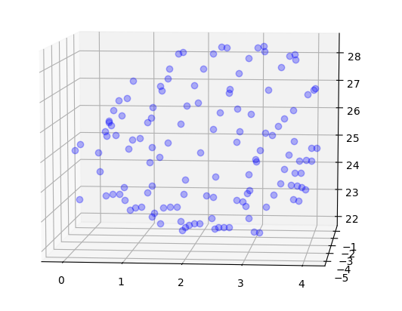
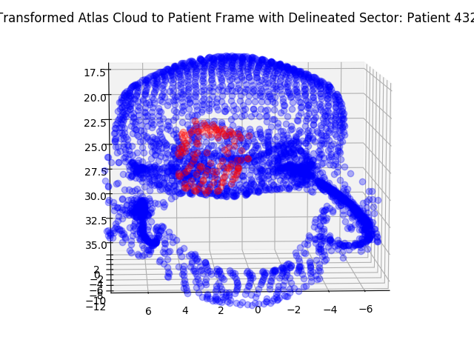
Region Identification Procedure
Create statistical atlas representing mean patient anatomy
Define surface points representing 3D region to be transformed
Query database and find point cloud of all anatomy included in both atlas and patient for desired patient
Deformably register atlas to the patient using coherent point drift.
Points outlining desired region in patient frame
Transform 3D region to patient coordinate frame using thin plate splines
Fit a thin plate spline to create a mapping for arbitrary (x , y)
[not implemented] calculate dose in delineated region

Slide 10
Simple Region Identification
A B C D
Fig. 5: Registration of a statistical atlas plus a 2x2x2 cm region to three randomly selected test patients (who were not included in statistical atlas) with four test case: (A) cube outside of anatomy, (B) cube surrounding left eye, (C) cube completely inside anatomical structure (brain), (D) Cube crossing boundary of anatomical structure
Statistical
Atlas
PatID = 904
PatID = 1159
PatID = 1369

Slide 11
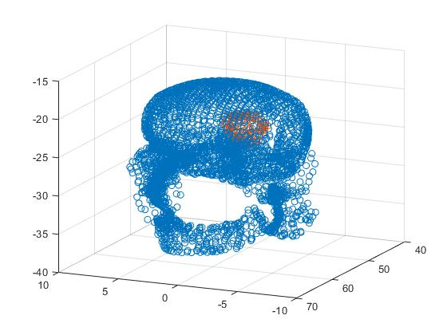
Cons of this approach:
Accurate, but costly:
- Runtime: 200-240 seconds for registration and sector delineation.
-Downsampling randomly adversely affects accuracy.
- Uniform downsampling can reduce accuracy significantly depending on patient anatomy.
- Next steps are to find a happy medium between accuracy and runtime.

Slide 12
Validation
Procedure:
Select 10 patients with chosen region subset (i.e. left eye, right eye, mandible)
Generate 10 atlases, leaving out a different patient for each
Register each atlas to the left-out patient, assess success/baseline variation among patients using dice coefficient
Repeat atlas registration to patient, this time leaving out an organ in the patient and defining the “sector” in the atlas as the point cloud of the left-out organ
Compute the dice coefficient between the predicted and actual position of the left-out organ to assess how well the atlas can predict the position of non-contoured anatomy
Status update: Started, not complete.

Slide 13
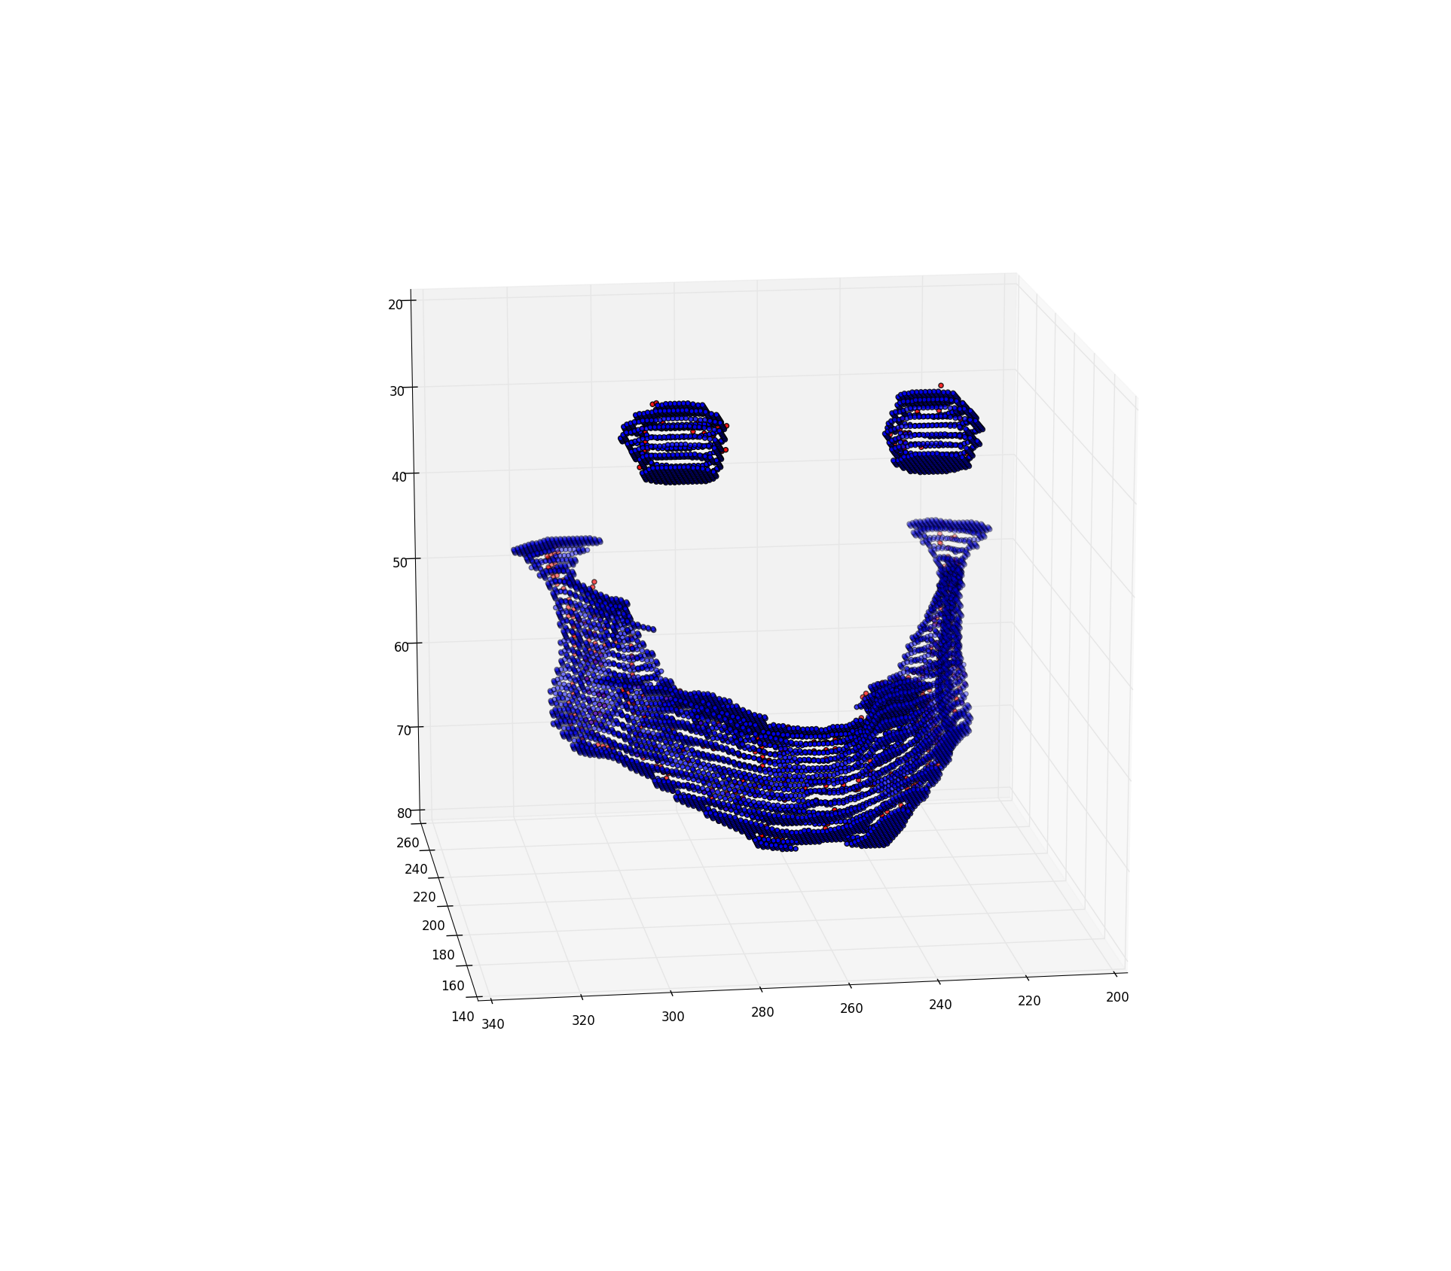
Validation (cont.)
$$Sample_{atlas}=0.25$$
$$Sample_{patient}=1$$
$$Sample_{atlas}=Sample_{patient}=0.25$$
$$DSC≈0.474$$
$$DSC≈0.0564$$

Slide 14
Validation (cont)

Slide 15
Validation Helper: Sort Atlas by Organ
Problem: Atlas is sorted along z-axis after down-sampling and combining of masks, so cannot extract points by organ (and cannot un-sort due to complexities in previously written code)
Solution: Add code to atlas creation method that maps each point in the initial point cloud to an organ and sorts the atlas points by which organ they belong to at the end
Before: can only sort along z-axis
After: can separate point cloud by organ

Slide 16
Problems and Solutions
Problem | Possible Solution
Region selection currently requires manually inputting points- not practical for large/complex volumes where surface requires many points to define | GUI to select region
Thin Plate Spline is costly in runtime, but effective. | Find a balance between error we can live with and runtime by downsampling the atlas.
Cannot always define volumes accurately from point cloud (point cloud != surface) | tessellate surfaces and include triangles with normal vectors in atlas so transformed region can be converted to a surface mask

Slide 17
Updated Dependencies
Dependency | Status
Access to the Oncospace database and analytics framework repository of Python code | Resolved (2/19)
Install CRKit (Computational Radiology Kit) | Resolved (2/20)
Find optimal deformable surface registration algorithm (need to discuss with Dr. McNutt’s students) | Resolved (3/3)
Talk with Pranav to understand existing code | Resolved by creating Slack channel to ask questions (3/8)

Slide 18
Previous Timeline
Week beginning: | 1/30 | 2/6 | 2/13 | 2/20 | 2/27 | 3/6 | 3/13 | 3/20 | 3/27 | 4/3 | 4/10 | 4/17 | 4/24 | 5/1 | 5/8 | 5/15
Minimum Deliverable
Literature search
Familiarize selves with existing codebase
Create detailed plan for additions to code
Implement statistical atlas creation method
Implement registration method
Validation method for error in regions of interest
Expected Deliverable
Allow user to add new points of reference in atlas to improve registration
Add validation method to find if performance improves with new points of reference
Maximum Deliverable
Create a GUI that integrates dose-volume histograms with regions of interest
Project Plan/Presentation
Checkpoint Presentation
Final Poster and Report

Slide 19
Updated Timeline
Today
Week beginning: | 1/30 | 2/6 | 2/13 | 2/20 | 2/27 | 3/6 | 3/13 | 3/20 | 3/27 | 4/3 | 4/10 | 4/17 | 4/24 | 5/1 | 5/8 | 5/15
Minimum Deliverable
Literature search
Familiarize selves with existing codebase
Create detailed plan for additions to code
Find registration method
Implement statistical atlas creation method
Creation of small statistical atlas for testing
Initial method for region prediction
Validation method for region selection
Expected Deliverable
Improved method for complex region prediction
Method to convert point cloud region to surface mask after registration
GUI to allow user to select region of interest
Creation of multiple larger atlases
Improved validation method based on masks
Optimization of atlas parameters
Maximum Deliverable
GUI that integrates dose-volume histograms with regions of interest
Project Plan/Presentation
Checkpoint Presentation
Final Poster and Report

Slide 20
References
Myronenko, A., & Song, X. (2010). Point Set Registration: Coherent Point Drift. IEEE Transactions on Pattern Analysis and Machine Intelligence, 32(12), 2262-2275. doi:10.1109/tpami.2010.46

