Slide 1
Group 8: UI for Radiation Therapy Cohort Selection Domonique Carbajal, Keefer Chern Mentors: Dr. Todd McNutt and Pranav Lakshminarayanan
Goals:
Create a User Interface allowing for the selection of patient cohorts from large database
Significance:
While significant data exists it cannot currently be utilized easily and only a Free Text SQL Query exists to select patient cohorts
Researchers and clinicians can improve studies and patient care by forming patient cohorts

Slide 2
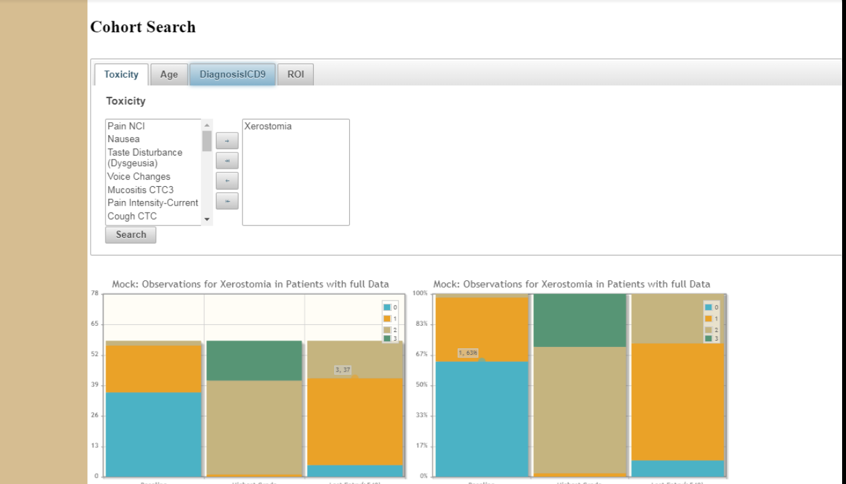
UI for Radiation Therapy Cohort Selection(cont.)
Results
Filtering by Static Variables (Age, Diagnosis, ROI)
Visualizations of Longitudinal Variables (Toxicity with grade by time)
Saving and Loading of Query results (able to account for new patient additions)
Cohort Information (Patient IDs, Patient Representations) downloadable to multiple formats
Double Search for comparison of patient populations visually

