Slide 1
User interface to extract radio-morphologic features for refined dose-toxicity analysis in radiotherapy
To develop a user interface to a library of methods that create spatially dependent dose features to identify specific areas of anatomy that are more or less critical and sensitive to radiation damage.
What Students Will Do:
Design a user interface to enable a user to:
Specify an anatomy normalization method and relevant parameters
Select anatomy to be used
Specify planes, shells and other attributes related to carving the anatomy into zones
Specify dose features to be calculated
Process model across a SQL database of over 1000 patients
Provide programmatic interface for adding new anatomy normalization methods, new geometric zoning methods and feature calculations
Deliverables:
Functioning user interface
User documentation
Software design documentation with programmatic interface
Size group: 1-3
Skills:
UI design, 3D shapes, Volumetric Image Segmentation
Programming experience (SQL, python)
Mentors: Todd McNutt (tmcnutt1@jhmi.edu) Pranav Lakshminarayanan (plakshm1@jhu.edu)

Slide 2
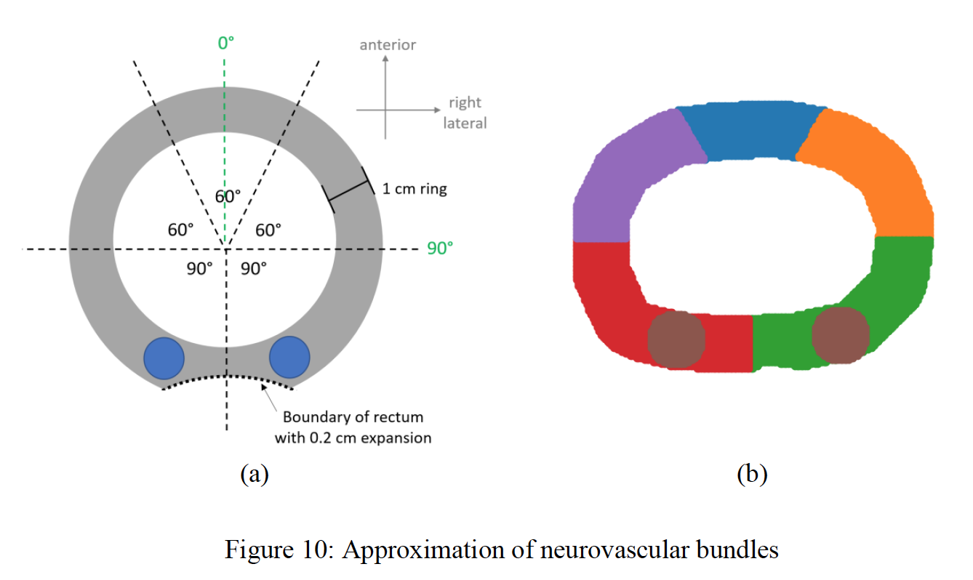
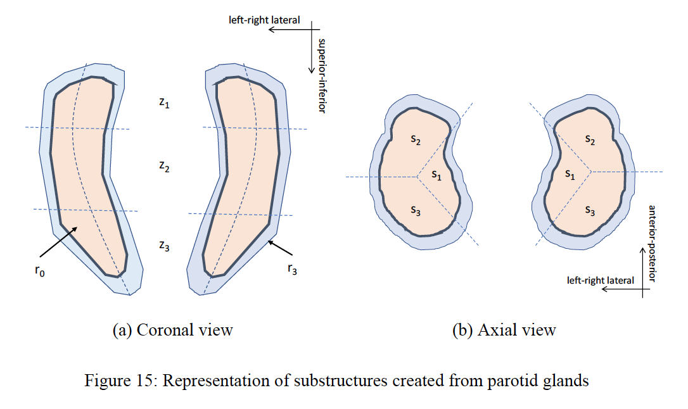
User interface for radio-morphology

