Slide 1
Review of a Couple Chicken Egg-Based Surgical Training Models
Seena Vafaee
CIS II Paper Presentation
March 9, 2021

Slide 2
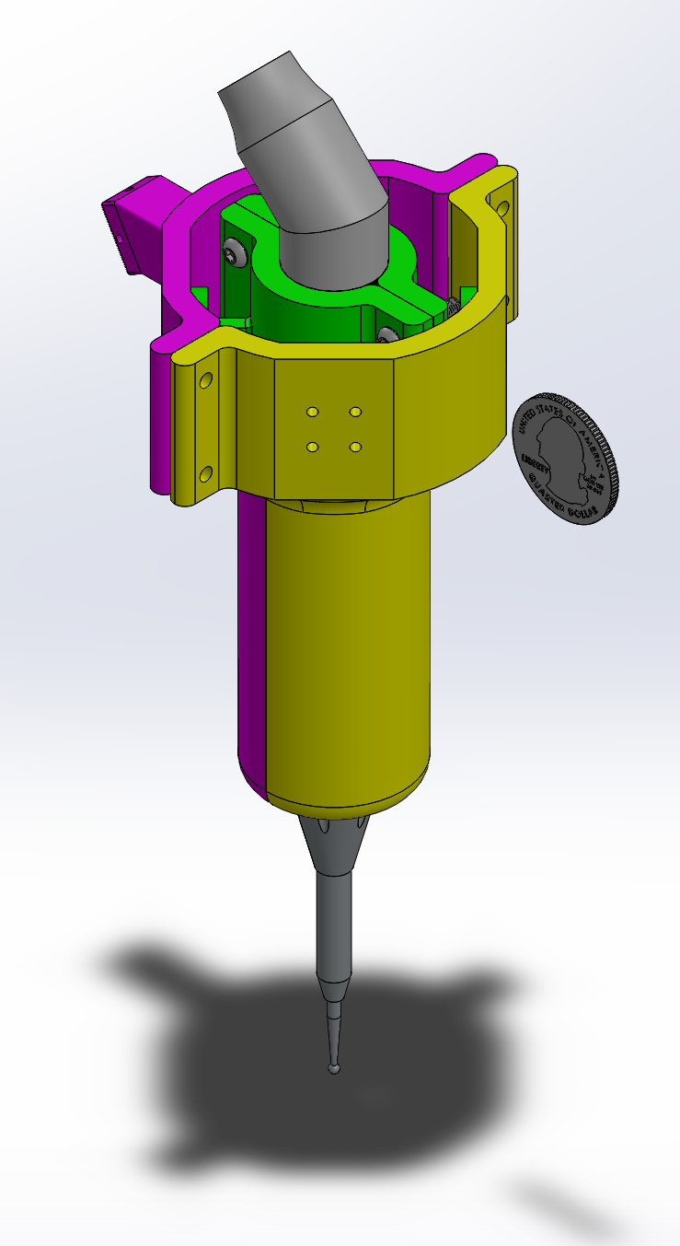
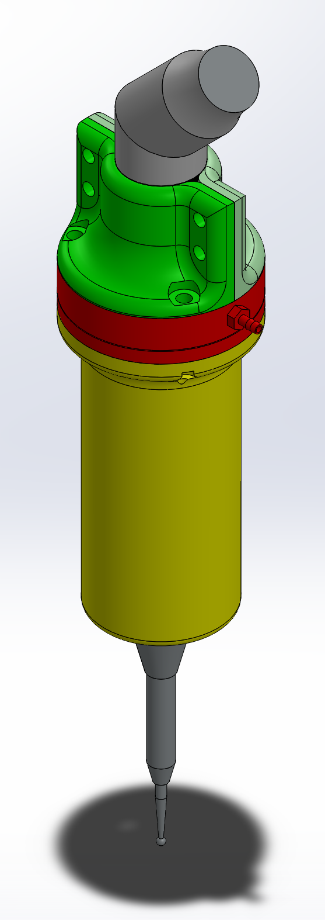
Force-Sensing Attachment for a Surgical Drill
Working with head/neck surgeons to develop a force-sensing attachment for a surgical drill used in surgeries around the inner/middle ear and skull base
Incredible skill and precision are required to prevent damaging sensitive anatomy
Force sensing enables future work to incorporate force feedback and virtual fixturing
Surprising lack of literature discussing drilling forces applied in these procedures

Slide 3
The chicken egg and skull model of eETSS improves trainee drilling skills (Okuda et al. 2014 [2])
Background & Motivation
Endoscopic Endonasal Transsphenoidal Surgery (eETSS) is highly specialized and very difficult
Most training (cadaver dissection, hands-on seminars) focuses on anatomy
Drilling eggshells without piercing the underlying membrane requires similar precision
There is a need for a low-cost training model

Slide 4
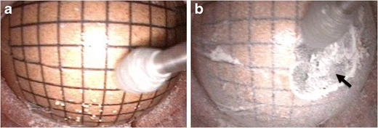
The chicken egg and skull model of eETSS improves trainee drilling skills (Okuda et al. 2014 [2])
Methods
5 residents with no experience in neuroendoscopic surgery
each drilled 10 eggs
4 experts (each drilled 1 egg)
Investigators measured the area of the shell that could be drilled without rupturing the membrane
used inkjet printable temporary tattoo paper with 2mm square grid

Slide 5
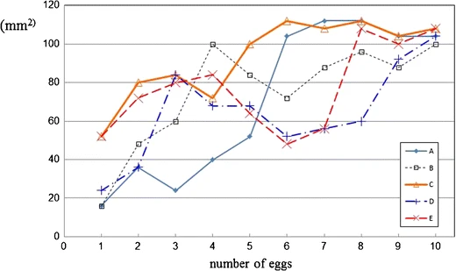
The chicken egg and skull model of eETSS improves trainee drilling skills (Okuda et al. 2014 [2])
Results
Residents 1st egg: 31.2±17.5 mm²
Residents 10th egg: 104.8±3.3 mm²
Experts: 257±31.73 mm²
Differences in individual ability were resolved through training
Experts clearly do much better
Ability to expertly manipulate endoscope plays a large role
Supports hypothesis that this method is effective for training techniques necessary in eETSS

Slide 6
The chicken egg and skull model of eETSS improves trainee drilling skills (Okuda et al. 2014 [2])
My Thoughts & Relevance
Training model looks very impressive
Tattoo paper grid was clever, but I am skeptical of measurement precision
This was an interesting way to measure surgical skill
However, careful control of forces and penetrating distance may be more pertinent

Slide 7
The Effect of Virtual Haptic Training on Real Surgical Drilling Proficiency (Sewell et al. 2007 [2])
Background & Motivation
Haptic technology can be used “to train motor skills to better perform tasks in which force-feedback is an essential component.”
“Little is yet known about the transference of specific motor skills learned in a haptic simulator to surgically-relevant tasks”
In procedures such as a stapedotomy, surgeons must remove a thin layer of bone without pushing through into underlying structures
Anecdotally, surgeons liken this bone to chicken egg shell

Slide 8
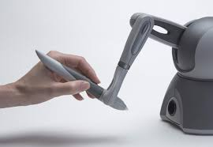
The Effect of Virtual Haptic Training on Real Surgical Drilling Proficiency (Sewell et al. 2007 [2])
Methods
Designed a simulator to train users to minimize penetration distance of a drill when it breaks through thin resistive layer
Users control a virtual drill with a Phantom haptic device
Apply a downward force onto a plane, which disappears after a force greater than 0.3 N is applied for a random time between 8 and 12 seconds

Slide 9
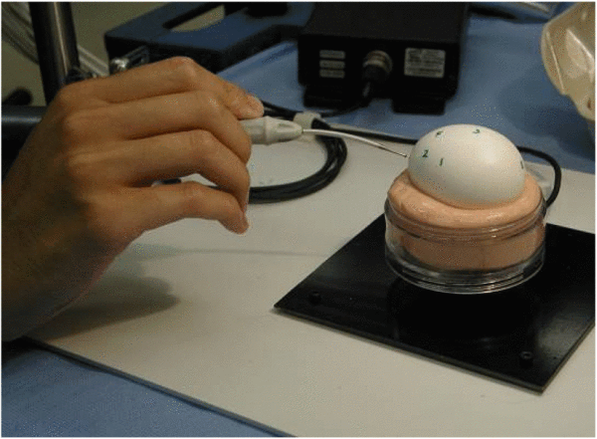
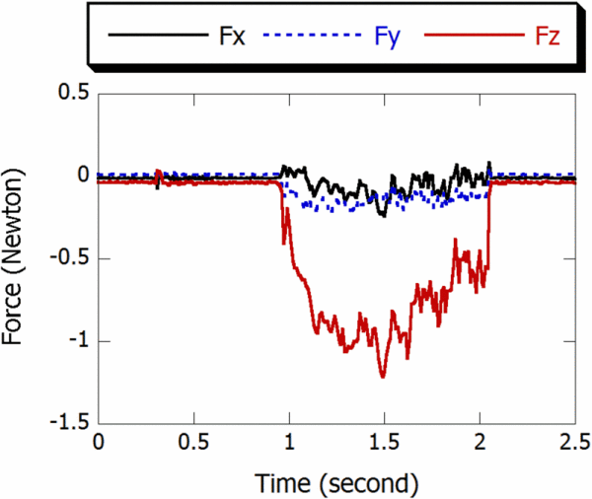
The Effect of Virtual Haptic Training on Real Surgical Drilling Proficiency (Sewell et al. 2007 [2])
Methods (cont’d.)
Drilling force measured with an ATI nano-17 F/T sensor
Sensor mounted under a dish filled with silly putty to hold the egg stationary

Slide 10
The Effect of Virtual Haptic Training on Real Surgical Drilling Proficiency (Sewell et al. 2007 [2])
Experimental Design
10 participants assigned to two even groups
All shown video of expert drilling holes in egg
Group A: drill 8 holes in each of 4 eggs
15 seconds per hole, at least as wide as drill burr
Group B: 24 trials on the simulator and then 8 holes in only 1 egg

Slide 11
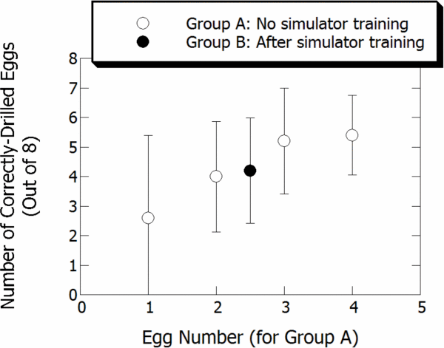
The Effect of Virtual Haptic Training on Real Surgical Drilling Proficiency (Sewell et al. 2007 [2])
Results
Group A demonstrated a learning effect
Group B was not as proficient after 24 trials with sim., but they started out farther along on the learning curve
Simulator trials are not as effective as the same number of real-world trials
But, when considering cost and availability, it is easier to complete many simulator trials
Relatively high variance and limited number of participants, so results are statistically inconclusive

Slide 12
The Effect of Virtual Haptic Training on Real Surgical Drilling Proficiency (Sewell et al. 2007 [2])
My Thoughts
Results do not directly address their goal of understanding “transference of specific motor skills”
Comparison of drilling through eggshell and and the thin bone of the stapes footplate is based entirely on anecdotal notes
Skeptical about silly putty
Thought results were really interesting, despite inconclusive statistics
As noted in the paper, future work is needed to improve simulator and recruit more participants
Investigators would also like to redesign the experiment to separate the skills of preserving the membrane from making a sufficiently large hole
Drilling force data is directly relevant to my team’s investigation (although more is needed!)

Slide 13
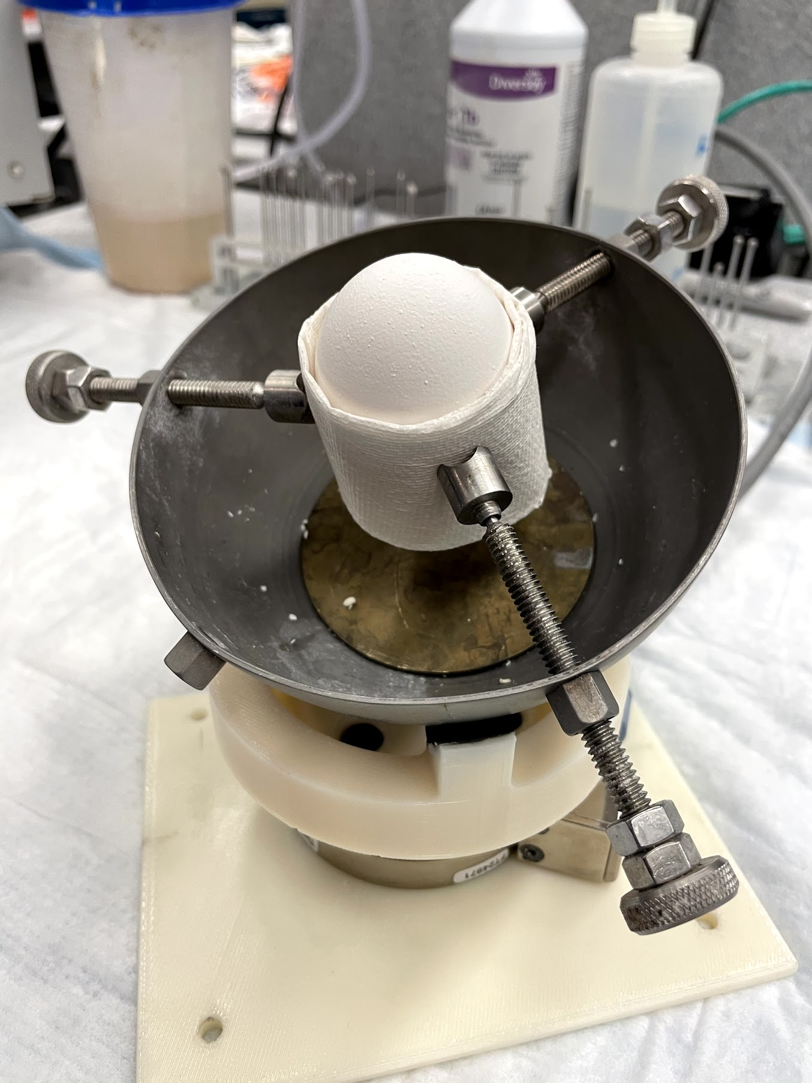
Conclusions
The measurements each study use to determine surgical skill complement each other nicely
Both papers assume drilling through chicken eggs is similar enough to sensitive surgical tasks
An obvious lack of data in the literature demonstrating actual drilling forces applied in these procedures to further validate the use of chicken eggs
We hope to fill this gap!

Slide 14
References
[1] Okuda, T., Yamashita, J., Fujita, M. et al. The chicken egg and skull model of endoscopic endonasal transsphenoidal surgery improves trainee drilling skills. Acta Neurochir 156, 1403–1407 (2014). https://doi.org/10.1007/s00701-014-2035-7
[2] C. Sewell, N. H. Blevins, S. Peddamatham and H. Z. Tan, "The Effect of Virtual Haptic Training on Real Surgical Drilling Proficiency," Second Joint EuroHaptics Conference and Symposium on Haptic Interfaces for Virtual Environment and Teleoperator Systems (WHC'07), Tsukuba, Japan, 2007, pp. 601-603, doi: 10.1109/WHC.2007.111.

