Slide 1
Force Sensing Drill/Cutter Tool for Skull Base Surgery
”Steady hand” cooperatively controlled robots like the Galen system respond to forces exerted by the surgeon on the handle of the tool, using a force sensor embedded in the tool holder. In some applications, it is desirable to control the tool-tissue forces as well. The goal of this project is to enable the Galen system to sense cutter-to-bone forces as well as surgeon-to-tool forces and to integrate this information into the control of the robot.
What Students Will Do
Design and fabricate force sensing tool holder
Develop electronic interfaces and connect to robot controller
Develop software and virtual fixtures permitting control of tool-to-bone cutting forces
Demonstrate for surgeons

Slide 2
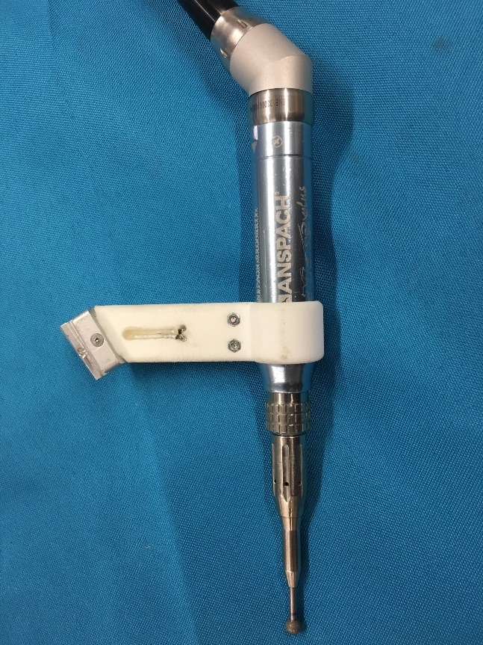
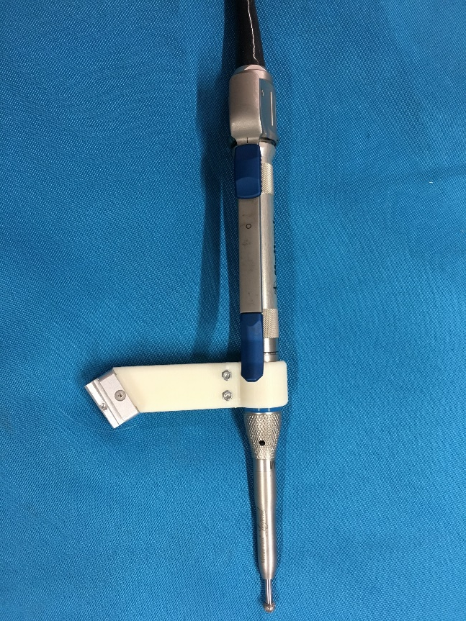
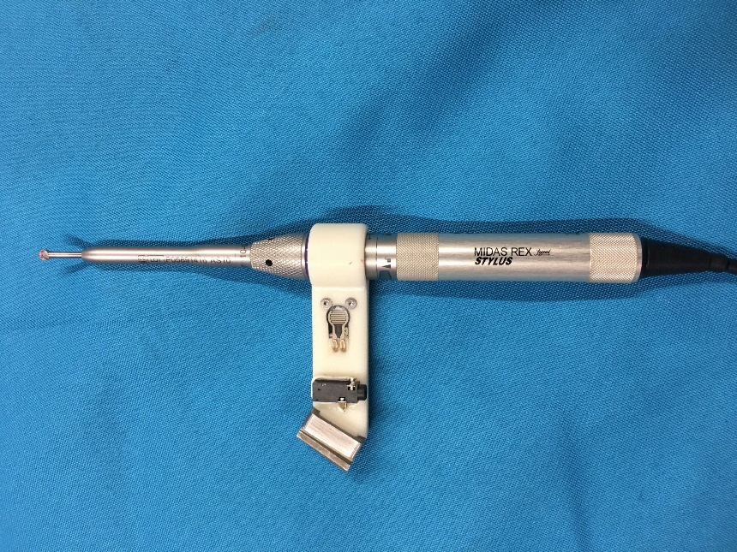
“dumb” drills

Slide 3
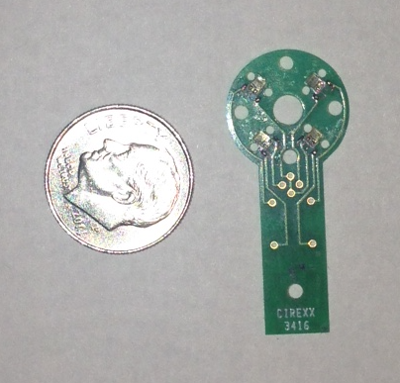
Force Sensing Surgical Drill Concept
Handle / Cover
Drill-to-cover force sensors
Robot-to-tool force sensor
NOTE: Kevin Olds has developed an inexpensive and very robust 3DOF force sensor for his neuro-rehabilitation project. We may be able to adapt the design both for the wrist force sensor and for the drill-to-cover force sensors
CONFIDENTIAL

Slide 4
Force Sensing Drill/Cutter Tool for Skull Base Surgery
” Deliverables: short description or bullets
Working prototype
Engineering demonstration
Evaluation
Size group: 3 max (Note: Existing project)
Skills:
Mechanical design and rapid prototyping
EE design
C/C++
Mentors:
Engineers: Russell Taylor (rht@jhu.edu)
Galen Company: Paul Wilkening, Yunus Sevimli, David Levi
Surgeons: Francis Creigton, MD, Chris Razavi, MD
Note: This could be the start of a good MS or PhD qualifying project

