Slide 1
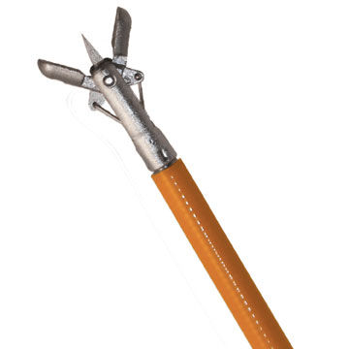
Multigrasp forcep for endoscopic biopsies
Commonly in endoscopic procedures, multiple biopsies are obtained to get important diagnostic information. This is an inefficient process that requires frequent threading of biopsy device in channel with subsequent removal and re-insertion.
Goal is to design and build an endoscopic biopsy forcep that can be used in the standard endoscope channel that has greater functionality to allow multiple biopsies for a single pass to improve diagnostic yield and efficiency
What Students Will Do:
Work with leading academic clinicians and patient safety researchers at the School of Medicine to develop a novel device with clinical importance
Deliverables
Co-design and development mechanism for obtaining multiple specimens
Co-design and development of prototype
Size group: 1-2
Skills: prior medical device design
Mentors: Simon C. Mathews, MD; Head of Clinical Innovation at the Armstrong Institute for Patient Safety; Assistant Professor of Medicine
smathe14@jhmi.ed; 917-291-4336

Slide 2
Email from Dr. Mathews
Russ,
Apologies for late notice. I've attached a very basic description on the multi-grasper (light on technical specifications as I would defer to your expertise). I'm in procedures tomorrow afternoon, but could come by in the morning or Friday afternoon to meet with students if there is interest. I'm quite committed to being very involved and can meet with students going forward on a weekly basis and would bring them to the SOM clinical spaces. While I have a lot of ideas of how this concept could look but I am open to co-development. Appreciate the potential opportunity and thanks again for your consideration. Sincerely
Simon
==================
Simon C. Mathews, MD
Assistant Professor of Medicine, Division of Gastroenterology, Johns Hopkins Medicine and Malone Center for Engineering in Healthcare
Assistant Director, Armstrong Institute for Patient Safety and Quality at Johns Hopkins Bayview
Head of Clinical Innovation, Armstrong Institute for Patient Safety and Quality
smathe14@jhmi.edu

