Slide 1
Anatomical Mesh-Based Virtual Fixtures for Surgical Robots
Student: Yiping Zheng
Mentor: Max Li, Russell Taylor

Slide 2
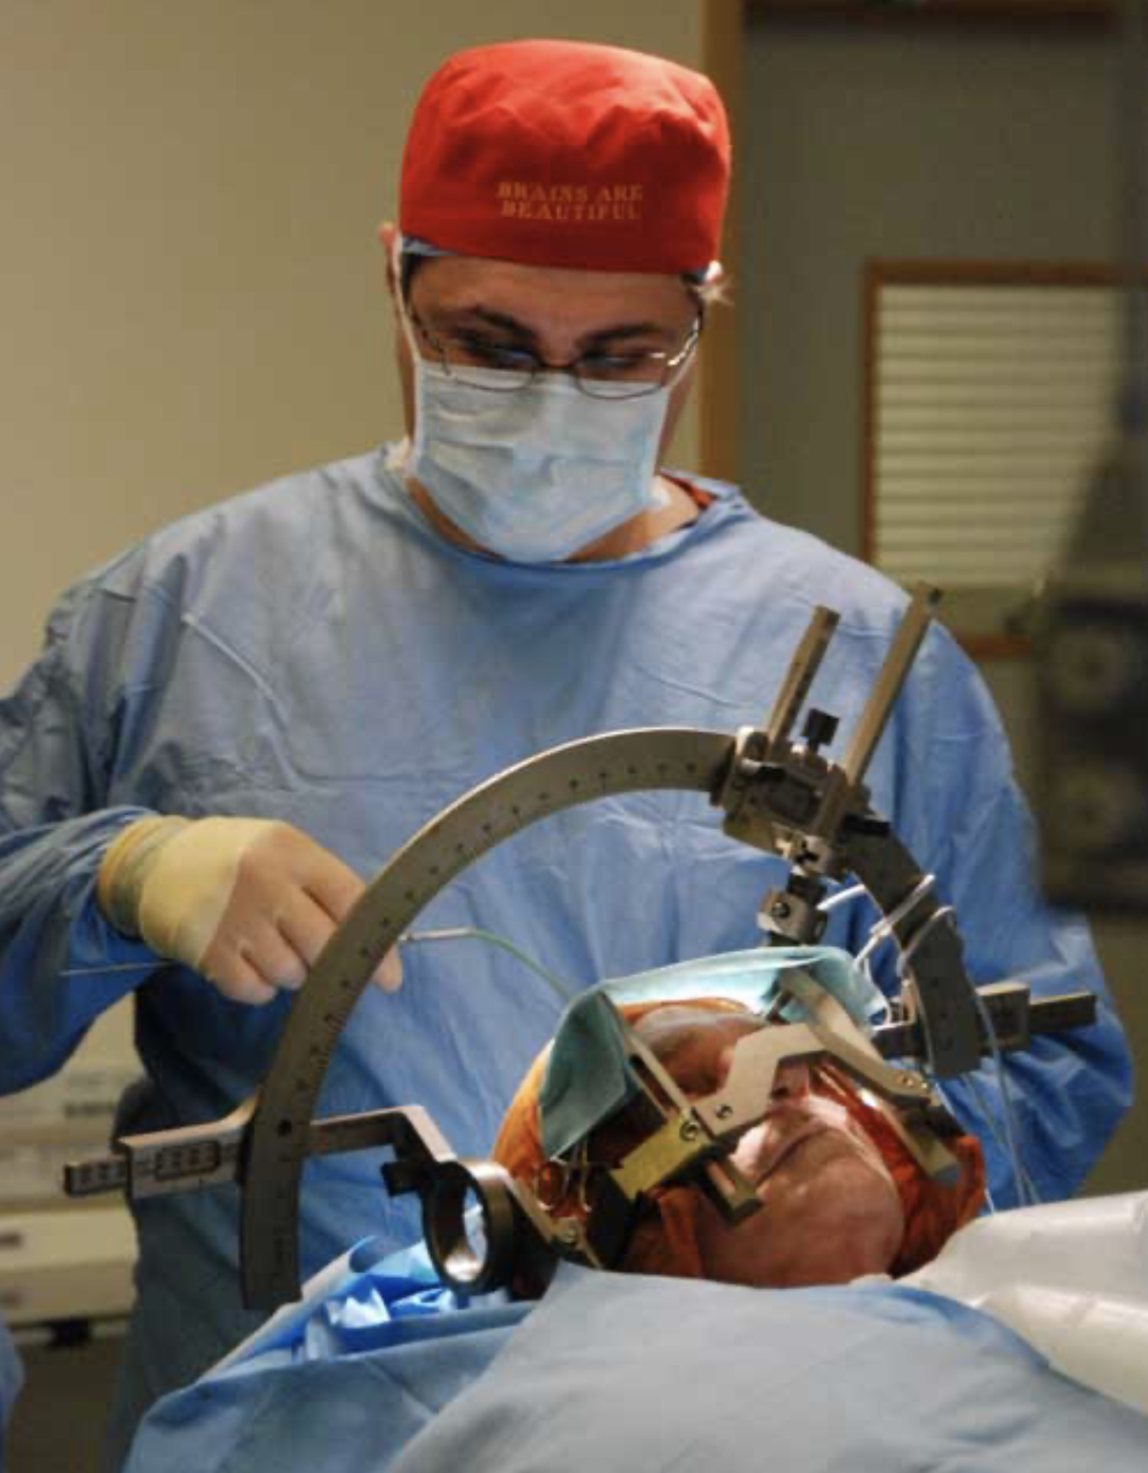
Background
Brain Surgery - BBC News https://www.bbc.co.uk/blogs/thereporters/ferguswalsh/2010/12/brain_surgery_to_relieve_headaches.html
Zhaoshuo Li et al. Anatomical Mesh-Based Virtual Fixtures for Surgical Robots (unpublished by Mar. 2020)

Slide 3
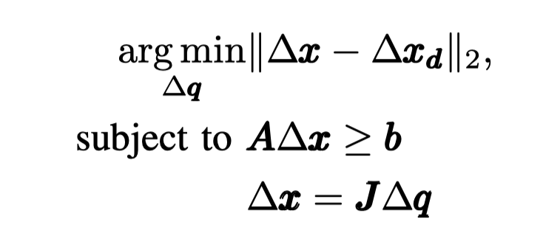
Constraint Optimization
Objective function solved for the desired motion:
where ∆x and ∆x_{d} are the computed and desired incremental Cartesian positions, and ∆q is the incremental joint position. J is the Jacobian matrix relating the joint space to the Cartesian space. A and b are matrix and vectors necessary to describe the linear constraints.

Slide 4
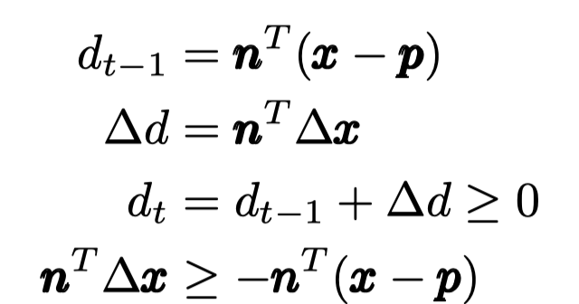
Constraint Optimization

Slide 5
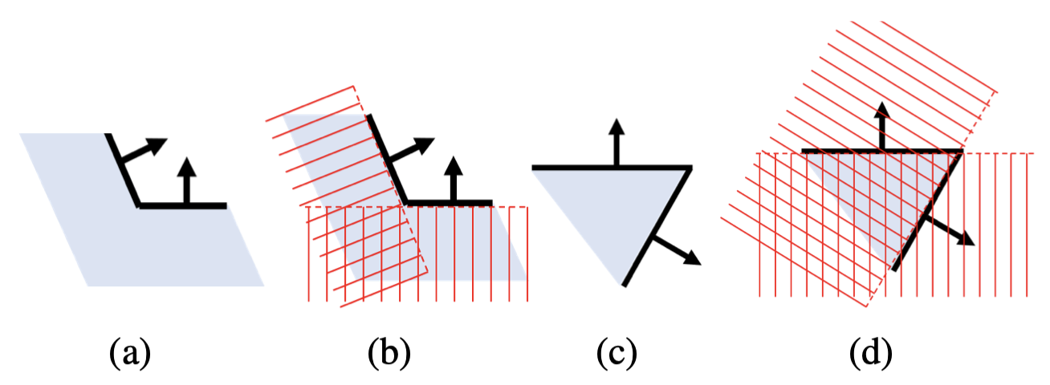
Polygon Mesh property
2D illustration of (a-b) a locally concave surface, and (c-d) a locally convex surface. Red crosshatched zones denote forbidden region. Note in (d) many allowable regions are ruled out. Arrows denote the face normals. Light blue zones denote the patient’s anatomy.
Notes:
A locally concave surface (Fig. 2a) produces a convex set of linear constraints. It is safe to include all triangles as plane constraints (Fig. 2b). A locally convex surface (Fig. 2c) produces a non-convex set of linear constraints. Naively adding all triangles as plane constraints will rule out many allowable regions (Fig. 2d).
This necessitates an approach to dynamically activate and deactivate the constraints based on the local convexity and concavity of the anatomical surfaces.

Slide 6
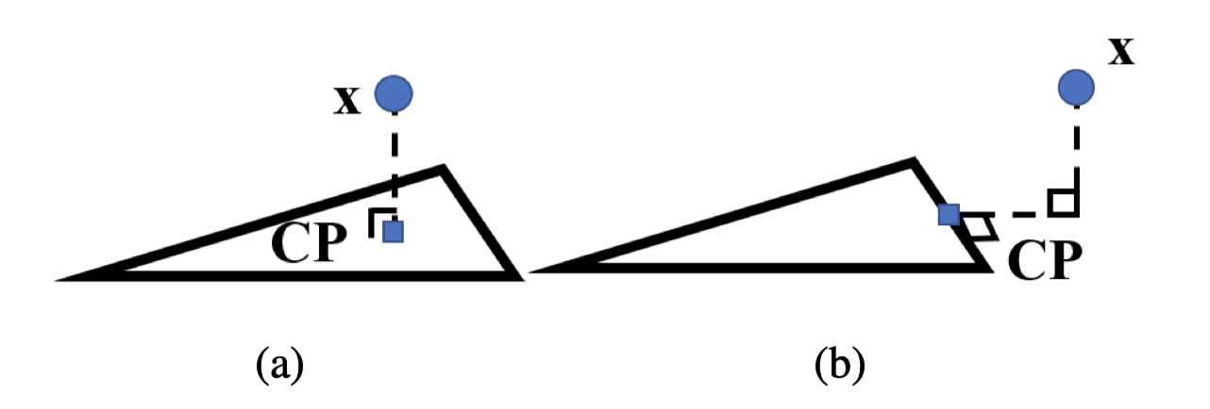
Closest Point
The closest points (CP) on each triangle are necessary to determine the local convexity/concavity and approximate local geometries using plane constraints.
CP location, (a) in-triangle, (b) on-edge. The blue rectangle denotes the CP. The right-angle sign denotes perpendicularity.

Slide 7
Polygon Mesh Constraint Algorithm

Slide 8
Completeness of Algorithm

Slide 10
Steps & milestones
Step 1: Getting started Mar. 5 ~ Mar. 19 (14 days)
- Write proposal, give presentation and construct the wiki page.
- Get familiar with the CISST code base
(Note: mainly focused on numerical environment, and the Constraint Controller part)
- Milestone: Complete the task of loading mesh stl binary ﬁle and add it to the library.
- Status: 90%
Step 2: Implement the algorithm Mar.20 ~ Apr. 5 (14 days)
- Get familiar with the Galen Robot code base
- Adding slack variable of soft constraints to the optimal controller.
(Note: This is also the minimum deliverable)
- Milestone: Pass compilation of the integrated Galen Robot cotroller.
- Status: 10%

Slide 11
Steps & milestones
Step 3: Test the integrated controller in simulation, using simple robot model Apr. 6 ~ Apr. 20 (14 days)
- Test the controller with a simple robot model (eg. UR5 robot arm)
- Test the controller with 3-Dof translation-only motion.
- Test the controller with simple geometry obstacle.
- Test the controller with 3D phantom of patient anatomy. (online data source)
- Improving the mesh-constraint algorithm with respect to the whole surface (use sphere model) of the end-eﬀector, rather than modeling it with a point. (Note: This is also the expected deliverable)
- Test the controller with 6-Dof motion.
- Milestone: A video to demonstrate a simple robot can actually perform the above tasks in simulation.
- Status: 0%

Slide 12
Steps & milestones
Step 4: Test the integrated controller in simulation, using Galen robot model Apr. 21 ~ Apr. 30 (10 days)
- Test the controller with a simple robot model (eg. UR5 robot arm)
- Test the controller with 3-Dof translation-only motion.
- Test the controller with simple geometry obstacle.
- Test the controller with 3D phantom of patient anatomy. (online data source)
- Improving the mesh-constraint algorithm with respect to the whole surface (use sphere model) of the end-eﬀector, rather than modeling it with a point. (Note: This is also the maximum deliverable)
- Test the controller with 6-Dof motion.
- Milestone: A video to demonstrate the Galen robot can actually perform the above tasks in simulation.
- Status: 0%

Slide 13
Dependencies

Slide 14
Current status
Step 1 just finished, marching towards Step 2

Slide 15
Bibliography
Zhaoshuo Li et al. Anatomical Mesh-Based Virtual Fixtures for Surgical Robots (unpublished by Mar. 2020)
Funda, J., Taylor, R. H., Eldridge, B., Gomory, S., & Gruben, K. G. (1996). Constrained Cartesian Motion Control for Teleoperated Surgical Robots. Robotics, 12(3).
Xia, T., Kapoor, A., Kazanzides, P., & Taylor, R. (2011). A constrained optimization approach to virtual ﬁxtures for multi-robot collaborative teleoperation. IEEE International Conference on Intelligent Robots and Systems, 639–644. https://doi.org/10.1109/IROS.2011.6048816
Li, M., Ishii, M., & Taylor, R. H. (2007). Spatial Motion Constraints Using Virtual Fixtures Generated by Anatomy. 23(1), 4–19.
Kapoor, A. (2008). Motion constrained control of robots for dexterous surgical tasks.

Slide 16
Q&A Session
Thank you !

