Slide 1
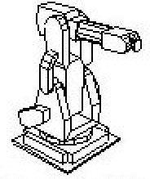
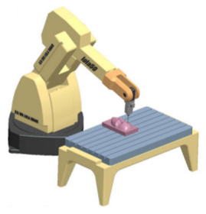
Reconfigurable robotic machining system controlled and programmed in a machine tool manner
Group 18
Team members: Joshua Liu, Jerry Fang
Mentors: Dr. Mehran Armand, Dr. Ryan Murphy, Dr. Chad Gordon

Slide 2
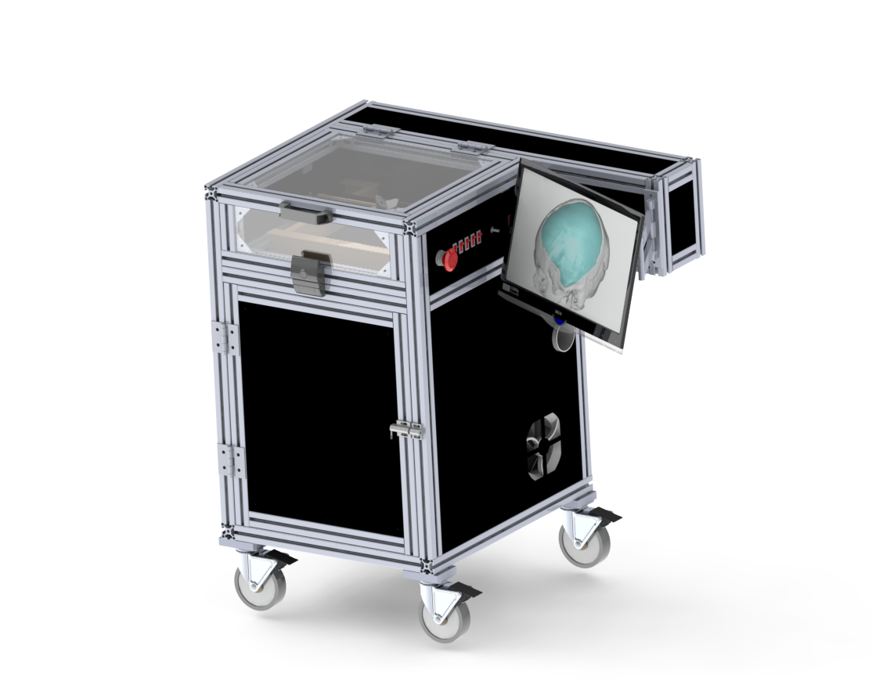
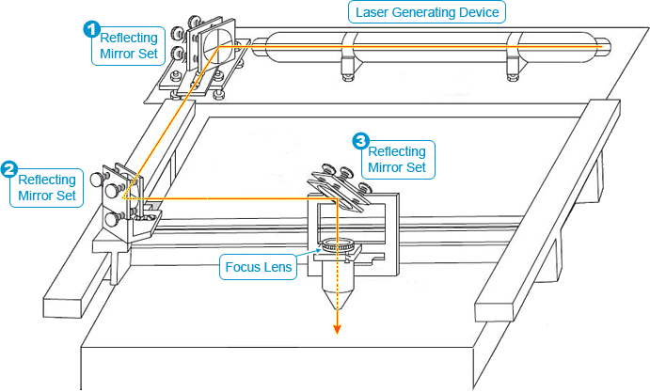
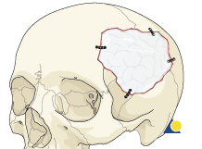
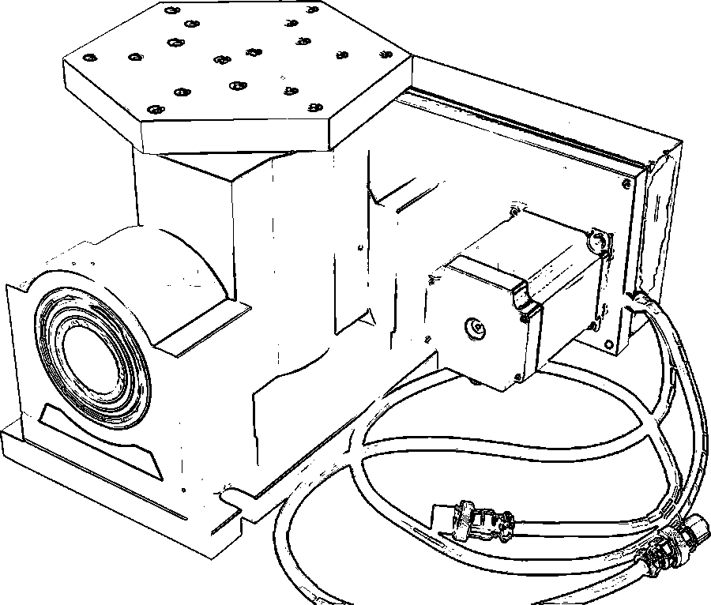
Control Architecture of Cranial Implant Laser Cutting System
Project Overview
Single-stage cranioplasty
Customized cranial implants (CCIs)
Existing procedure for resizing implants is time consuming and done manually
Goal: to develop a 5 DOF laser cutting system that assists surgeons to quickly and accurately resize custom cranial implants (CCIs) in single-stage cranioplasty
Notes:
Cranioplasty is a surgical procedure to repair the defect or deformity of a skull. Single-stage cranioplasty is to perform dissection of the skull and closing the defect with an implan in an single stage.

Slide 3
Paper Selection
Milutinovic, D., Glavonjic, M., Slavkovic, N., Dimic, Z., Zivanovic, S., Kokotovic, B., & Tanovic, L.. “Reconfigurable robotic machining system controlled and programmed in a machine tool manner.” The International Journal of Advanced Manufacturing Technology Int J Adv Manuf Technol, 53(9-12), 2010, pp. 1217-1229.

Slide 4
Significance
Introduce the concept of reconfigurable robot multi-axis machining system for machining complex parts of light materials
Provide very detailed kinematic model, and present the control software (EMC2)
Robot modeling approach is shown in detail for the basic configuration of a five-axis robotic machining system and the prototype of developed control system with programming in G-code
Implement control in LinuxCNC (EMC2).

Slide 5
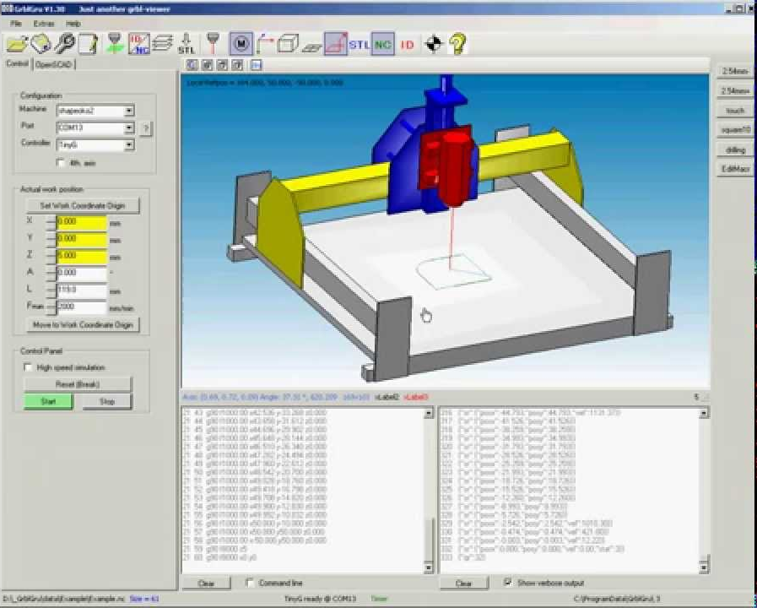
Background
What’s G-code?
Language for the numerical control (NC)
Used to control automated machine tools through a set of instructions
Example: x150 y20 z30 A-5 B10
Why?
The same concept also extends to other types of tools such as forming or measuring, 3D printing, and laser cutting.

Slide 6
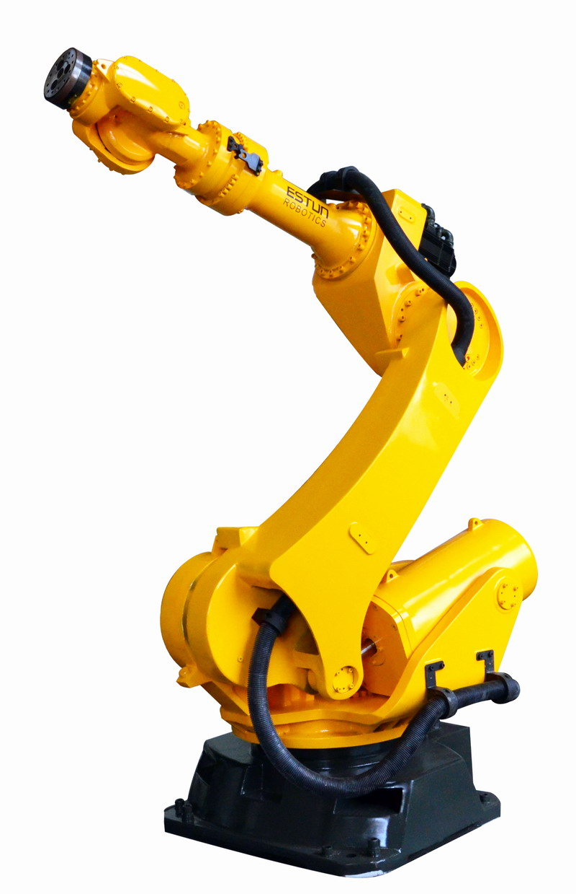
Concept
Industrial robots have been widely used in handling material, welding, assembly. Few industrial robots is used for machining due to its poor accuracy, stiffness, and complexity of programming
No industry standard for robot programming for making the robot programming close to the programming efficiency of CNC machine tools
Cheaper and more flexible with potentially larger work space
Reconfigurable robot based multi-axis machining system, a versatile software solution allowing CNC machine tool programmers by using the existing CAD/CAM systems and programming in G-code

Slide 7
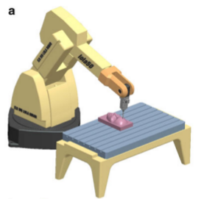
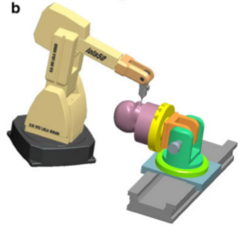
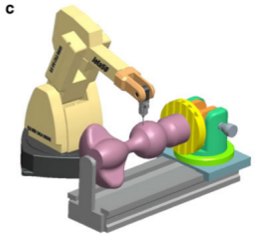
Reconfigurable robotic machining system
Possibilities of reconfigurable system
The vertical articulated robot for complex surfaces machining is considered as a specific configuration of the five-axis vertical milling machine (X, Y, Z, A, B) spindle-tilting type

Slide 8
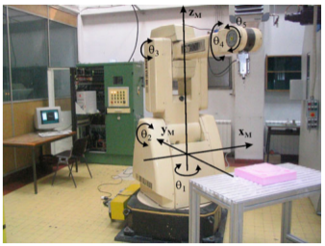
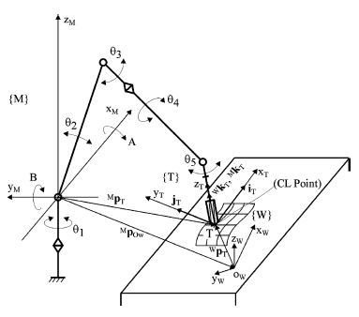
Kinematic Modeling
Coordinate System
{M} - robot reference frame
{T} - tool frame
{W} - work piece frame
Joint coordinate
For CAD/CAM system, a tool path defined by a set of successive tool positions and orientations (G-code) expressed in the work piece frame {W}

Slide 9
Kinematic Modeling
A tool position is given by the position vector of the tool tip T in the work piece frame {W} as
and the tool orientation is given by unit vector associated to the tool axis direction as
World coordinate
(position of tool tip)
(orientation of T)

Slide 10
Kinematic Modeling
The tool tip position vector and unit vector of tool axis direction in the robot reference frame {M} can be expressed as
is the position vector of the origin of work piece frame {W} in respect to the machine reference frame {M}
through homogenous coordinate transformation matrix 4x4, as
The description of the position and orientation of frame {T} relative to the frame {M} can be represented

Slide 11
Kinematic Modeling
To bring the tool axis of the frame {T} to a desirable angular position with respect to the frame {M}, the frame {T} must be rotated first about the x_M axis by angle A, and then about the y_M axis by angle B. The rotation matrix can be derived from
Where rotation matrices Ry_B and Rx_A are basic rotation matrices

Slide 12
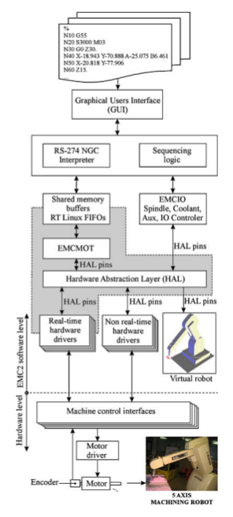
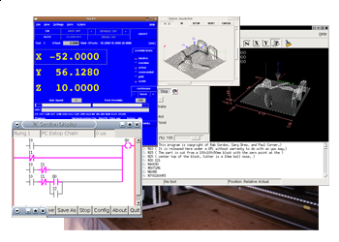
Control and programming
Open source CNC machine controller
Motion controller (EMCMOT)\
the Discrete I/O controller (EMCIO)
Task coordinating module (EMCTASK)
Graphical user interface (GUI)
Hardware abstraction layer (HAL)

Slide 13
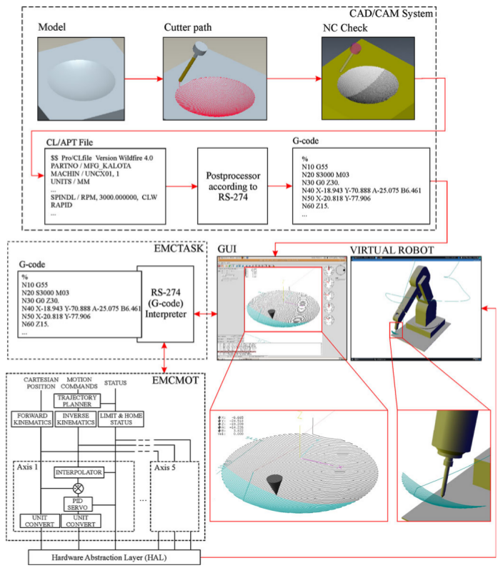
Virtual Robot

Slide 14
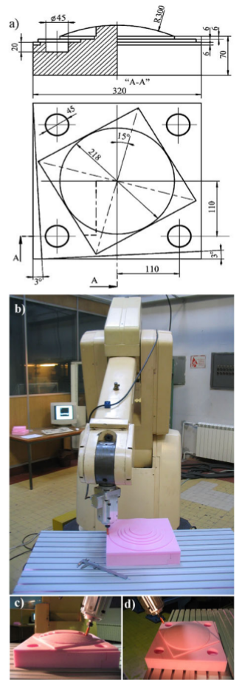
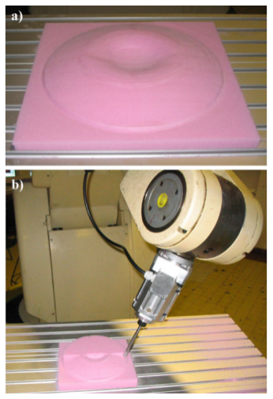
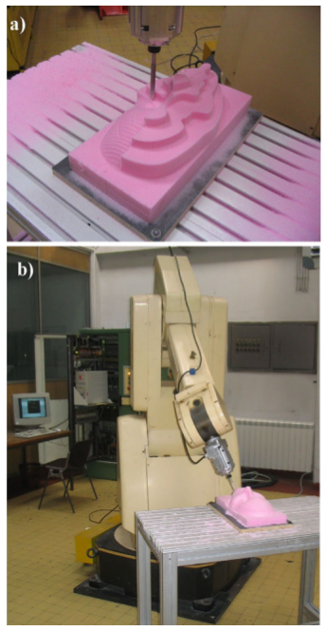
Experiment

Slide 15
Paper Assessment
Pros
Concept of reconfigurable robot based multi-axis machining system
Detailed kinematic model and the derivation of direct and inverse kinematics of the robot system
Singularity avoidance
Control software (EMC2) and programming
Well-done experiments
Cons
The workbench is potentialy movable
No description about setting robot reference frame, tool frame, and work piece frame in software

Slide 16
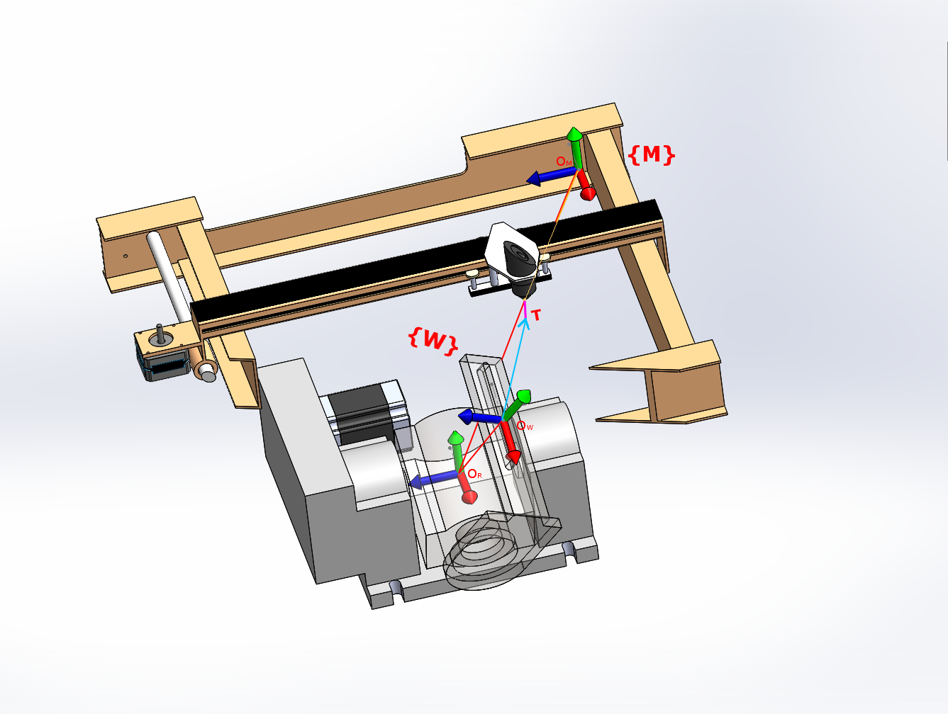
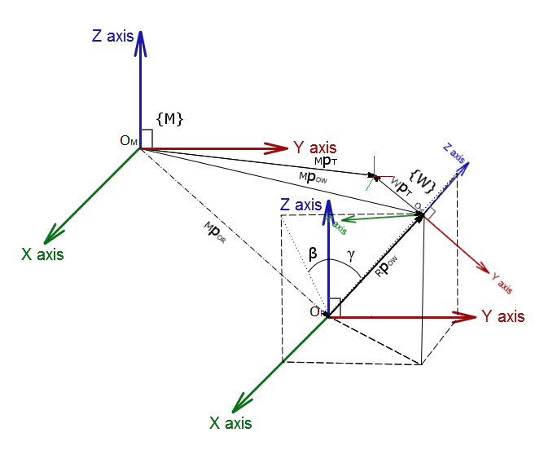
Conclusion
This paper is very relevant and applicable to our project as we are building a laser machine also based on multi-axis cutting system. We will follow the same approach from this paper to derive the kinematic model of our system, and use the same control software (EMC2) to control the laser cutting system.

Slide 17
Video

Slide 18
Questions?

