Slide 1
Mobile Telesurgery Platform in Mixed Reality - Final Presentation
Student: Guanhao(Dean) Fu
Mentor: Peter Kazanzides, Ehsan Azimi

Slide 2
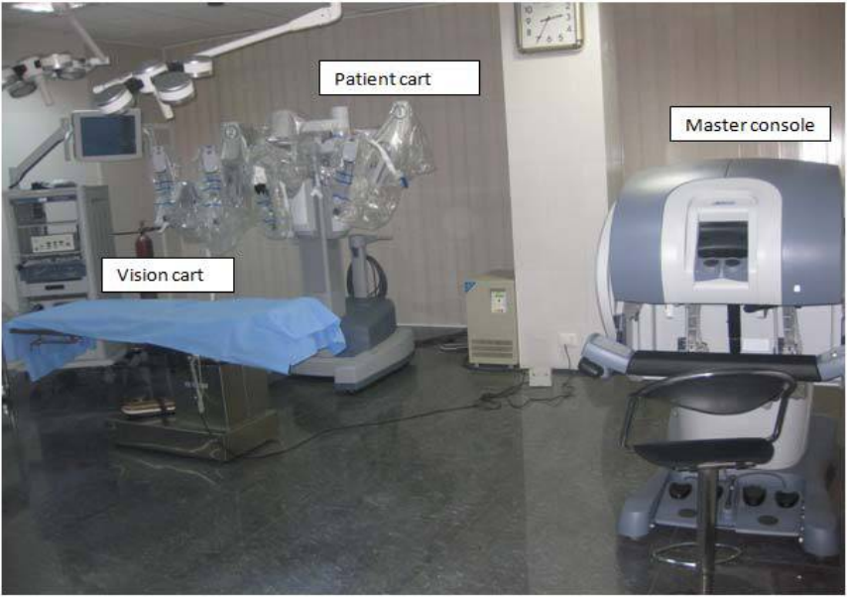
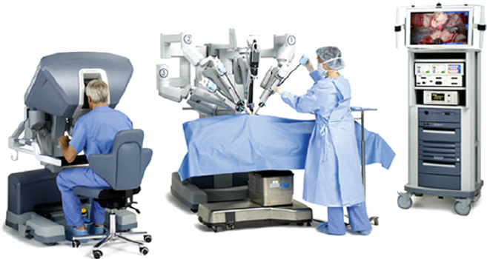
Background
Sterile
Non-sterile
https://www.researchgate.net/figure/Da-Vinci-robotic-systems-have-three-major-components-the-surgeon-console-the-surgical_fig1_281377370
https://www.laparoscopyhospital.com/Book/Ch-03.pdf
Surgeon is in non-sterile field
Need 2 surgeons (at least)
Sterile vs. non-sterile
Notes:
OR room:
Patient bed: Sterile field
Surgeon Console: Non-sterile field

Slide 3
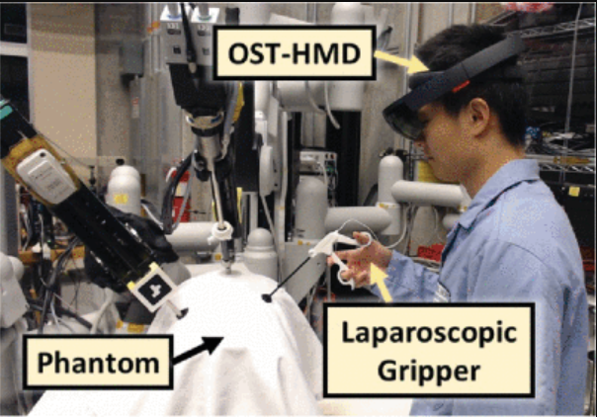
Background
HMD (Head-Mounted Display)
In place of stereo endoscope on the surgeon console
[3]: L. Qian et al., 2019

Slide 4
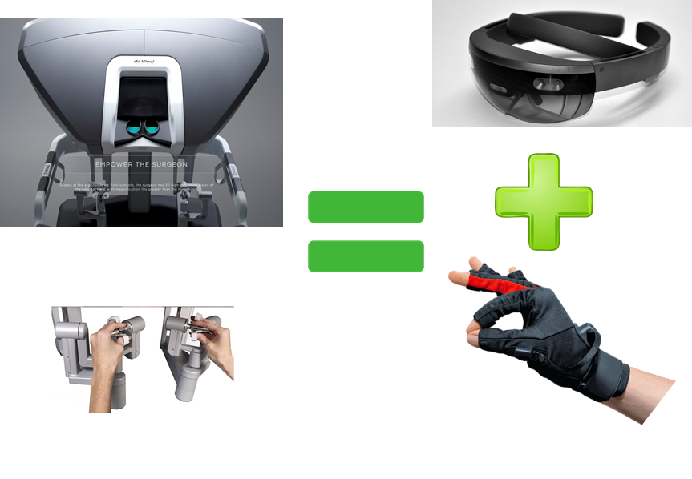
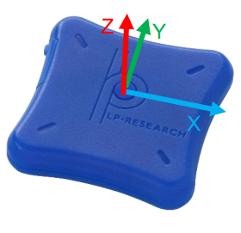
Grand Goal
Lower cost
Sterile bedside operation(solo)
Mobile
Non-sterile, stationary
Novel Surgeon Console!
Sterile, mobile
https://ciis.lcsr.jhu.edu/lib/exe/fetch.php?media=courses:456:2020:cis_ii_mobile_telesurgery.pptx
https://lp-research.com/wp-content/uploads/2020/03/20200310LpmsB2HardwareManual.pdf
Notes:
The project is mainly focused on improving the current Da vinci Surgical System by developing a lower cost surgeon console which enables potential solo surgery.

Slide 5
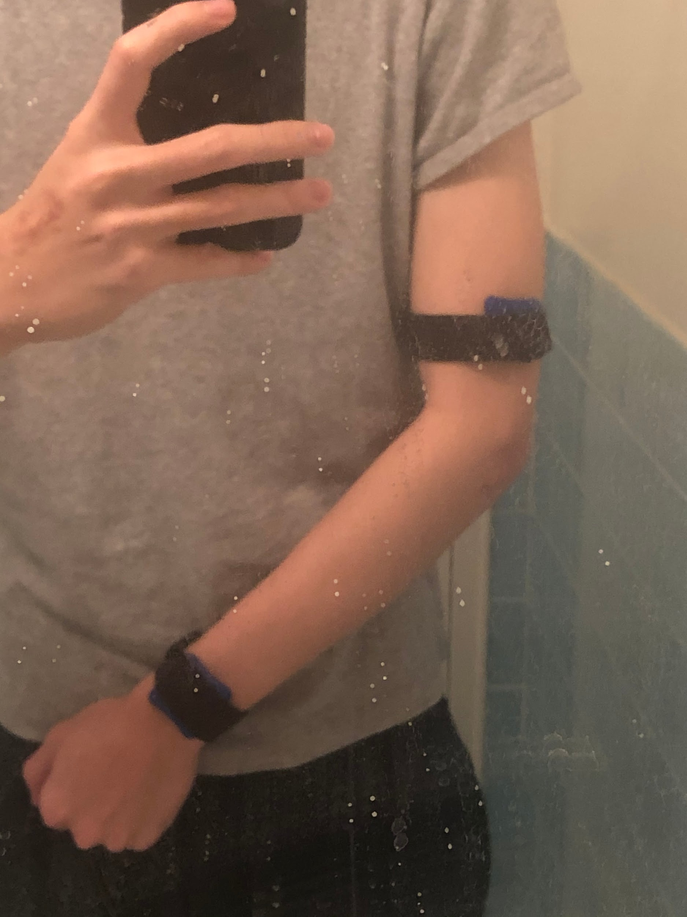
Project Goal
Design a wearable system that
Captures surgeon’s arm motion in 3/4DOF at tool (palm)
Can control state-of-the-art robot in virtual context (Unity)
Has high precision in position control of the robot
Has a similar workspace as the da Vinci’s MTM
Rules of engagement
IMU
2-IMU system

Slide 6
Project Tasks breakdown
Develop Kinematics algorithm to capture joint angles
Joint space control in Unity - Minimum Deliverable
Establish Calibration Protocol to find the link-length of the human arm
Develop Forward Kinematics to calculate the end effector pos/orientation from IMU data
Cartesian space control in Unity - Expected Deliverable

Slide 7
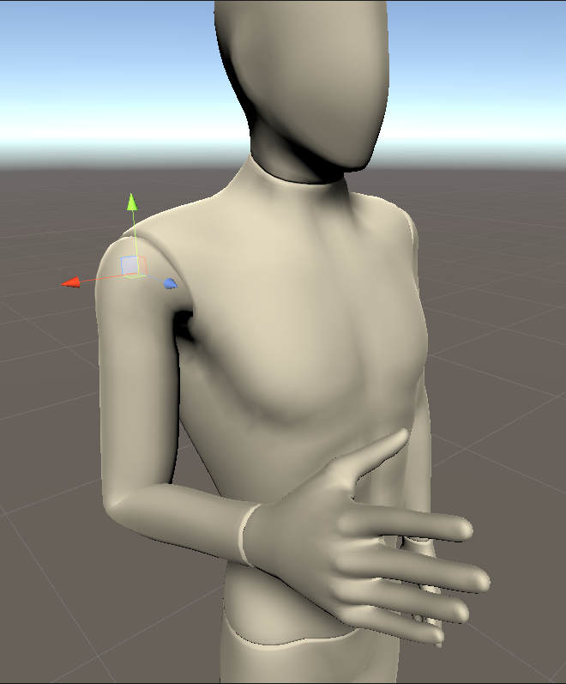
System Diagram
https://lp-research.com/wp-content/uploads/2020/03/20200310LpmsB2HardwareManual.pdf
Bluetooth
Joint angles
Forward Kinematics
mixamo.com

Slide 8
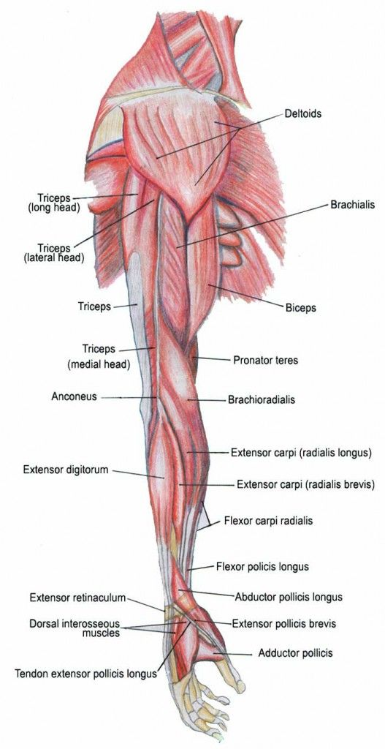
System overview
1st IMU location
Align with triceps(medial head)
2nd IMU location
Align with Extensor retinaculum
2-IMU system
https://www.google.com/url?sa=i&url=https%3A%2F%2Fgr.pinterest.com%2Fpin%2F745768019514523468%2F&psig=AOvVaw3f1ue9minCb4wqK3_0UtAJ&ust=1588795058034000&source=images&cd=vfe&ved=0CAMQjB1qGAoTCMCo0PvAnekCFQAAAAAdAAAAABDkAQ

Slide 9
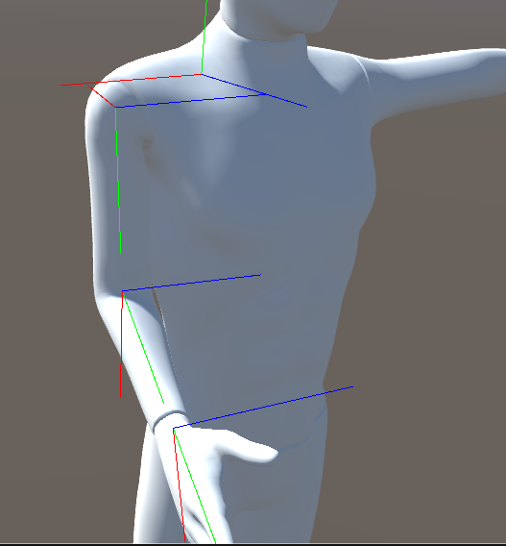
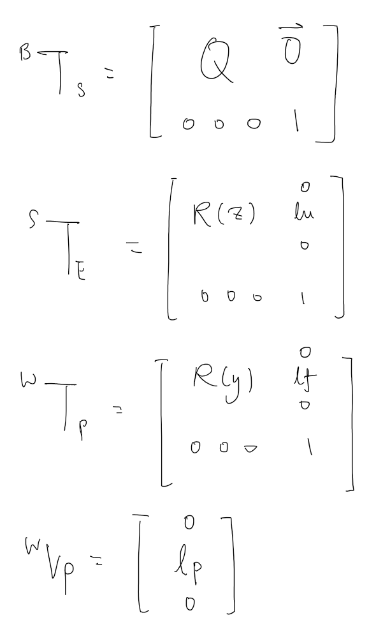
Human Arm Kinematics
B
S
Q: rotation matrix of shoulder
Lu: length of upper arm
Lf: length of forearm
Lp: distance from palm to wrist
E
W
v_pw
mixamo.com

Slide 10
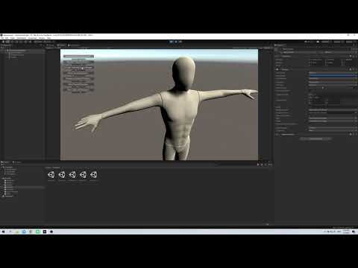
Joint limit Demo

Slide 11
Calibration Protocol - rotation
IMU’s internal +y should be perpendicular to the workspace(screen)
IMU’s internal -z should be pointing toward ground
If IMU drifts during operation, perform “heading reset”
https://lp-research.com/wp-content/uploads/2020/03/20200310LpmsB2HardwareManual.pdf

Slide 12
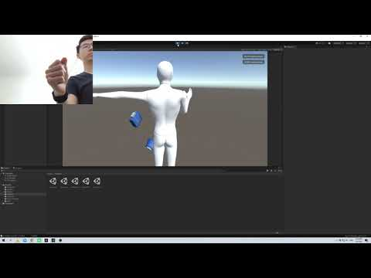
Joint space Control

Slide 13
Calibration Protocol - link length
Calibration workspace - “mouse pad”
Calibration posts - corners of workspace (4)
Calibration variable: distance between posts (12)
Calibration method: min objective function
Objective function: norm(true distance - calculated distance)
Output: link length that minimizes the objective function
Calibration posts
0.34m
0.279m
Calibration workspace

Slide 14
Forward Kinematics
B
S
Q: IMU data
Lu: variable in obj function
R(z): IMU data
Lf: variable in obj function
R(y): IMU data
Lp: known
E
W
v_pw
mixamo.com

Slide 15
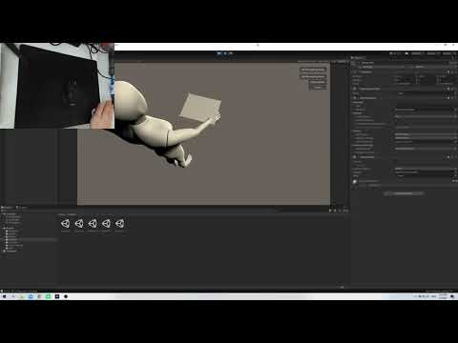
Calibration Demo

Slide 16
Link length Calibration output
True link length:
Lu = 0.26m
Lf = 0.25m
Calibration output:
Lu = 0.521m
Lf = 0.158m
Output error:
e(lu) = 0.261m
e(lf) = 0.092m
Error in Elbow Angle Capture
Error in Forward Kinematics
Error during Calibration

Slide 17
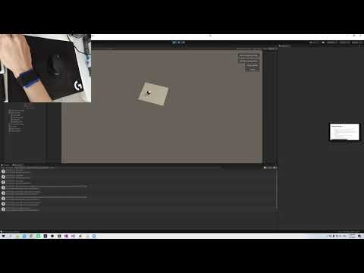
Cartesian Space Control

Slide 18
Management - deliverables
Minimum Deliverable:
Joint space control of single human arm (3/4 DOF at tool), virtual demo in Unity.
Expected Deliverable:
Cartesian space control of same human arm.
Rules of engagement.
Maximum Deliverable:
Achieve wrist 3DOF using 2 IMUs from wrist to dorsal side of hand.

Slide 19
Management - work done
Resolve hardware/software dependencies
Develop Kinematics algorithm to capture joint angles
Joint space control in Unity - Minimum Deliverable
Establish Calibration Protocol to find the link-length of the human arm
Develop Forward Kinematics to calculate the end effector pos/orientation from IMU data
Cartesian space control in Unity - Expected Deliverable
Construct Unity Environment and write all the code associated

Slide 20
Management - Future Steps
Improve Elbow joint angles kinematics model
Conduct Accuracy Assessment for kinematics model
Evaluate IMU drift and determine whether further sensor fusion are needed
Improve Calibration Protocol
Extend to 3-IMU system to capture wrist 2DOF
Conduct comparative study with dVRK
Write Academic paper

Slide 21
Management - lesson learnt
Unity virtual demonstration (from 0 to now)
Unresolved dependencies can be highly impactful
System Visualization is highly productive

Slide 22
Question time
Q&A

Slide 23
Reading List
P. Kazanzides, E. Azimi, Intuitive Surgical - Technology Research Grant Proposal
Surgical Asepsis and the Principles of Sterile Technique, https://opentextbc.ca/clinicalskills/chapter/surgical-asepsis/
L. Qian, A. Deguet, Z. Wang, Y. Liu and P. Kazanzides, "Augmented Reality Assisted Instrument Insertion and Tool Manipulation for the First Assistant in Robotic Surgery," 2019 International Conference on Robotics and Automation (ICRA), Montreal, QC, Canada, 2019, pp. 5173-5179.
Sabatini AM. Estimating three-dimensional orientation of human body parts by inertial/magnetic sensing. Sensors (Basel). 2011;11(2):1489–1525. doi:10.3390/s110201489
Determine Orientation Using Inertial Sensors, MATLAB, https://www.mathworks.com/help/fusion/gs/determine-orientation-through-sensor-fusion.html
Jarrassé, N., & Morel, G. (2011). On the kinematic design of exoskeletons and their fixations with a human member. Robotics: Science and Systems, 6, 113–120. https://doi.org/10.7551/mitpress/9123.003.0019
D-H https://robotacademy.net.au/lesson/denavit-hartenberg-notation/
D-H http://www.aeromech.usyd.edu.au/MTRX4700/Course_Documents/material/lectures/L2_Kinematics_Dynamics_2013.pdf
IMU https://stanford.edu/class/ee267/lectures/lecture9.pdf
El-Gohary, M., & McNames, J. (2012). Shoulder and elbow joint angle tracking with inertial sensors. IEEE Transactions on Biomedical Engineering, 59(9), 2635–2641. https://doi.org/10.1109/TBME.2012.2208750
Naidu, D., Stopforth, R., Bright, G., & Davrajh, S. (2011). A 7 DOF exoskeleton arm: Shoulder, elbow, wrist and hand mechanism for assistance to upper limb disabled individuals. IEEE AFRICON Conference, (September), 1–6. https://doi.org/10.1109/AFRCON.2011.6072065
Wong, C., Zhang, Z. Q., Lo, B., & Yang, G. Z. (2015). Wearable Sensing for Solid Biomechanics: A Review. IEEE Sensors Journal, 15(5), 2747–2760. https://doi.org/10.1109/JSEN.2015.2393883
Lopez-Nava, I. H., & Angelica, M. M. (2016). Wearable Inertial Sensors for Human Motion Analysis: A review. IEEE Sensors Journal, PP(99), 7821–7834. https://doi.org/10.1109/JSEN.2016.2609392
Steidle, F., Tobergte, A., & Albu-Schäffer, A. (2016). Optical-inertial tracking of an input device for real-time robot control. Proceedings - IEEE International Conference on Robotics and Automation, 2016-June, 742–749. https://doi.org/10.1109/ICRA.2016.7487202
Kim, Y., Leonard, S., Shademan, A., Krieger, A., & Kim, P. C. W. (2014). Kinect technology for hand tracking control of surgical robots: Technical and surgical skill comparison to current robotic masters. Surgical Endoscopy, 28(6), 1993–2000. https://doi.org/10.1007/s00464-013-3383-8
Tobergte, A., Pomarlan, M., Passig, G., & Hirzinger, G. (2011). An approach to ulta-tightly coupled data fusion for handheld input devices in robotic surgery. Proceedings - IEEE International Conference on Robotics and Automation, 2424–2430. https://doi.org/10.1109/ICRA.2011.5980120
Taunyazov, T., Omarali, B., & Shintemirov, A. (2016). A novel low-cost 4-DOF wireless human arm motion tracker. Proceedings of the IEEE RAS and EMBS International Conference on Biomedical Robotics and Biomechatronics, 2016-July, 157–162. https://doi.org/10.1109/BIOROB.2016.7523615

