Slide 1
DESIGN AND FABRICATION OF TACTILE INTERFACE FOR PALPATION Checkpoint presentation
Project By: Amrita Krishnaraj
Team 16
Mentors: Dr. Nitish Thakor, Dr. Jeremy Brown

Slide 2
Introduction
Project Goal:
Design and Fabricate a tactile interface and a method for detecting the breast lumps.
Importance:
Current screening methods are X-ray Mammograph, MRI, Ultrasound, PET, Molecular based detection.
Low dose radiations increase the cancer risk by 43%.
Success rate of clinical breast examination in USA-27.3% and
Europe- 59%
Success rates for screening mammogram in 57%. False +ve: 50%
False -ve: 24%

Slide 3
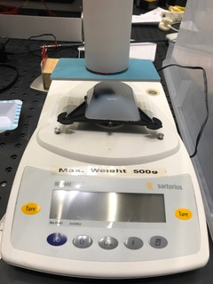
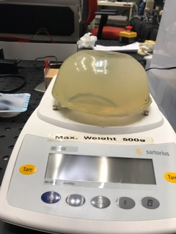
Technical Summary
Tactile Sensor
Readout Circuit
Data
Processing
Data Visualization

Slide 4
Technology Overview
6x6 sensing elements with interelement spacing 0.5cms.
Conductive fabric size: 0.5 cms
Maximum output Voltage: 5V
Operating Range: 0-30 N
Sensitivity: 0.1N
Resolution: 0.06 N (6 gms)
Rdiv = 10k ohms

Slide 5
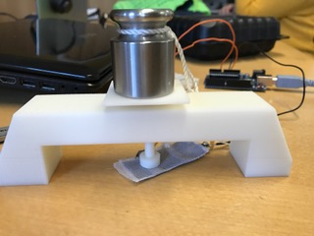
Sensor Calibration
Sensor force resistance(FSR) :
V * Rdiv
E-V

Slide 6
Software Structure
data
Read digital data
Signal processing
Lump classification
Interpolate
data
Threshold
data
Segment data
Connected components
Size and Location estimation
Smooth data
Visualisation
Matlab GUI

Slide 7
Output
Force: 0, 0.85N, 1.5N
Sample size: 7x7cms
Sample size: 7x7cms
Depth
Circular object: 1mm
Concave square: 7-2 mm varied depth
Depth : 1 cm

Slide 8
Matlab Visualisation
Lumps: 2
Centroid: [15 15]
[38.9756 46.333]
Area: 0.9841
6.1433
Segments: 1 , 0 , 0 ,0
3 , 4 , 0 , 0

Slide 9
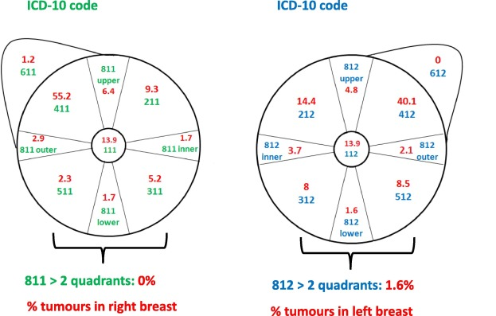
Lump differentiation
Data:
First order principles.
Signal processing:
o/p voltage, 1st order and 2nd order time derivative, lump locations
Lump Classification:
SVM
data
Signal processing
Lump classification

Slide 10
Updated Deliverable
Minimum:
Develop a tactile interface for breast lump detection (3/11/18)
Determine the location of lump (2/4/18)
Expected:
Develop a method to differentiate between the lumps. (4/22/18) In progress
Develop user interface for data visualisation. (4/29/18) In progress
Maximum:
Develop an ioT interface for visualisation
Evaluate clinical diagnostic parameters (5/5/18)
Design the probe (5/10/18)

Slide 11
Timeline
Old timeline
Expected | Determine the texture of lump | Calibrate sensor | 4/7/18 | 4/22/18
 |  | Develop algorithms for texture detection | 4/14/18
 |  | Experimental analysis and accuracy correction | 4/20/14
 | Develop visualization | GUI for data visualization and Documentation | 4/27/18 | 4/27/18
Maximum | Develop IoT interface | Develop an app for the visualization of sensor data | 10/5/18 | 5/10/18
Updated timeline
Expected | Determine the texture of lump | Calibrate Sensor | 4/7/18 | 4/22/18
 |  | Develop the first principle method for texture detection | 4/20/18
 |  | Develop classification algorithm for texture detection (if needed) | 4/26/18
 | Develop visualization | GUI for data visualization and Documentation | 4/29/18 | 4/29/18
Maximum | Determine clinical diagnostic parameters | Validate the method on different samples and improve accuracy. Determine sensitivity and specificity | 5/5/18 | 5/10/18
 | Design probe | Design a model and required components for the probe prototype | 5/10/18

Slide 12
Updated Dependencies
Need | Date of Resolution | Action taken | Alternate | Deliverable
Training on fabrication of sensor | 2/13/18 | Completed |  | Minimum
Materials for sensor | 2/13/18 | Completed |  | Minimum
Access to BME instrumentation Lab | 2/23/18 | Completed |  | Minimum
Access to 3D printing | 4/1/18 | Completed | Make a cardboard structure | Expected
Samples with different hardness | 3/10/18 | Completed | No alternate | Minimum
Android phone/tab | 4/25/18 |  | Use someone's old/new phone | Maximum
Silicon breast model |  | Completed |  | Minimum

Slide 13
Management Plan
Weekly meetings with Dr. Brown
Results updated on the web page
Results maintained in a google doc shared with Luke
Code to be shared in JH box

Slide 14
Reading List
Tactile Sensor
F. P. Bowden and L. Leben, ”The nature of sliding and the analysis of friction,” Proc. Roy. Soc. London A, vol. 169, pp. 371-379, 1939.
K. L. Johnson, K. Kendall, and A. D. Roberts, ”Surface energy and the contact of elastic solids,” in Proc. Roy. Soc. London A, vol. 324, pp. 324-313, 1971.
W. W. Lee, J. J. Cabibihan and N. V. Thakor, ”Biomimetic strategies for tactile sensing,” in Proc. IEEE Int. Conf. Sensors, 2013, pp. 1084-1087.
L. Osborn, R. Kaliki, and N. V. Thakor, ”Utilizing tactile feedback for biomimetic grasping control in upper limb prostheses,” in Proc. IEEE Int. Conf. Sensors, 2013, pp. 1266-1269.
E. D. Engeberg and S. G. Meek, ”Adaptive Sliding Mode Control for Prosthetic Hands to Simultaneously Prevent Slip and Minimize Deformation of Grasped Objects,” IEEE/ASME Trans. Mechatron.,vol. 18, pp. 376-385, 2013.
W.W.Lee, H.Yu and N.V. Thakor,”Gait event detection through neuromorphic spike sequence learning”, in Proc. IEEE RAS and EMBS Int. Conf, 2014,pp. 899-905.

Slide 15
Reading List
Clustering and Classification algorithms
K. D. Irwin, "An application of electrothermal feedback for high resolution cryogenic particle detection", Appl. Phys. Lett., vol. 66, no. 15, pp. 1998-2000, Apr. 1995.
Md Sohrab Mahmud, Md. Mostafizer Rahman, Md. Nasim Akhtar, "Improvement of K-means Clustering algorithm with better initial centroids based on weighted average", 7th International Conference on Electrical and Computer Engineering, pp. 647-650, 2012.
R.G. Stockwell, L. Mansinha, R.P. Lowe, Localization of the complex spectrum: the S-transform, IEEE Trans. Signal Process. 44 (4) (1996) 998–1001.
L. Cohen, Time–frequency distributions—a review, Proc. IEEE 77 (1989) 941–981.
S.C. Johnson, Hierarchical clustering schemes, Psychometrika 2 (1967) 241–254.
J.H. Ward, Hierarchical grouping to optimize an objective function, J. Am. Stat. Assoc. 58 (301) (1963) 236–244.
R.O. Duda, P.E. Hart, Pattern Classification and Scene Analysis, Wiley, New York, 1973.
R. Fisher, The statistical utilization of multiple measurements, Ann. Eugenics 8 (1938) 376–386.
L.G. Durand, et al., Spectral analysis and acoustic transmission of mitral and aortic valve closure sounds in dogs. Part 1. Modelling the heart/thorax acoustic system, Med. Biol. Eng. Comput. 28 (4) (1990) 269–277.

Slide 16
Thank You !!

