Slide 1
Force-Based Control for Robot-Assisted Retinal Vein Cannulation
This project aims to modify the Eye Robot (ER) control algorithms for assisting retinal vein cannulation (RVC).
What Students Will Do:
New control mode(s) to aid cannulation (C++)
Artificial retinal vein phantom, single subject experiments and statistical analyses (MATLAB)
Deliverables:
Software: C++ code
Retina vein phantom
Experimental setup
Experimental results
Size group: 2 people
Skills: MATLAB, C++
Mentors: Berk Gonenc (bgonenc1@jhu.edu), Iulian Iordachita, Russell Taylor
Microneedle (ø70 µm)

Slide 2
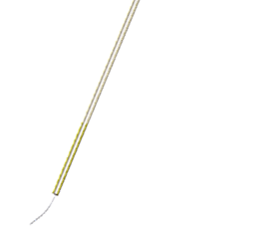
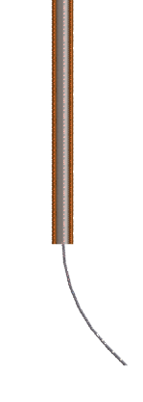
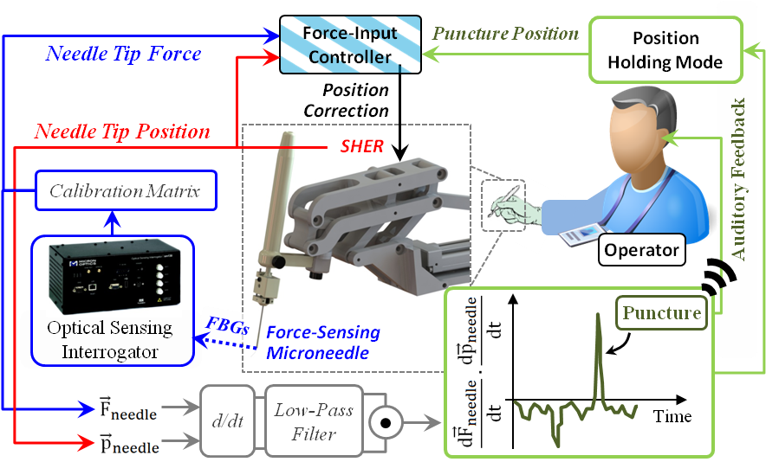
Force-Based Control for Robot-Assisted Retinal Vein Cannulation
1
Detect Venous Puncture
2
Hold the Needle Fixed
Retinal Vein (Ø<200µm)
F
Use a force-sensing needle
Develop software (C++)
Conduct experiments on artificial phantoms
Contact: Berk Gonenc (bgonenc1@jhu.edu)

