Slide 1
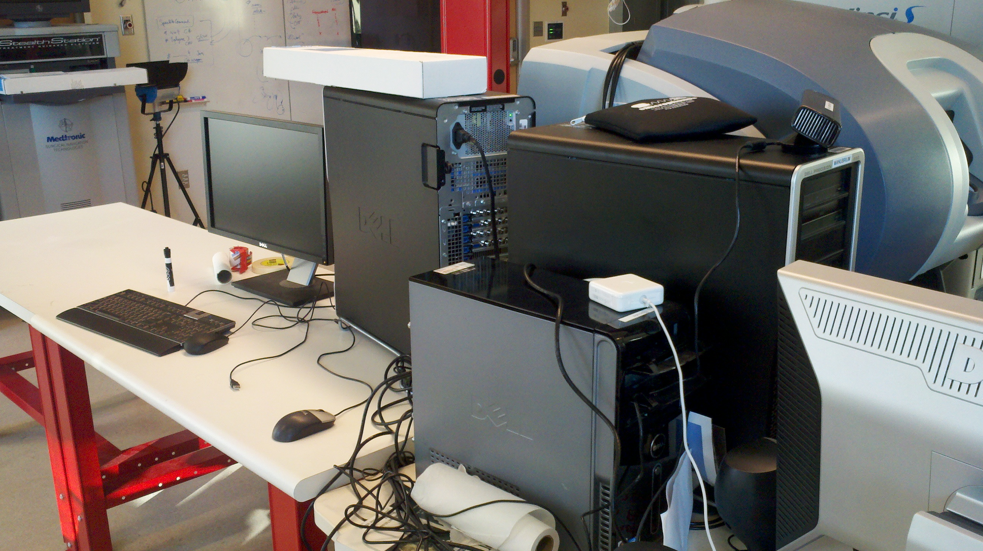
iPad: A Mobile Surgical Console Hanlin Wan, Jonathan Satria Mentors: Balazs Vagvolgyi, Russell Taylor
Goals:
Develop an iPad application to control component settings on the EyeRobot
Significance:
Provide a centralized and easy to use device to control all components without the clutter of computer peripherals
Results:
Incorporated the cisst libraries and ICE into an iPad application that communicates with the cisst Scenario Manager to change various component settings
Detailed tutorial for future development of iOS applications that integrate with SAW
Eliminates clutter

