Slide 1
Project 07: A Cognitive Training Quiz Application
Ran Liu, Nick Uebele
Mentors:
Michael Cohen, Gorkem Sevinc, Yuri Agrawal

Slide 2
Project Motivation
Older adults often have difficulty with spatial memory and navigation.
There is a test to help develop and assess these cognitive skills, but it’s currently a pencil-and-paper test.
Digitizing this test would enable access by so many more individuals.
Notes:
Nick

Slide 3
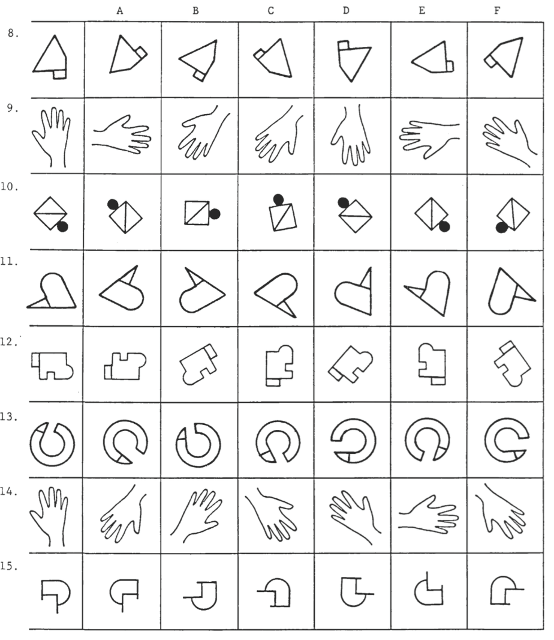
Project Description
Create a web-based visuospatial cognitive training program
Has 5 modules and progressively trains participants
Custom-designed graphics and animations supplied by the Arts as Applied to Medicine Department
Employ user experience design and gamification to enhance the test
Notes:
Nick

Slide 4
Requirements
Allow elderly patients to self-administer cognitive visual/spatial training and testing
Application should attempt to replicate current written test, while improving the ease with which physicians can collect, access, and monitor patient data
HIPAA Compliance
Notes:
Nick
Mention that we’ve drafted design documents, this is an overview

Slide 5
Use-Cases
Actors: Physicians, Patients
Physician:
Logs in, arrives at dashboard of patients
Selects patient and views their testing history
Patient:
Logs in, arrives at dashboard of quiz modules
Selects module, completes training, then test
Also able to view their own testing history
Notes:
Ran

Slide 6
Architecture
Client
Front-end
RESTful API backend
Spring/Hibernate/H2(SQL)
Platform agnostic web-app
AngularJS
Unsemantic
Responsive design
Back-end
ORM
Database
Notes:
Ran

Slide 7
RESTful API Specification
REST endpoints are routes mapped to controllers
Parameters are passed as JSON in the body of HTTP requests
Example:
User login endpoint
Path: /api/user/login
Method: POST
Parameters: username [String], password [String]
Success response:
Code: 200
{ “accessToken” : [String] }
Notes:
Ran

Slide 8
UML Class Diagram

Slide 9
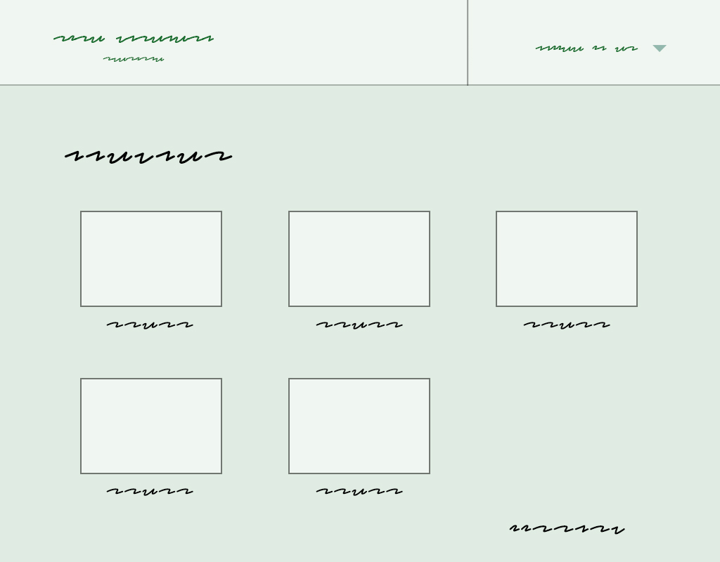
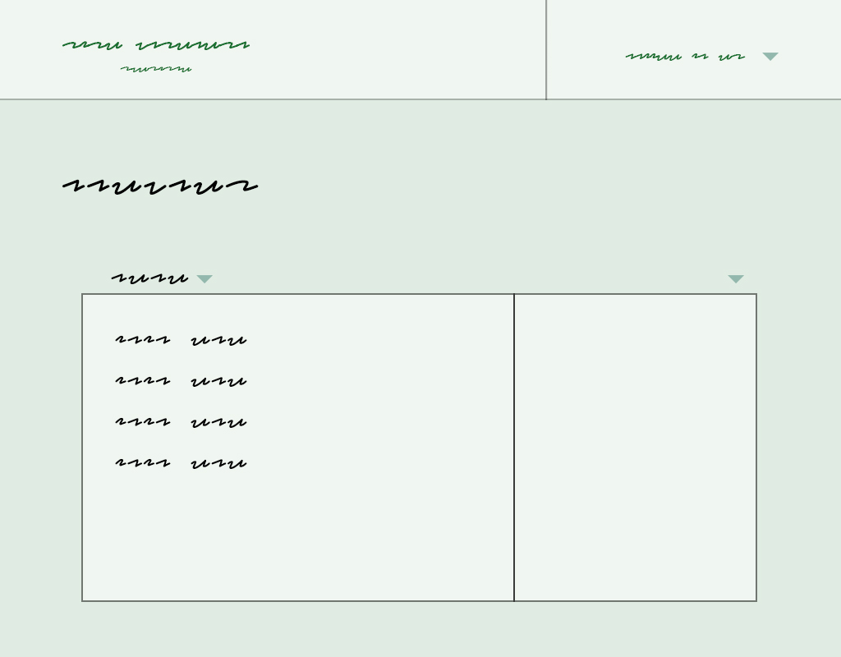
UI Sketches
Login
Physician Dashboard
Patient Dashboard
Notes:
Nick

Slide 10
Deliverables
Design documents
Production code
Iterations on the above
Particularly on refining UI/UX
Build, deploy, obtain feedback, revise design
Notes:
Nick

Slide 11
Deliverables
Minimum:
Design documents & UI mockup
HIPAA-Compliant, Encrypted Database
Serve the quiz (3 out of 5 modules)
Working barebone interface
Expected:
Serve all 5 modules of the quiz
Store results, allow patients to view own results, allow physicians to view their patent’s results
Polished UI
Plot performance history over time
Maximum:
Data analytics on stored data
Allow for advanced queries on data
Conduct usability studies/pilot studies with actual patients
Notes:
Nick

Slide 12
Dependencies
Software dependency management: npm, bower, mvn – Done
Test question illustrations – Arts as Applied to Medicine Department
Stash (Git) access – Pending (waiting for confirmation from Michael)
Jira access – Pending (waiting for confirmation from Michael)
Possible deployment environment – Pending
Notes:
Ran:
David Rini (AAMD) – have contacted about a timeline, haven’t heard back yet

Slide 13
HIPAA Compliance
Full-database encryption, user authentication, HTTPS, access logs
Consult Mike regarding security in general
Notes:
Ran

Slide 14
Management Plan
Team meetings: Sundays and Wednesdays
Weekly meeting with TIC: Wednesday 12:00-1:00 PM
Use Jira for project management and Stash (Git) for version control
Ran | Nick
Encryption and Creation of Database, Backend | UI Design and Mockup Creation
Data Storage/Viewing | User Studies
Polish UI
Notes:
Ran

Slide 15
Min Deliverables
Maximum Deliverables
3/10/2016
Paper Seminar
Expected Deliverables
5/6/2016
3/24/2016
4/15/2016
Final Poster Session
5/6/2016
2016
Feb
Mar
Apr
May
Today
Minimum Deliverables
2/10/2016 - 3/11/2016
Create Design Documents
2/17/2016 - 2/22/2016
Develop Project Plan Presentation
2/17/2016 - 2/23/2016
Write Formal Project Plan
2/22/2016 - 2/25/2016
Write backend
2/25/2016 - 3/3/2016
Create Application for IRB Certification
2/29/2016 - 3/9/2016
Test and deploy backend
3/4/2016 - 3/11/2016
Write static UI mockups in HTML/CSS
2/25/2016 - 3/10/2016
Development of Angular SPA front-end
3/3/2016 - 3/31/2016
Expected Deliverables
3/11/2016 - 4/15/2016
Polish UI
3/11/2016 - 4/15/2016
Plot performance history for both patients and clinicians
3/28/2016 - 4/15/2016
Maximum Deliverables
4/15/2016 - 5/6/2016
Implement data analytics on quiz data
4/15/2016 - 4/27/2016
Enable advanced queries on quiz data
4/25/2016 - 5/6/2016
Conduct usability studies/pilot study with actual patients
4/18/2016 - 5/6/2016
Notes:
Nick

Slide 16
Questions?

