Slide 1
Data collection and analysis of sinus surgery
Collect and analyze performance of sinus surgery
What Students Will Do:
Help prepare experimental apparatus
Help with data collection
Analyze collected data (motion trajectory and eye gaze)
Deliverables:
Robust data collection protocol
Complete a couple of data collection sessions
A written report on data analysis
Size group: 2
Skills:
Systems engineering
Modeling temporal data
Mentors: Prof. Russ Taylor, Prof. Chien-Ming Huang, Jindan Huang
Contact info: Prof. Chien-Ming Huang (cmhuang@cs.jhu.edu)

Slide 2
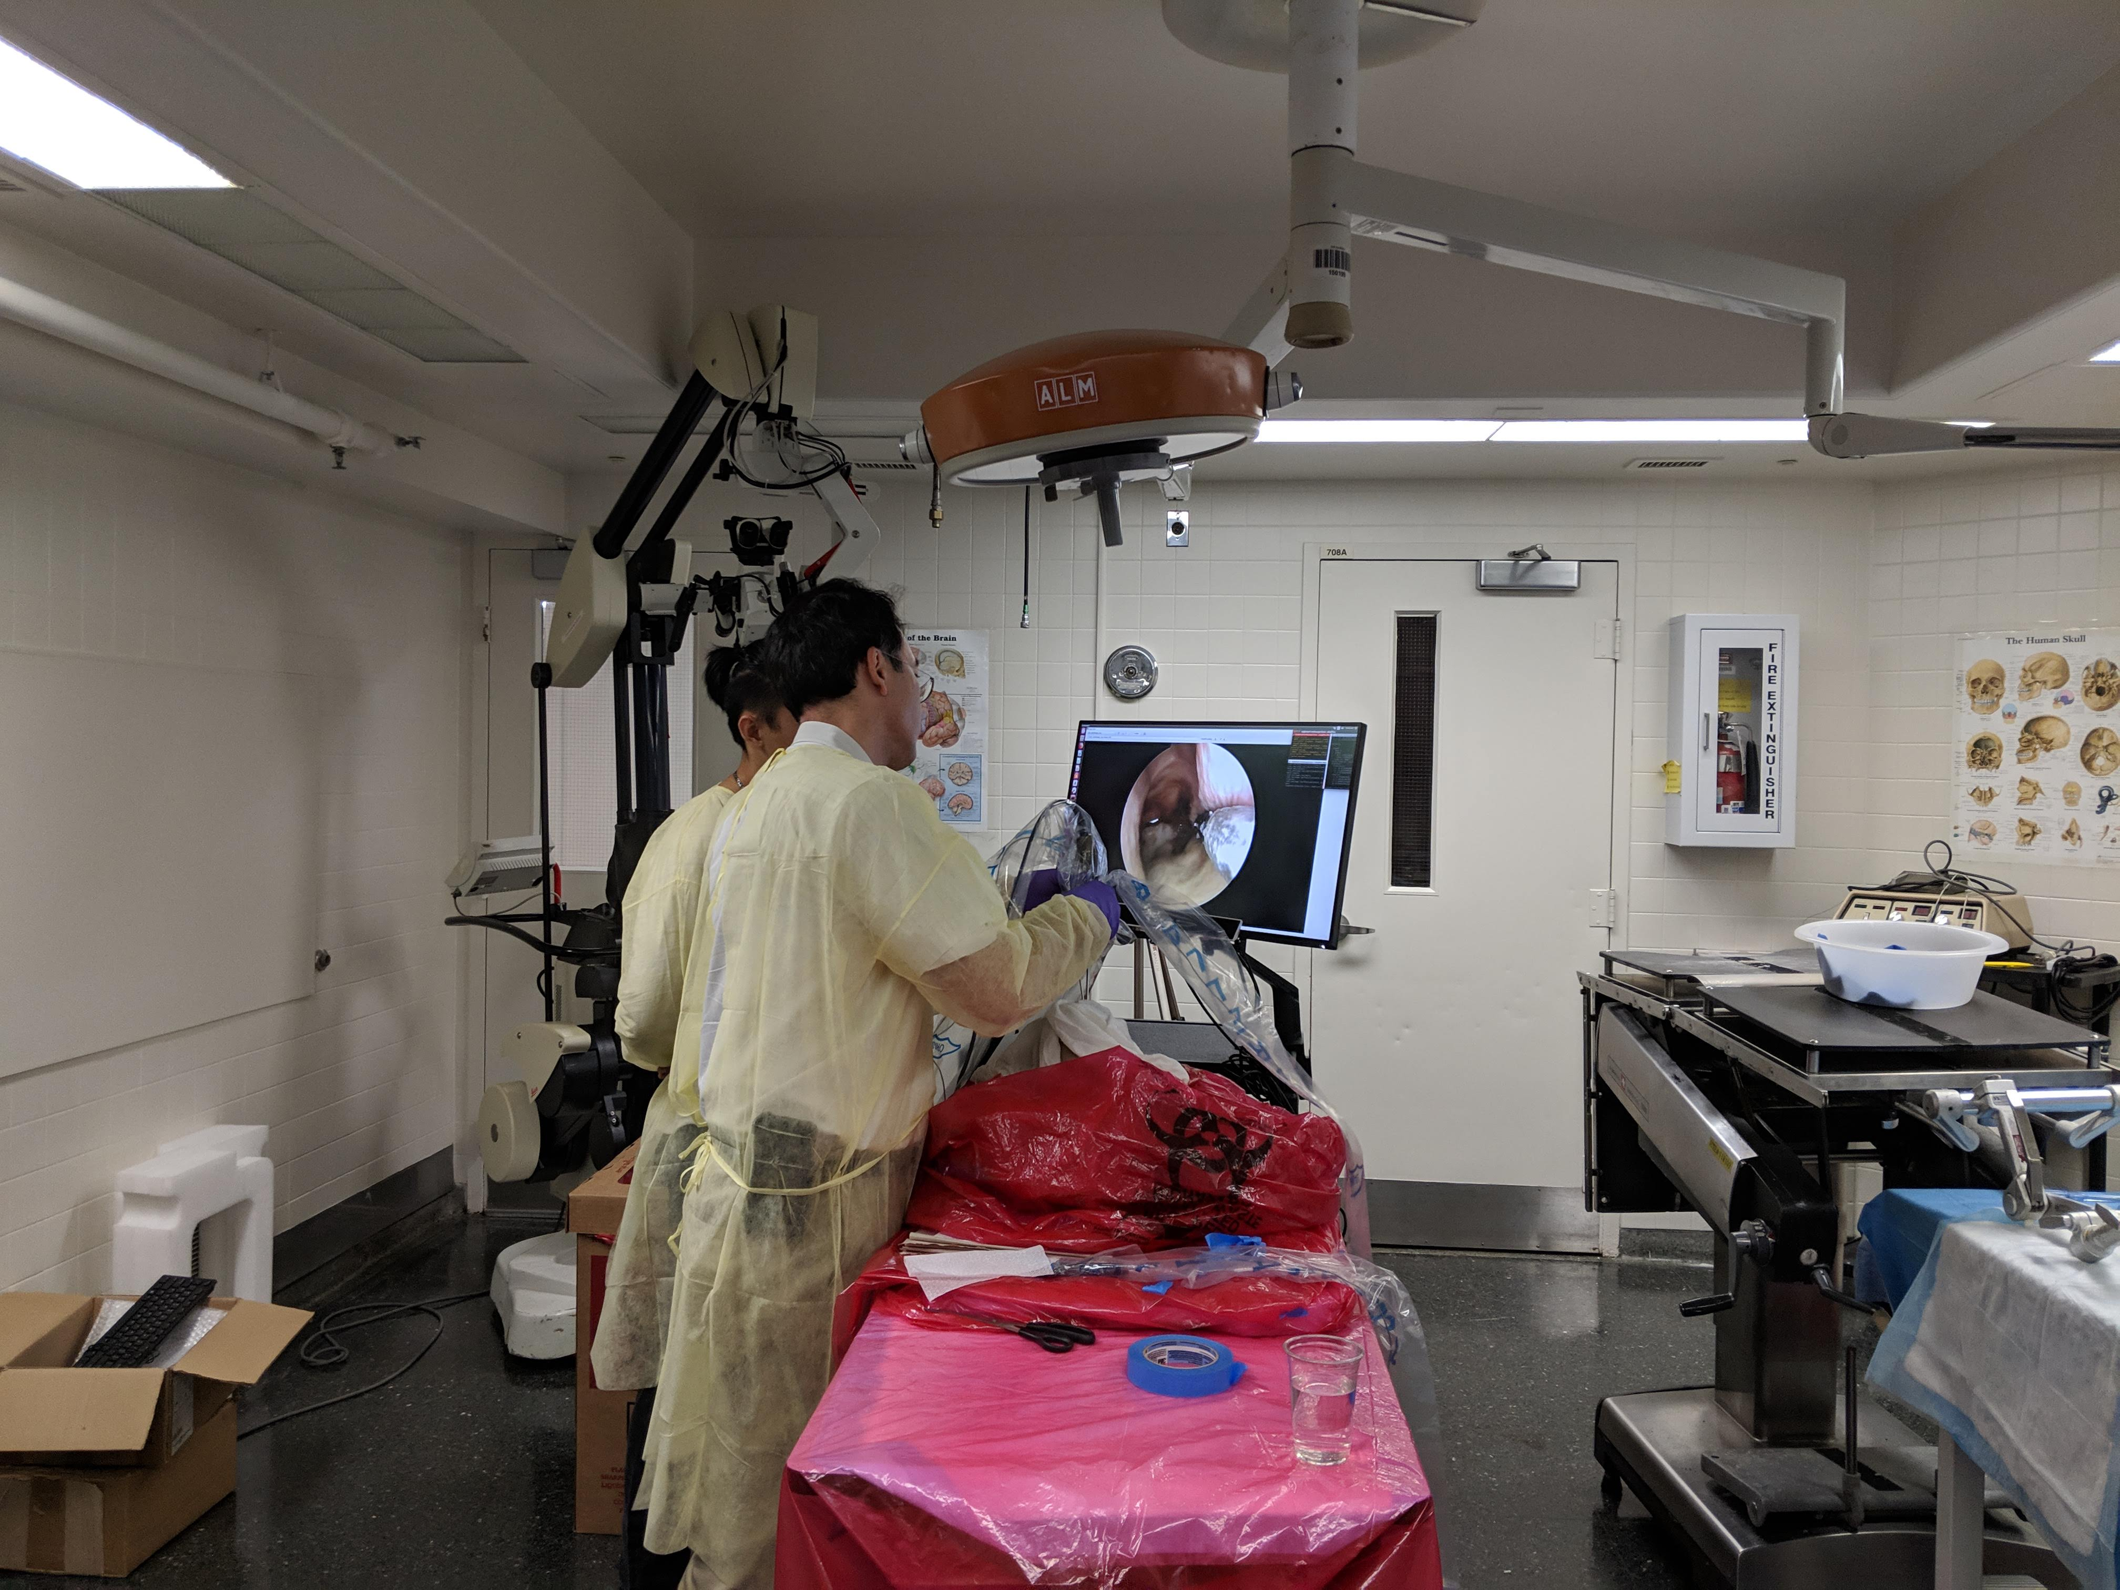

Slide 3
