Slide 1
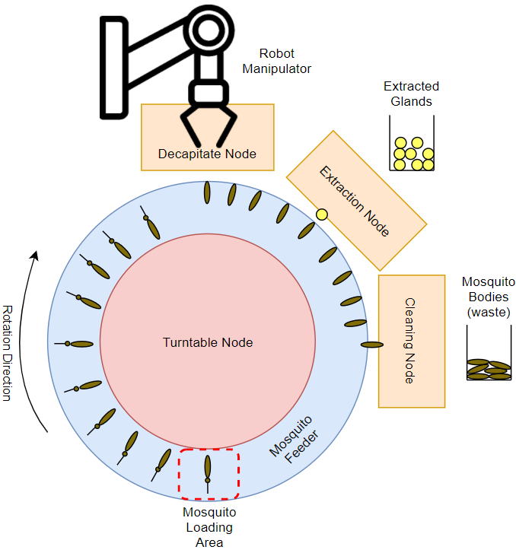
Robot System Controller for Automating Mosquito Microdissection Group 3: Zhuohong (Zooey) He Mentors: Dr. Simon Leonard, Dr. Russell Taylor Partners: Dr. Kim Lee Sim, Sumana Chakravarty (Sanaria Inc.)
Goals:
To develop a control algorithm for an automated system to streamline mosquito gland extraction.
Incorporate parallel processes and error recoveries
Utilize the ROS ActionLib Architecture
Significance:
Gland extraction is a bottleneck in malaria vaccine production.
A malaria vaccine can curb a disease affecting 228 million people annually.
Results:
Successful parallel controller with error recovery that implements 3 nodes.
67% success on pick-place-decapitate node
75% success on extraction node
100% success on turntable node
Incorporated simulator to improve debugging capabilities.
See in action

Slide 2
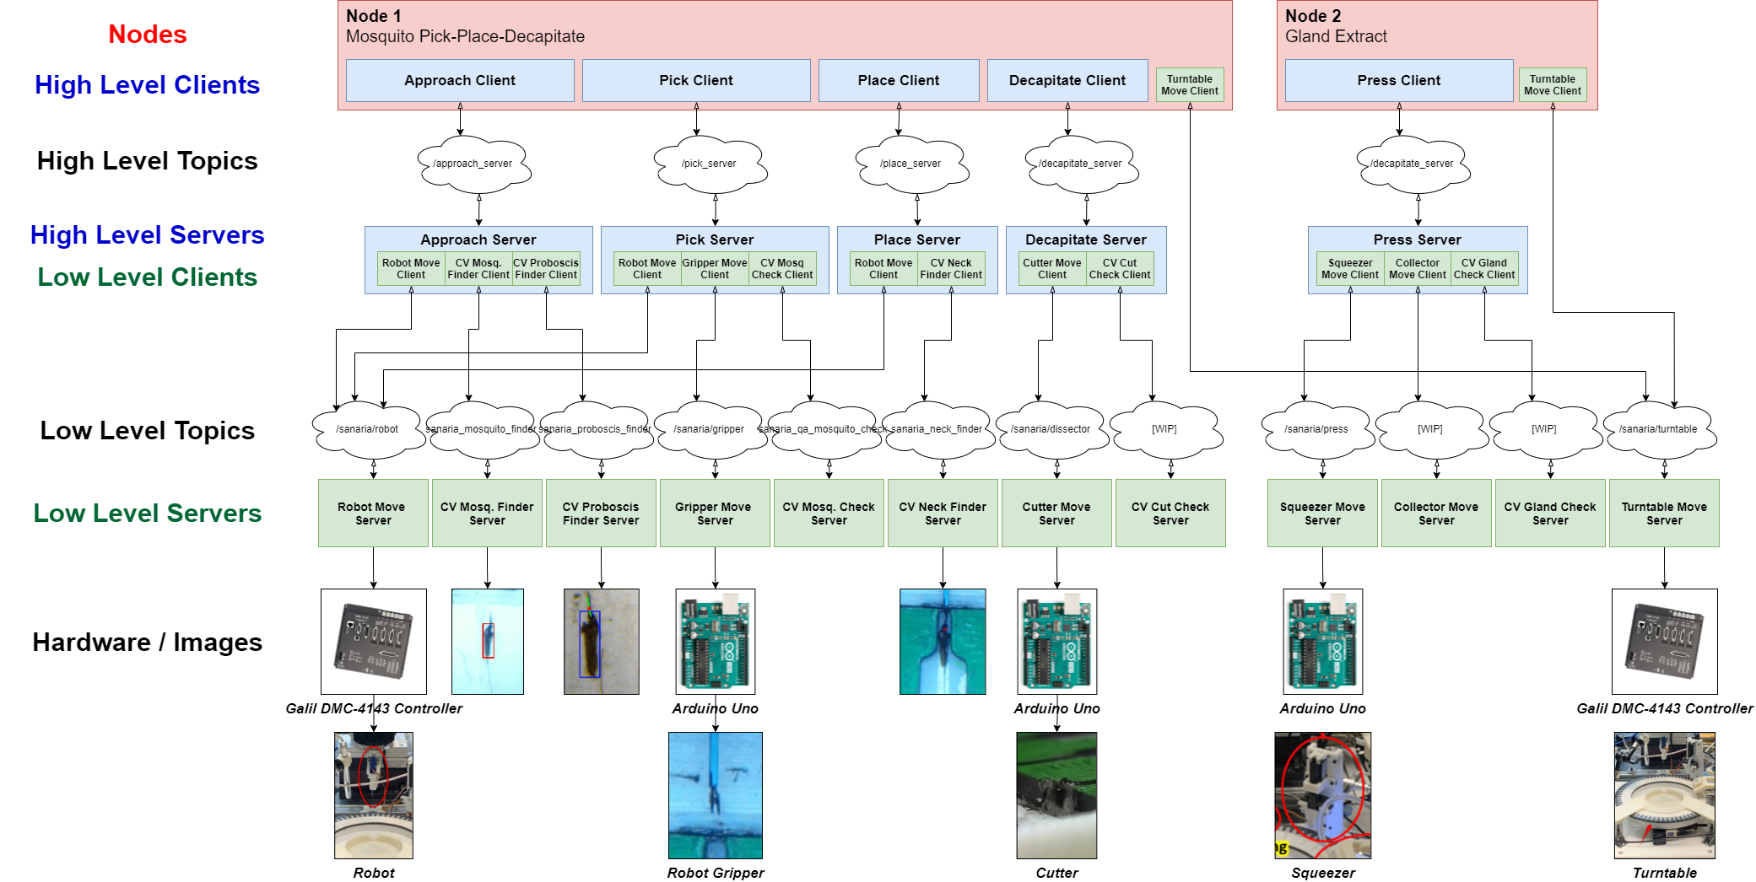
Detailed Visualizations
Pick-Place-Decapitate Node & Gland Extract Node
ROS ActionLib Client/Server Architecture

Slide 3
Robot System Control for Automating Mosquito Microdissection
Team Member: Zhuohong (Zooey) He zhe17@jhu.edu
Mentors: Dr. Simon Leonard sleonard@jhu.edu
Dr. Russell Taylor rht@jhu.edu
Industry Partners: Dr. Kim Lee Sim Sanaria Inc.
Sumana Chakravarty Sanaria Inc.
Date: May 6th, 2021
**The information in this presentation is strictly confidential

Slide 4
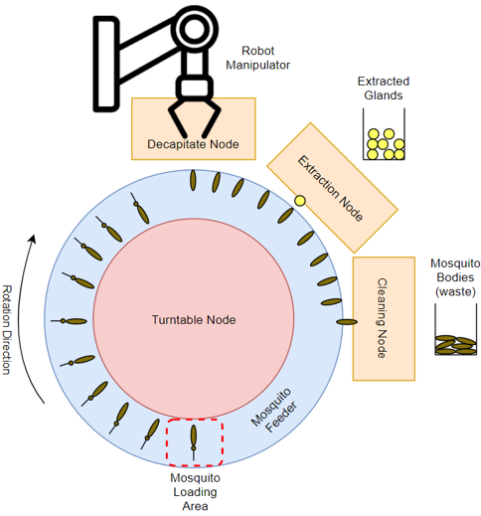
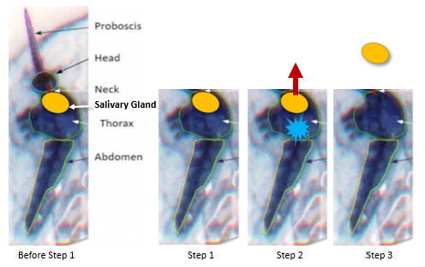
Problem Statement
Slide 1 of 5
Problem:
Malaria affects 228 million and kills 405,000 people annually [1].
Salivary gland extraction is the greatest bottleneck facing large scale production of a malaria vaccine.
Figure 1: manual extraction process.
Project Goal:
Develop a control algorithm for a robotic system that will automate the gland extraction procedure.
Implement Error Detection & Recovery
Create Parallel Processes
Figure 2: proposed robotic system

Slide 5
System in Action
Slide 2 of 5
Video 1: overview of system powered by old (non-ROS) controller [2]

Slide 6
Method
Slide 3 of 5
Hierarchical Controller:
Advantages:
Levels of abstraction
Errors recovered at correct scope.
Easily serviced / replaceable modules.
Independent nodes
System-wide tracking of slot statuses.
Packages and Tools Used
ROS – Framework for creating complex robotic system.
ActionLib – ROS package which supports client-server architecture.
RVIZ – ROS package with lightweight visualization capabilities.

Slide 7
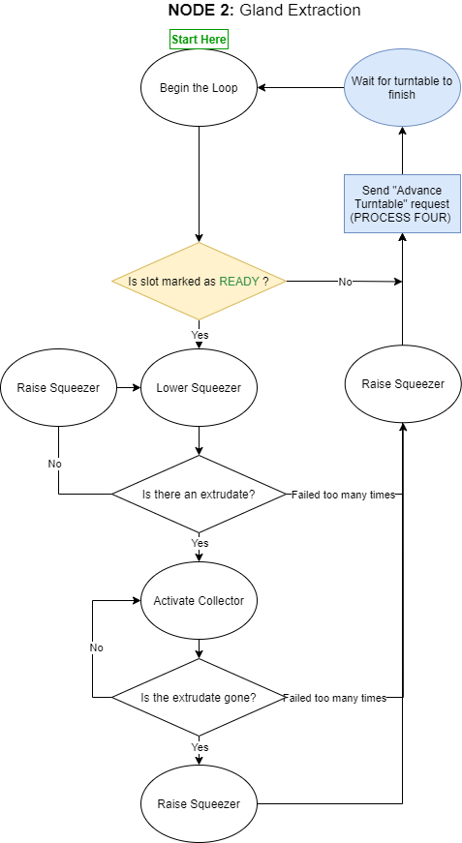
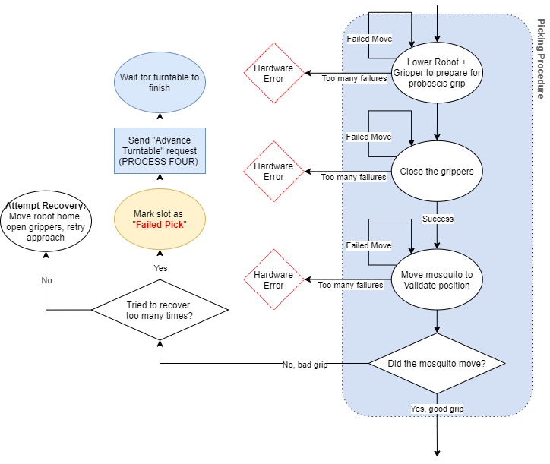
Process Flowchart: Error Recovery Demonstration
Full Diagram:
https://app.diagrams.net/#G1jNIYksN9SPy2IVpKX6J9o-kpQ6ZNawvy

Slide 8
Video Results
Slide 4 of 5
Parallelism:
Video 1: parallel operation of turntable, pick & place, and gland extraction nodes.
Error Detection / Recovery:
Video 2: recovery from a unsuccessful hold on the mosquito.

Slide 9
Quantitative Results
Slide 5 of 5
Discussion:
Four errors recovered during pick sub process.
60 mosquitoes per hour (MPH) to 360 MPH speed increase due to parallelism.
Place-holders and structure to easily implement more error recovery in the future.
Next Steps:
Increase speed to reach 600 MPH goal.
Improve cumulative success rate to >95%.
Integration of more CV error checking algorithms (CIS Project 5).
Further testing on the controller, hardware, and CV components.

Slide 10
References:
[1] World Health Organization, “World malaria report 2019,” Dec 2019. [Online]. Available: https://www.who.int/publications-detail/worldmalaria-report-2019
[2] Submission by W. Li et al. to CASE 2021

