Slide 1
Vision Guided Mosquito Dissection for the Production of Malaria Vaccine
Nick Greene
Project 5
Mentors: Balazs Vagvolgyi, Alan Lai, Parth Vora

Slide 2
Motivation
Malaria is a major human health issue
In 2019, there were 229 million cases of malaria, with 411 000 deaths [1]
Children under 5 made up 274 000 of those deaths
Primary way to combat malaria is by preventing contact with mosquitos through mosquito nets and insecticide.
Limited effectiveness
[1] WHO 2020

Slide 3
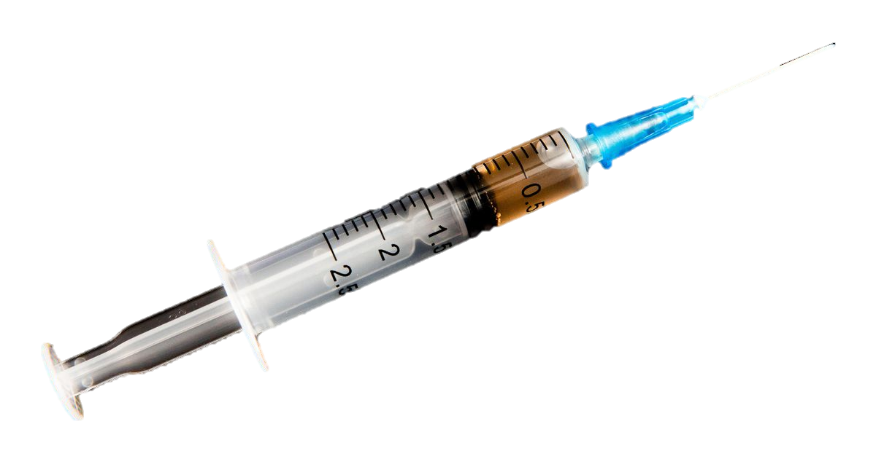
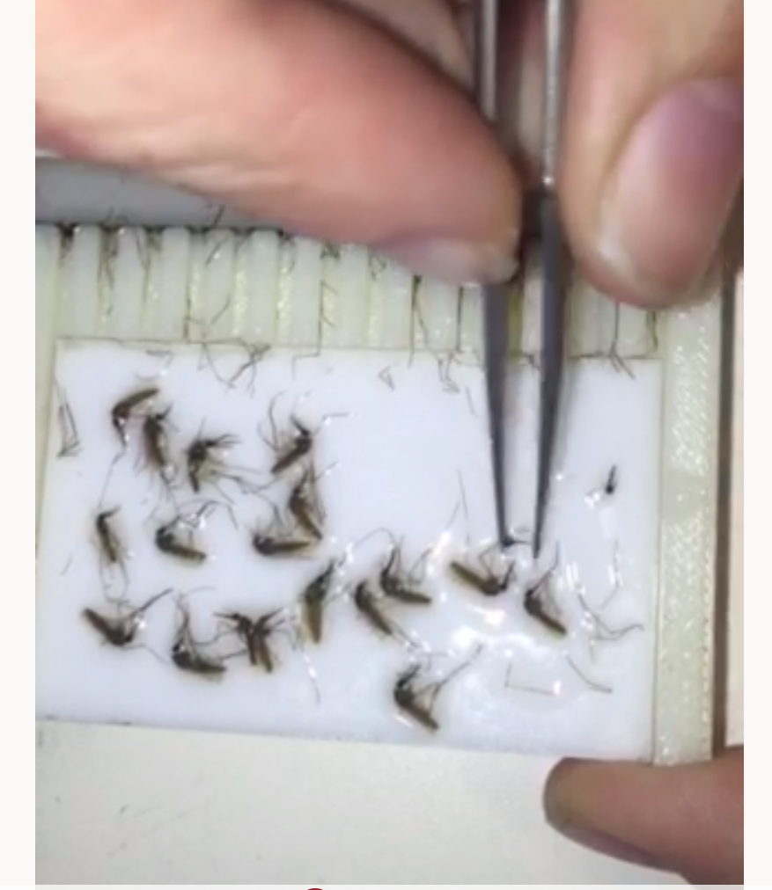
Motivation
Sanaria has developed practical and effective malaria vaccines which could be critical in the global fight against malaria [2] [3]
Currently, production of malaria vaccine is heavily bottlenecked by manual extraction of mosquito salivary glands
Goal is to automate salivary gland extraction quickly and efficiently
image: CNET
[2] Jongo et al. 2018
[3] Sanaria
image: JHU

Slide 4
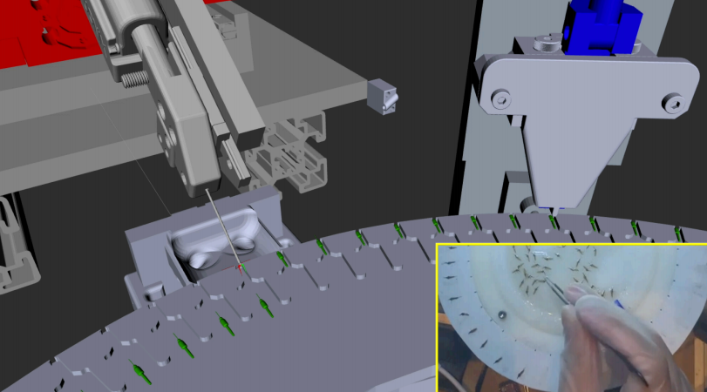
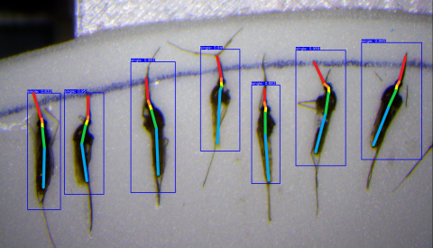
Prior Work
Work done in the LCSR (and by previous CIS II students) includes
Ongoing development of an automated robot system for the mosquito salivary gland extraction
Development of other vision algorithms required by other steps in the system
Deep learning based approach for detection of mosquito proboscis and mosquito orientation
Image processing based approach for detection of mosquito proboscis and mosquito orientation
An existing software framework for integrating vision algorithms into the robot system with ROS
All Images from JHU

Slide 5
Goal
Implement vision algorithms with both machine learning and conventional image processing:
Implementing both methods serves to see which method works better in practice, and allows for a consensus of results
Tasks are:
Check if turntable cleaning was successful at the cleaning station
Check if gripper clearing was successful
Estimate the volume of the mosquito extrudate
Integrate these algorithms with the current system
This would help efficiency and robustness of the system

Slide 6
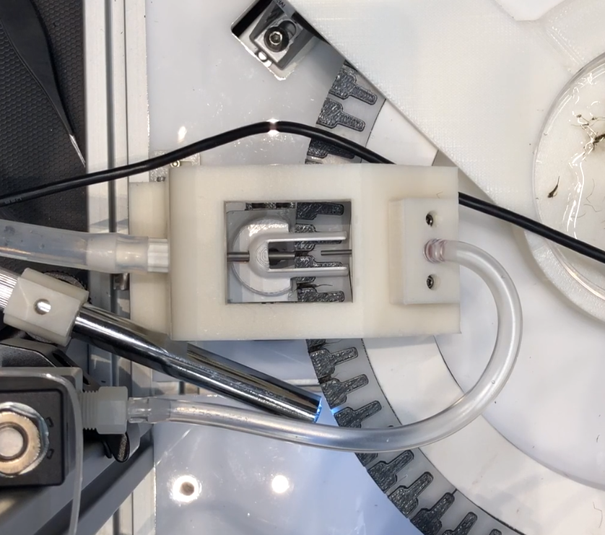
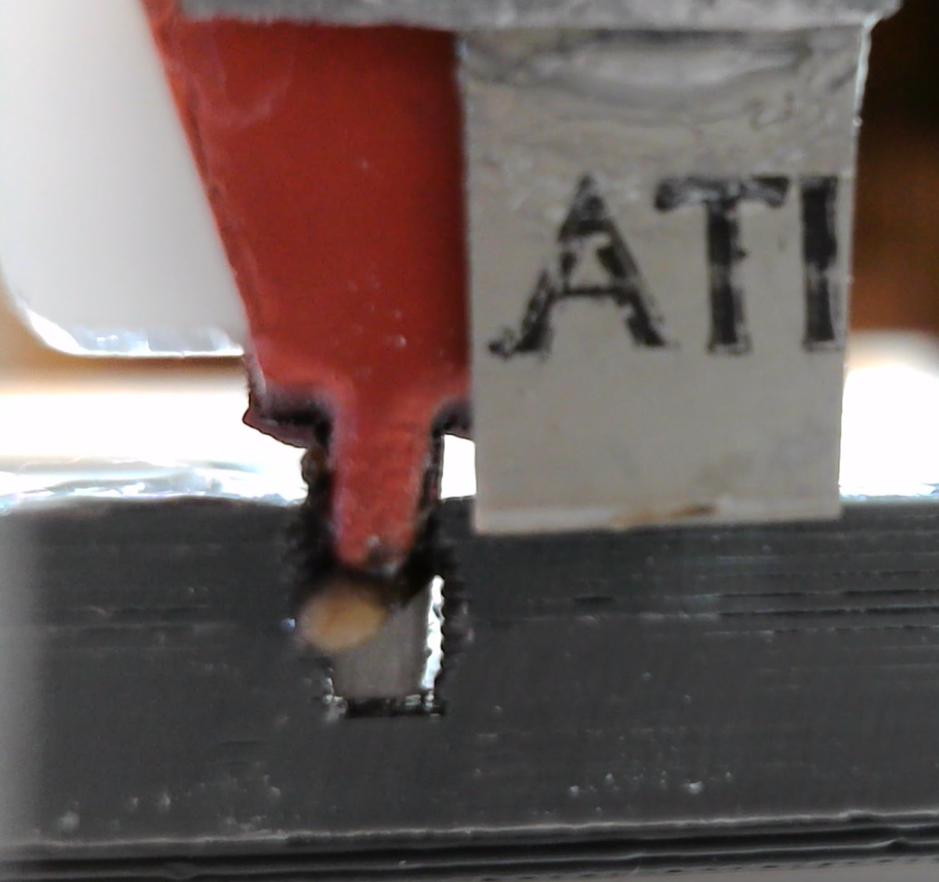
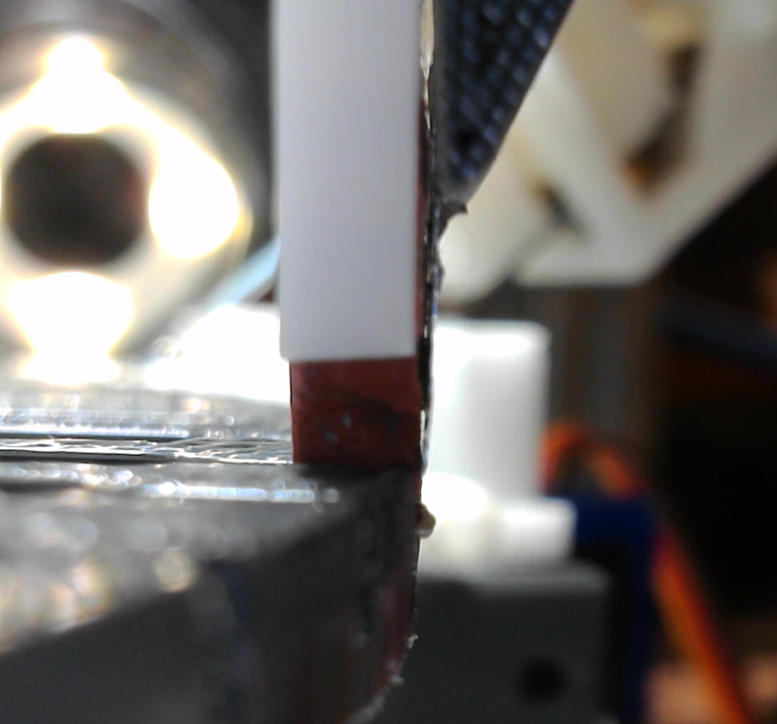
Setup
Cleaning Station Top View
Squeezing Station Front View
Squeezing Station Side View
This blob is the mosquito extrudate
(contains the salivary glands)
All Images from JHU

Slide 7
Technical Approach - Vision
Images
All images will come from fixed position cameras with stable lighting conditions for maximum consistency in the results
Annotations
At least 1000 images will be hand annotated for both cleaning tasks.
For exudate estimation, a plan to collect accurate ground truth must be devised with the hardware team.
The Annotations will be used to train a neural network classifier (using transfer learning) and they will also be used to validate the image processing methods
Implementation
Neural Network method will be implemented in Python with PyTorch
Image processing method will be implemented using OpenCV and C++

Slide 8
Technical Approach - Integration
The vision algorithms will be integrated with the existing system through the use of ROS Services.
ROS Service will be implemented in C++
for OpenCV and Python for PyTorch
PyTorch
OpenCV
Camera
image
image
Network
output
image
output
Robot System
Controlling Computer
Ros Service Request
Vision Computer
Compare and Validate
final result
Ros Service Response
Actuators
commands

Slide 9
Deliverables
Activity
Deliverable
Deadline
Collect images of cleaning station and annotate
Annotated cleaning station dataset
3/1
Implement image processing method for cleaning station
Functioning image processing based code and high quality documentation in a wiki
3/15
Min
Develop and train a neural network on the cleaning station dataset
Trained parameters of a neural network classifier, along with code and high quality documentation in a wiki
3/18
Integrate both with the rest of the system using ROS
Working ROS services which can be successfully interfaced with from the robot control computer, and thorough documentation for how to use them in a wiki page
3/22
Exp.
Repeat for gripper cleaning
Same deliverables as for turntable cleaning station.
4/7
Discuss with hardware team about collecting exudate data
Plan for collecting exudate ground truth data
4/1
Max
Repeat for exudate volume estimation
Same deliverables as for previous two tasks.
5/1

Slide 10
Dependencies
Dependency | Need | Status | Contingency Plan | Planned Deadline | Hard Deadline
Continued access to GPU | GPU for training neural network | Currently have access to the Diva computer | I have a very capable personal GPU | Ongoing | Ongoing
Cameras for collection of images of each task need to be mounted and integrated | To collect images for annotation | Cameras mounted for turntable cleaning station and squeezing station but not for gripper cleaning | Use existing but less desirable views from the other existing cameras. | 3/14 | 3/22 (for remaining camera)
Hardware team | 300+ images of turntable cleaning station in progress with mosquitos. | Hardware team is currently running experiments and collecting these images on a near daily basis while they run their experiments | Begin working on the image processing methods for the other tasks while waiting for additional training data collection. | 3/1 | 3/7
Hardware team | 300+ images of gripper cleaning in progress with mosquitos. | The gripper cleaning water jet has not yet been installed, so there are no ongoing gripper cleaning experiments | Small Delay: Begin working “out of order” on the image annotation and image processing for the exudate estimation task Long Delay or Expected Failure: Change from the gripper cleaning task to one of the are many remaining vision tasks | 3/14 | 3/22
Hardware team | Method for ground truth collection of mosquito exudate volume for training images | I will bring this up during the weekly meetings | Abandon neural network approach and only do image processing for this task | 3/15 | 4/1

Slide 11
Timeline – Gantt Chart

Slide 12
Management
Weekly meetings with the entire mosquito project team
Additional meetings as needed with the Vision team (likely approximately weekly)

Slide 13
Reading List
H. Phalen, P. Vagdargi, M. Schrum, S. Chakravarty, A. Canezin,M. Pozin, S. Coemert, I. Iordachita, S. Hoffman, G. Chirikjian, andR. Taylor, “A mosquito pick-and-place system for pfspz-based malariavaccine production,” IEEE Transactions on Automation Science andEngineering, 2020, issn:1545-5955, doi:10.1109/TASE.2020.2992131.
S. Lathuili`ere, P. Mesejo, X. Alameda-Pineda and R. Horaud, ”A Comprehensive Analysisof Deep Regression,” in IEEE Transactions on Pattern Analysis and Machine Intelligence,vol. 42, no. 9, pp. 2065-2081, 1 Sept. 2020, doi: 10.1109/TPAMI.2019.2910523.
Lo, Frank Po Wen, Yingnan Sun, Jianing Qiu, and Benny Lo. ”Image-Based Food Clas-sification and Volume Estimation for Dietary Assessment: A Review.” IEEE journal ofbiomedical and health informatics 24, no. 7 (2020): 1926-1939.
Belagiannis, Vasileios, Christian Rupprecht, Gustavo Carneiro, and Nassir Navab. ”Robustoptimization for deep regression.” In Proceedings of the IEEE international conference oncomputer vision, pp. 2830-2838. 2015.
Chandrarathne, Gayani, Kokul Thanikasalam, and Amalka Pinidiyaarachchi. ”A compre-hensive study on deep image classification with small datasets.” In Advances in ElectronicsEngineering, pp. 93-106. Springer, Singapore, 2020.
Hurtik, Petr, Vojtech Molek, Jan Hula, Marek Vajgl, Pavel Vlasanek, and Tomas Ne-jezchleba. ”Poly-YOLO: higher speed, more precise detection and instance segmentationfor YOLOv3.” arXiv preprint arXiv:2005.13243 (2020).

Slide 14
References
[1] WHO, 2019. World Malaria Report 2017. Geneva, Switzerland: World Health Organization.
[2] Jongo, Said A., Seif A. Shekalaghe, LW Preston Church, Adam J. Ruben, Tobias Schindler, Isabelle Zenklusen, Tobias Rutishauser et al. "Safety, immunogenicity, and protective efficacy against controlled human malaria infection of Plasmodium falciparum sporozoite vaccine in Tanzanian adults." The American journal of tropical medicine and hygiene 99, no. 2 (2018): 338-349.
[3] Sanaria, Sanaria.com.

