Slide 1
Building an Intra-operative “Kinect” with a Flexible Endoscope
Implement structured light with an existing laser pattern by integrating with a flexible endoscope through the working channel.
What Students Will Do:
Calibrate 3D sensor with light and camera
Implement real-time 3D reconstruction
Implement “camera tracking” to stitch 3D reconstruction
Tested under both static and dynamic scenarios
Deliverables:
Source code and quantitative demonstration of: calibration (with accuracy), reconstruction (with accuracy), and camera tracking (with accuracy)
Size group: 1-3
Skills: intro to computer vision; Python, C++, or MATLAB
Mentors: Austin Reiter, Russ Taylor

Slide 2
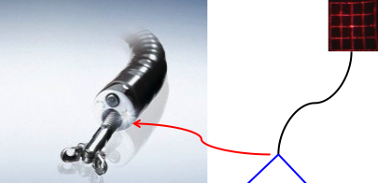
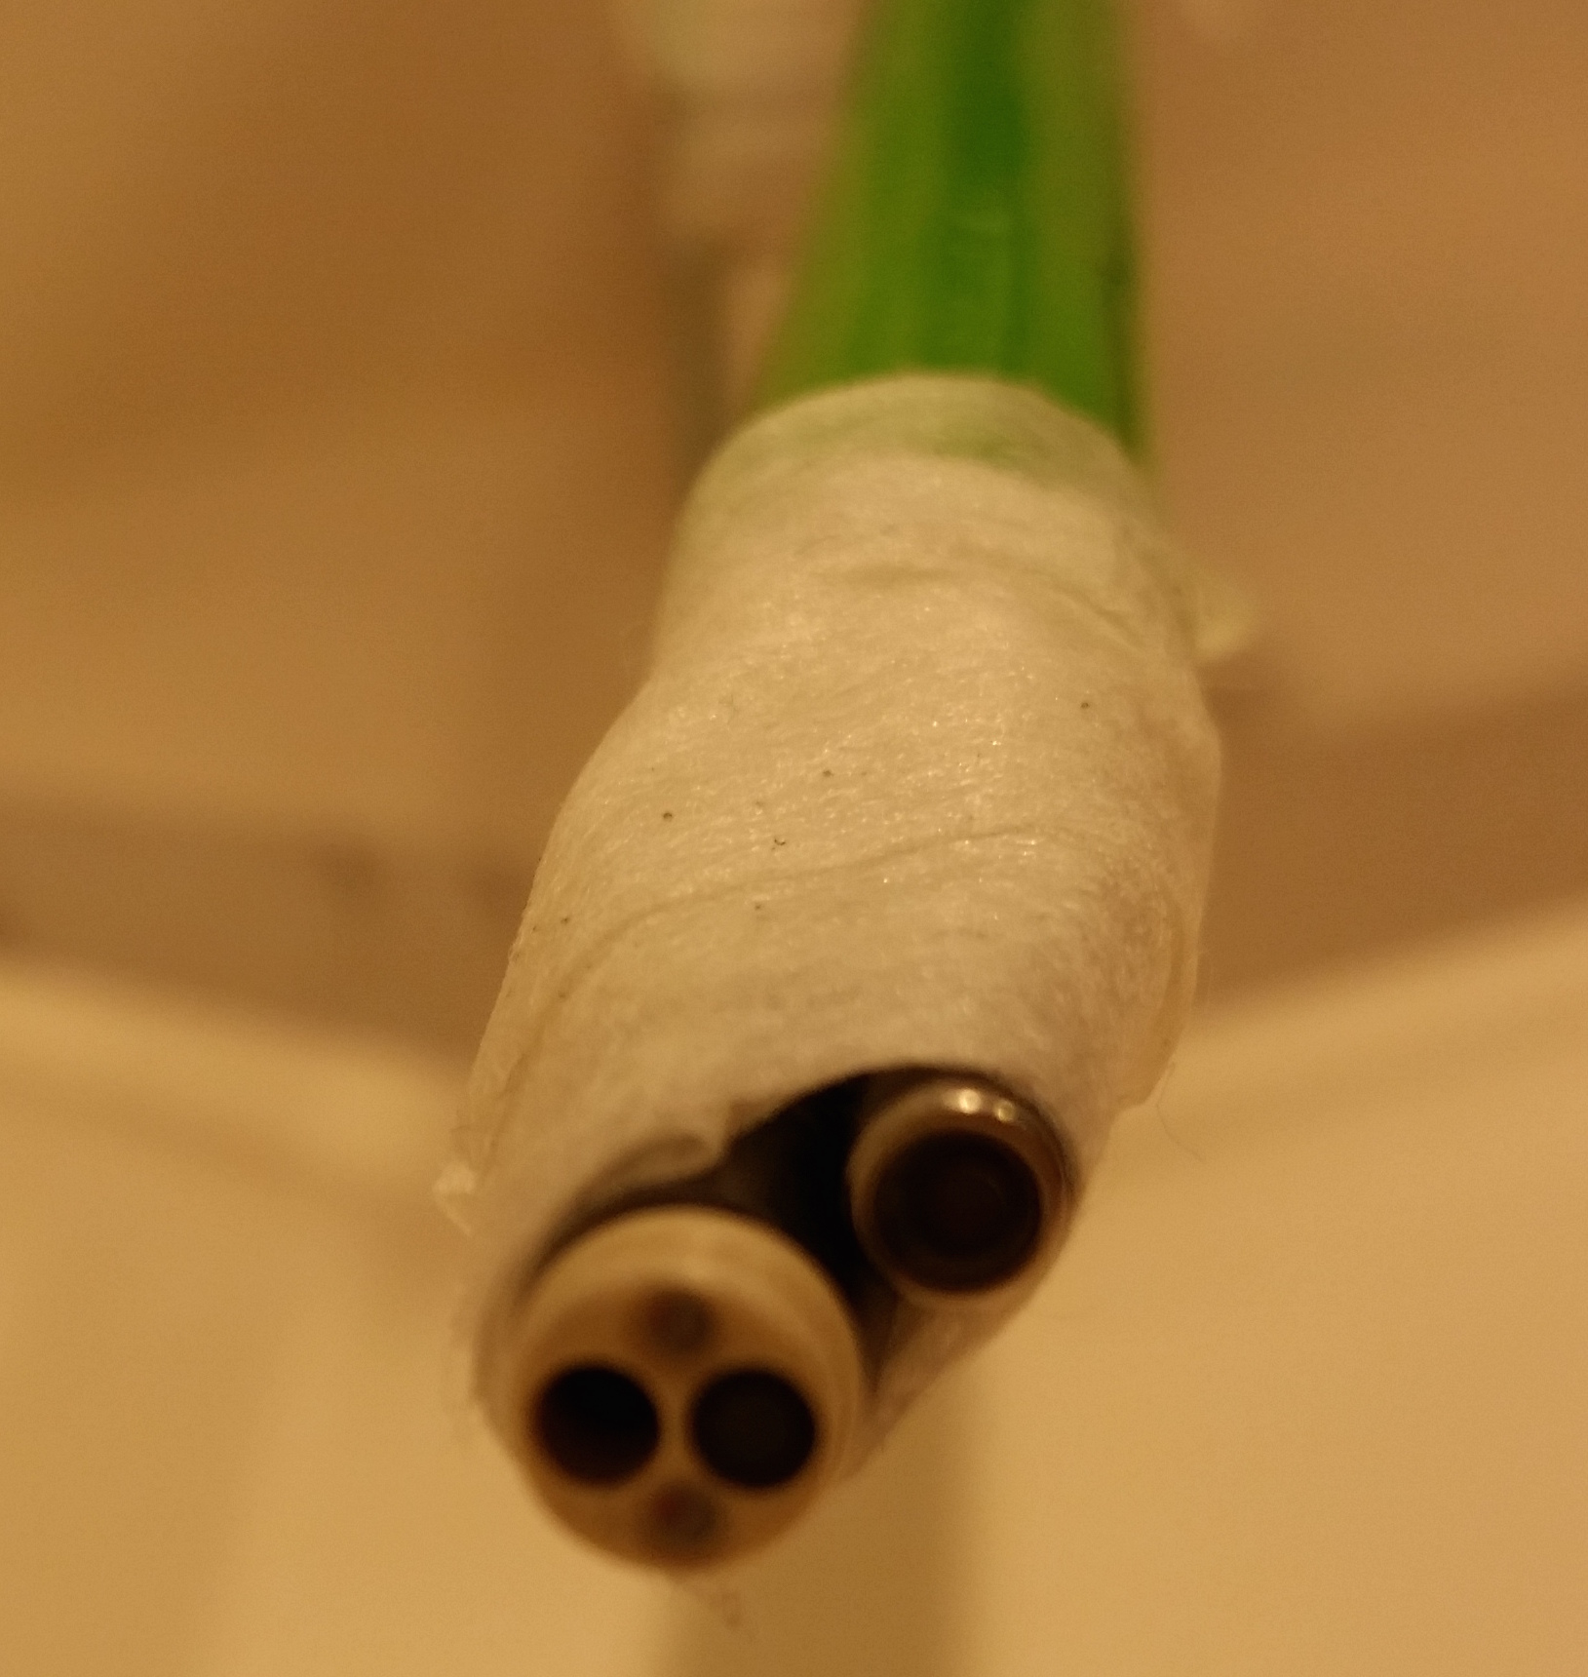
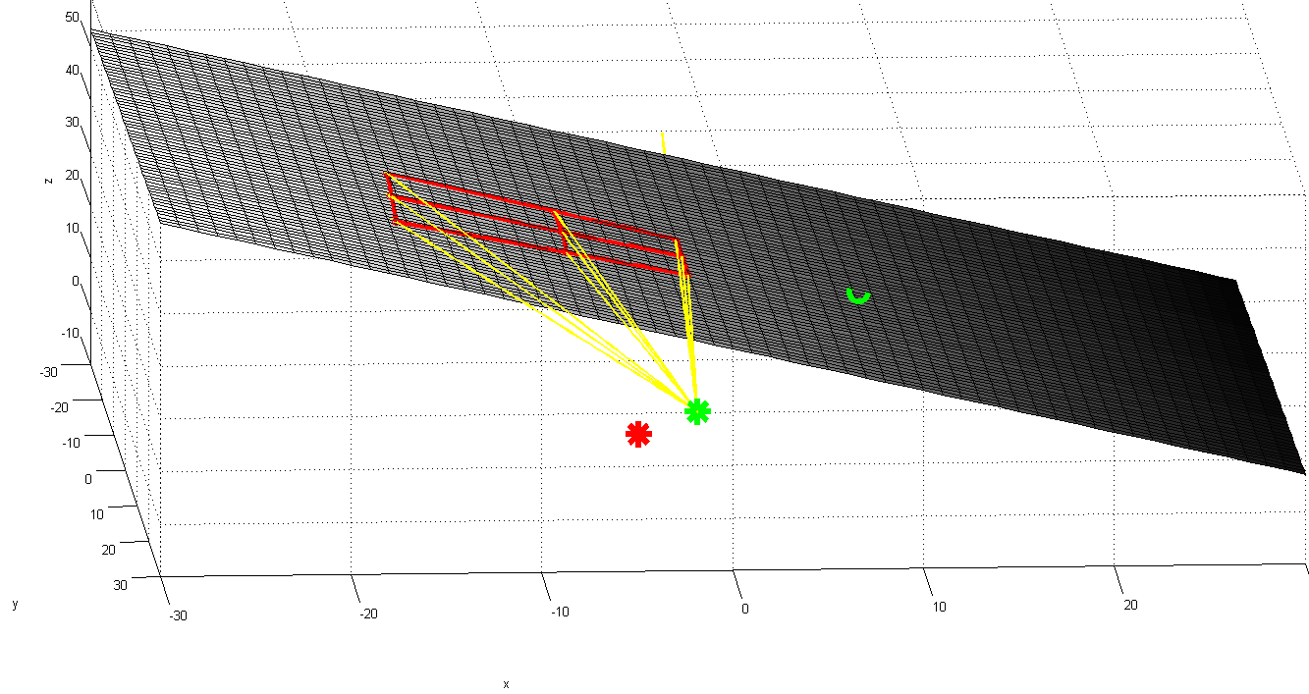
Application to Sleep Apnea
This technology incredibly useful for diagnosing and planning interventions for Sleep Apnea
Dynamic 3D reconstruction from video an unsolved problem in medical computer vision field

