Slide 1
Force Sensing Drill/Cutter Tool for Skull Base Surgery
Prasad Vagdargi, Brandon Tran, Nick Skacel

Slide 2
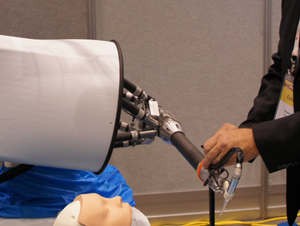
Topic and Goal
Current methodology: Cooperative control of robot for neurosurgery.
For some applications it is useful to measure and control the tool-to-tissue forces as well.
Goal: To sense these forces and integrate this data for better control of the Galen robot
Uses:
Visual Feedback
Safety Limits
Surgical Skill evaluation
Unbiased comparison of surgical techniques

Slide 3
Mentors and Team Roles
Mentors
Dr. Russell Taylor
Galen Surgical: Paul Wilkening, Yunus Sevimli, David Levi
Johns Hopkins Medicine: Francis Creighton, MD and Chris Razavi, MD
Roles
Team Leader and Mechanical Design: Prasad Vagdargi
Electronic Design: Brandon Tran & Nick Skacel
Communications/Software: Nick Skacel
Controls: Brandon Tran

Slide 4
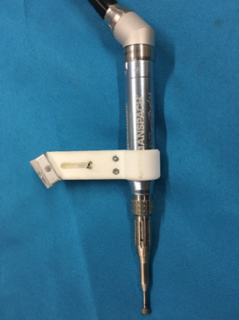
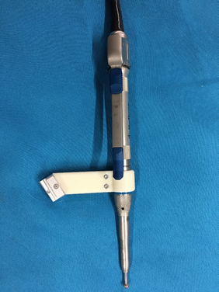
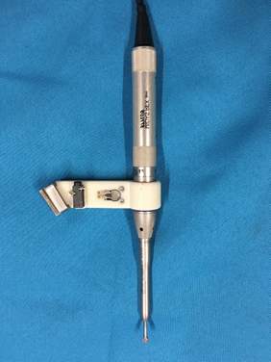
Existing “Dumb” Drills
Notes:
Medtronic Midas Surgical Drill
No force sensing

Slide 5
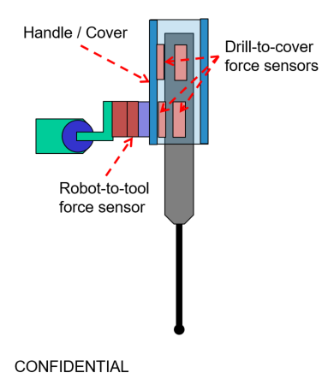
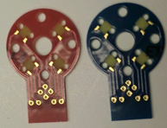
Challenges
Physicians gain expertise using preferred tool designs: spacing problems to maintain profile
Frequent changing of drill bits
Drill rotation frequency might interfere with sensing
Minimal no. of sensors required, system analysis accordingly.
Noise reduction
Notes:
So we are going to use a drill cover so it has a similar feel as

Slide 6
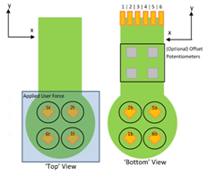
Approach
Prototype tool sleeve, initial analysis
Test sensors and its arrangement, redesign
Calibration of tool forces with standard force sensors
Develop communication protocols
Develop UI and display data
Test and move robot according to safety limits

Slide 7
Deliverables
Minimum
Design and prototype force sensing tool holder
Provide XYZ force sensing at the tooltip
Communicate sensed forces at the tooltip to the Galen UI
Expected
Design iteration for ergonomics
Provide calibrated XYZ force sensing at the tooltip
Test on phantom skulls and measuring forces
Maximum
Incorporate threshold based warning and motion control based on safety limits.
Integrate the drill force as a measure for creating virtual fixtures.
Documentation: Design iterations, calibration procedure and UI

Slide 8
Dependencies
Dependency | Status
Order for new force sensors, DAQ board | Completed (2 have arrived, waiting for more) Backup: Work with ATI force sensors
Access to Galen UI for DAQ to Robot communication | In Progress - will contact Paul Wilkening
Access to 3D printing facilities | Completed

Slide 9
Management Plan
Weekly Galen meeting
Currently Friday at 10 AM (subject to change)
Includes feedback from Dr. Razavi
Team meeting times: Bi-weekly
Thursday after class
Sunday for an extended time

Slide 11
Milestones
Initial Prototype Manufacture | Feb. 25
Order/Test Sensors | Mar. 1
Test rig development | Mar. 10
Calibration and Analysis | April 1
UI design | April 12
Safety limits testing | April 28
Presentation | May 12

Slide 12
Reading List
Y. Hu, H. Jin, L. Zhang, P. Zhang and J. Zhang, "State Recognition of Pedicle Drilling With Force Sensing in a Robotic Spinal Surgical System," in IEEE/ASME Transactions on Mechatronics, vol. 19, no. 1, pp. 357-365, Feb. 2014.
P. Kazanzides, J. Zuhars, B. Mittelstadt and R. H. Taylor, "Force sensing and control for a surgical robot," Proceedings 1992 IEEE International Conference on Robotics and Automation, Nice, 1992, pp. 612-617 vol.1.
Force of Cochlear Implant Electrode Insertion Performed by a Robotic Insertion Tool: Comparison of Traditional Versus Advance Off-Stylet Techniques, Daniel Schurzig, Robert J. Webster III, Mary S. Dietrich, and Robert F. Labadie, Otology & Neurotology, 2010

