Slide 1
Ultrasound-Compatible Gynecologic Training Phantom for Hydrogel Injection Tracy Kao Mentors: Carmen Kut, Younsu Kim, Dr. Emad Boctor, Dr. Akila Viswanathan
Multi-Media Content (Images and Videos)

Slide 2
Common site of hydrogel injection

Slide 3
The Original Project

Slide 4
Plastisol

Slide 5
Set-Up

Slide 6
Experimenting with Ratios & Colors

Slide 7
Experimenting with Echogenicity
Sigma Aldrich 75 micron
acid-washed glass microbeads
0.70%
0.22%
0.046%

Slide 8
Experimenting with Mold

Slide 9
1st Prototype: Realistic Texture

Slide 10
1st Prototype: Realistic Texture
Part | Ratio by Volume (Plastisol:Softener) | Color
Vaginal Cavity | 4:1 | Pink
Rectum | 4:1 | Pink
Uterus | 3:1 | Transparent
Surrounding Fat/Tissue | 2:1 | Transparent

Slide 11
2nd Prototype: Echogenicity

Slide 12
2nd Prototype: Echogenicity
Part | Color | Ratio by Volume (Plastisol:Softener:Hardener) | Microbead Density (%weight)
Vaginal Cavity | Pink | 4:1:0 | 0.70%
Rectum | Blue | 4:1:0 | 0.70%
Cervix | Green | 4:1:0 | 0.70%
Tumor Mass | Black | 2:0:1 | 0.22%
Surrounding Fat/Tissue | Transparent | 2:1:0 | 0.046%

Slide 13
2nd Prototype: Echogenicity

Slide 14
2nd Prototype: Abdominal Ultrasound (with Needle)
^ needle

Slide 15
3rd Prototype: Anatomical Accuracy

Slide 16
3rd Prototype: Anatomical Accuracy
Part | Color | Ratio by Volume (Plastisol:Softener:Hardener) | Microbead Density (%weight)
Bladder | Green | 1:1:0 | 0.05%
Vagina | Pink | 4:1:0 | 0.7%
Rectum | Blue | 4:1:0 | 0.7%
Cervix | Pink | 4:1:0 | 0.7%
Tumor | Black | 2:0:1 | 0.2%
Surrounding Fat/Tissue | Transparent | 2:1:0 | 0.35%

Slide 17
3rd Prototype: Anatomical Accuracy

Slide 18
3rd Prototype: Anatomical Accuracy

Slide 19
3rd Prototype: Abdominal Ultrasound
Rectum
Vaginal
Cavity
Bladder

Slide 20
3rd Prototype: Abdominal Ultrasound
Rectum
Tumor
Vagina
^
needle
Bladder

Slide 21
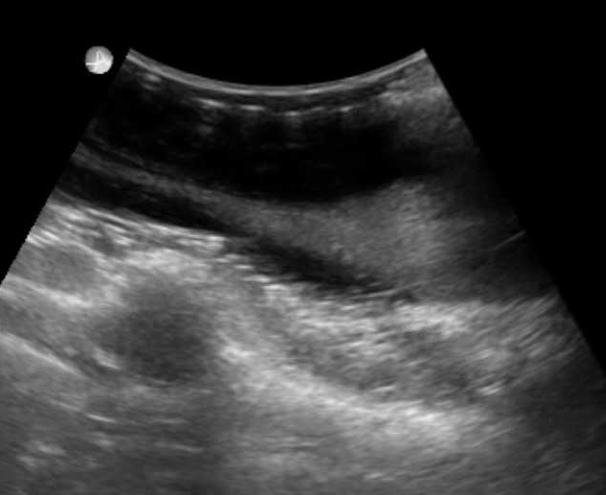
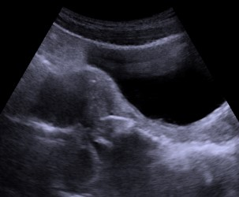
3rd Prototype: Abdominal Ultrasound
Bladder
Bladder
Uterus
Uterus
*
Vagina
Vagina
Phantom Ultrasound Image (* = tumor)
Real Patient Ultrasound Image (* = tumor)

Slide 22
3rd Prototype: Transrectal Ultrasound (TRUS)
Bladder
Bladder
Bladder
Tumor
Uterus

Slide 23
3rd Prototype: Transrectal Ultrasound (TRUS)
Vaginal Cavity
^ needle

