Slide 1
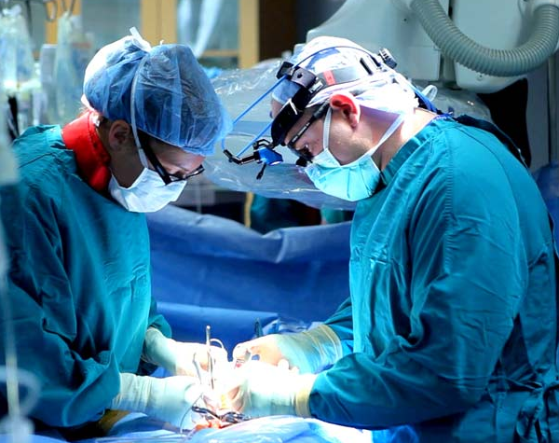
Evaluation of Various Sensing Modalities for Accurate Measurement of Neck Flexion Angle during Thyroid Surgery
Goal
To investigate and compare postural ergonomics of surgeons during two different surgical scenarios:
Traditional case (or using microscopes)→ standing over and looking down to the patient
Laparoscopic→ looking straight
at a monitor by using endoscopes
To project the surgical scene on
a monitor

Slide 2
What Students Will Do
Investigating the possibility of accurate tracking of neck flexion angle using two IMUs
Processing signals from two IMUs to extract neck flexion angle
Collecting ground truth data using other sensing modalities (e.g., optical tracker or EM tracker) for calibration and validation purposes
Evaluating and comparing tracking accuracies achieved by IMUs vs. Kinect sensor vs. external tracker
Using and evaluating the developed system in
Phantom studies
IRB approved study in the OR

Slide 3
Deliverables:
Minimum: Developing prototype system with two IMUs, together with external ground truth system (e.g., EM tracker or optical tracker)
Expected: Validation of the system against ground truth; comparison against Kinect data
Maximum: Experimental evaluation in surgical setting (phantoms and/or actual surgery)
Group Size: 1-2
Skills:
Programming skills such as C++ and Python/MATLAB
Knowledge of signal processing
Knowledge of sensor fusion and Kalman filter is a plus
Mentors: Dr. Mahya Shahbazi, Dr. Russell Taylor, Dr. Francis Creighton, Dr. Chris Razavi
Contact: mahya.sh@jhu.edu, rht@jhu.edu, francis.creighton@jhmi.edu, crazavi1@jhmi.edu

