Slide 1
Antibiotic Ninja
Antibiotic Ninja is a start-up team at Johns Hopkins Medicine created to solve the problem of antibiotic over-prescription in the United States. The team has designed a mobile, interactive app that helps diagnose and provide antibiotic recommendations for conditions.
What Students Will Do: Work with the antibiotic steward (physician), a business/design student from Johns Hopkins Carey Business school, and the TIC to develop this application so that it is ready for pilot at the Johns Hopkins Bayview campus
Deliverables:
Design management system for mapping clinical pathways based on different syndromes
Build mobile app minimum viable product for Bayview pilot
Size group: 1-3
Skills: Ruby on Rails or Python, data structures, prior experience with building a mobile or responsive web application
Mentors: Jennifer Townsend (jholme27@jhmi.edu), Gorkem Sevinc (gsevinc1@jhmi.edu) / Michael Cohen (mcohen56@jhmi.edu)

Slide 3
Depictation
Depictation is a start-up team at Johns Hopkins Medicine that is working to bring the sketch back to post-operative note with 3-D imaging tool that is manipulatable. The tool will improve communication, save time, and increase efficiency.
What Students Will Do: Work with a Johns Hopkins surgeon, two medical illustrators, and potentially a 3-D gaming company to design wireframes and build interface for this application. Depending on students’ abilities, could also work with 3-D gaming company to build out 3-D models.
Deliverables:
Updated wireframes
User Interface design and development
EMR integration
Assistance with 3-D modeling (Optional)
Size group: 1-3
Skills: Ruby on Rails or Python / Django, Unity (optional), experience developing a mobile app previously
Mentors: David Efron (defron1@jhmi.edu), Gorkem Sevinc (gsevinc1@jhmi.edu), Michael Cohen (mcohen56@jhmi.edu)

Slide 4
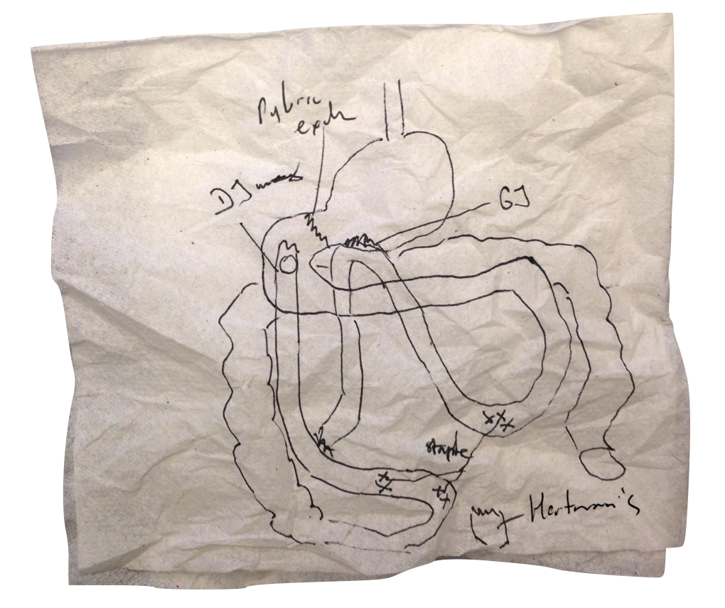
“A bad picture on a napkin is better than reading the post-op note…”

Slide 5
The Solution
DEPICTATION Tool
Begins with a 3D model
Takes < 3 minutes to modify
Signable & EMR embeddable
Improves communication, saves time, and increases safety

Slide 6
Murmur Detection Algorithm
The Murmur detection algorithm is the next phase of the Murmurquiz.org project, a gamified teaching website for medical students, residents, and other clinical professionals to quiz themselves on heart auscultation cases collected over years of research.
What Students Will Do: Work with Dr. Reid Thompson and the TIC to help develop an algorithm based on existing data around auscultations for prediction of different types of heart murmurs
Deliverables:
Build algorithm to detect murmur in audio files and potentially identify other features of the murmur
Size group: 1-3
Skills: Ruby on Rails, applied math and algorithms
Mentors: Reid Thompson (thompson@jhmi.edu), Gorkem Sevinc (gsevinc1@jhmi.edu), Michael Cohen (mcohen56@jhmi.edu)

Slide 7
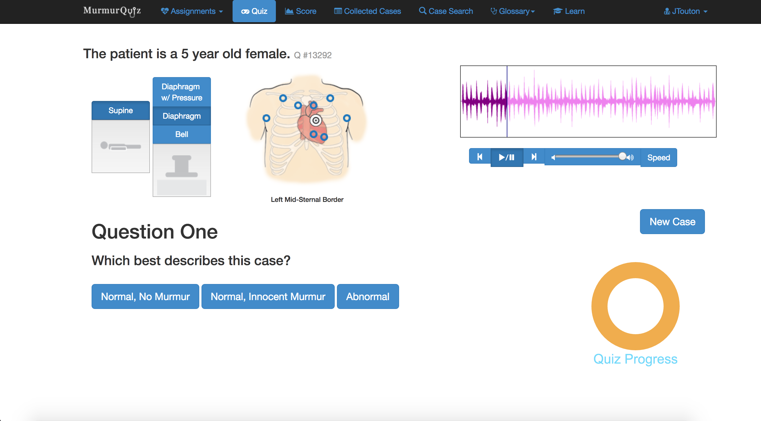

Slide 8
Clinical Environment Tracking
The Clinical Environment Tracking project comes out of the Sibley Innovation Hub. Operating room staff need more training in a low-risk environment to set up a operating room table. They’ve designed and now need assistance building a mobile app for interactive training.
What Students Will Do: Work with the Sibley Innovation Hub and the TIC to develop a iPad that allows for interactive training (i.e. drag and drop features/mimics the setup of an operating room).
Deliverables:
Build wireframes
iPad app minimum viable product developed for training at Sibley
Size group: 1-3 participants
Skills: Ruby on Rails or Django (Python), JavaScript, Cordova-based cross-platform mobile application development or Swift/Objective-C
Mentors: Sibley Innovation Hub team, Gorkem Sevinc (gsevinc1@jhmi.edu) , Michael Cohen (mcohen56@jhmi.edu)

Slide 9
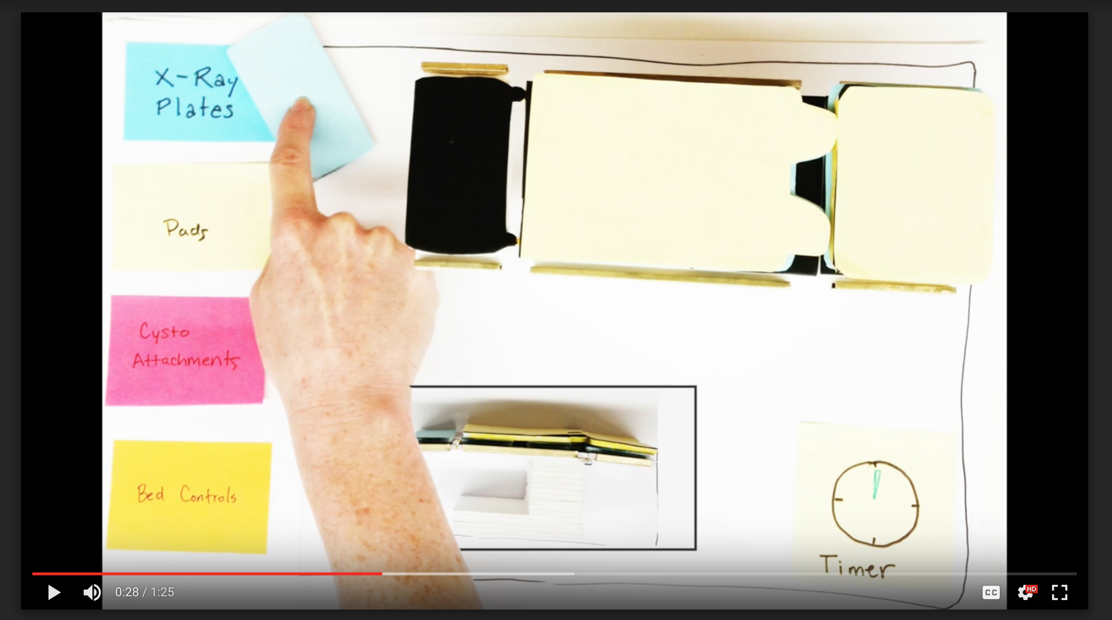

Slide 10
PainCare
Development of an app for chronic pain management, allowing for patients to communicate with physicians, collect data from devices (such as Fitbit or HealthKit), and eventually predict pain flares
What Students Will Do: Work with Hopkins physicians and an outside company to co-develop an Apple ResearchKit application
Deliverables:
Wireframes
Algorithm development
Data exploration and discovery with researchers
Mobile App minimum viable product
Size group: 1 to 3 participants
Skills: JavaScript, Cordova-based cross-platform mobile application development or Swift/Objective-C, data visualization
Mentors: Gorkem Sevinc (gsevinc1@jhmi.edu) , Michael Cohen (mcohen56@jhmi.edu), Susan Crosby, Joe Cufari, Claudia Campbell, Patrick Finan, Dan Roche

